Slide 1

Notes:
[Sources]
- First-slide hook: Images 2.0 native generation from approved exact copy: 1,200分，能把你带到马尔代夫吗？

Slide 2
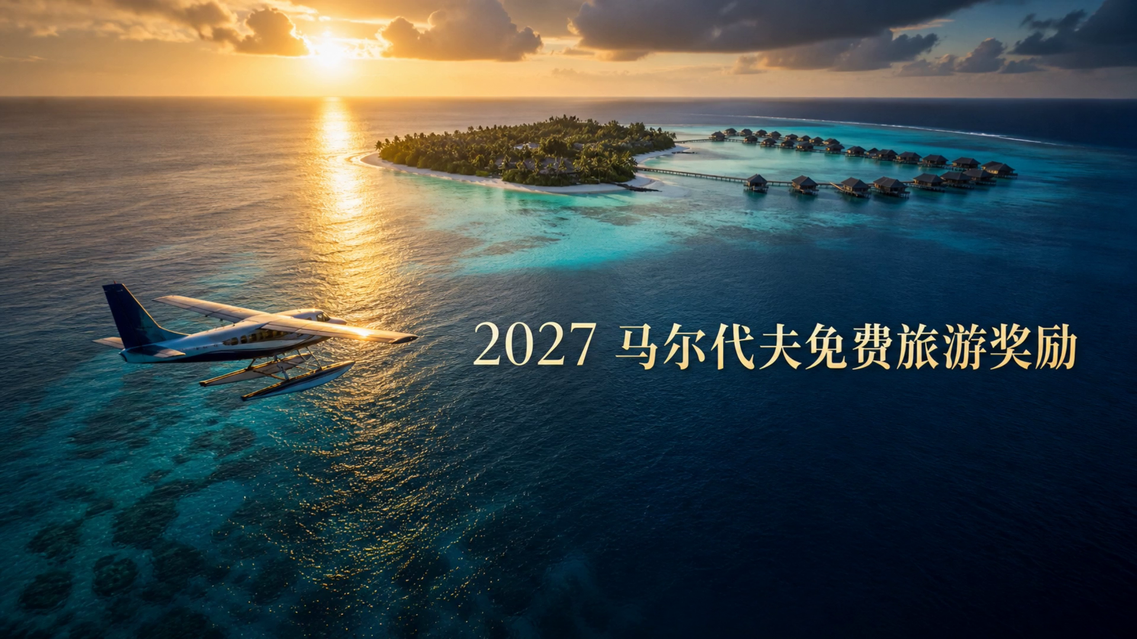

Slide 3


Slide 4


Slide 5
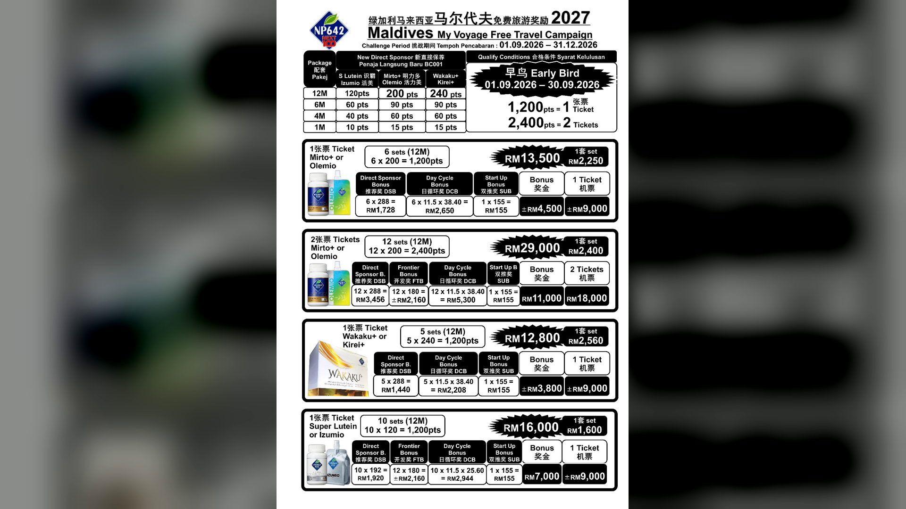

Slide 6


Slide 7
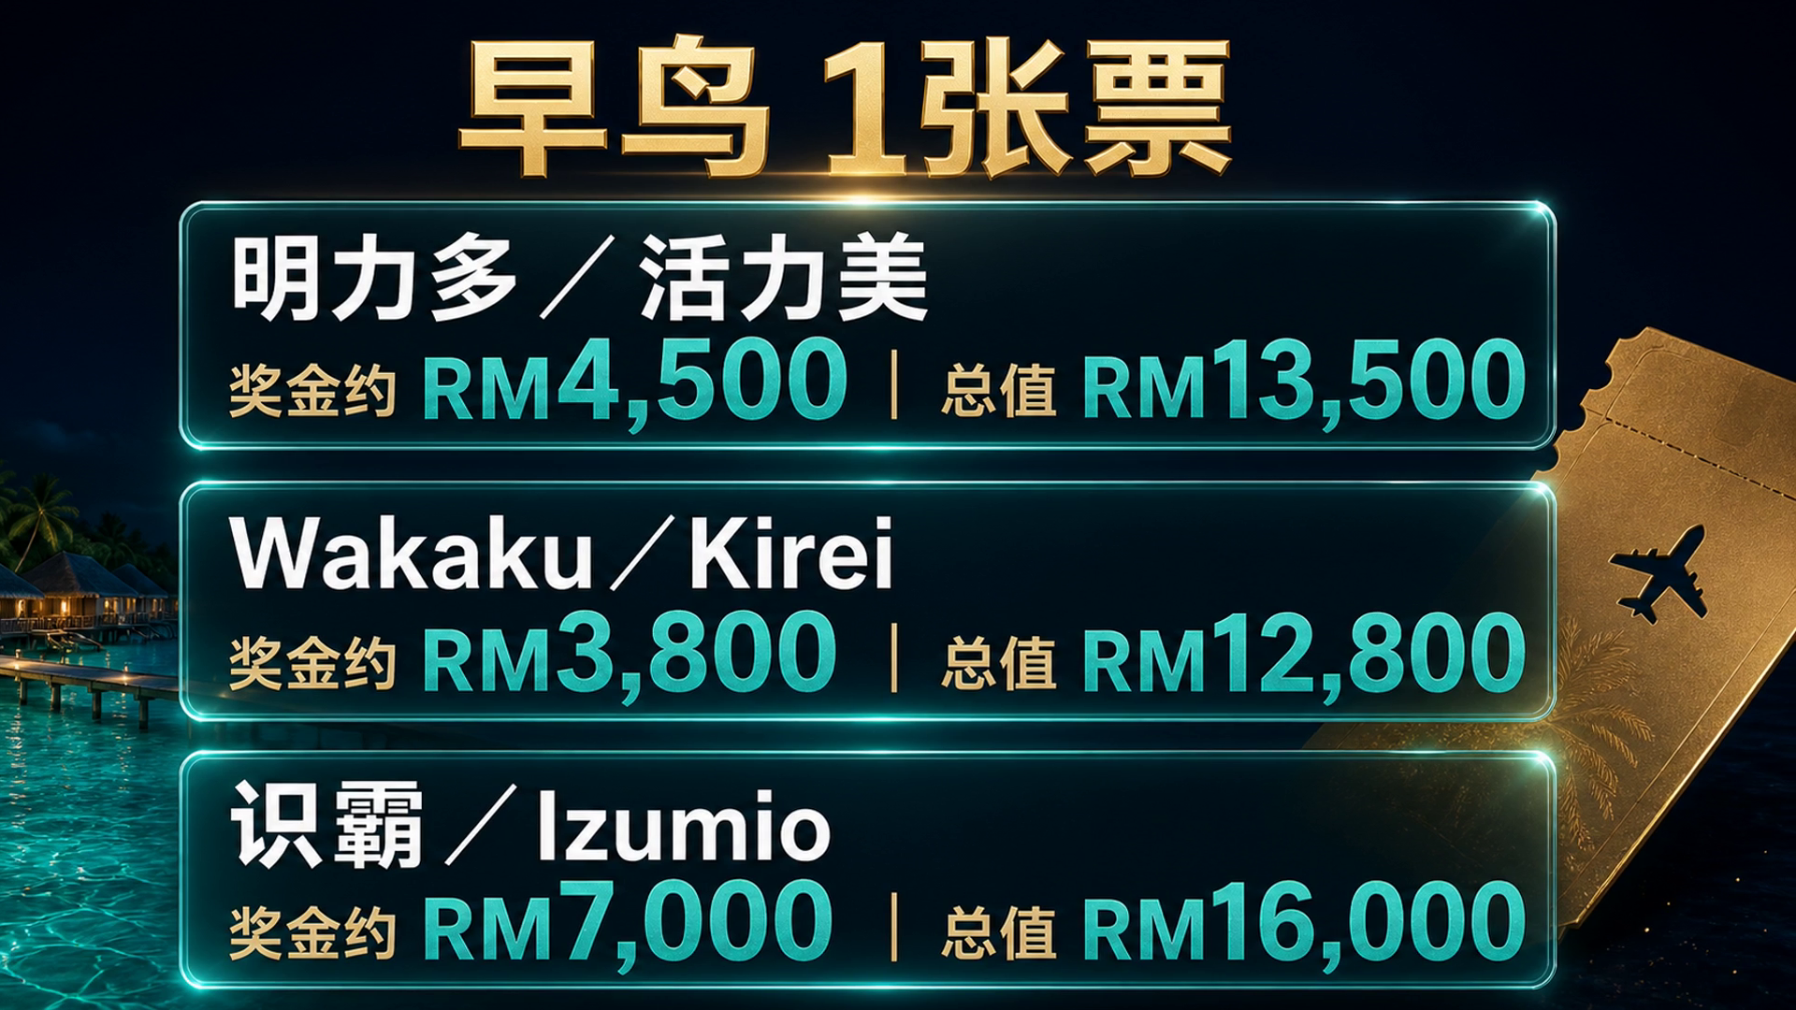

Slide 8


Slide 9
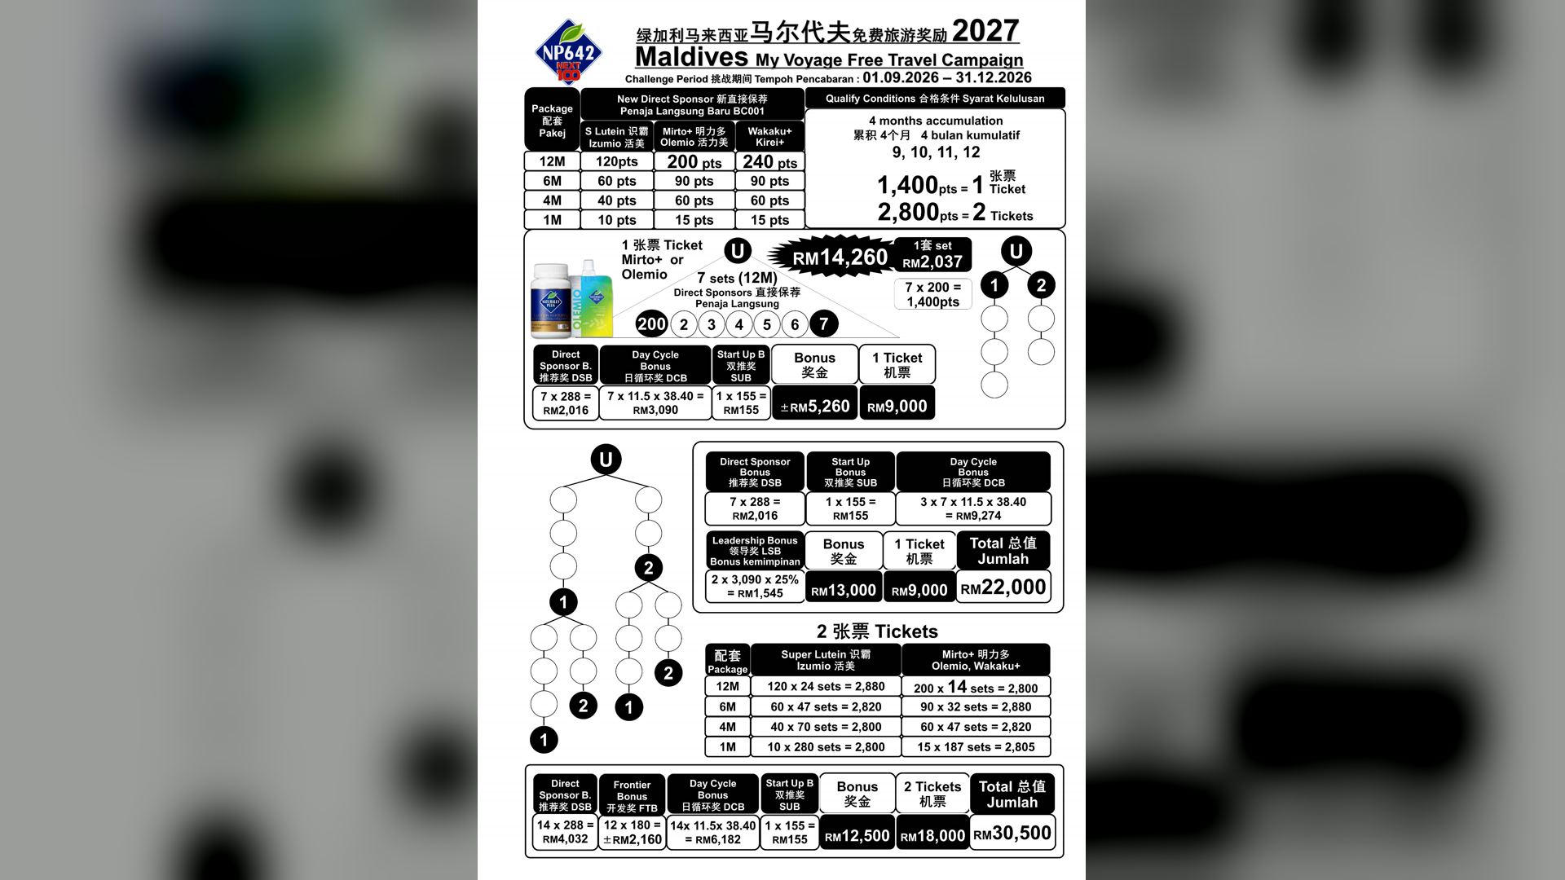

Slide 10
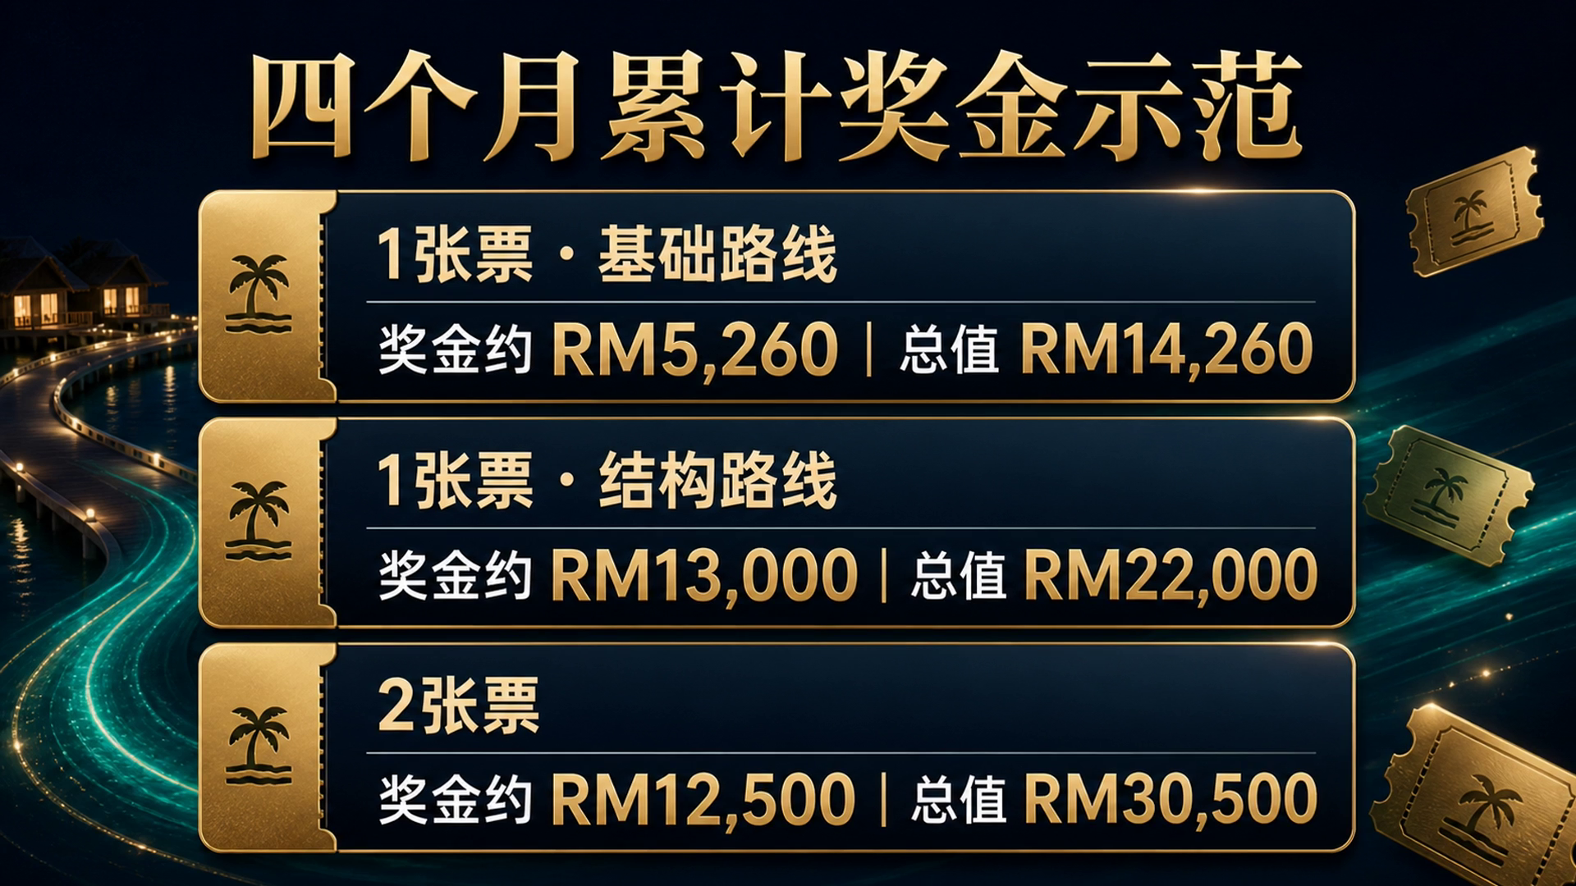

Slide 11


Slide 12


