Slide 1

Filing • English
1 / 55
Notes:
No top narration on original page.
Source: 2026 scan filing.pdf; source PDF page cover.
Full-page localized image redraw. Facts, names, figures and page order must match the retained Chinese original. Image model requested:2.5; actual backend unexposed and unverified. Video production stopped by owner pending deck review.
Image-generated artwork plus native PowerPoint text for exact presenter narration, proper names, figures and reference wording. Original product/documentary picture layers retain source bytes.

Slide 2
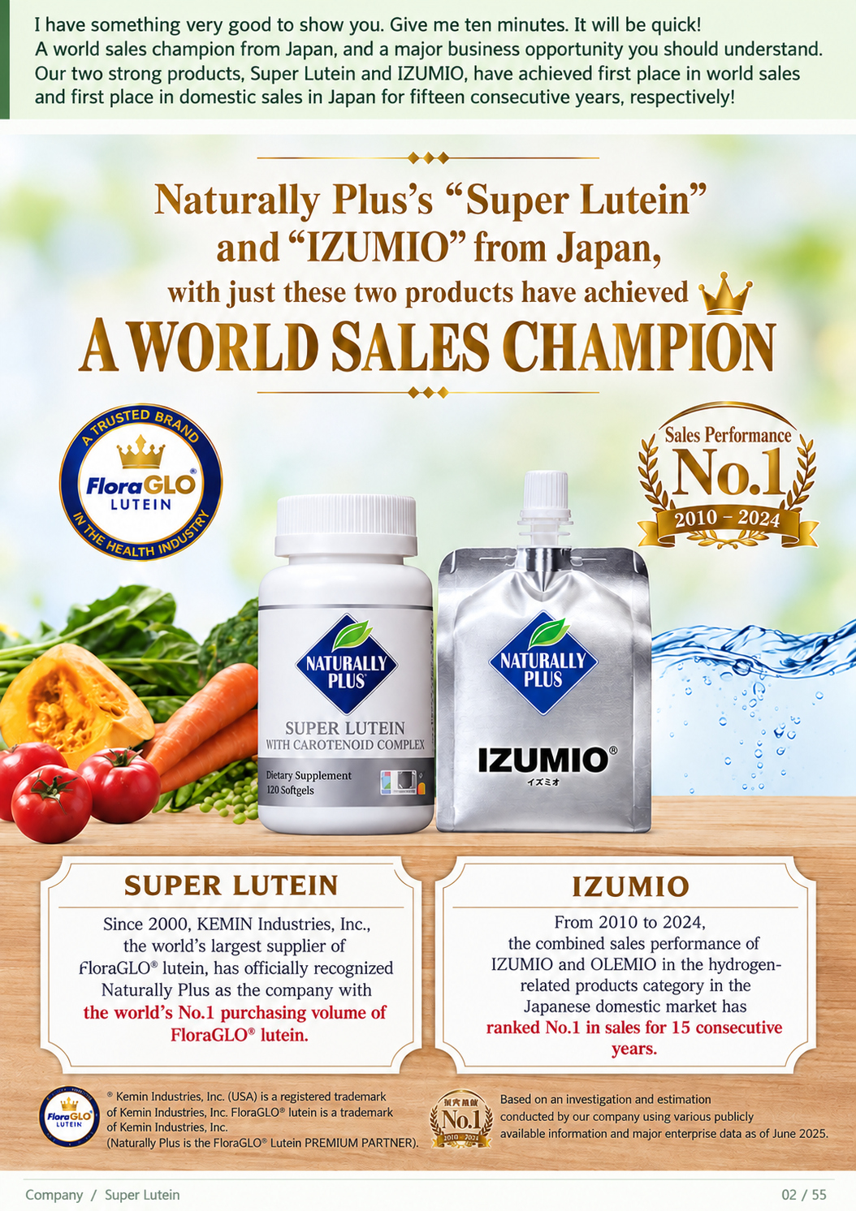
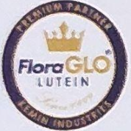
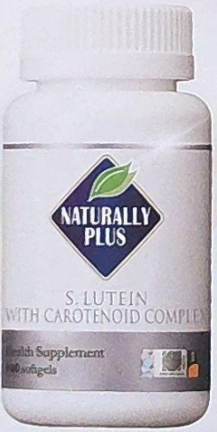
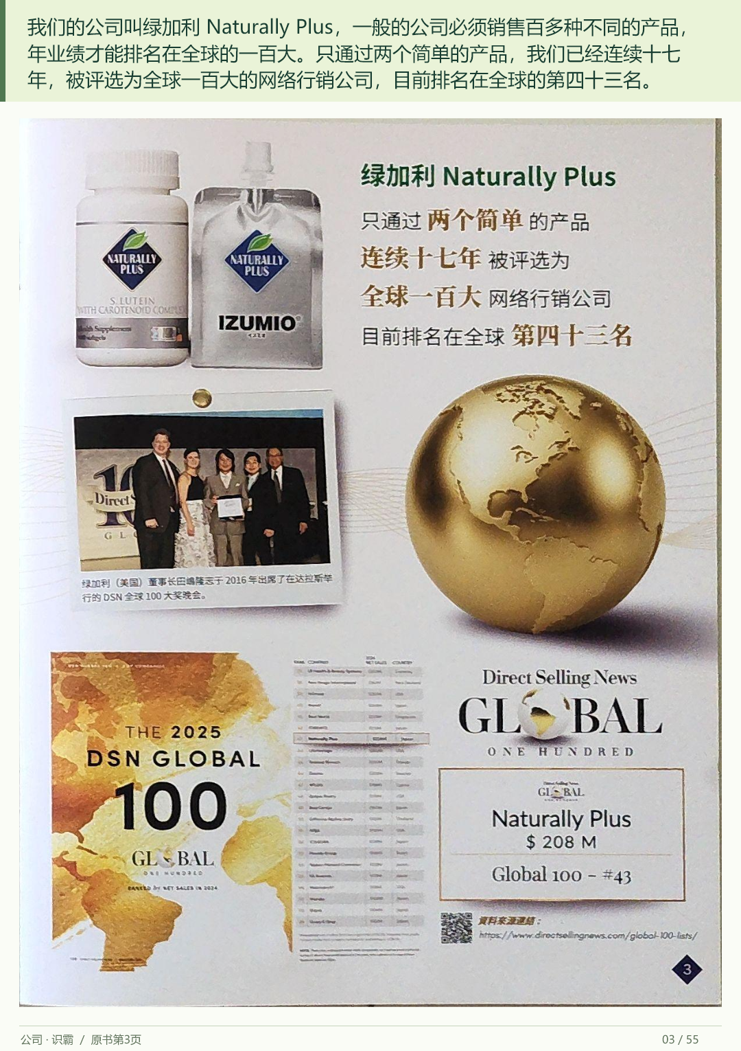
I have something very good to show you. Give me ten minutes. It will be quick! A world sales champion from
Japan, and a major business opportunity you should understand. Our two strong products, Super Lutein and
IZUMIO, have achieved first place in world sales and first place in domestic sales in Japan for fifteen consecutive
years, respectively!
Filing • English
2 / 55
Notes:
I have something very good to show you. Give me ten minutes. It will be quick! A world sales champion from Japan, and a major business opportunity you should understand. Our two strong products, Super Lutein and IZUMIO, have achieved first place in world sales and first place in domestic sales in Japan for fifteen consecutive years, respectively!
Source: 2026 scan filing.pdf; source PDF page 3.
Full-page localized image redraw. Facts, names, figures and page order must match the retained Chinese original. Image model requested:2.5; actual backend unexposed and unverified. Video production stopped by owner pending deck review.
Image-generated artwork plus native PowerPoint text for exact presenter narration, proper names, figures and reference wording. Original product/documentary picture layers retain source bytes.

Slide 3
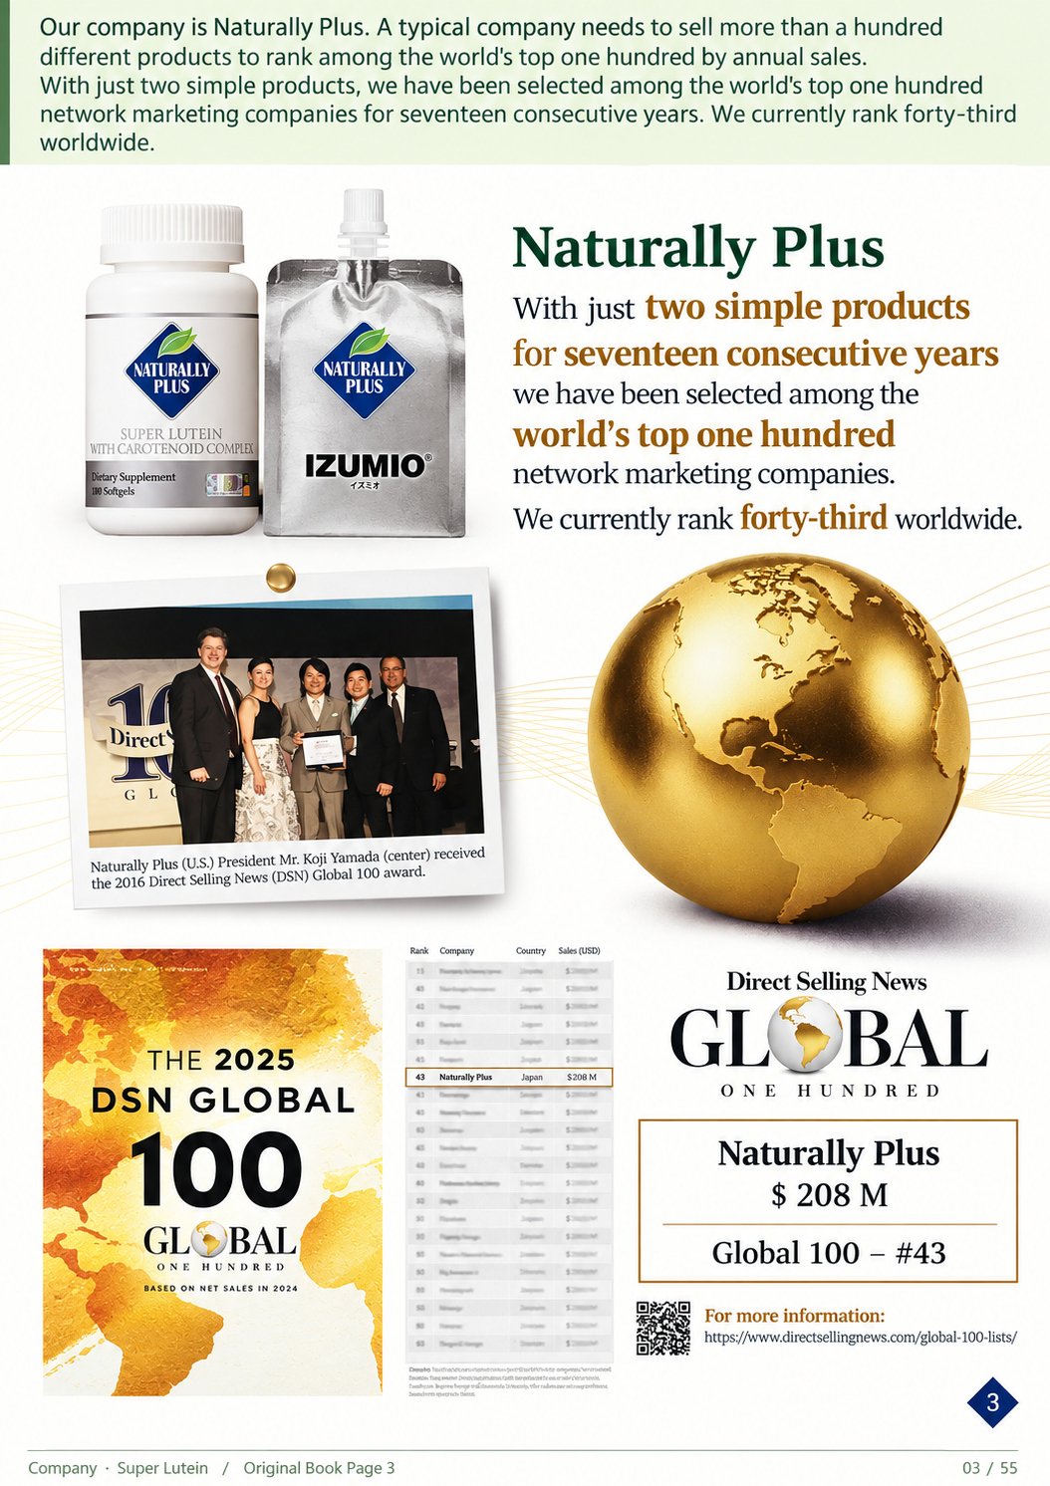
Our company is Naturally Plus. A typical company needs to sell more than a hundred different
products to rank among the world's top one hundred by annual sales. With just two simple products,
we have been selected among the world's top one hundred network marketing companies for
seventeen consecutive years. We currently rank forty-third worldwide.
Filing • English
3 / 55
Notes:
Our company is Naturally Plus. A typical company needs to sell more than a hundred different products to rank among the world's top one hundred by annual sales. With just two simple products, we have been selected among the world's top one hundred network marketing companies for seventeen consecutive years. We currently rank forty-third worldwide.
Source: 2026 scan filing.pdf; source PDF page 2.
Full-page localized image redraw. Facts, names, figures and page order must match the retained Chinese original. Image model requested:2.5; actual backend unexposed and unverified. Video production stopped by owner pending deck review.
Image-generated artwork plus native PowerPoint text for exact presenter narration, proper names, figures and reference wording. Original product/documentary picture layers retain source bytes.

Slide 4
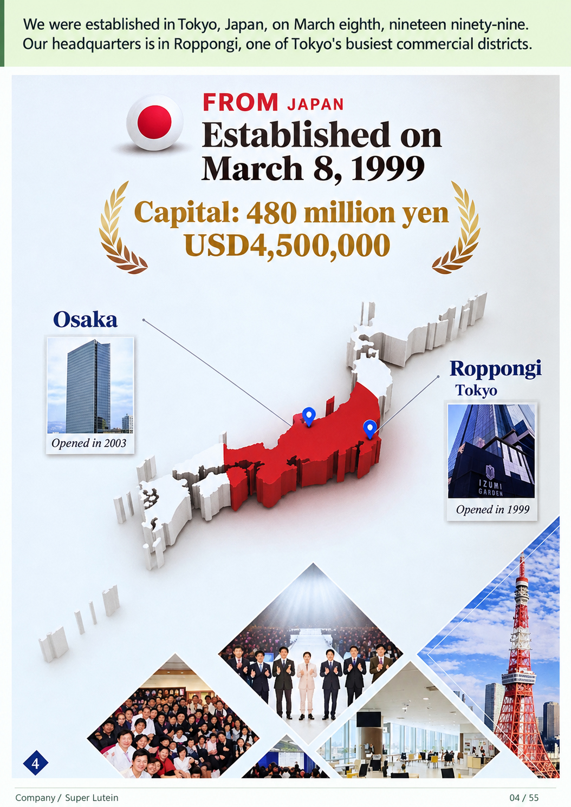
We were established in Tokyo, Japan, on March eighth, nineteen ninety-nine. Our
headquarters is in Roppongi, one of Tokyo's busiest commercial districts.
Filing • English
4 / 55
Notes:
We were established in Tokyo, Japan, on March eighth, nineteen ninety-nine. Our headquarters is in Roppongi, one of Tokyo's busiest commercial districts.
Source: 2026 scan filing.pdf; source PDF page 4.
Full-page localized image redraw. Facts, names, figures and page order must match the retained Chinese original. Image model requested:2.5; actual backend unexposed and unverified. Video production stopped by owner pending deck review.
Image-generated artwork plus native PowerPoint text for exact presenter narration, proper names, figures and reference wording. Original product/documentary picture layers retain source bytes.

Slide 5
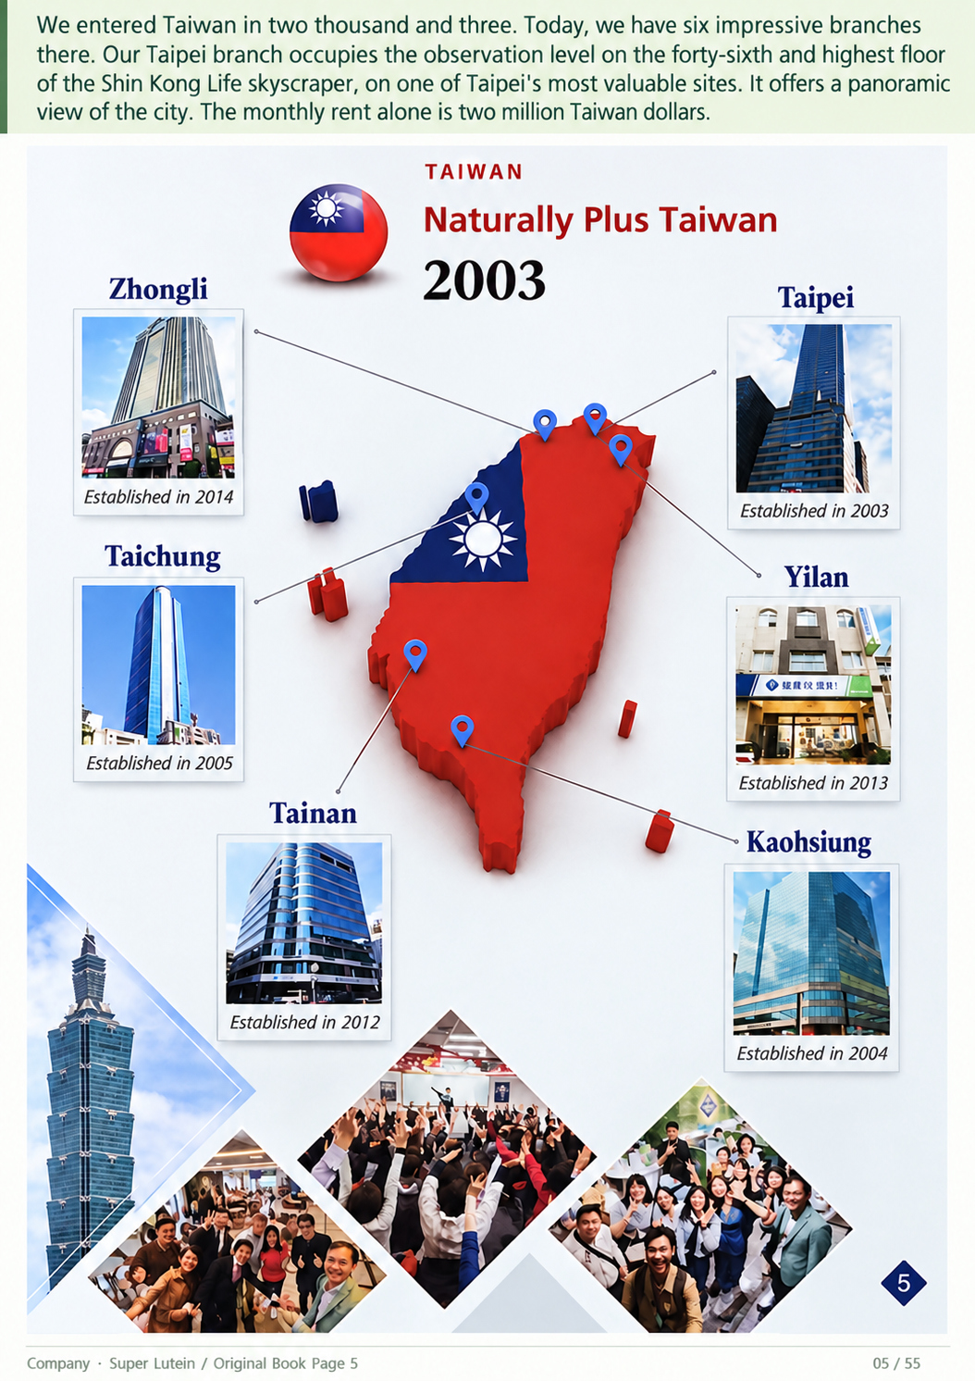
We entered Taiwan in two thousand and three. Today, we have six impressive branches there. Our Taipei branch
occupies the observation level on the forty-sixth and highest floor of the Shin Kong Life skyscraper, on one of Taipei's
most valuable sites. It offers a panoramic view of the city. The monthly rent alone is two million Taiwan dollars.
Filing • English
5 / 55
Notes:
We entered Taiwan in two thousand and three. Today, we have six impressive branches there. Our Taipei branch occupies the observation level on the forty-sixth and highest floor of the Shin Kong Life skyscraper, on one of Taipei's most valuable sites. It offers a panoramic view of the city. The monthly rent alone is two million Taiwan dollars.
Source: 2026 scan filing.pdf; source PDF page 4.
Full-page localized image redraw. Facts, names, figures and page order must match the retained Chinese original. Image model requested:2.5; actual backend unexposed and unverified. Video production stopped by owner pending deck review.
Image-generated artwork plus native PowerPoint text for exact presenter narration, proper names, figures and reference wording. Original product/documentary picture layers retain source bytes.

Slide 6
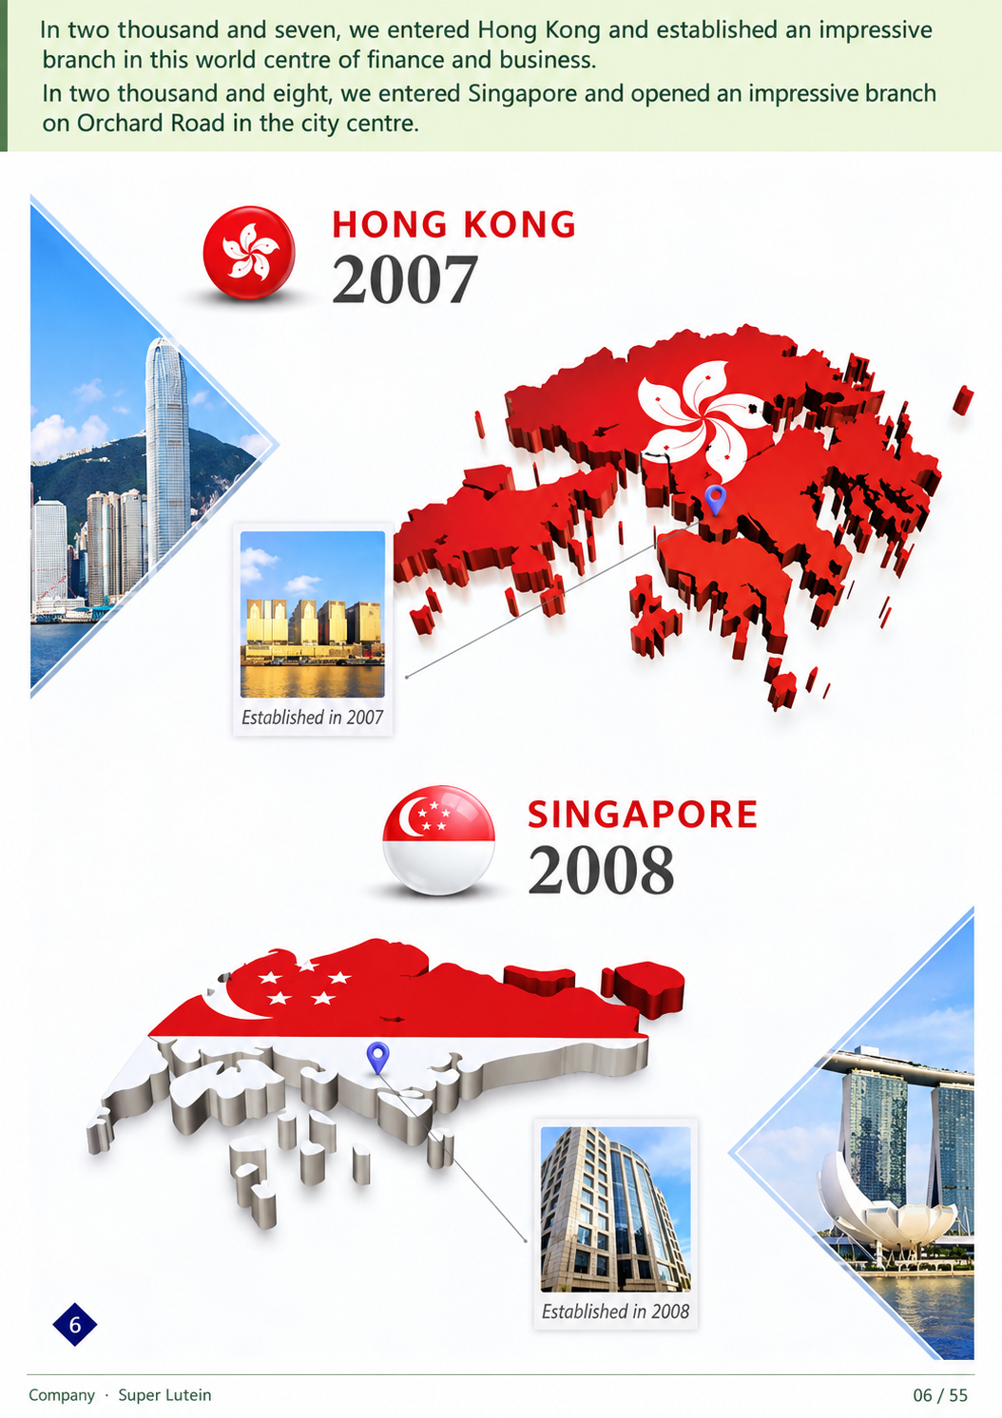
In two thousand and seven, we entered Hong Kong and established an impressive branch in
this world centre of finance and business. In two thousand and eight, we entered Singapore
and opened an impressive branch on Orchard Road in the city centre.
Filing • English
6 / 55
Notes:
In two thousand and seven, we entered Hong Kong and established an impressive branch in this world centre of finance and business. In two thousand and eight, we entered Singapore and opened an impressive branch on Orchard Road in the city centre.
Source: 2026 scan filing.pdf; source PDF page 7.
Full-page localized image redraw. Facts, names, figures and page order must match the retained Chinese original. Image model requested:2.5; actual backend unexposed and unverified. Video production stopped by owner pending deck review.
Image-generated artwork plus native PowerPoint text for exact presenter narration, proper names, figures and reference wording. Original product/documentary picture layers retain source bytes.

Slide 7
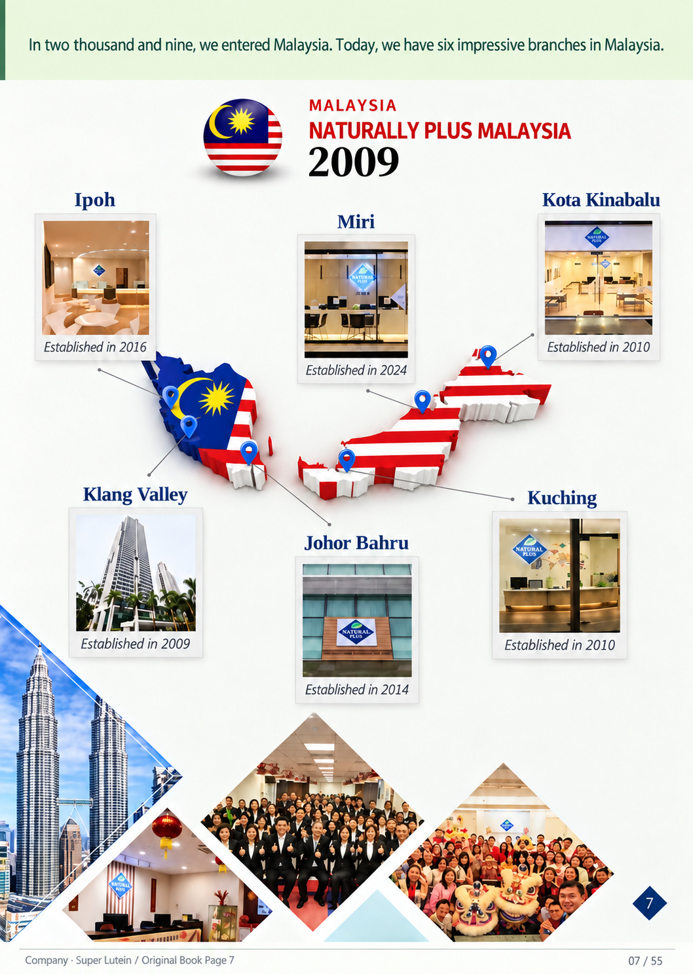
In two thousand and nine, we entered Malaysia. Today, we have six impressive branches in
Malaysia.
Filing • English
7 / 55
Notes:
In two thousand and nine, we entered Malaysia. Today, we have six impressive branches in Malaysia.
Source: 2026 scan filing.pdf; source PDF page 7.
Full-page localized image redraw. Facts, names, figures and page order must match the retained Chinese original. Image model requested:2.5; actual backend unexposed and unverified. Video production stopped by owner pending deck review.
Image-generated artwork plus native PowerPoint text for exact presenter narration, proper names, figures and reference wording. Original product/documentary picture layers retain source bytes.

Slide 8
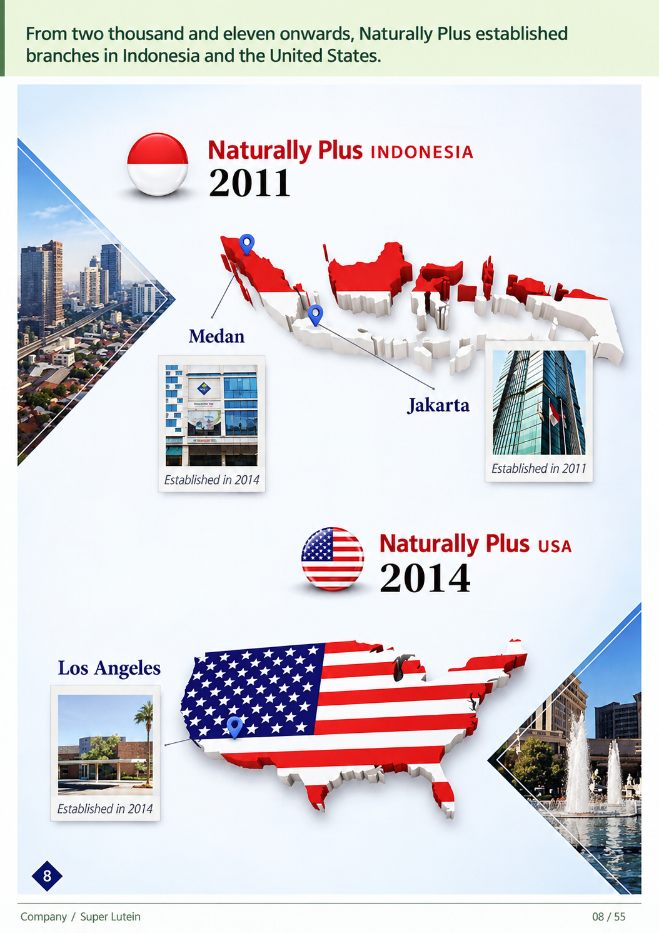
From two thousand and eleven onwards, Naturally Plus established branches in Indonesia
and the United States.
Filing • English
8 / 55
Notes:
From two thousand and eleven onwards, Naturally Plus established branches in Indonesia and the United States.
Source: 2026 scan filing.pdf; source PDF page 9.
Full-page localized image redraw. Facts, names, figures and page order must match the retained Chinese original. Image model requested:2.5; actual backend unexposed and unverified. Video production stopped by owner pending deck review.
Image-generated artwork plus native PowerPoint text for exact presenter narration, proper names, figures and reference wording. Original product/documentary picture layers retain source bytes.

Slide 9
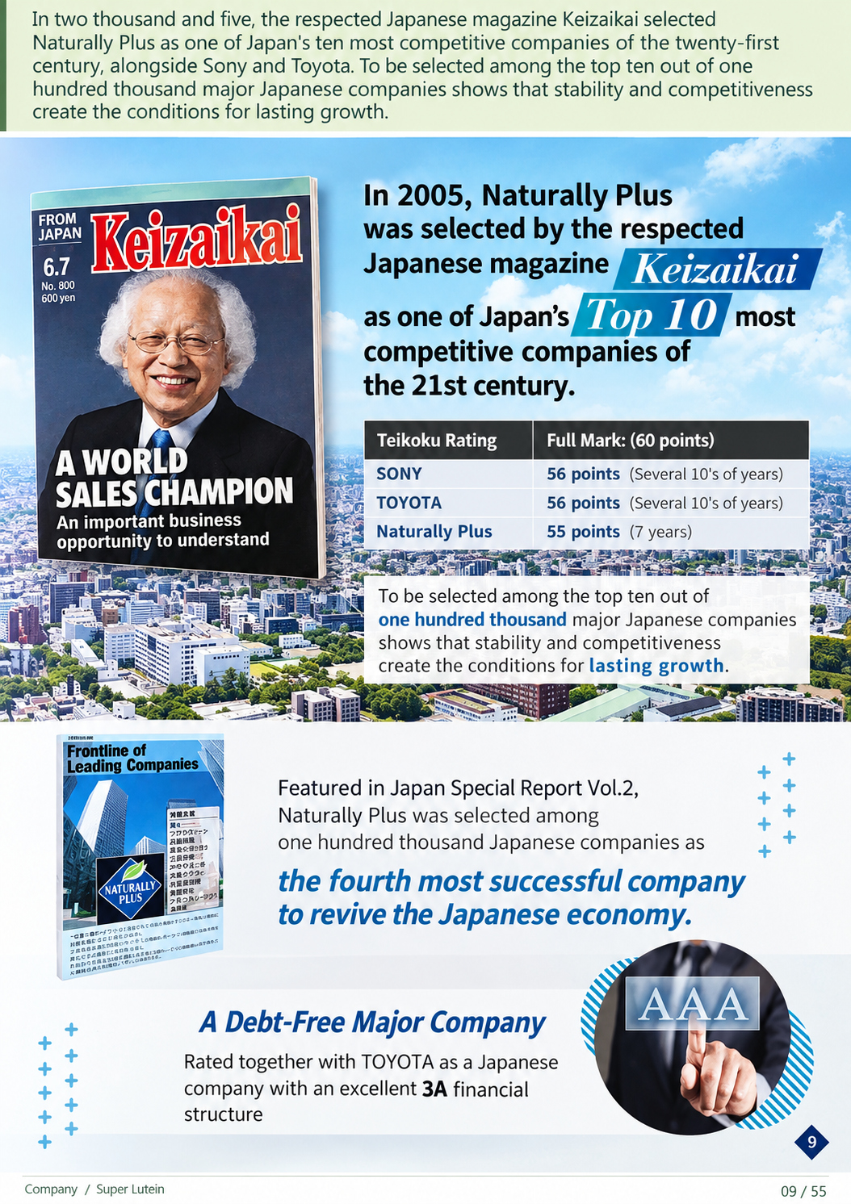
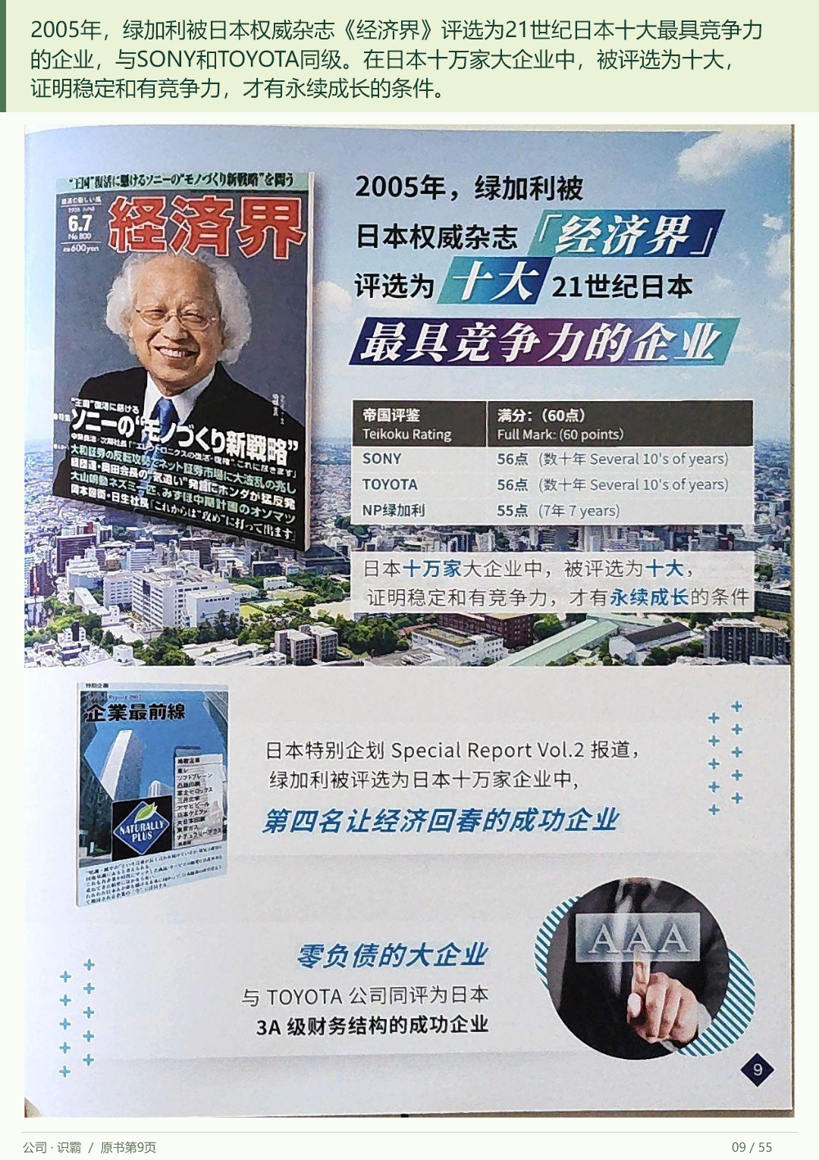
In two thousand and five, the respected Japanese magazine Keizaikai selected Naturally Plus as one
of Japan's ten most competitive companies of the twenty-first century, alongside Sony and Toyota. To
be selected among the top ten out of one hundred thousand major Japanese companies shows that
stability and competitiveness create the conditions for lasting growth.
Filing • English
9 / 55
Notes:
In two thousand and five, the respected Japanese magazine Keizaikai selected Naturally Plus as one of Japan's ten most competitive companies of the twenty-first century, alongside Sony and Toyota. To be selected among the top ten out of one hundred thousand major Japanese companies shows that stability and competitiveness create the conditions for lasting growth.
Source: 2026 scan filing.pdf; source PDF page 8.
Full-page localized image redraw. Facts, names, figures and page order must match the retained Chinese original. Image model requested:2.5; actual backend unexposed and unverified. Video production stopped by owner pending deck review.
Image-generated artwork plus native PowerPoint text for exact presenter narration, proper names, figures and reference wording. Original product/documentary picture layers retain source bytes.

Slide 10
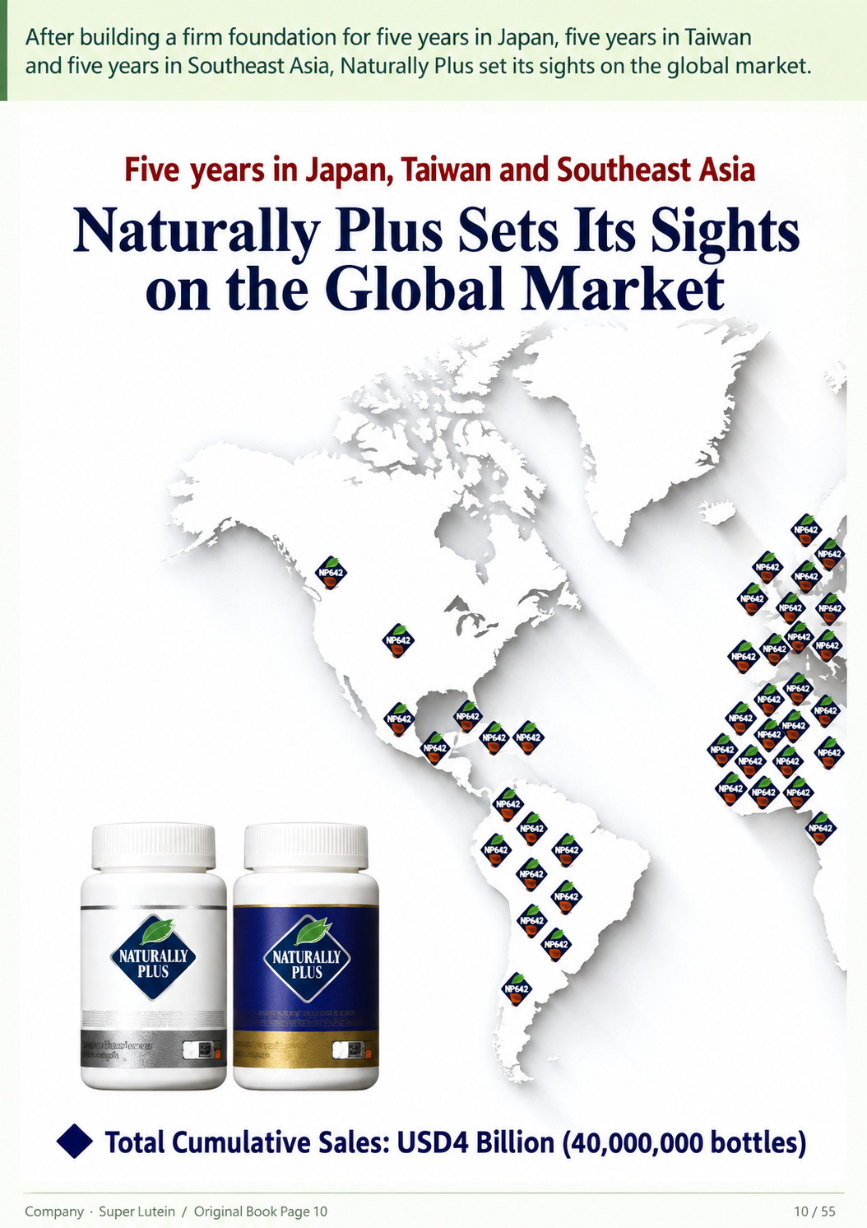
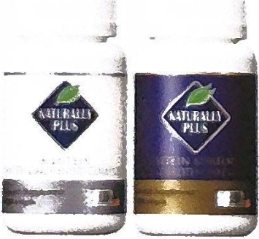
After building a firm foundation for five years in Japan, five years in Taiwan and five years in
Southeast Asia, Naturally Plus set its sights on the global market.
Filing • English
10 / 55
Notes:
After building a firm foundation for five years in Japan, five years in Taiwan and five years in Southeast Asia, Naturally Plus set its sights on the global market.
Source: 2026 scan filing.pdf; source PDF page 10.
Full-page localized image redraw. Facts, names, figures and page order must match the retained Chinese original. Image model requested:2.5; actual backend unexposed and unverified. Video production stopped by owner pending deck review.
Image-generated artwork plus native PowerPoint text for exact presenter narration, proper names, figures and reference wording. Original product/documentary picture layers retain source bytes.

Slide 11
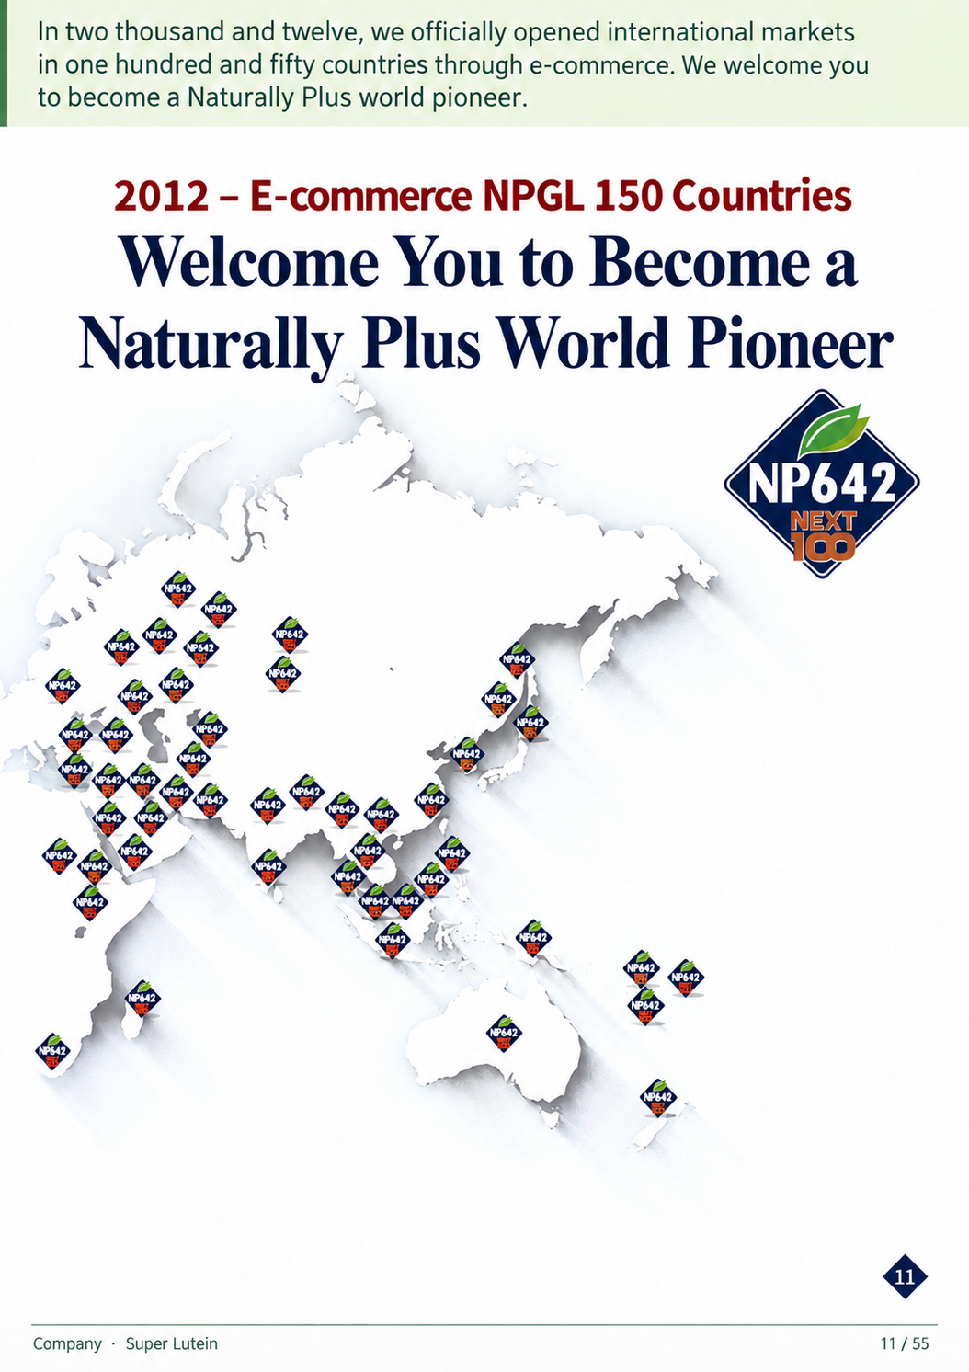
In two thousand and twelve, we officially opened international markets in one hundred and
fifty countries through e-commerce. We welcome you to become a Naturally Plus world
pioneer.
Filing • English
11 / 55
Notes:
In two thousand and twelve, we officially opened international markets in one hundred and fifty countries through e-commerce. We welcome you to become a Naturally Plus world pioneer.
Source: 2026 scan filing.pdf; source PDF page 10.
Full-page localized image redraw. Facts, names, figures and page order must match the retained Chinese original. Image model requested:2.5; actual backend unexposed and unverified. Video production stopped by owner pending deck review.
Image-generated artwork plus native PowerPoint text for exact presenter narration, proper names, figures and reference wording. Original product/documentary picture layers retain source bytes.

Slide 12

What do you seek in life? Even if we became billionaires and owned the finest things in the
world, our lives would amount to zero if we lost our health. That is why we often say: health
is wealth!
Filing • English
12 / 55
Notes:
What do you seek in life? Even if we became billionaires and owned the finest things in the world, our lives would amount to zero if we lost our health. That is why we often say: health is wealth!
Source: 2026 scan filing.pdf; source PDF page 12.
Full-page localized image redraw. Facts, names, figures and page order must match the retained Chinese original. Image model requested:2.5; actual backend unexposed and unverified. Video production stopped by owner pending deck review.
Image-generated artwork plus native PowerPoint text for exact presenter narration, proper names, figures and reference wording. Original product/documentary picture layers retain source bytes.

Slide 13
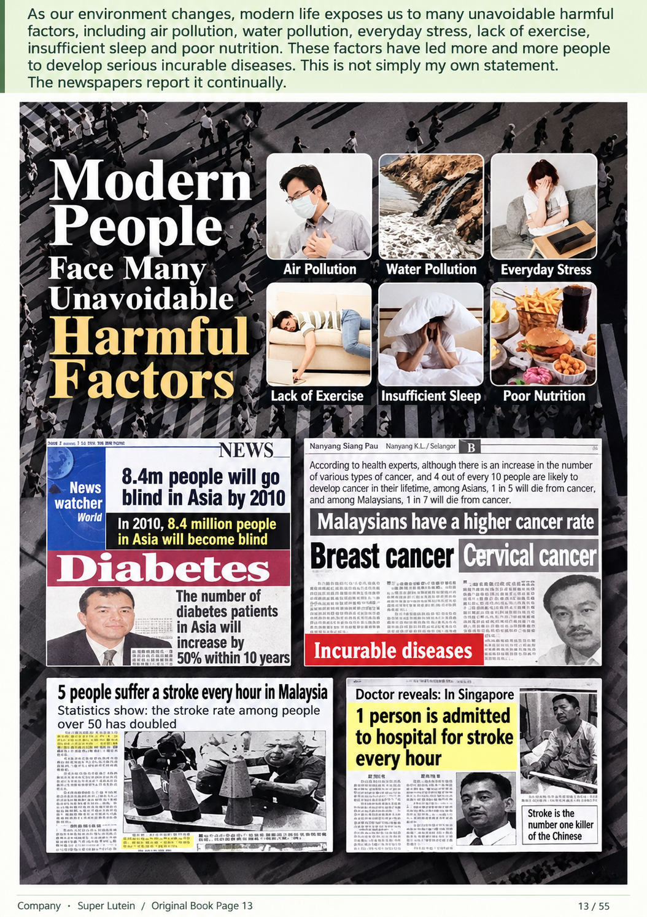
As our environment changes, modern life exposes us to many unavoidable harmful factors, including air
pollution, water pollution, everyday stress, lack of exercise, insufficient sleep and poor nutrition. These factors
have led more and more people to develop serious incurable diseases. This is not simply my own statement.
The newspapers report it continually.
Filing • English
13 / 55
Notes:
As our environment changes, modern life exposes us to many unavoidable harmful factors, including air pollution, water pollution, everyday stress, lack of exercise, insufficient sleep and poor nutrition. These factors have led more and more people to develop serious incurable diseases. This is not simply my own statement. The newspapers report it continually.
Source: 2026 scan filing.pdf; source PDF page 12.
Full-page localized image redraw. Facts, names, figures and page order must match the retained Chinese original. Image model requested:2.5; actual backend unexposed and unverified. Video production stopped by owner pending deck review.
Image-generated artwork plus native PowerPoint text for exact presenter narration, proper names, figures and reference wording. Original product/documentary picture layers retain source bytes.

Slide 14
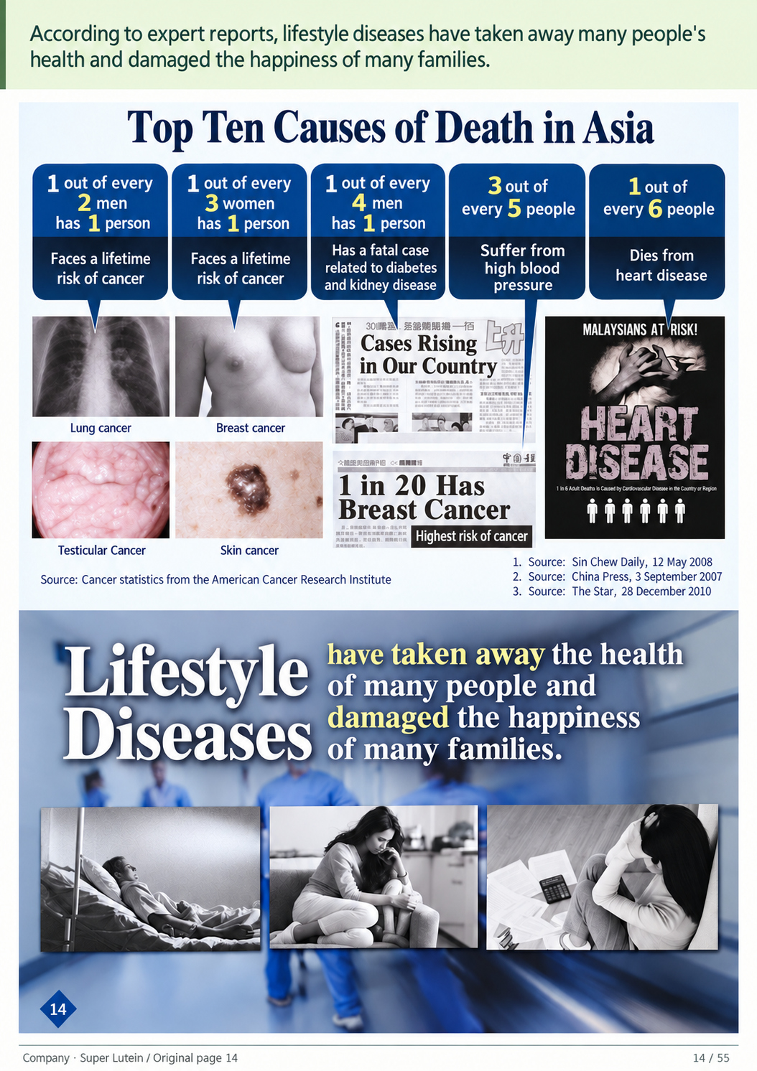
According to expert reports, lifestyle diseases have taken away many people's health and
damaged the happiness of many families.
Filing • English
14 / 55
Notes:
According to expert reports, lifestyle diseases have taken away many people's health and damaged the happiness of many families.
Source: 2026 scan filing.pdf; source PDF page 13.
Full-page localized image redraw. Facts, names, figures and page order must match the retained Chinese original. Image model requested:2.5; actual backend unexposed and unverified. Video production stopped by owner pending deck review.
Image-generated artwork plus native PowerPoint text for exact presenter narration, proper names, figures and reference wording. Original product/documentary picture layers retain source bytes.

Slide 15
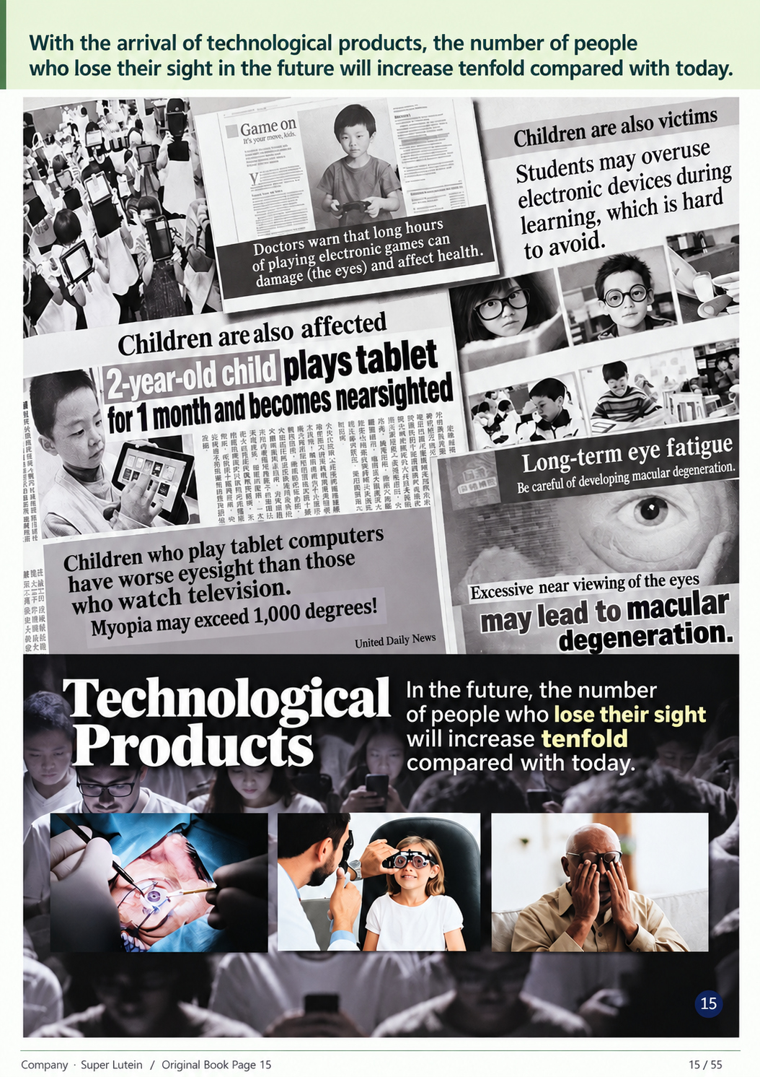
With the arrival of technological products, the number of people who lose their sight in the
future will increase tenfold compared with today.
Filing • English
15 / 55
Notes:
With the arrival of technological products, the number of people who lose their sight in the future will increase tenfold compared with today.
Source: 2026 scan filing.pdf; source PDF page 13.
Full-page localized image redraw. Facts, names, figures and page order must match the retained Chinese original. Image model requested:2.5; actual backend unexposed and unverified. Video production stopped by owner pending deck review.
Image-generated artwork plus native PowerPoint text for exact presenter narration, proper names, figures and reference wording. Original product/documentary picture layers retain source bytes.

Slide 16

Prevention is better than cure. While we still have our health, we should look after it promptly and preserve what
we have. If we wait until we or our family members develop these incurable diseases before becoming concerned,
it will be too late! But with so many health supplements on the market, which one truly deserves our trust?
Filing • English
16 / 55
Notes:
Prevention is better than cure. While we still have our health, we should look after it promptly and preserve what we have. If we wait until we or our family members develop these incurable diseases before becoming concerned, it will be too late! But with so many health supplements on the market, which one truly deserves our trust?
Source: 2026 scan filing.pdf; source PDF page 14.
Full-page localized image redraw. Facts, names, figures and page order must match the retained Chinese original. Image model requested:2.5; actual backend unexposed and unverified. Video production stopped by owner pending deck review.
Image-generated artwork plus native PowerPoint text for exact presenter narration, proper names, figures and reference wording. Original product/documentary picture layers retain source bytes.

Slide 17
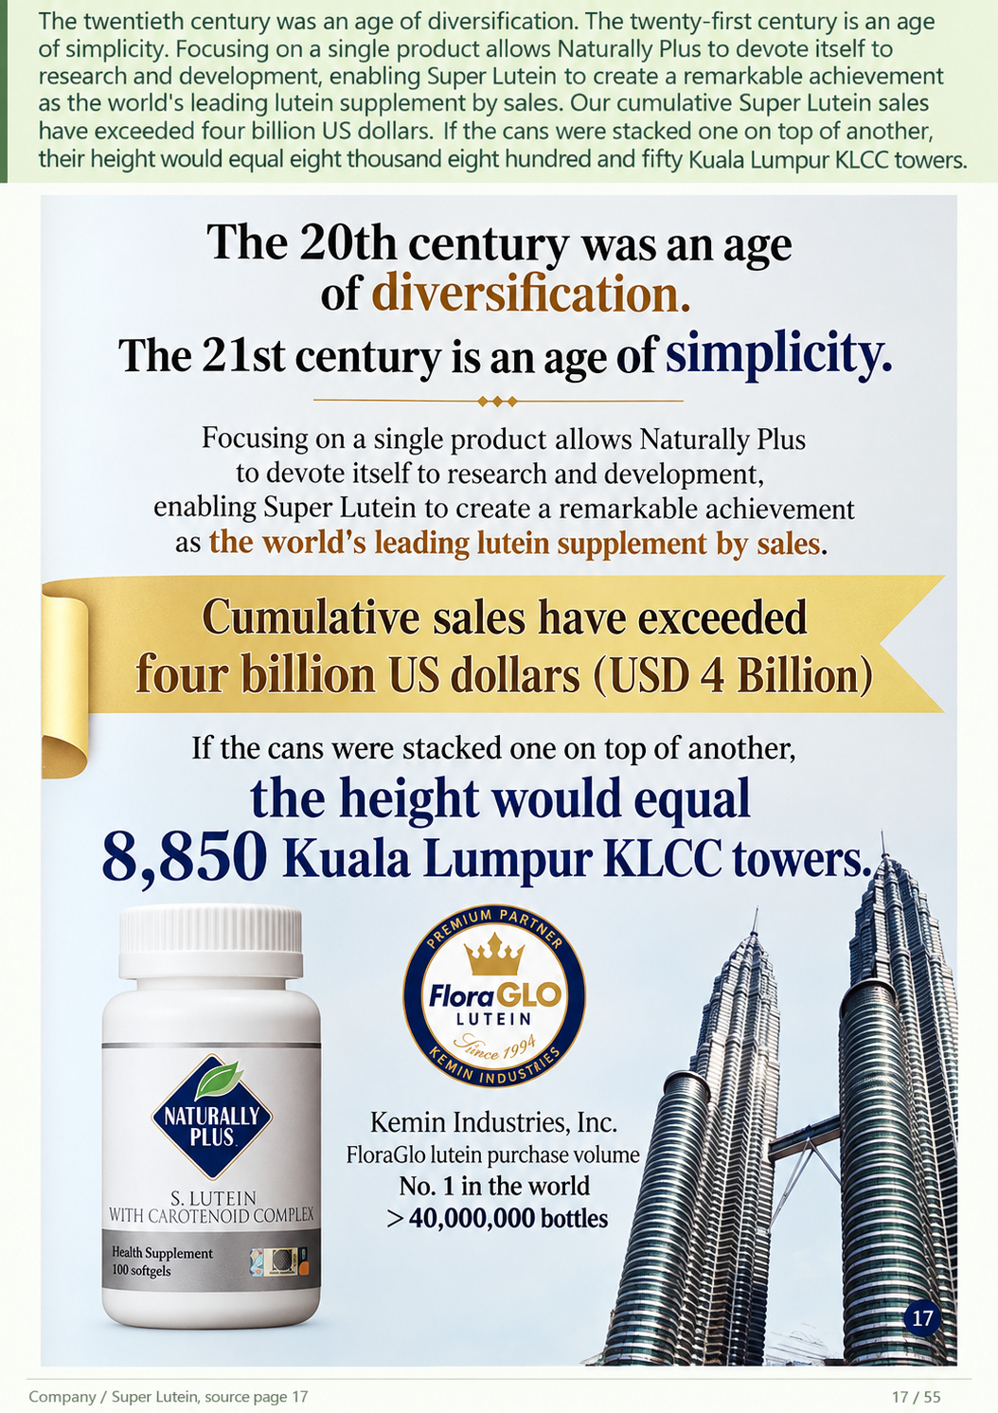
The twentieth century was an age of diversification. The twenty-first century is an age of simplicity. Focusing
on a single product allows Naturally Plus to devote itself to research and development, enabling Super Lutein
to create a remarkable achievement as the world's leading lutein supplement by sales. Our cumulative Super
Lutein sales have exceeded four billion US dollars. If the cans were stacked one on top of another, their
height would equal eight thousand eight hundred and fifty Kuala Lumpur KLCC towers.
Filing • English
17 / 55
Notes:
The twentieth century was an age of diversification. The twenty-first century is an age of simplicity. Focusing on a single product allows Naturally Plus to devote itself to research and development, enabling Super Lutein to create a remarkable achievement as the world's leading lutein supplement by sales. Our cumulative Super Lutein sales have exceeded four billion US dollars. If the cans were stacked one on top of another, their height would equal eight thousand eight hundred and fifty Kuala Lumpur KLCC towers.
Source: 2026 scan filing.pdf; source PDF page 14.
Full-page localized image redraw. Facts, names, figures and page order must match the retained Chinese original. Image model requested:2.5; actual backend unexposed and unverified. Video production stopped by owner pending deck review.
Image-generated artwork plus native PowerPoint text for exact presenter narration, proper names, figures and reference wording. Original product/documentary picture layers retain source bytes.

Slide 18
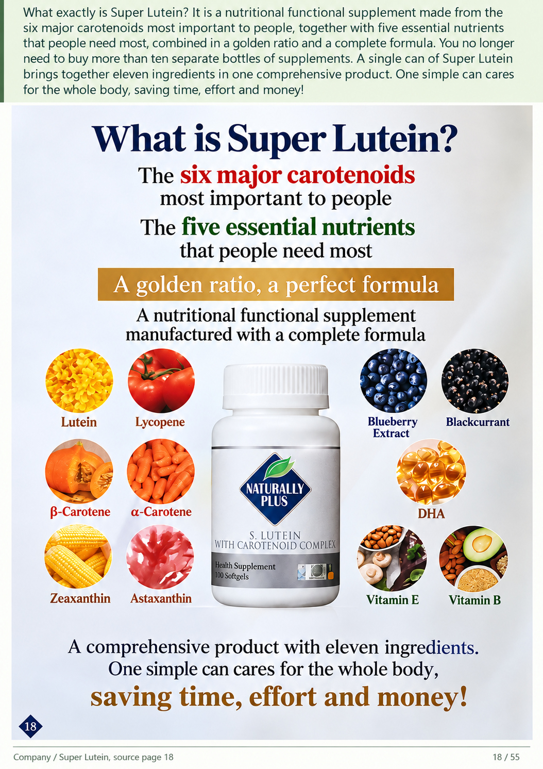
What exactly is Super Lutein? It is a nutritional functional supplement made from the six major
carotenoids most important to people, together with five essential nutrients that people need most,
combined in a golden ratio and a complete formula. You no longer need to buy more than ten
separate bottles of supplements. A single can of Super Lutein brings together eleven ingredients in
one comprehensive product. One simple can cares for the whole body, saving time, effort and money!
Filing • English
18 / 55
Notes:
What exactly is Super Lutein? It is a nutritional functional supplement made from the six major carotenoids most important to people, together with five essential nutrients that people need most, combined in a golden ratio and a complete formula. You no longer need to buy more than ten separate bottles of supplements. A single can of Super Lutein brings together eleven ingredients in one comprehensive product. One simple can cares for the whole body, saving time, effort and money!
Source: 2026 scan filing.pdf; source PDF page 15.
Full-page localized image redraw. Facts, names, figures and page order must match the retained Chinese original. Image model requested:2.5; actual backend unexposed and unverified. Video production stopped by owner pending deck review.
Image-generated artwork plus native PowerPoint text for exact presenter narration, proper names, figures and reference wording. Original product/documentary picture layers retain source bytes.

Slide 19
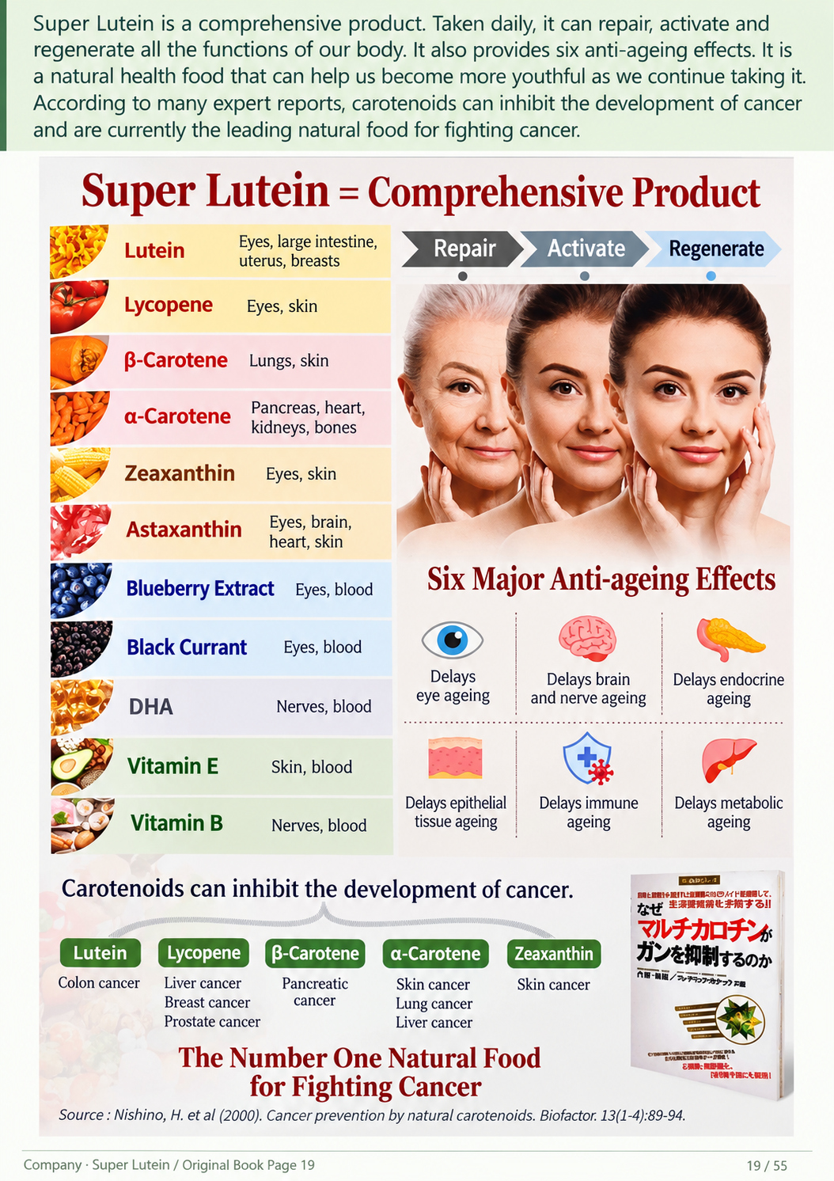
Super Lutein is a comprehensive product. Taken daily, it can repair, activate and regenerate all the
functions of our body. It also provides six anti-ageing effects. It is a natural health food that can help
us become more youthful as we continue taking it. According to many expert reports, carotenoids can
inhibit the development of cancer and are currently the leading natural food for fighting cancer.
Filing • English
19 / 55
Notes:
Super Lutein is a comprehensive product. Taken daily, it can repair, activate and regenerate all the functions of our body. It also provides six anti-ageing effects. It is a natural health food that can help us become more youthful as we continue taking it. According to many expert reports, carotenoids can inhibit the development of cancer and are currently the leading natural food for fighting cancer.
Source: 2026 scan filing.pdf; source PDF page 16.
Full-page localized image redraw. Facts, names, figures and page order must match the retained Chinese original. Image model requested:2.5; actual backend unexposed and unverified. Video production stopped by owner pending deck review.
Image-generated artwork plus native PowerPoint text for exact presenter narration, proper names, figures and reference wording. Original product/documentary picture layers retain source bytes.

Slide 20
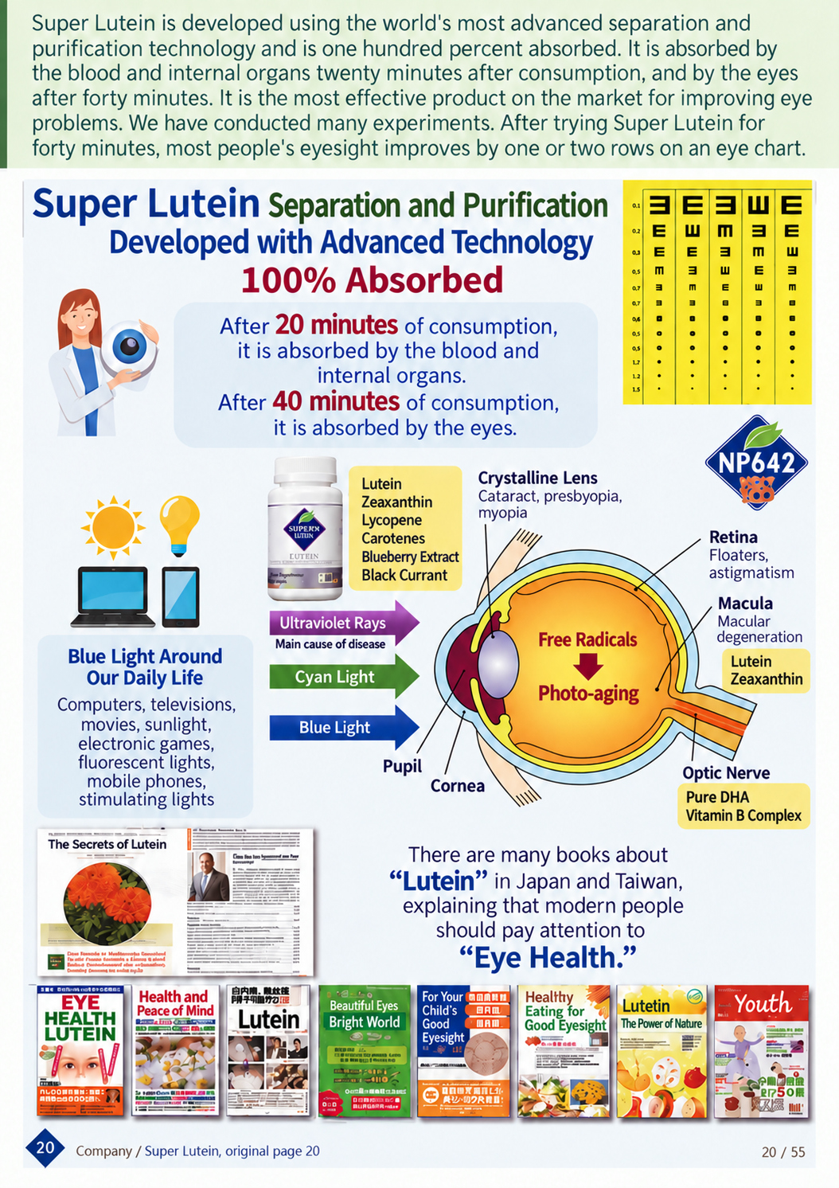
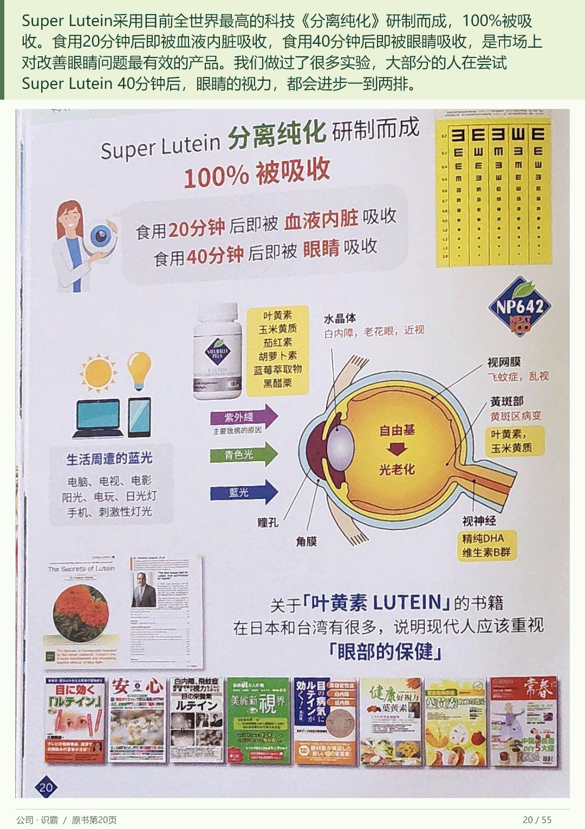
Super Lutein is developed using the world's most advanced separation and purification technology
and is one hundred percent absorbed. It is absorbed by the blood and internal organs twenty minutes
after consumption, and by the eyes after forty minutes. It is the most effective product on the market
for improving eye problems. We have conducted many experiments. After trying Super Lutein for forty
minutes, most people's eyesight improves by one or two rows on an eye chart.
Filing • English
20 / 55
Notes:
Super Lutein is developed using the world's most advanced separation and purification technology and is one hundred percent absorbed. It is absorbed by the blood and internal organs twenty minutes after consumption, and by the eyes after forty minutes. It is the most effective product on the market for improving eye problems. We have conducted many experiments. After trying Super Lutein for forty minutes, most people's eyesight improves by one or two rows on an eye chart.
Source: 2026 scan filing.pdf; source PDF page 17.
Full-page localized image redraw. Facts, names, figures and page order must match the retained Chinese original. Image model requested:2.5; actual backend unexposed and unverified. Video production stopped by owner pending deck review.
Image-generated artwork plus native PowerPoint text for exact presenter narration, proper names, figures and reference wording. Original product/documentary picture layers retain source bytes.

Slide 21
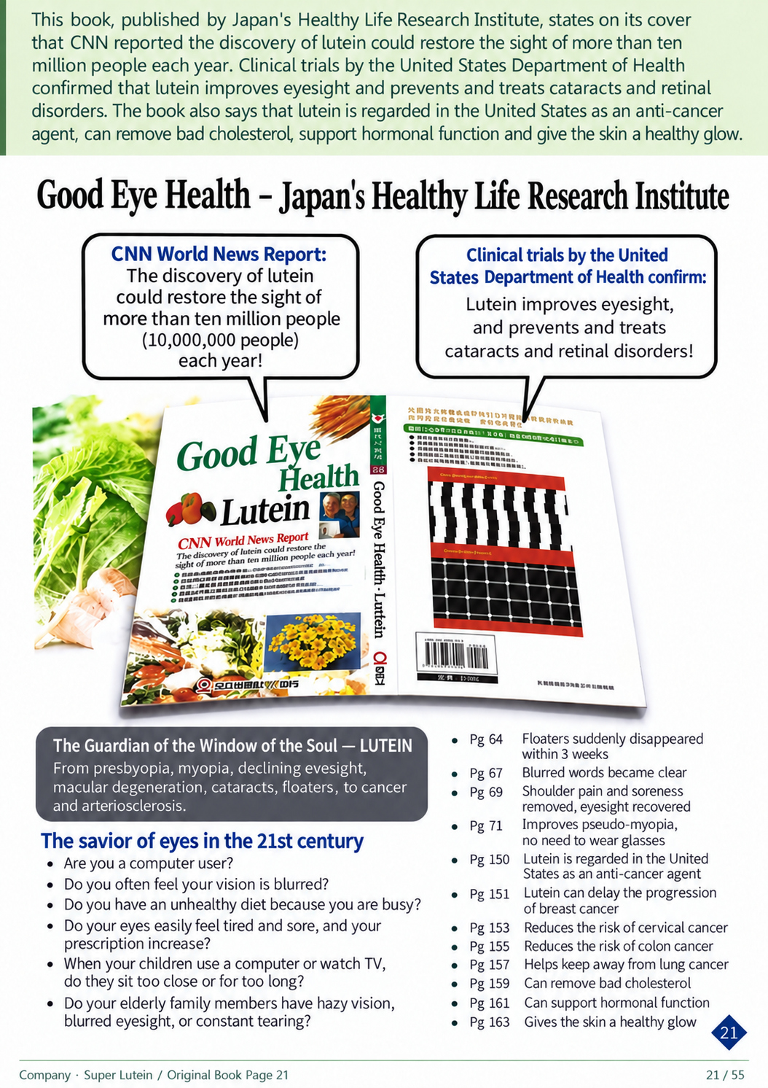
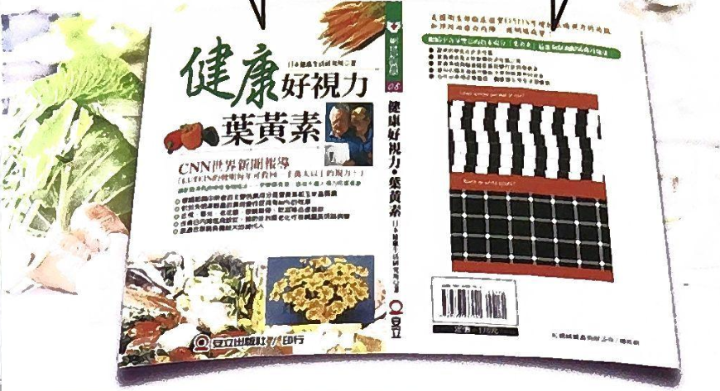
This book, published by Japan's Healthy Life Research Institute, states on its cover that CNN reported the
discovery of lutein could restore the sight of more than ten million people each year. Clinical trials by the
United States Department of Health confirmed that lutein improves eyesight and prevents and treats
cataracts and retinal disorders. The book also says that lutein is regarded in the United States as an
anti-cancer agent, can remove bad cholesterol, support hormonal function and give the skin a healthy glow.
Filing • English
21 / 55
Notes:
This book, published by Japan's Healthy Life Research Institute, states on its cover that CNN reported the discovery of lutein could restore the sight of more than ten million people each year. Clinical trials by the United States Department of Health confirmed that lutein improves eyesight and prevents and treats cataracts and retinal disorders. The book also says that lutein is regarded in the United States as an anti-cancer agent, can remove bad cholesterol, support hormonal function and give the skin a healthy glow.
Source: 2026 scan filing.pdf; source PDF page 18.
Full-page localized image redraw. Facts, names, figures and page order must match the retained Chinese original. Image model requested:2.5; actual backend unexposed and unverified. Video production stopped by owner pending deck review.
Image-generated artwork plus native PowerPoint text for exact presenter narration, proper names, figures and reference wording. Original product/documentary picture layers retain source bytes.

Slide 22
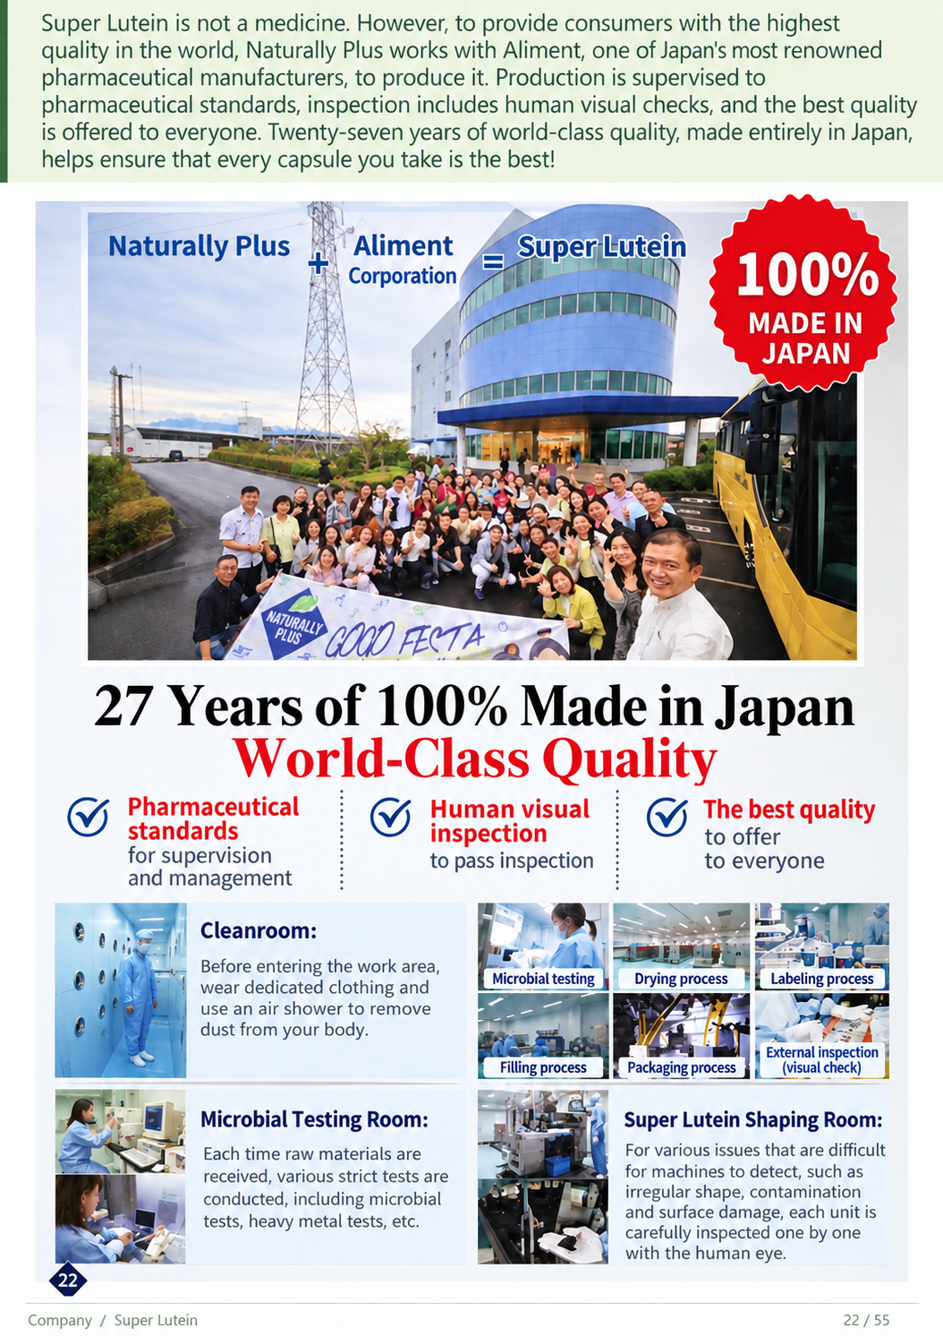
Super Lutein is not a medicine. However, to provide consumers with the highest quality in the world,
Naturally Plus works with Aliment, one of Japan's most renowned pharmaceutical manufacturers, to
produce it. Production is supervised to pharmaceutical standards, inspection includes human visual
checks, and the best quality is offered to everyone. Twenty-seven years of world-class quality, made
entirely in Japan, helps ensure that every capsule you take is the best!
Filing • English
22 / 55
Notes:
Super Lutein is not a medicine. However, to provide consumers with the highest quality in the world, Naturally Plus works with Aliment, one of Japan's most renowned pharmaceutical manufacturers, to produce it. Production is supervised to pharmaceutical standards, inspection includes human visual checks, and the best quality is offered to everyone. Twenty-seven years of world-class quality, made entirely in Japan, helps ensure that every capsule you take is the best!
Source: 2026 scan filing.pdf; source PDF page 19.
Full-page localized image redraw. Facts, names, figures and page order must match the retained Chinese original. Image model requested:2.5; actual backend unexposed and unverified. Video production stopped by owner pending deck review.
Image-generated artwork plus native PowerPoint text for exact presenter narration, proper names, figures and reference wording. Original product/documentary picture layers retain source bytes.

Slide 23
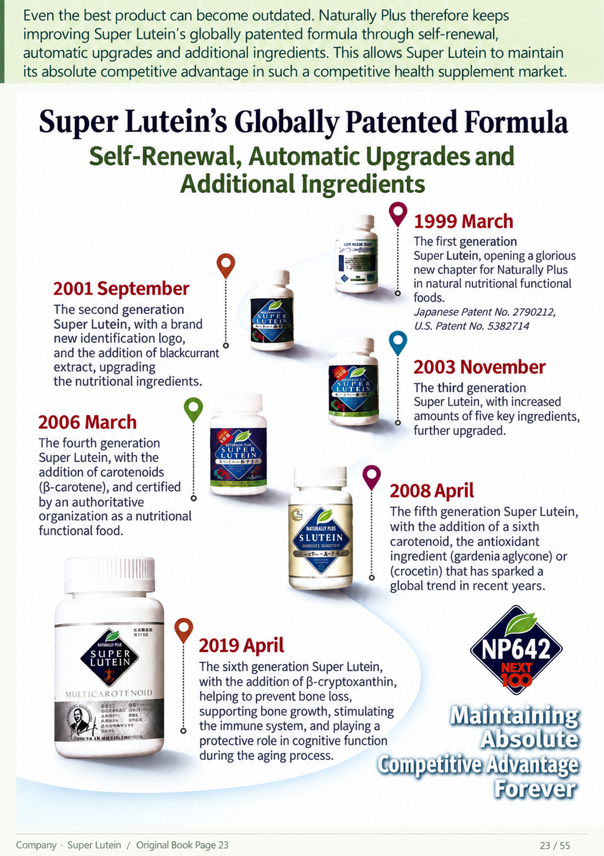
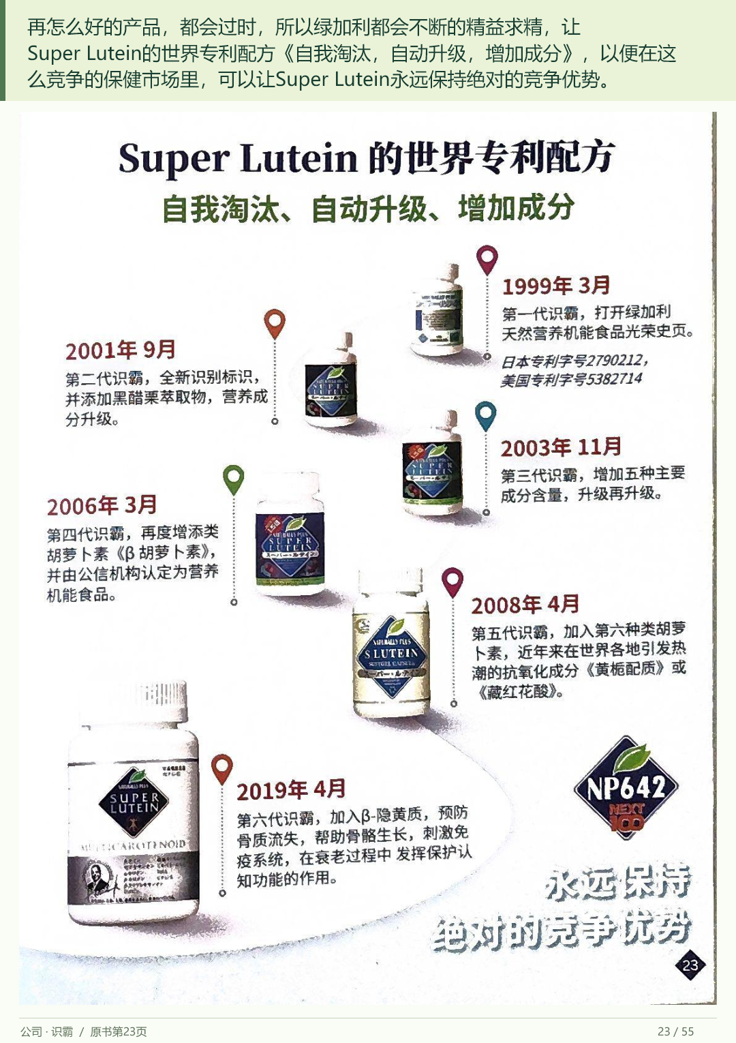
Even the best product can become outdated. Naturally Plus therefore keeps improving Super Lutein's globally
patented formula through self-renewal, automatic upgrades and additional ingredients. This allows Super
Lutein to maintain its absolute competitive advantage in such a competitive health supplement market.
Filing • English
23 / 55
Notes:
Even the best product can become outdated. Naturally Plus therefore keeps improving Super Lutein's globally patented formula through self-renewal, automatic upgrades and additional ingredients. This allows Super Lutein to maintain its absolute competitive advantage in such a competitive health supplement market.
Source: 2026 scan filing.pdf; source PDF page 20.
Full-page localized image redraw. Facts, names, figures and page order must match the retained Chinese original. Image model requested:2.5; actual backend unexposed and unverified. Video production stopped by owner pending deck review.
Image-generated artwork plus native PowerPoint text for exact presenter narration, proper names, figures and reference wording. Original product/documentary picture layers retain source bytes.

Slide 24
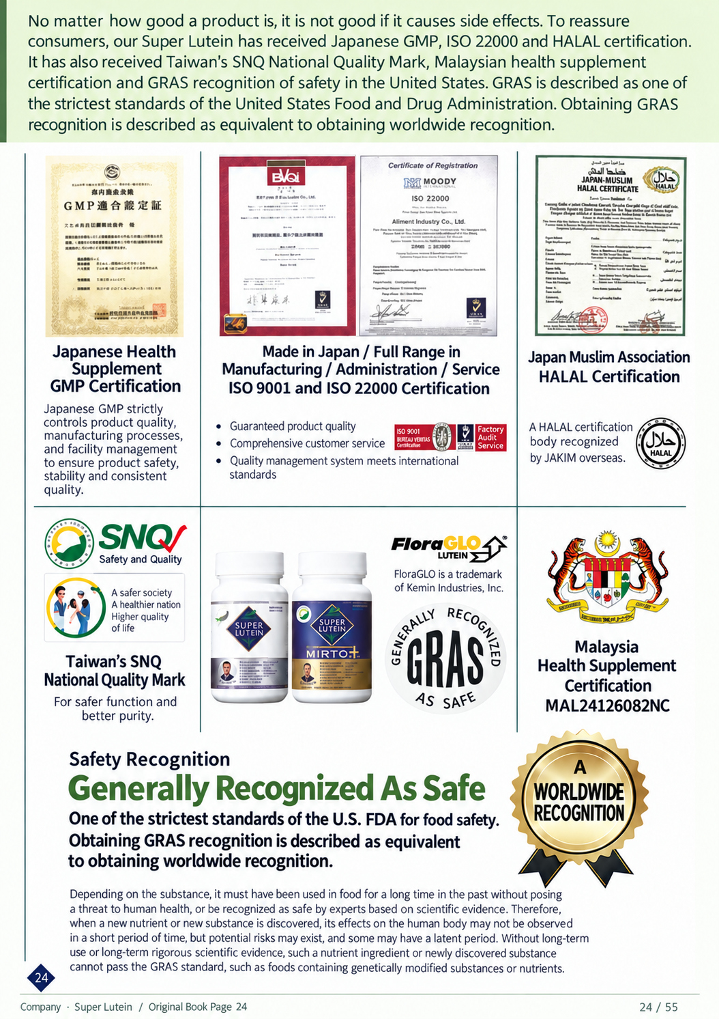
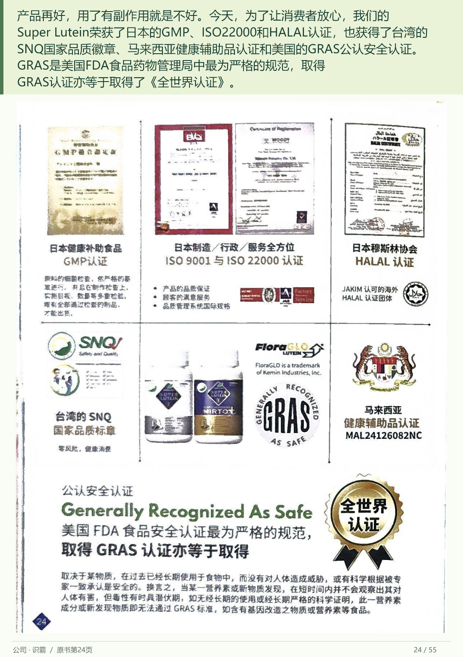
No matter how good a product is, it is not good if it causes side effects. To reassure consumers, our Super
Lutein has received Japanese GMP, ISO twenty-two thousand and HALAL certification. It has also received
Taiwan's SNQ National Quality Mark, Malaysian health supplement certification and GRAS recognition of
safety in the United States. GRAS is described as one of the strictest standards of the United States Food
and Drug Administration. Obtaining GRAS recognition is described as equivalent to obtaining worldwide
recognition.
Filing • English
24 / 55
Notes:
No matter how good a product is, it is not good if it causes side effects. To reassure consumers, our Super Lutein has received Japanese GMP, ISO twenty-two thousand and HALAL certification. It has also received Taiwan's SNQ National Quality Mark, Malaysian health supplement certification and GRAS recognition of safety in the United States. GRAS is described as one of the strictest standards of the United States Food and Drug Administration. Obtaining GRAS recognition is described as equivalent to obtaining worldwide recognition.
Source: 2026 scan filing.pdf; source PDF page 21.
Full-page localized image redraw. Facts, names, figures and page order must match the retained Chinese original. Image model requested:2.5; actual backend unexposed and unverified. Video production stopped by owner pending deck review.
Image-generated artwork plus native PowerPoint text for exact presenter narration, proper names, figures and reference wording. Original product/documentary picture layers retain source bytes.

Slide 25
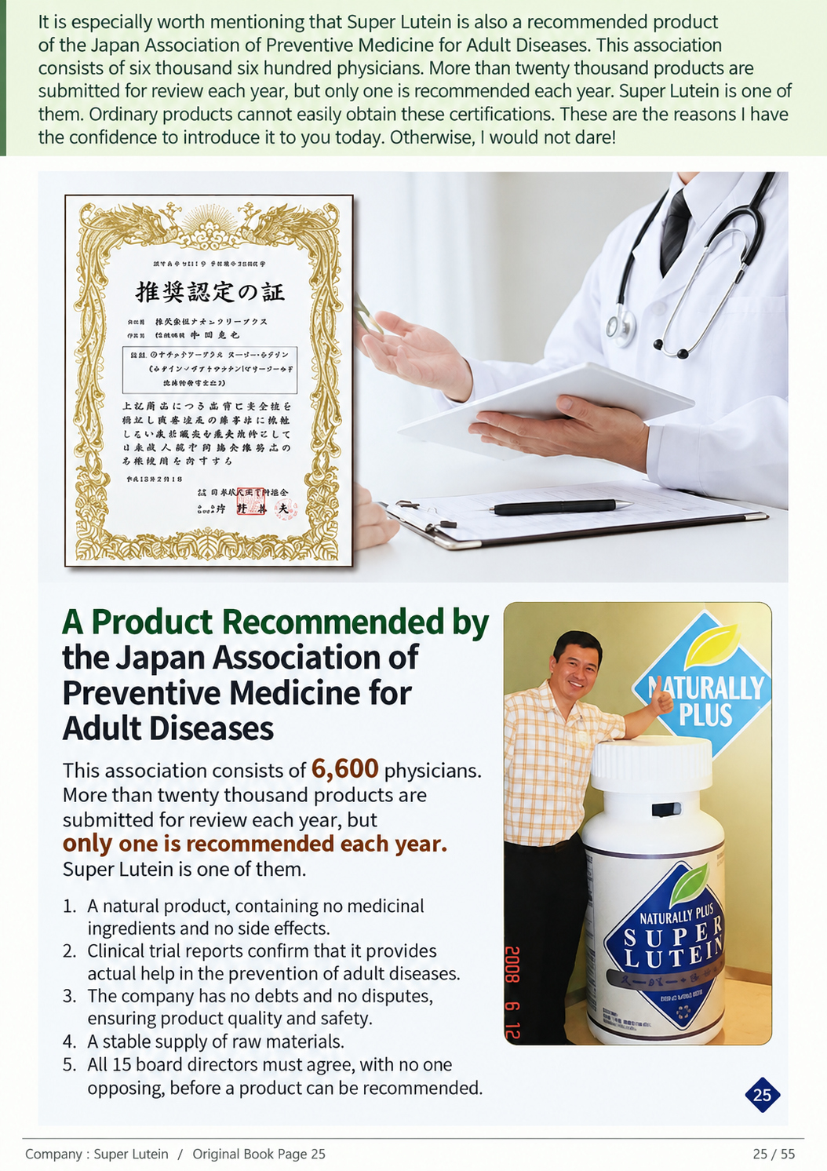
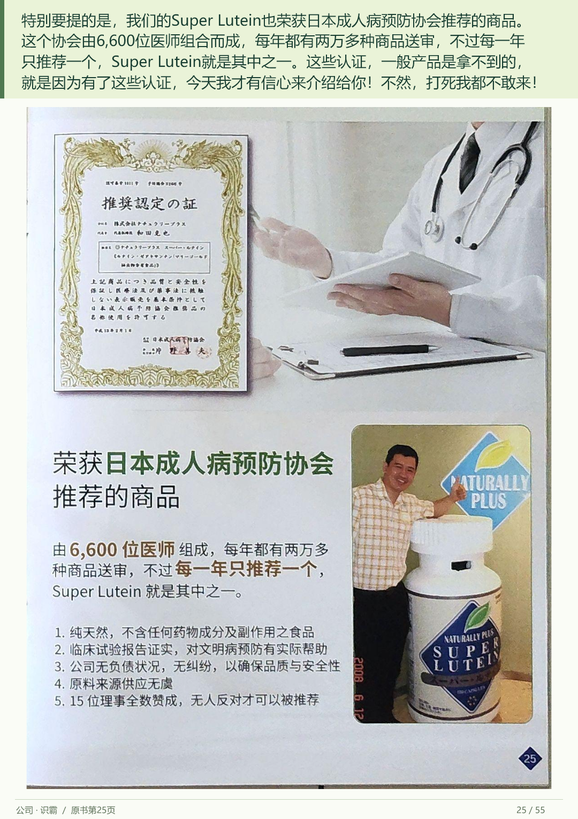
It is especially worth mentioning that Super Lutein is also a recommended product of the Japan Association of
Preventive Medicine for Adult Diseases. This association consists of six thousand six hundred physicians.
More than twenty thousand products are submitted for review each year, but only one is recommended each
year. Super Lutein is one of them. Ordinary products cannot easily obtain these certifications. These are the
reasons I have the confidence to introduce it to you today. Otherwise, I would not dare!
Filing • English
25 / 55
Notes:
It is especially worth mentioning that Super Lutein is also a recommended product of the Japan Association of Preventive Medicine for Adult Diseases. This association consists of six thousand six hundred physicians. More than twenty thousand products are submitted for review each year, but only one is recommended each year. Super Lutein is one of them. Ordinary products cannot easily obtain these certifications. These are the reasons I have the confidence to introduce it to you today. Otherwise, I would not dare!
Source: 2026 scan filing.pdf; source PDF page 22.
Full-page localized image redraw. Facts, names, figures and page order must match the retained Chinese original. Image model requested:2.5; actual backend unexposed and unverified. Video production stopped by owner pending deck review.
Image-generated artwork plus native PowerPoint text for exact presenter narration, proper names, figures and reference wording. Original product/documentary picture layers retain source bytes.

Slide 26
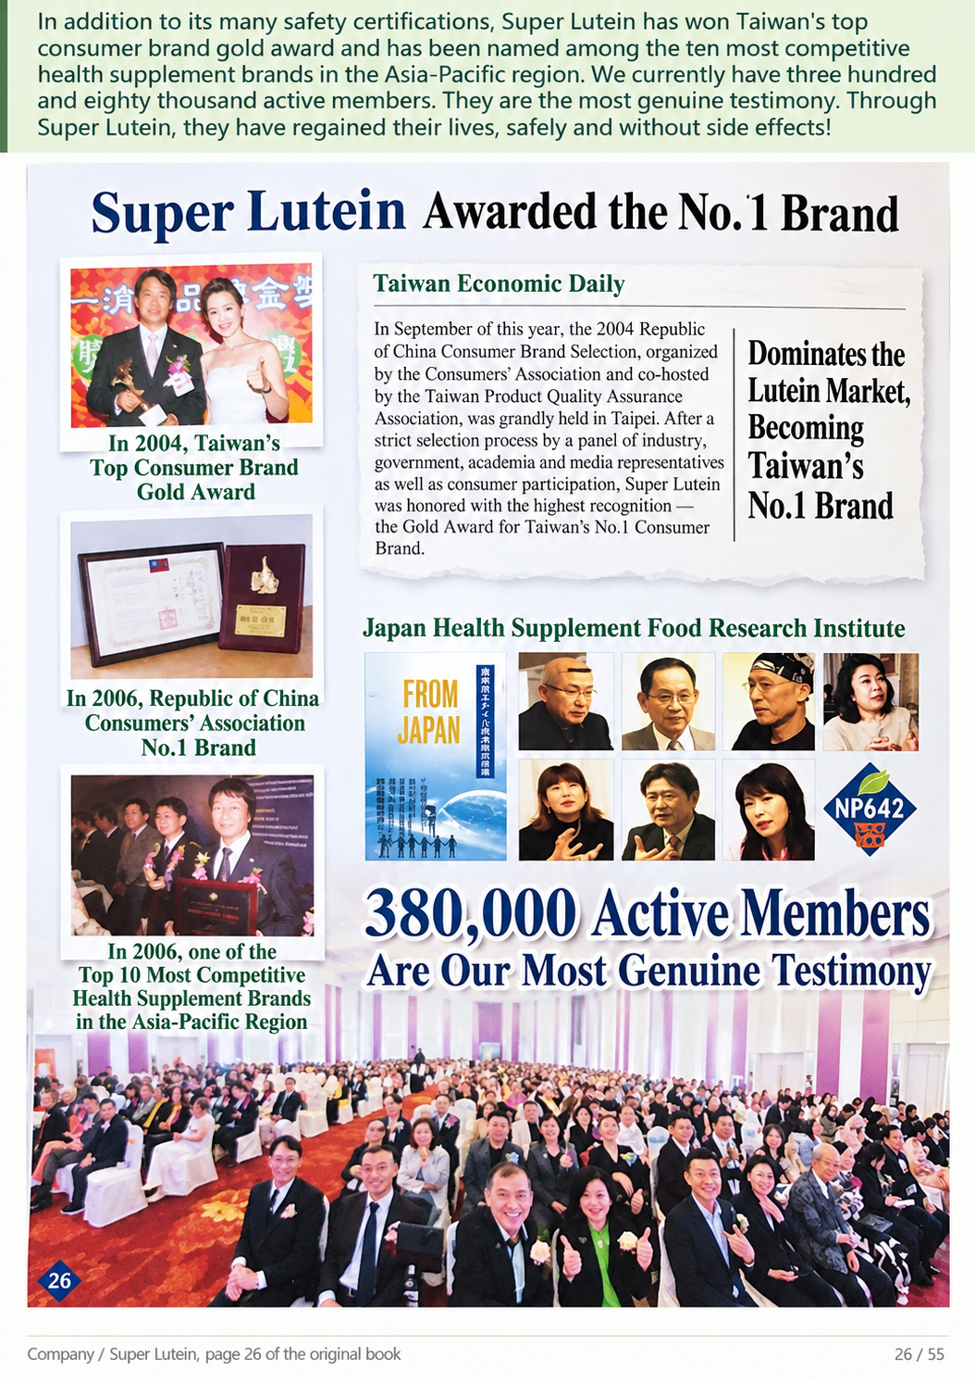
In addition to its many safety certifications, Super Lutein has won Taiwan's top consumer brand gold award
and has been named among the ten most competitive health supplement brands in the Asia-Pacific region.
We currently have three hundred and eighty thousand active members. They are the most genuine
testimony. Through Super Lutein, they have regained their lives, safely and without side effects!
Filing • English
26 / 55
Notes:
In addition to its many safety certifications, Super Lutein has won Taiwan's top consumer brand gold award and has been named among the ten most competitive health supplement brands in the Asia-Pacific region. We currently have three hundred and eighty thousand active members. They are the most genuine testimony. Through Super Lutein, they have regained their lives, safely and without side effects!
Source: 2026 scan filing.pdf; source PDF page 24.
Full-page localized image redraw. Facts, names, figures and page order must match the retained Chinese original. Image model requested:2.5; actual backend unexposed and unverified. Video production stopped by owner pending deck review.
Image-generated artwork plus native PowerPoint text for exact presenter narration, proper names, figures and reference wording. Original product/documentary picture layers retain source bytes.

Slide 27
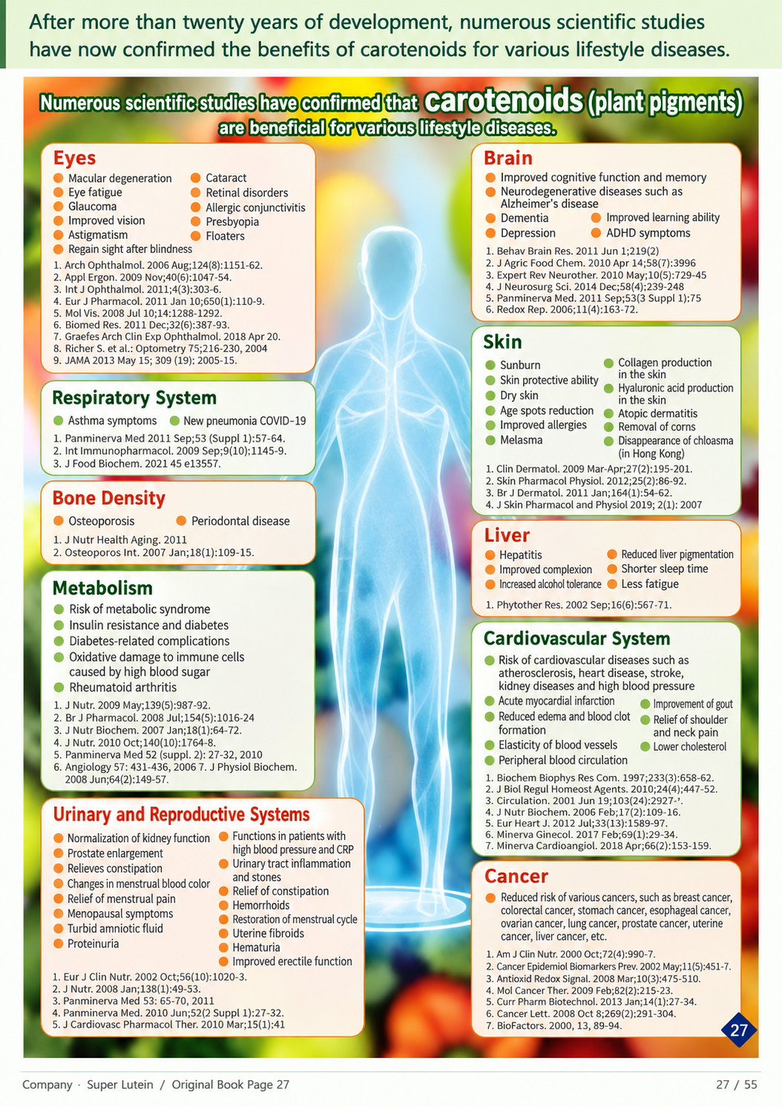
After more than twenty years of development, numerous scientific studies have now confirmed the benefits of
carotenoids for various lifestyle diseases.
Filing • English
27 / 55
Notes:
After more than twenty years of development, numerous scientific studies have now confirmed the benefits of carotenoids for various lifestyle diseases.
Source: 2026 scan filing.pdf; source PDF page 24.
Full-page localized image redraw. Facts, names, figures and page order must match the retained Chinese original. Image model requested:2.5; actual backend unexposed and unverified. Video production stopped by owner pending deck review.
Image-generated artwork plus native PowerPoint text for exact presenter narration, proper names, figures and reference wording. Original product/documentary picture layers retain source bytes.

Slide 28
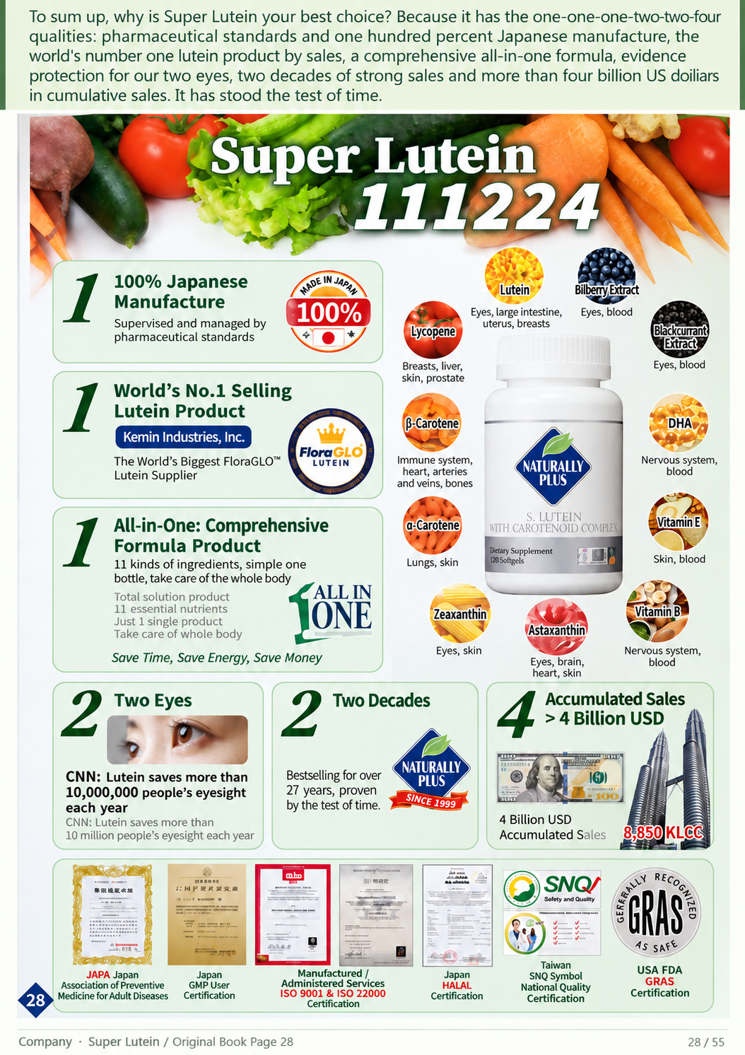
To sum up, why is Super Lutein your best choice? Because it has the one-one-one-two-two-four qualities:
pharmaceutical standards and one hundred percent Japanese manufacture, the world's number one lutein
product by sales, a comprehensive all-in-one formula, evidence of protection for our two eyes, two decades
of strong sales and more than four billion US dollars in cumulative sales. It has stood the test of time.
World’s No.1 Selling
Lutein Product
Kemin Industries, USA
The world’s largest
lutein supplier
Filing • English
28 / 55
Notes:
To sum up, why is Super Lutein your best choice? Because it has the one-one-one-two-two-four qualities: pharmaceutical standards and one hundred percent Japanese manufacture, the world's number one lutein product by sales, a comprehensive all-in-one formula, evidence of protection for our two eyes, two decades of strong sales and more than four billion US dollars in cumulative sales. It has stood the test of time.
Source: 2026 scan filing.pdf; source PDF page 25.
Full-page localized image redraw. Facts, names, figures and page order must match the retained Chinese original. Image model requested:2.5; actual backend unexposed and unverified. Video production stopped by owner pending deck review.
Image-generated artwork plus native PowerPoint text for exact presenter narration, proper names, figures and reference wording. Original product/documentary picture layers retain source bytes.

Slide 29
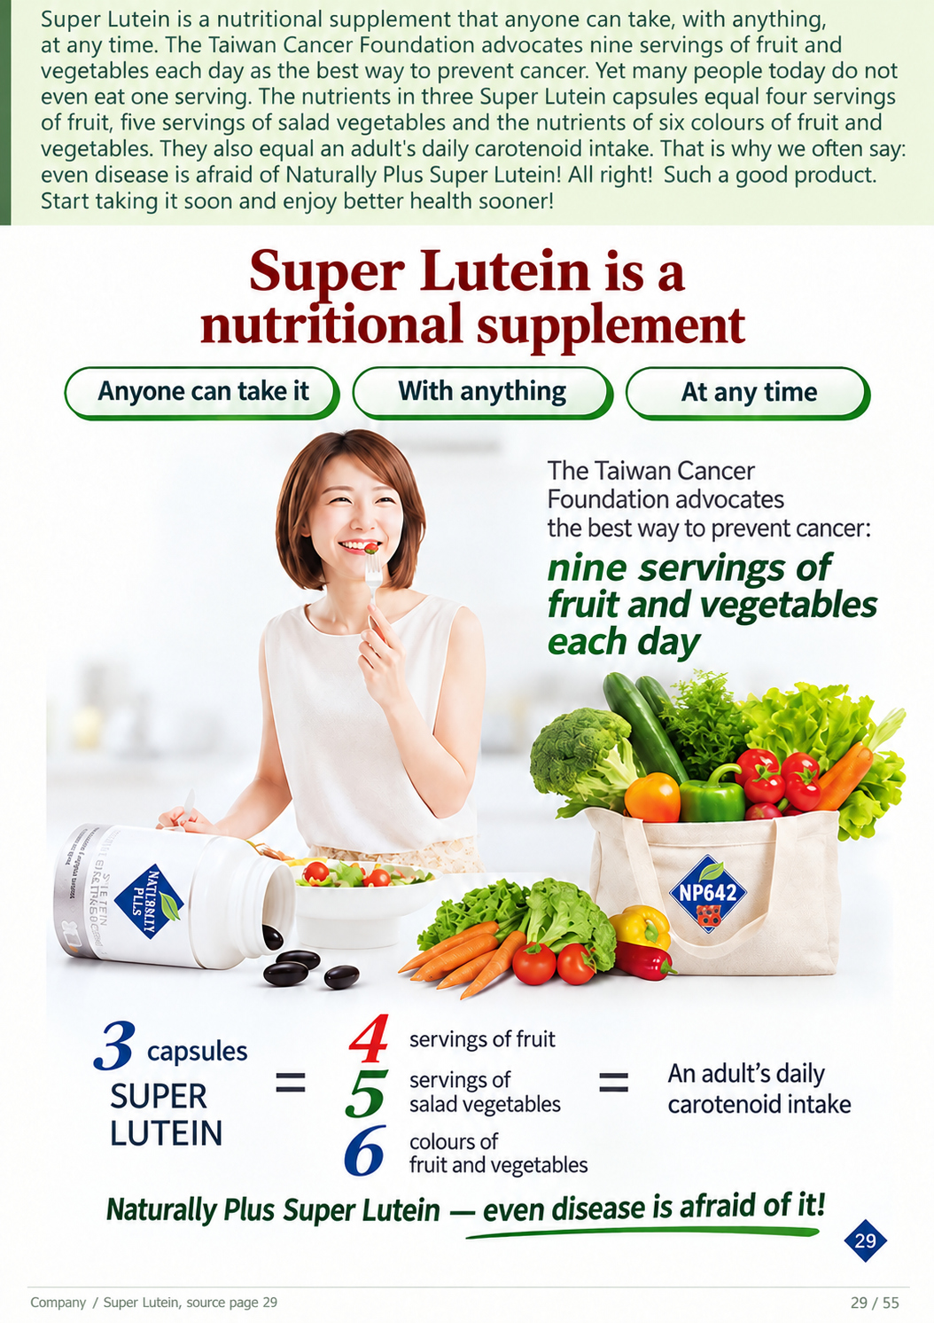
Super Lutein is a nutritional supplement that anyone can take, with anything, at any time. The Taiwan
Cancer Foundation advocates nine servings of fruit and vegetables each day as the best way to
prevent cancer. Yet many people today do not even eat one serving. The nutrients in three Super
Lutein capsules equal four servings of fruit, five servings of salad vegetables and the nutrients of six
colours of fruit and vegetables. They also equal an adult's daily carotenoid intake. That is why we
often say: even disease is afraid of Naturally Plus Super Lutein! All right! Such a good product. Start
taking it soon and enjoy better health sooner!
Filing • English
29 / 55
Notes:
Super Lutein is a nutritional supplement that anyone can take, with anything, at any time. The Taiwan Cancer Foundation advocates nine servings of fruit and vegetables each day as the best way to prevent cancer. Yet many people today do not even eat one serving. The nutrients in three Super Lutein capsules equal four servings of fruit, five servings of salad vegetables and the nutrients of six colours of fruit and vegetables. They also equal an adult's daily carotenoid intake. That is why we often say: even disease is afraid of Naturally Plus Super Lutein! All right! Such a good product. Start taking it soon and enjoy better health sooner!
Source: 2026 scan filing.pdf; source PDF page 26.
Full-page localized image redraw. Facts, names, figures and page order must match the retained Chinese original. Image model requested:2.5; actual backend unexposed and unverified. Video production stopped by owner pending deck review.
Image-generated artwork plus native PowerPoint text for exact presenter narration, proper names, figures and reference wording. Original product/documentary picture layers retain source bytes.

Slide 30
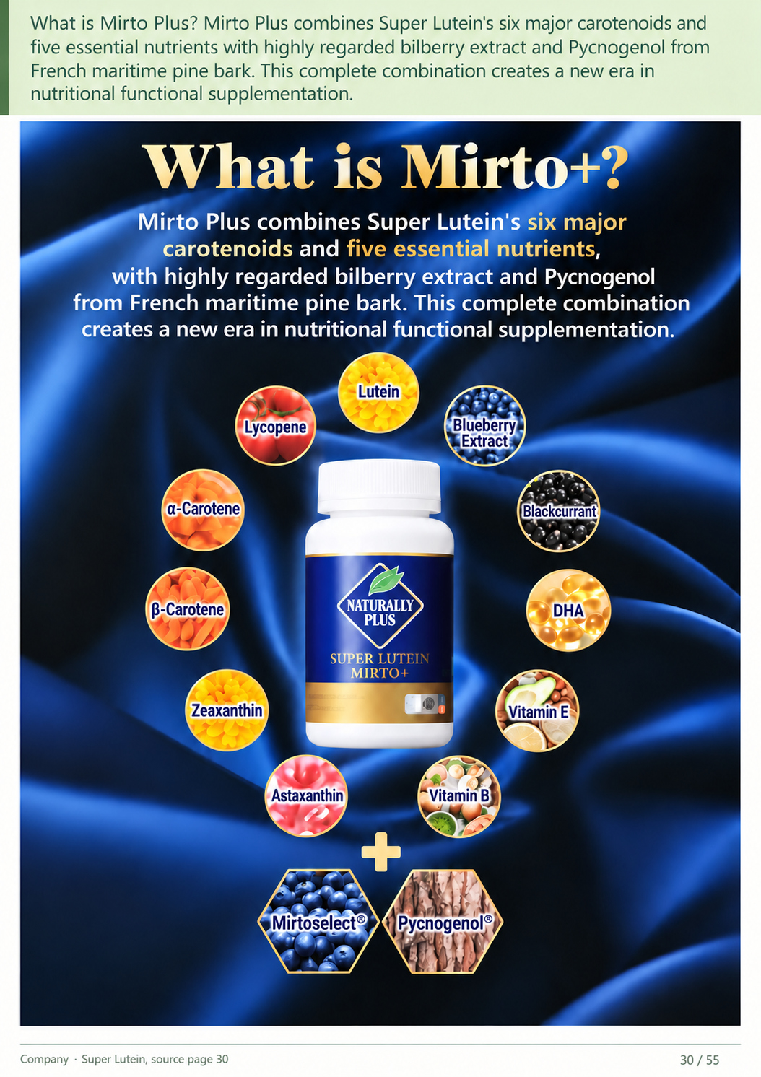
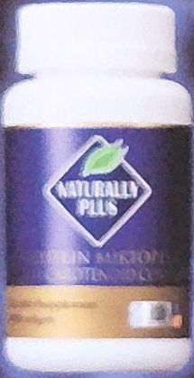
What is Mirto Plus? Mirto Plus combines Super Lutein's six major carotenoids and five essential
nutrients with highly regarded bilberry extract and Pycnogenol from French maritime pine bark. This
complete combination creates a new era in nutritional functional supplementation.
Filing • English
30 / 55
Notes:
What is Mirto Plus? Mirto Plus combines Super Lutein's six major carotenoids and five essential nutrients with highly regarded bilberry extract and Pycnogenol from French maritime pine bark. This complete combination creates a new era in nutritional functional supplementation.
Source: 2026 scan filing.pdf; source PDF page 28.
Full-page localized image redraw. Facts, names, figures and page order must match the retained Chinese original. Image model requested:2.5; actual backend unexposed and unverified. Video production stopped by owner pending deck review.
Image-generated artwork plus native PowerPoint text for exact presenter narration, proper names, figures and reference wording. Original product/documentary picture layers retain source bytes.

Slide 31
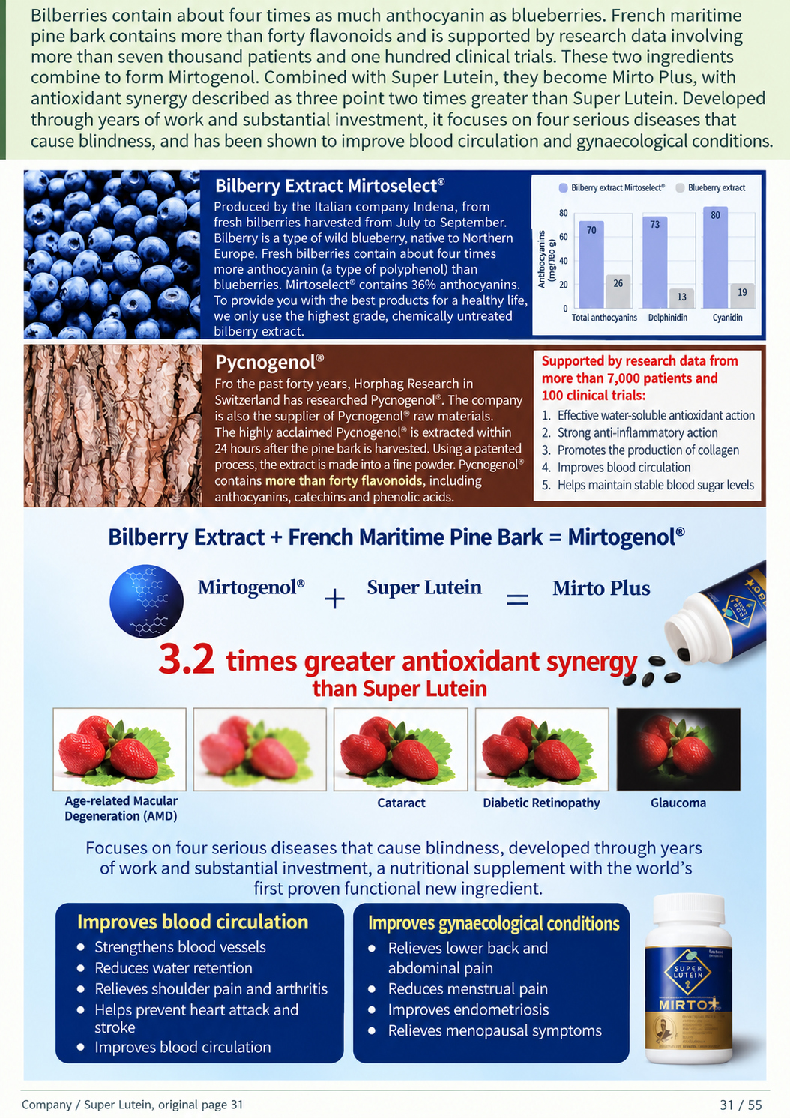
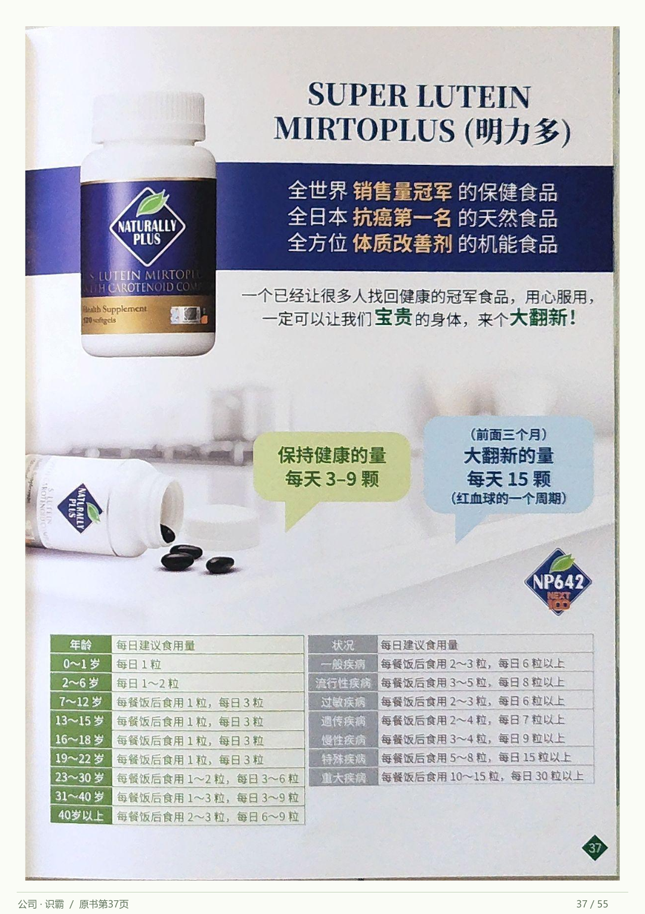
Bilberries contain about four times as much anthocyanin as blueberries. French maritime pine bark contains more
than forty flavonoids and is supported by research data involving more than seven thousand patients and one
hundred clinical trials. These two ingredients combine to form Mirtogenol. Combined with Super Lutein, they
become Mirto Plus, with antioxidant synergy described as three point two times greater than Super Lutein.
Developed through years of work and substantial investment, it focuses on four serious diseases that cause
blindness, and has been shown to improve blood circulation and gynaecological conditions.
Filing • English
31 / 55
Notes:
Bilberries contain about four times as much anthocyanin as blueberries. French maritime pine bark contains more than forty flavonoids and is supported by research data involving more than seven thousand patients and one hundred clinical trials. These two ingredients combine to form Mirtogenol. Combined with Super Lutein, they become Mirto Plus, with antioxidant synergy described as three point two times greater than Super Lutein. Developed through years of work and substantial investment, it focuses on four serious diseases that cause blindness, and has been shown to improve blood circulation and gynaecological conditions.
Source: 2026 scan filing.pdf; source PDF page 27.
Full-page localized image redraw. Facts, names, figures and page order must match the retained Chinese original. Image model requested:2.5; actual backend unexposed and unverified. Video production stopped by owner pending deck review.
Image-generated artwork plus native PowerPoint text for exact presenter narration, proper names, figures and reference wording. Original product/documentary picture layers retain source bytes.

Slide 32
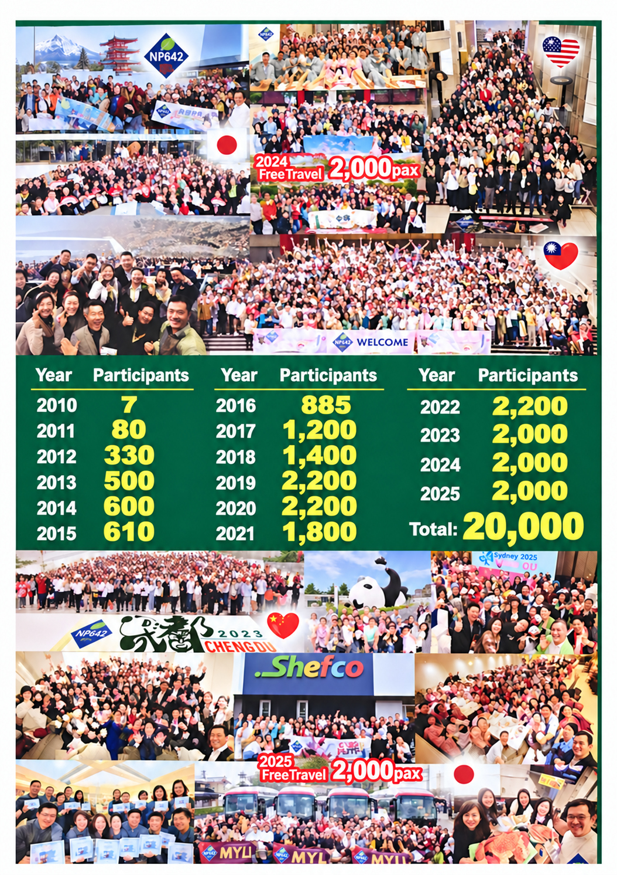
Filing • English
32 / 55
Notes:
No top narration on original page.
Source: 2026 scan filing.pdf; source PDF page 29.
Full-page localized image redraw. Facts, names, figures and page order must match the retained Chinese original. Image model requested:2.5; actual backend unexposed and unverified. Video production stopped by owner pending deck review.
Image-generated artwork plus native PowerPoint text for exact presenter narration, proper names, figures and reference wording. Original product/documentary picture layers retain source bytes.

Slide 33
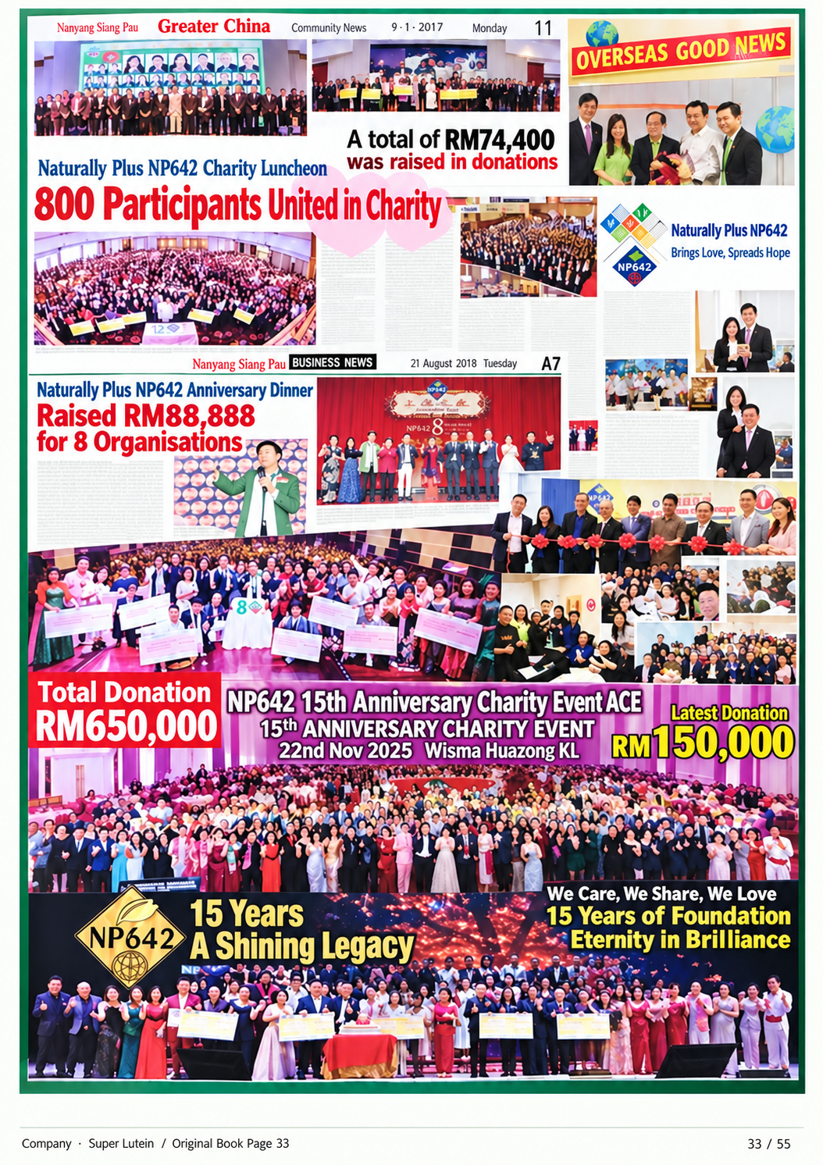
Filing • English
33 / 55
Notes:
No top narration on original page.
Source: 2026 scan filing.pdf; source PDF page 30.
Full-page localized image redraw. Facts, names, figures and page order must match the retained Chinese original. Image model requested:2.5; actual backend unexposed and unverified. Video production stopped by owner pending deck review.
Image-generated artwork plus native PowerPoint text for exact presenter narration, proper names, figures and reference wording. Original product/documentary picture layers retain source bytes.

Slide 34
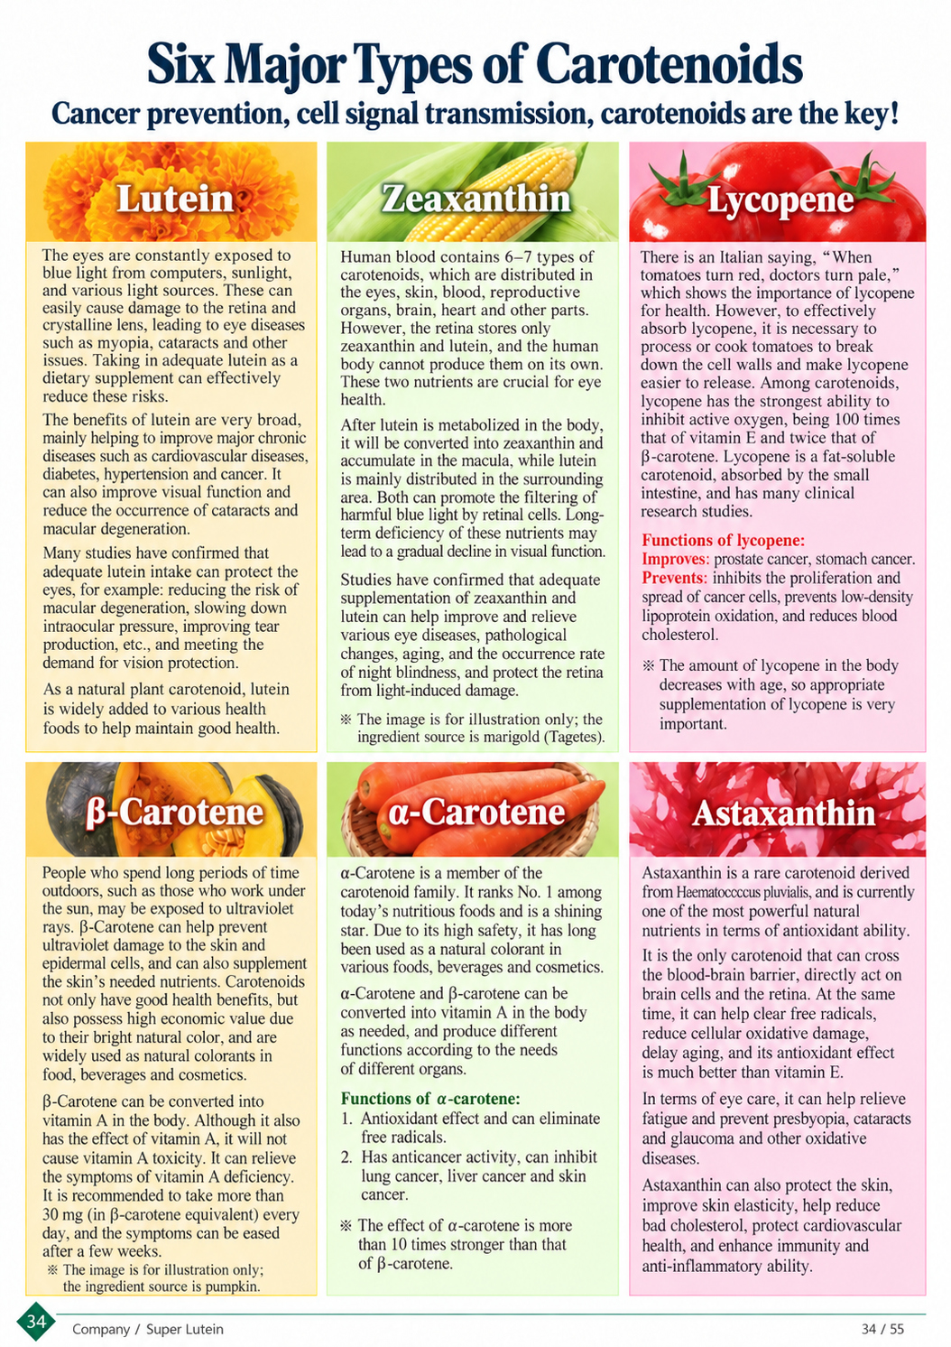
Filing • English
34 / 55
Notes:
No top narration on original page.
Source: 2026 scan filing.pdf; source PDF page 31.
Full-page localized image redraw. Facts, names, figures and page order must match the retained Chinese original. Image model requested:2.5; actual backend unexposed and unverified. Video production stopped by owner pending deck review.
Image-generated artwork plus native PowerPoint text for exact presenter narration, proper names, figures and reference wording. Original product/documentary picture layers retain source bytes.

Slide 35
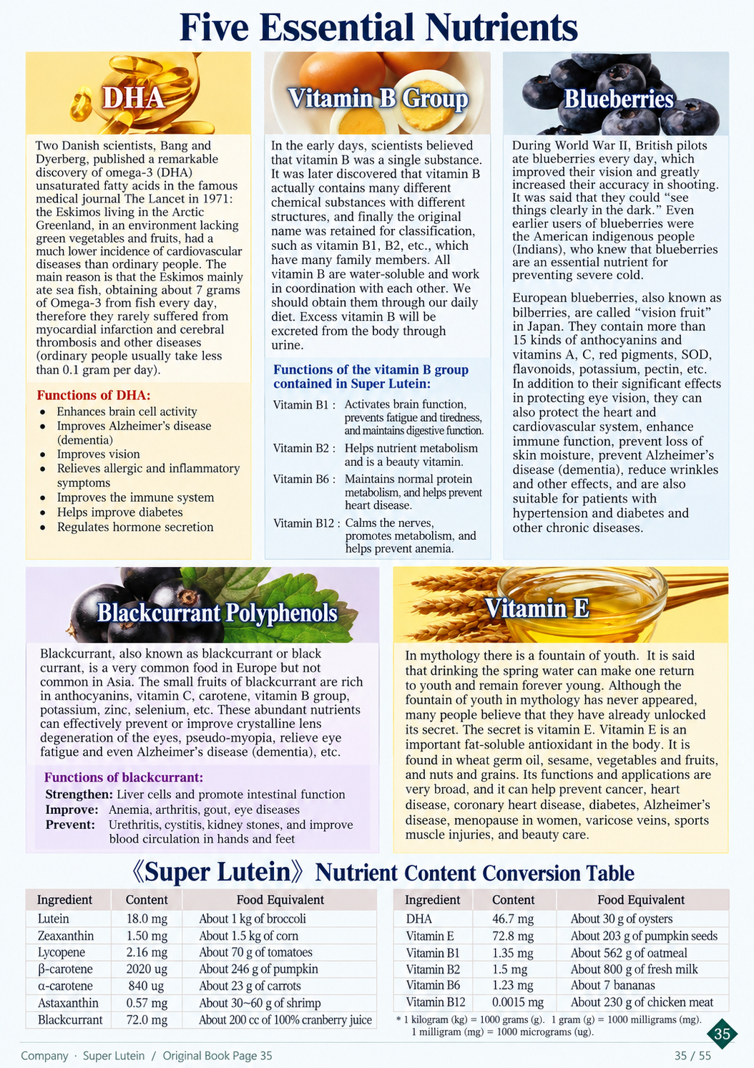
1 kg = 1,000 g; 1 g = 1,000 mg;
1 mg = 1,000 μg.
Filing • English
35 / 55
Notes:
No top narration on original page.
Source: 2026 scan filing.pdf; source PDF page 32.
Full-page localized image redraw. Facts, names, figures and page order must match the retained Chinese original. Image model requested:2.5; actual backend unexposed and unverified. Video production stopped by owner pending deck review.
Image-generated artwork plus native PowerPoint text for exact presenter narration, proper names, figures and reference wording. Original product/documentary picture layers retain source bytes.

Slide 36
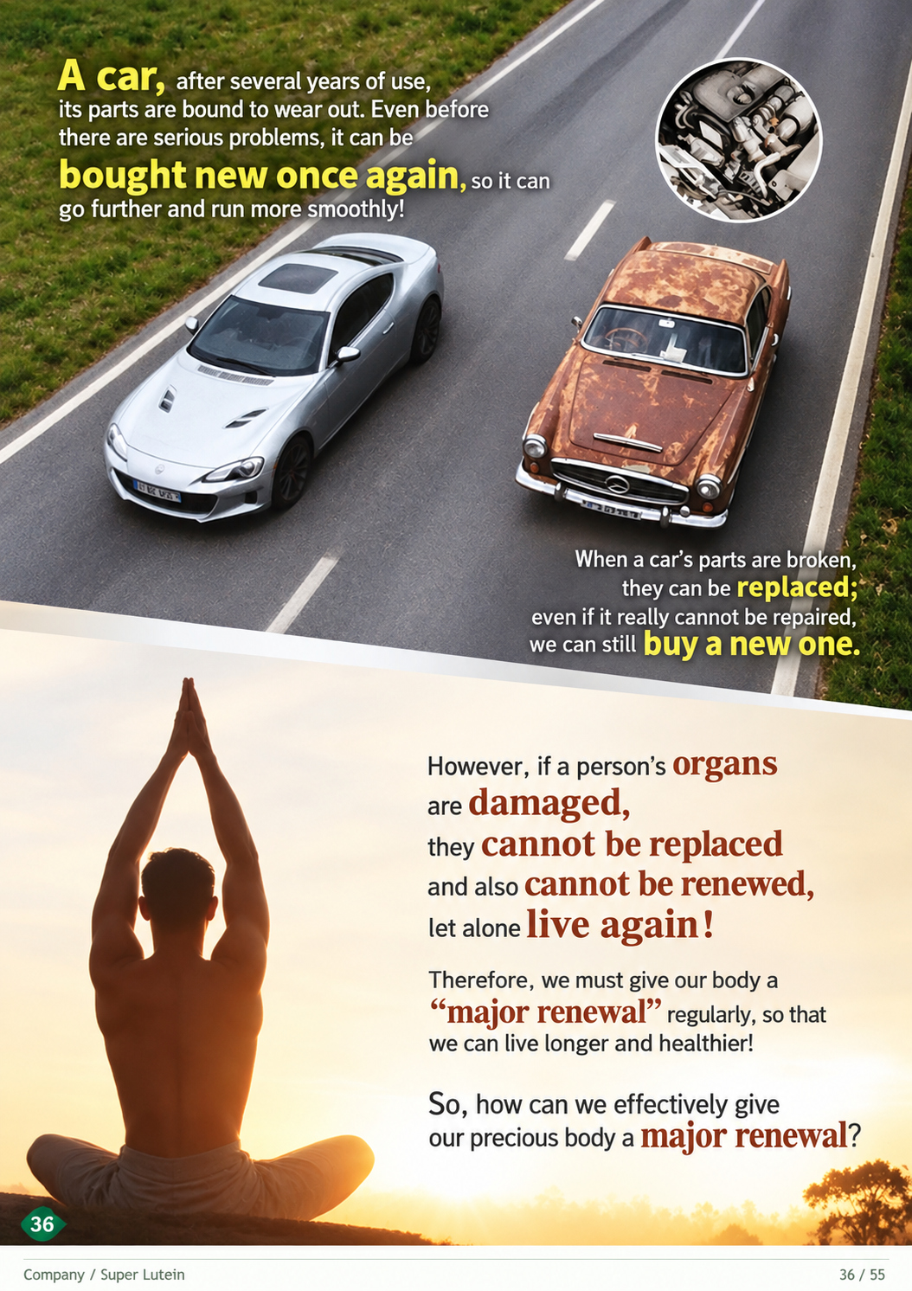
Filing • English
36 / 55
Notes:
No top narration on original page.
Source: 2026 scan filing.pdf; source PDF page 34.
Full-page localized image redraw. Facts, names, figures and page order must match the retained Chinese original. Image model requested:2.5; actual backend unexposed and unverified. Video production stopped by owner pending deck review.
Image-generated artwork plus native PowerPoint text for exact presenter narration, proper names, figures and reference wording. Original product/documentary picture layers retain source bytes.

Slide 37
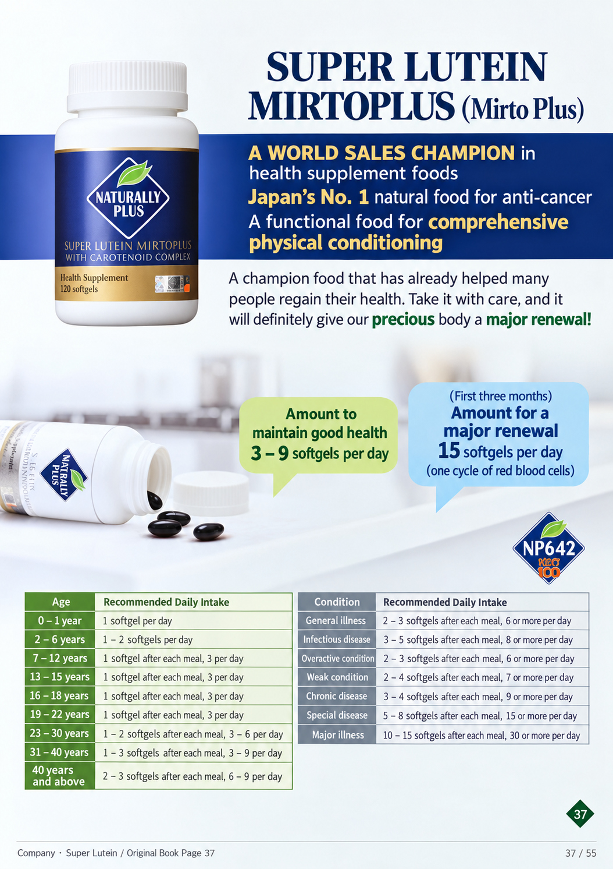
Filing • English
37 / 55
Notes:
No top narration on original page.
Source: 2026 scan filing.pdf; source PDF page 33.
Full-page localized image redraw. Facts, names, figures and page order must match the retained Chinese original. Image model requested:2.5; actual backend unexposed and unverified. Video production stopped by owner pending deck review.
Image-generated artwork plus native PowerPoint text for exact presenter narration, proper names, figures and reference wording. Original product/documentary picture layers retain source bytes.

Slide 38
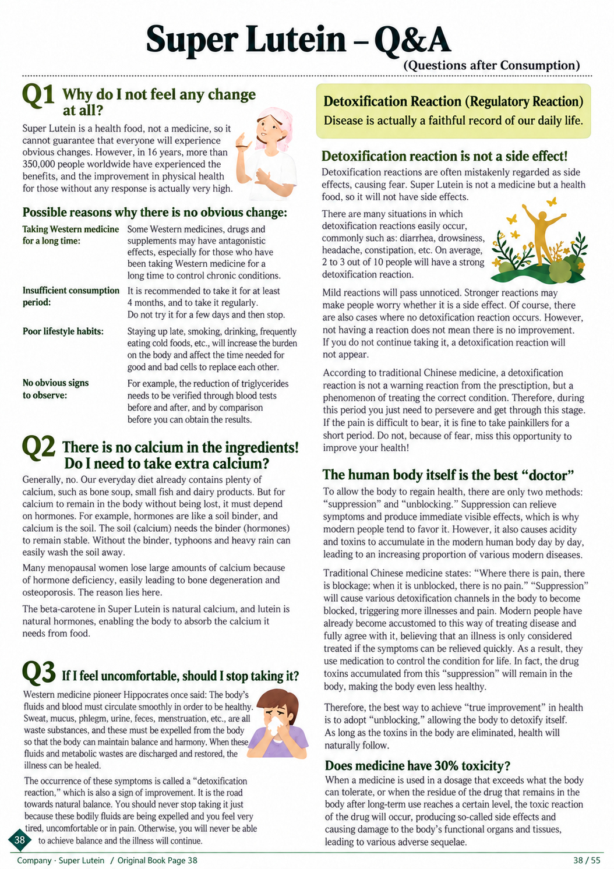
Super Lutein — Questions & Answers
Questions after consumption
Western medicine pioneer Dr. Westin A. Price said:
The body’s fluids and blood must circulate smoothly
for good health. Sweat, mucus, phlegm, urine, feces
and menstruation are wastes to be expelled so that
the body maintains balance and harmony. When
these fluids and metabolic wastes are discharged
and balance is restored, illness can be healed.
Filing • English
38 / 55
Notes:
No top narration on original page.
Source: 2026 scan filing.pdf; source PDF page 35.
Full-page localized image redraw. Facts, names, figures and page order must match the retained Chinese original. Image model requested:2.5; actual backend unexposed and unverified. Video production stopped by owner pending deck review.
Image-generated artwork plus native PowerPoint text for exact presenter narration, proper names, figures and reference wording. Original product/documentary picture layers retain source bytes.

Slide 39
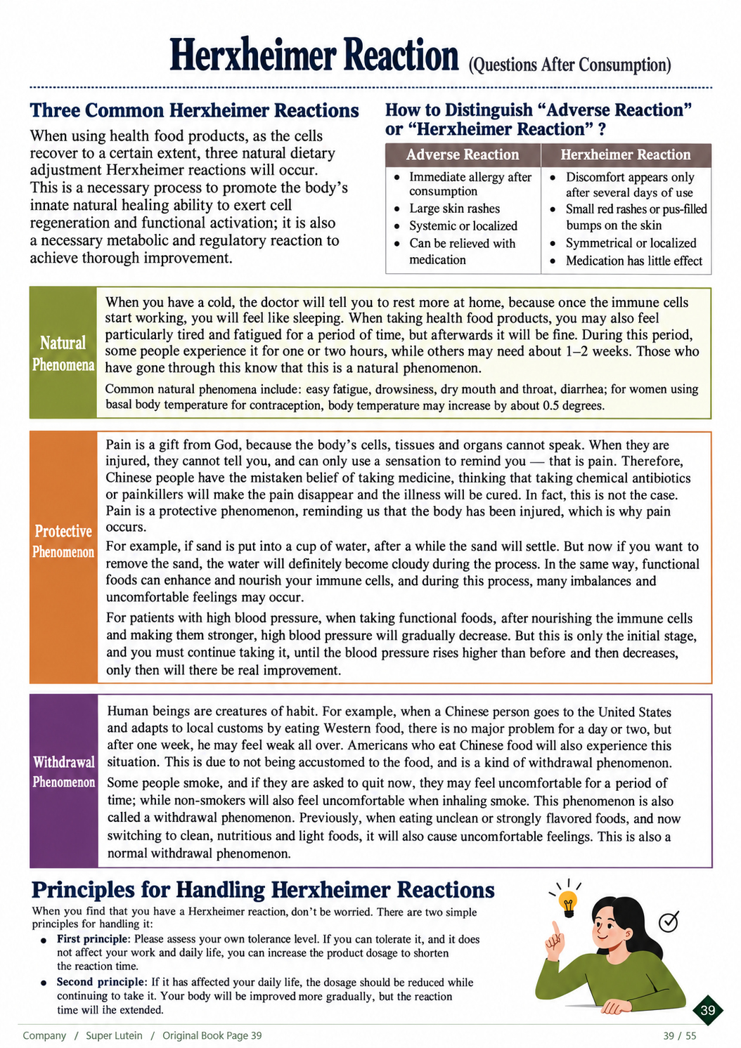
Filing • English
39 / 55
Notes:
No top narration on original page.
Source: 2026 scan filing.pdf; source PDF page 36.
Full-page localized image redraw. Facts, names, figures and page order must match the retained Chinese original. Image model requested:2.5; actual backend unexposed and unverified. Video production stopped by owner pending deck review.
Image-generated artwork plus native PowerPoint text for exact presenter narration, proper names, figures and reference wording. Original product/documentary picture layers retain source bytes.

Slide 40
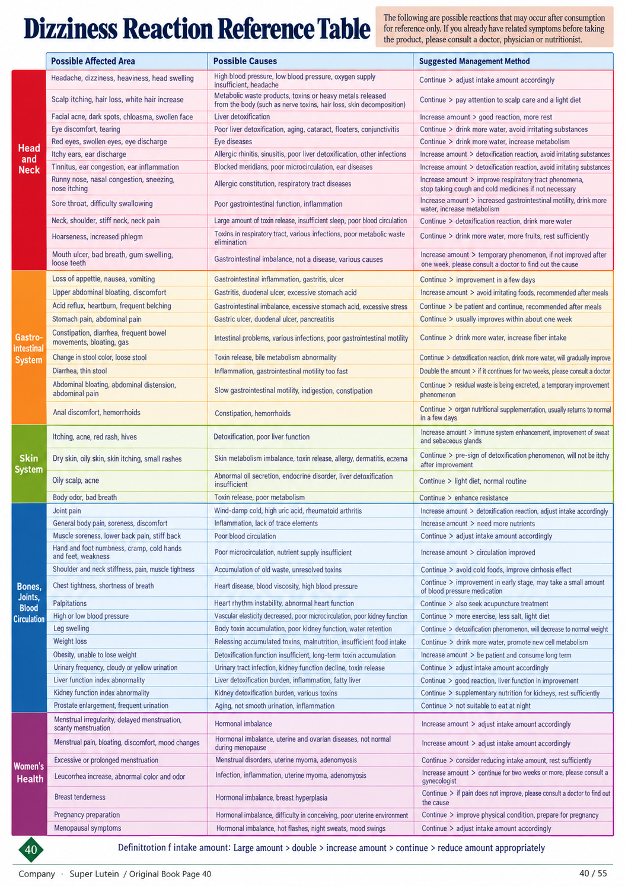
Healing Reaction
Reference Table
Filing • English
40 / 55
Notes:
No top narration on original page.
Source: 2026 scan filing.pdf; source PDF page 38.
Full-page localized image redraw. Facts, names, figures and page order must match the retained Chinese original. Image model requested:2.5; actual backend unexposed and unverified. Video production stopped by owner pending deck review.
Image-generated artwork plus native PowerPoint text for exact presenter narration, proper names, figures and reference wording. Original product/documentary picture layers retain source bytes.

Slide 41
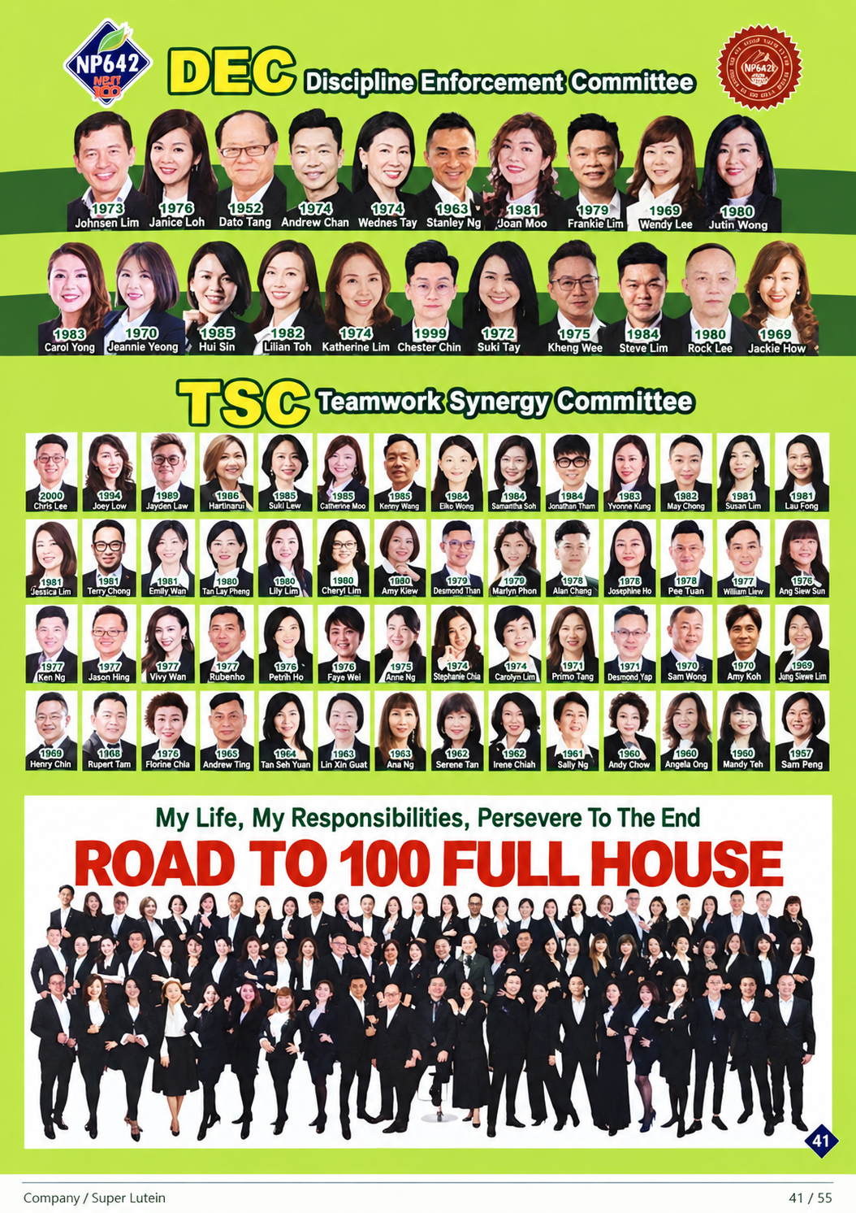

Filing • English
41 / 55
Notes:
No top narration on original page.
Source: 2026 scan filing.pdf; source PDF page 37.
Full-page localized image redraw. Facts, names, figures and page order must match the retained Chinese original. Image model requested:2.5; actual backend unexposed and unverified. Video production stopped by owner pending deck review.
Image-generated artwork plus native PowerPoint text for exact presenter narration, proper names, figures and reference wording. Original product/documentary picture layers retain source bytes.

Slide 42

I have something very good to show you. Give me ten minutes. It will be quick! These are the world's
four miracle waters, described as able to cure a hundred illnesses and attracting millions of people to
drink them. There is one each in France, Mexico, Germany and northern Pakistan.
Filing • English
42 / 55
Notes:
I have something very good to show you. Give me ten minutes. It will be quick! These are the world's four miracle waters, described as able to cure a hundred illnesses and attracting millions of people to drink them. There is one each in France, Mexico, Germany and northern Pakistan.
Source: 2026 scan filing.pdf; source PDF page 39.
Full-page localized image redraw. Facts, names, figures and page order must match the retained Chinese original. Image model requested:2.5; actual backend unexposed and unverified. Video production stopped by owner pending deck review.
Image-generated artwork plus native PowerPoint text for exact presenter narration, proper names, figures and reference wording. Original product/documentary picture layers retain source bytes.

Slide 43

Why are miracle waters said to cure a hundred illnesses and attract millions of drinkers? The deterioration of our living
environment means that, of the fifty litres of oxygen we breathe in each day, eleven litres turn into reactive oxygen.
Reactive oxygen is the main culprit behind modern lifestyle diseases and a major cause of cancer. Miracle waters
naturally contain large amounts of molecular hydrogen, which can turn reactive oxygen into harmless substances.
Filing • English
43 / 55
Notes:
Why are miracle waters said to cure a hundred illnesses and attract millions of drinkers? The deterioration of our living environment means that, of the fifty litres of oxygen we breathe in each day, eleven litres turn into reactive oxygen. Reactive oxygen is the main culprit behind modern lifestyle diseases and a major cause of cancer. Miracle waters naturally contain large amounts of molecular hydrogen, which can turn reactive oxygen into harmless substances.
Source: 2026 scan filing.pdf; source PDF page 40.
Full-page localized image redraw. Facts, names, figures and page order must match the retained Chinese original. Image model requested:2.5; actual backend unexposed and unverified. Video production stopped by owner pending deck review.
Image-generated artwork plus native PowerPoint text for exact presenter narration, proper names, figures and reference wording. Original product/documentary picture layers retain source bytes.

Slide 44

Patients have shown substantial improvement after drinking miracle water. These are not my own
figures. They are clinical data reported by Japanese television. But if miracle water is so good, why
can it not be made into packaged drinking water? Molecular hydrogen is extremely unstable. Once
the water leaves its source, its dissolved hydrogen concentration decreases over time. Neither plastic
nor glass bottles can retain it. People have to queue at the source and drink it there.
Filing • English
44 / 55
Notes:
Patients have shown substantial improvement after drinking miracle water. These are not my own figures. They are clinical data reported by Japanese television. But if miracle water is so good, why can it not be made into packaged drinking water? Molecular hydrogen is extremely unstable. Once the water leaves its source, its dissolved hydrogen concentration decreases over time. Neither plastic nor glass bottles can retain it. People have to queue at the source and drink it there.
Source: 2026 scan filing.pdf; source PDF page 42.
Full-page localized image redraw. Facts, names, figures and page order must match the retained Chinese original. Image model requested:2.5; actual backend unexposed and unverified. Video production stopped by owner pending deck review.
Image-generated artwork plus native PowerPoint text for exact presenter narration, proper names, figures and reference wording. Original product/documentary picture layers retain source bytes.

Slide 45


After years of research, Naturally Plus became the first company in the world in two thousand and
seven to develop IZUMIO, the antioxidant hydrogen-rich water that once again swept across Japan.
IZUMIO uses natural groundwater from one of Japan's one hundred finest water sources. It is
transported to a designated factory with more than three hundred years of history and GMP and
FSSC twenty-two thousand safety certifications. Patented advanced manufacturing technology then
refines it into antioxidant water with a high hydrogen concentration. Drinking it daily allows us to
remove disease-causing reactive oxygen, or free radicals, from our bodies with ease.
IZUMIO
Filing • English
45 / 55
Notes:
After years of research, Naturally Plus became the first company in the world in two thousand and seven to develop IZUMIO, the antioxidant hydrogen-rich water that once again swept across Japan. IZUMIO uses natural groundwater from one of Japan's one hundred finest water sources. It is transported to a designated factory with more than three hundred years of history and GMP and FSSC twenty-two thousand safety certifications. Patented advanced manufacturing technology then refines it into antioxidant water with a high hydrogen concentration. Drinking it daily allows us to remove disease-causing reactive oxygen, or free radicals, from our bodies with ease.
Source: 2026 scan filing.pdf; source PDF page 41.
Full-page localized image redraw. Facts, names, figures and page order must match the retained Chinese original. Image model requested:2.5; actual backend unexposed and unverified. Video production stopped by owner pending deck review.
Image-generated artwork plus native PowerPoint text for exact presenter narration, proper names, figures and reference wording. Original product/documentary picture layers retain source bytes.

Slide 46

At normal temperature and atmospheric pressure, the maximum dissolved hydrogen concentration is one point
six million parts per trillion. Through patented technology and various innovations, however, IZUMIO has become
the world's only hydrogen-rich water with a concentration exceeding three point three million parts per trillion.
The world’s only hydrogen-rich water exceeding 3,300,000 ppt.
Filing • English
46 / 55
Notes:
At normal temperature and atmospheric pressure, the maximum dissolved hydrogen concentration is one point six million parts per trillion. Through patented technology and various innovations, however, IZUMIO has become the world's only hydrogen-rich water with a concentration exceeding three point three million parts per trillion.
Source: 2026 scan filing.pdf; source PDF page 43.
Full-page localized image redraw. Facts, names, figures and page order must match the retained Chinese original. Image model requested:2.5; actual backend unexposed and unverified. Video production stopped by owner pending deck review.
Image-generated artwork plus native PowerPoint text for exact presenter narration, proper names, figures and reference wording. Original product/documentary picture layers retain source bytes.

Slide 47

IZUMIO has the highest dissolved hydrogen concentration in current global manufacturing technology: three point three
million parts per trillion, six thousand times that of miracle water. Drinking one two-hundred-millilitre pouch is equivalent to
buying a plane ticket to Lourdes in France and drinking one thousand two hundred litres of miracle water. IZUMIO has
been ranked Japan's number one hydrogen-rich water by sales for fifteen consecutive years. More than three hundred
million pouches have been sold worldwide. Placed end to end, they would stretch more than once around the Earth.
3.3 mg/L • 1 mg/L = 1 ppm
Filing • English
47 / 55
Notes:
IZUMIO has the highest dissolved hydrogen concentration in current global manufacturing technology: three point three million parts per trillion, six thousand times that of miracle water. Drinking one two-hundred-millilitre pouch is equivalent to buying a plane ticket to Lourdes in France and drinking one thousand two hundred litres of miracle water. IZUMIO has been ranked Japan's number one hydrogen-rich water by sales for fifteen consecutive years. More than three hundred million pouches have been sold worldwide. Placed end to end, they would stretch more than once around the Earth.
Source: 2026 scan filing.pdf; source PDF page 44.
Full-page localized image redraw. Facts, names, figures and page order must match the retained Chinese original. Image model requested:2.5; actual backend unexposed and unverified. Video production stopped by owner pending deck review.
Image-generated artwork plus native PowerPoint text for exact presenter narration, proper names, figures and reference wording. Original product/documentary picture layers retain source bytes.

Slide 48

This is Doctor Shigeo Ohta. In two thousand and seven, he published a paper on molecular hydrogen in the
world-renowned medical journal Nature Medicine. It quickly attracted worldwide attention and a wave of research.
More than one thousand academic papers on molecular hydrogen medicine have now been published worldwide.
Experts around the world regard Doctor Ohta as a leading pioneer in molecular hydrogen medicine.
Dr. Shigeo Ohta
Graduated from the University of Tokyo’s School of Pharmacy in 1974 and earned a doctorate
from the University of Tokyo in 1979. Previously served as a senior researcher at the
Biocenter, University of Basel, Switzerland; lecturer and associate professor at Jichi Medical
University; chief professor at the Institute of Advanced Medical Sciences, Nippon Medical
School; chairman of the Japanese Molecular Hydrogen Association and the International
Molecular Hydrogen Medical Biology Association, among other positions.
17 Biological Research Papers on Hydrogen
Published by Dr. Shigeo Ohta
1. Hydrogen acts as a therapeutic antioxidant by selectively reducing cytotoxic
oxygen radicals
10. Protection of the retina by rapid diffusion of hydrogen: administration of
hydrogen-loaded eye drops in retinal ischemia-reperfusion injury
Nature Medicine 13(6), 2007:688–694
Investigative Ophthalmology & Visual Science 51(1), 2010:487–492
2. Inhalation of hydrogen gas suppressed hepatic injury caused by
ischemia/reperfusion through reducing oxidative stress
11. The 2011 Medical Molecular Hydrogen Symposium: An inaugural
symposium of the journal Medical Gas Research
Biochemical and Biophysical Research Communications 361(3), 2007:670–674
Medical Gas Research 1(1), 2011:10
3. Inhalation of hydrogen gas reduces infarct size in the rat model of myocardial
ischemia-reperfusion injury
12. Molecular hydrogen protects chondrocytes from oxidative stress and
indirectly alters gene expressions through reducing peroxynitrite derived from
nitric oxide
Biochemical and Biophysical Research Communications 373(1), 2008:30–35
Medical Gas Research 1(1), 2011:18
4. Hydrogen therapy reduces apoptosis in neonatal hypoxia-ischemia rat model
Neuroscience Letters 441(2), 2008:167–172
13. Molecular hydrogen suppresses obesity and diabetes by inducing hepatic
FGF21 and stimulating energy metabolism in db/db mice
5. Consumption of molecular hydrogen prevents the stress-induced impairments in
hippocampus-dependent learning tasks during chronic physical restraint in mice
Obesity 19(7), 2011:1396–1403
Neuropsychopharmacology 34(2), 2009:501–508
14. Hydrogen therapy attenuates irradiation-induced lung damage by reducing
oxidative stress
6. Consumption of hydrogen water prevents atherosclerosis in apolipoprotein E
knockout mice
American Journal of Physiology–Lung Cellular and Molecular Physiology 301(4),
2011:L415–L426
Biochemical and Biophysical Research Communications 377(4), 2008:1195–1198
7. Hydrogen-rich pure water prevents superoxide formation in brain slices of vitamin
C-depleted SMP30/GNL knockout mice
15. Molecular hydrogen is a novel antioxidant to efficiently reduce oxidative
stress with potential for the improvement of mitochondrial diseases
Biochemical and Biophysical Research Communications 375(3), 2008:346–350
Biochimica et Biophysica Acta 1820(5), 2012:586–594
8. Molecular hydrogen is protective against 6-hydroxydopamine-induced nigrostriatal
degeneration in a rat model of Parkinson’s disease
16. H2 gas improves functional outcome after cardiac arrest to an extent
comparable to therapeutic hypothermia in a rat model
Neuroscience Letters 453(2), 2009:81–85
Journal of the American Heart Association 1(5), 2012
9. Molecular hydrogen alleviates nephrotoxicity induced by an anti-cancer drug
cisplatin without compromising anti-tumor activity in mice
17. Pilot study of H2 therapy in Parkinson’s disease: A randomized double-blind
placebo-controlled trial
Cancer Chemotherapy and Pharmacology 64(4), 2009:753–761
Movement Disorders, 2013
Filing • English
48 / 55
Notes:
This is Doctor Shigeo Ohta. In two thousand and seven, he published a paper on molecular hydrogen in the world-renowned medical journal Nature Medicine. It quickly attracted worldwide attention and a wave of research. More than one thousand academic papers on molecular hydrogen medicine have now been published worldwide. Experts around the world regard Doctor Ohta as a leading pioneer in molecular hydrogen medicine.
Source: 2026 scan filing.pdf; source PDF page 45.
Full-page localized image redraw. Facts, names, figures and page order must match the retained Chinese original. Image model requested:2.5; actual backend unexposed and unverified. Video production stopped by owner pending deck review.
Image-generated artwork plus native PowerPoint text for exact presenter narration, proper names, figures and reference wording. Original product/documentary picture layers retain source bytes.
Source reference4 retained unchanged. PubMed18603371 lists a2026retraction (PMID41794566). Historical source citation, not current evidence endorsement. https://pubmed.ncbi.nlm.nih.gov/18603371/

Slide 49


In China, many renowned experts, including Academician Zhong Nanshan and Professor Sun Xuejun, have
published findings on the significant benefits of molecular hydrogen for patients and athletes. In the United
States, Professor Nicolson, described as a Nobel Prize nominee, has recognised our IZUMIO as the only
hydrogen-rich water suitable for his research.
Filing • English
49 / 55
Notes:
In China, many renowned experts, including Academician Zhong Nanshan and Professor Sun Xuejun, have published findings on the significant benefits of molecular hydrogen for patients and athletes. In the United States, Professor Nicolson, described as a Nobel Prize nominee, has recognised our IZUMIO as the only hydrogen-rich water suitable for his research.
Source: 2026 scan filing.pdf; source PDF page 45.
Full-page localized image redraw. Facts, names, figures and page order must match the retained Chinese original. Image model requested:2.5; actual backend unexposed and unverified. Video production stopped by owner pending deck review.
Image-generated artwork plus native PowerPoint text for exact presenter narration, proper names, figures and reference wording. Original product/documentary picture layers retain source bytes.

Slide 50


Molecular hydrogen is described as the world's smallest atom and can reach the body's smallest spaces. IZUMIO
uses the water that makes up much of our body as a medium to carry large amounts of molecular hydrogen to the
furthest parts of our cells and remove reactive oxygen. Its speed and effectiveness are described as unmatched
by ordinary antioxidant supplements or health waters on the market. According to many expert reports, besides
supporting health, molecular hydrogen can inhibit cancer cell proliferation and promote cancer cell death.
= Hydrogen
Hydrogen
molecule
Vitamin C
176 times
Catechin
290 times
Coenzyme Q10
863 times
Filing • English
50 / 55
Notes:
Molecular hydrogen is described as the world's smallest atom and can reach the body's smallest spaces. IZUMIO uses the water that makes up much of our body as a medium to carry large amounts of molecular hydrogen to the furthest parts of our cells and remove reactive oxygen. Its speed and effectiveness are described as unmatched by ordinary antioxidant supplements or health waters on the market. According to many expert reports, besides supporting health, molecular hydrogen can inhibit cancer cell proliferation and promote cancer cell death.
Source: 2026 scan filing.pdf; source PDF page 46.
Full-page localized image redraw. Facts, names, figures and page order must match the retained Chinese original. Image model requested:2.5; actual backend unexposed and unverified. Video production stopped by owner pending deck review.
Image-generated artwork plus native PowerPoint text for exact presenter narration, proper names, figures and reference wording. Original product/documentary picture layers retain source bytes.

Slide 51

After more than ten years of development, numerous scientific studies have now confirmed
the benefits of molecular hydrogen for various lifestyle diseases.
Filing • English
51 / 55
Notes:
After more than ten years of development, numerous scientific studies have now confirmed the benefits of molecular hydrogen for various lifestyle diseases.
Source: 2026 scan filing.pdf; source PDF page 47.
Full-page localized image redraw. Facts, names, figures and page order must match the retained Chinese original. Image model requested:2.5; actual backend unexposed and unverified. Video production stopped by owner pending deck review.
Image-generated artwork plus native PowerPoint text for exact presenter narration, proper names, figures and reference wording. Original product/documentary picture layers retain source bytes.

Slide 52


To sum up, why is IZUMIO your best choice? Because it has the one-one-one-one-one-one qualities:
patented technology and one hundred percent Japanese manufacture, Japan's number one hydrogen-rich
water by sales, an all-in-one approach to removing free radicals throughout the body, the world's highest
dissolved hydrogen concentration, a decade of strong sales and more than one billion US dollars in
cumulative sales. It has stood the test of time.
IZUMIO
Filing • English
52 / 55
Notes:
To sum up, why is IZUMIO your best choice? Because it has the one-one-one-one-one-one qualities: patented technology and one hundred percent Japanese manufacture, Japan's number one hydrogen-rich water by sales, an all-in-one approach to removing free radicals throughout the body, the world's highest dissolved hydrogen concentration, a decade of strong sales and more than one billion US dollars in cumulative sales. It has stood the test of time.
Source: 2026 scan filing.pdf; source PDF page 48.
Full-page localized image redraw. Facts, names, figures and page order must match the retained Chinese original. Image model requested:2.5; actual backend unexposed and unverified. Video production stopped by owner pending deck review.
Image-generated artwork plus native PowerPoint text for exact presenter narration, proper names, figures and reference wording. Original product/documentary picture layers retain source bytes.

Slide 53

IZUMIO is health drinking water that anyone can drink, with anything, at any time. It is especially
suitable for athletes seeking fast relief from physical fatigue, patients seeking fast relief from the
discomfort of illness, children seeking stronger brain function and resistance, young people wishing to
stay healthy and youthful, and older people wishing to slow ageing and regain vitality. Drink IZUMIO
every day and life will be beautiful. All right! Such a good product. Start drinking it soon and enjoy
better health sooner!
Filing • English
53 / 55
Notes:
IZUMIO is health drinking water that anyone can drink, with anything, at any time. It is especially suitable for athletes seeking fast relief from physical fatigue, patients seeking fast relief from the discomfort of illness, children seeking stronger brain function and resistance, young people wishing to stay healthy and youthful, and older people wishing to slow ageing and regain vitality. Drink IZUMIO every day and life will be beautiful. All right! Such a good product. Start drinking it soon and enjoy better health sooner!
Source: 2026 scan filing.pdf; source PDF page 49.
Full-page localized image redraw. Facts, names, figures and page order must match the retained Chinese original. Image model requested:2.5; actual backend unexposed and unverified. Video production stopped by owner pending deck review.
Image-generated artwork plus native PowerPoint text for exact presenter narration, proper names, figures and reference wording. Original product/documentary picture layers retain source bytes.

Slide 54


What is OLEMIO? OLEMIO is the world's first hydrogen water to combine herbal
ingredients, OleaVita olive leaf extract and L-citrulline.
• The best natural drinking water for
removing free radicals.
• Made from 100% of Japan’s purest
spring water.
• Antioxidant functional water that
strengthens the body’s own immunity.
• The world’s highest dissolved hydrogen
concentration: 3.3 ppm.
• One pouch cares for the whole body,
saving time, effort and money.
• Bestselling for 19 years, with sales
exceeding US$1 billion; Japan’s domestic
hydrogen-water sales champion.
• Exclusively supplied by the Phytodia
laboratory in France.
• The only natural olive leaf extract
simultaneously containing oleanolic
acid, oleuropein and total polyphenols.
• Known for its strong antioxidant
action and for stimulating
mitochondrial activity in human cells.
Filing • English
54 / 55
Notes:
What is OLEMIO? OLEMIO is the world's first hydrogen water to combine herbal ingredients, OleaVita olive leaf extract and L-citrulline.
Source: 2026 scan filing.pdf; source PDF page 50.
Full-page localized image redraw. Facts, names, figures and page order must match the retained Chinese original. Image model requested:2.5; actual backend unexposed and unverified. Video production stopped by owner pending deck review.
Image-generated artwork plus native PowerPoint text for exact presenter narration, proper names, figures and reference wording. Original product/documentary picture layers retain source bytes.

Slide 55


OleaVita olive leaf extract is one of the few herbs clinically tested for treating high blood pressure. It won the
Nutra award for weight management ingredient of the year. L-citrulline can promote heart health by widening
blood vessels, improve exercise performance and play a role in muscle training. OLEMIO offers six added
values: improving skin cell function, improving glucose metabolism, improving brain function, increasing the
number of mitochondria, increasing energy, and reducing body fat while increasing muscle mass.
Filing • English
55 / 55
Notes:
OleaVita olive leaf extract is one of the few herbs clinically tested for treating high blood pressure. It won the Nutra award for weight management ingredient of the year. L-citrulline can promote heart health by widening blood vessels, improve exercise performance and play a role in muscle training. OLEMIO offers six added values: improving skin cell function, improving glucose metabolism, improving brain function, increasing the number of mitochondria, increasing energy, and reducing body fat while increasing muscle mass.
Source: 2026 scan filing.pdf; source PDF page 50.
Full-page localized image redraw. Facts, names, figures and page order must match the retained Chinese original. Image model requested:2.5; actual backend unexposed and unverified. Video production stopped by owner pending deck review.
Image-generated artwork plus native PowerPoint text for exact presenter narration, proper names, figures and reference wording. Original product/documentary picture layers retain source bytes.

