Slide 1
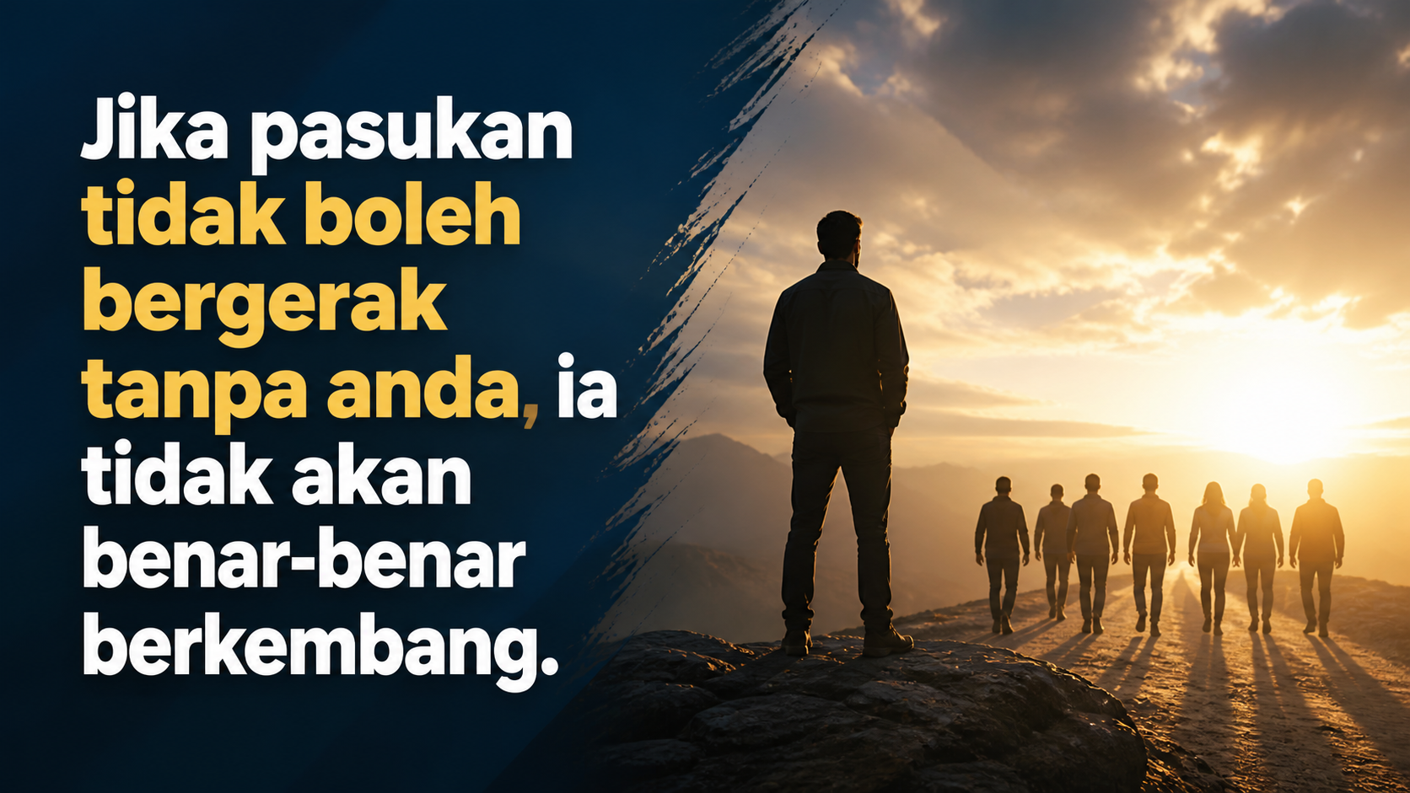
Notes:
[Sources]
- First-slide hook: Images 2.0 native generation from approved exact copy: Jika pasukan tidak boleh bergerak tanpa anda, ia tidak akan benar-benar berkembang.

Slide 2
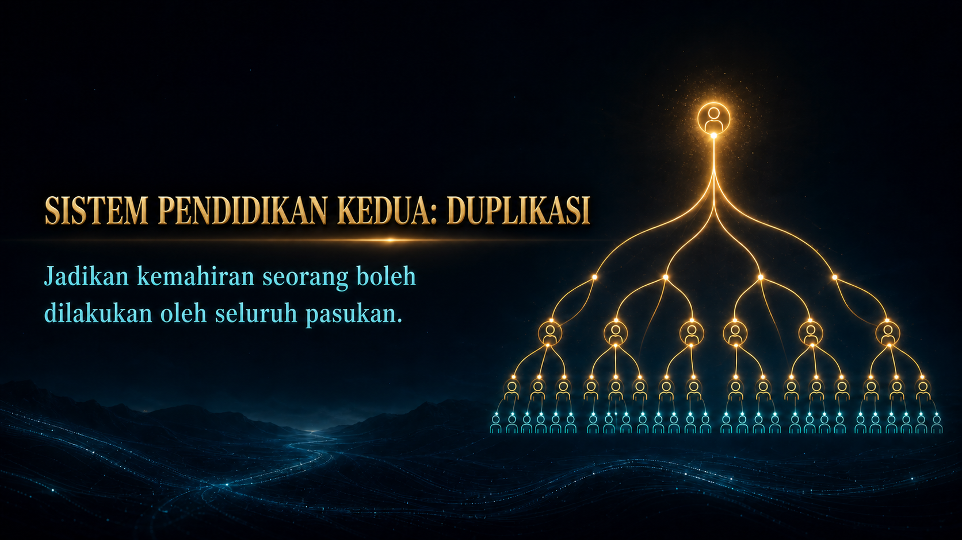
Notes:
[Sources]
- User-provided NP642 System Training (NST) source pages.
- OpenAI ImageGen generated slide visual.

Slide 3
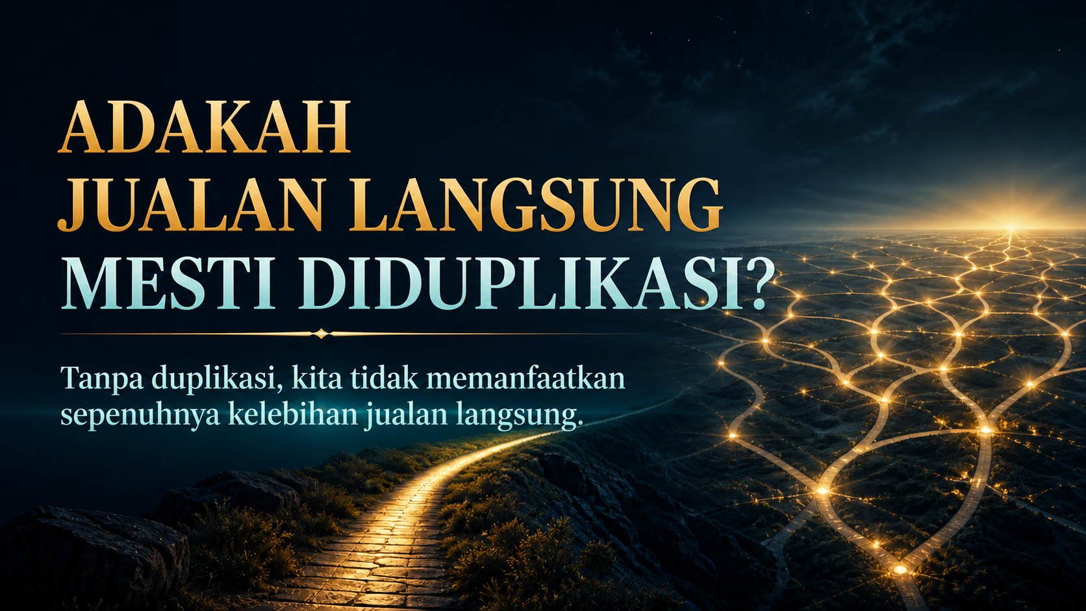
Notes:
[Sources]
- User-provided NP642 System Training (NST) source pages.
- OpenAI ImageGen generated slide visual.

Slide 4

Notes:
[Sources]
- User-provided NP642 System Training (NST) source pages.
- OpenAI ImageGen generated slide visual.

Slide 5
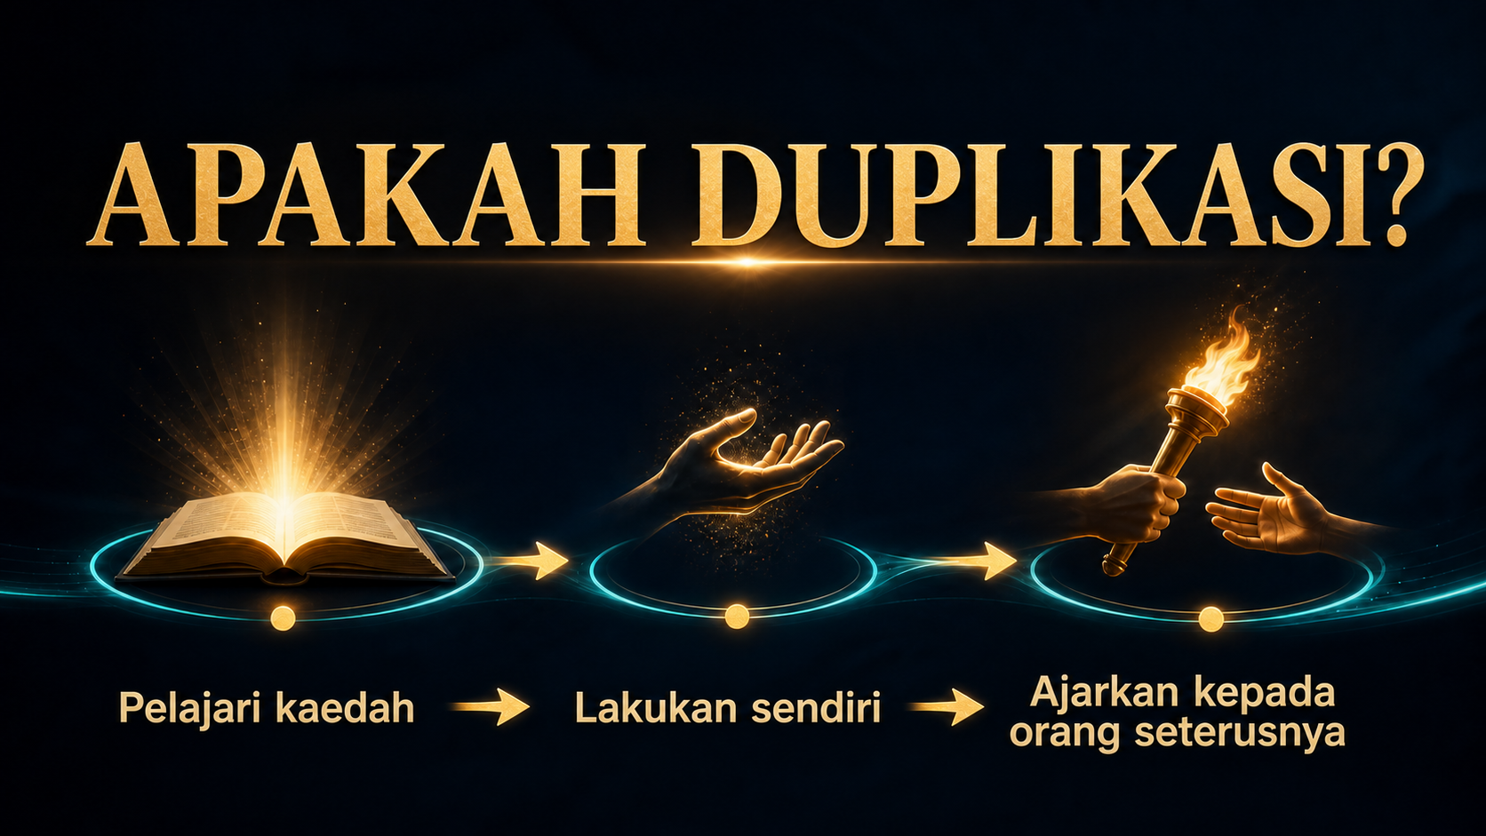
Notes:
[Sources]
- User-provided NP642 System Training (NST) source pages.
- OpenAI ImageGen generated slide visual.

Slide 6

Notes:
[Sources]
- User-provided NP642 System Training (NST) source pages.
- OpenAI ImageGen generated slide visual.

Slide 7

Notes:
[Sources]
- User-provided NP642 System Training (NST) source pages.
- OpenAI ImageGen generated slide visual.

Slide 8

Notes:
[Sources]
- User-provided NP642 System Training (NST) source pages.
- OpenAI ImageGen generated slide visual.

Slide 9

Notes:
[Sources]
- User-provided NP642 System Training (NST) source pages.
- OpenAI ImageGen generated slide visual.

Slide 10
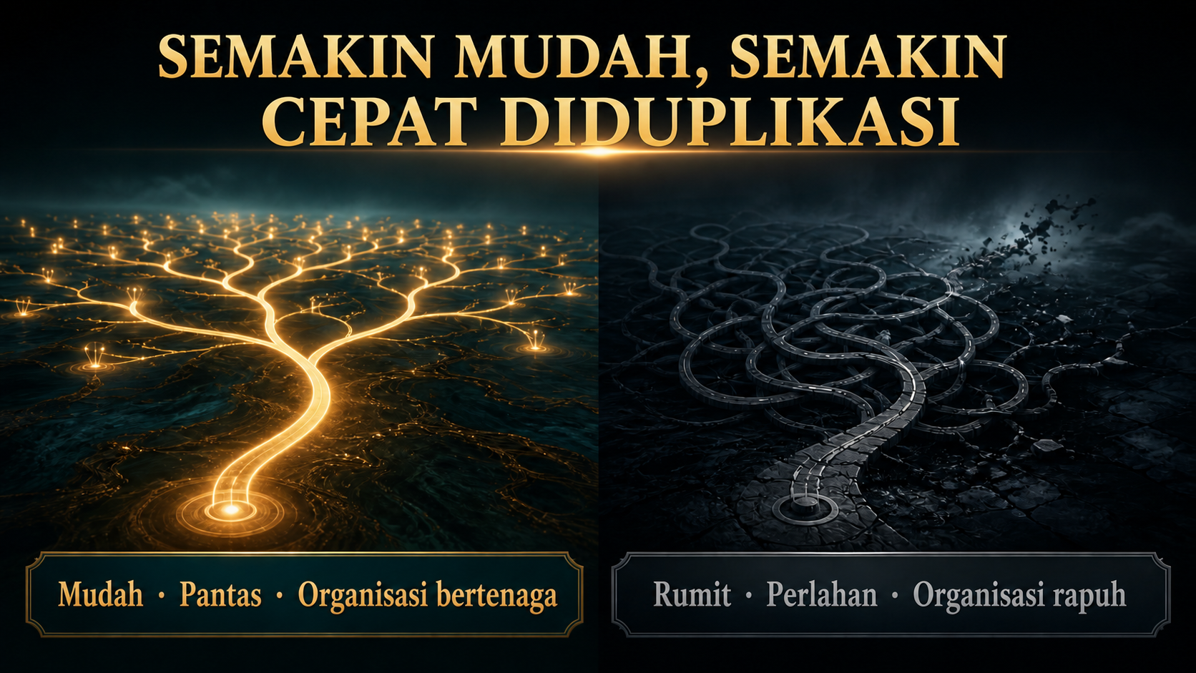
Notes:
[Sources]
- User-provided NP642 System Training (NST) source pages.
- OpenAI ImageGen generated slide visual.

Slide 11

Notes:
[Sources]
- User-provided NP642 System Training (NST) source pages.
- OpenAI ImageGen generated slide visual.

Slide 12
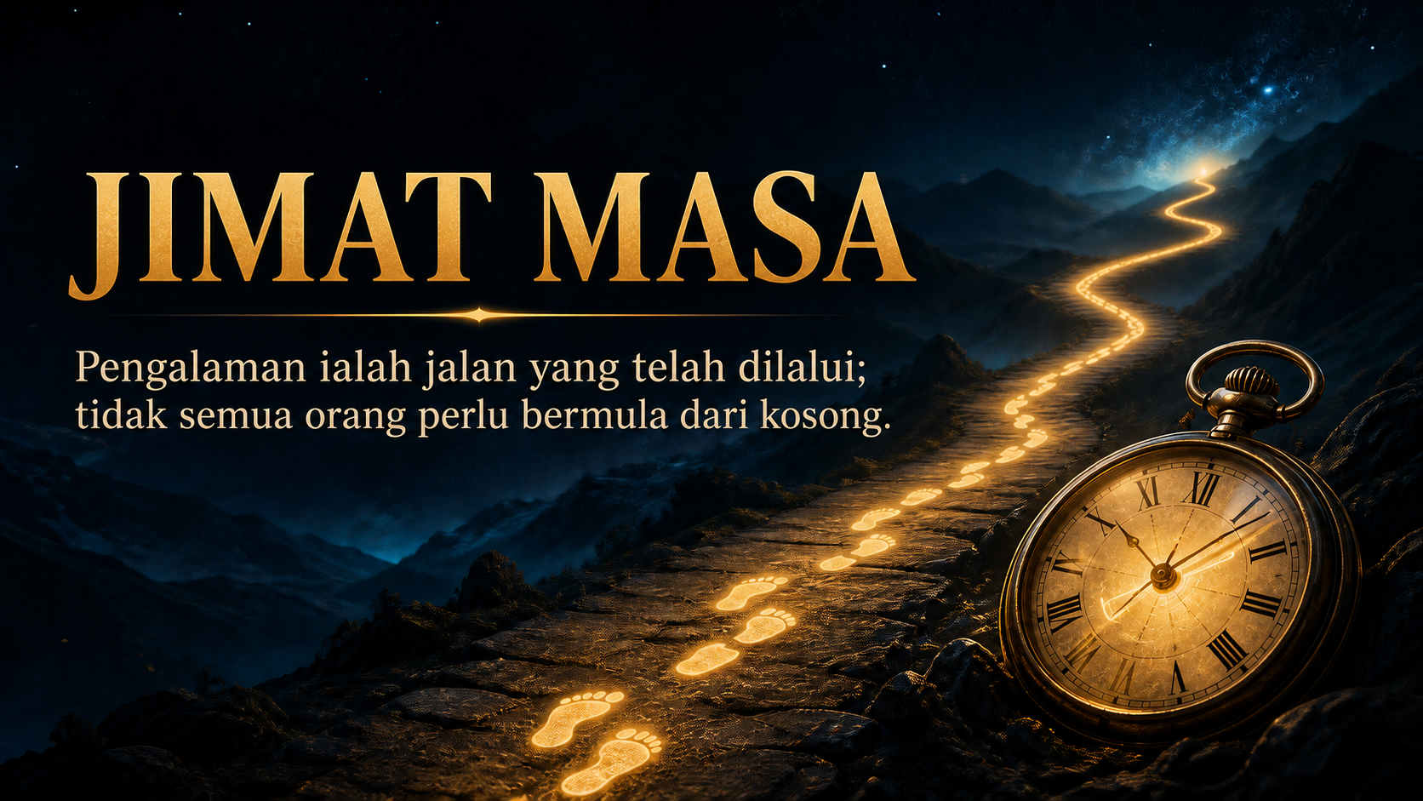
Notes:
[Sources]
- User-provided NP642 System Training (NST) source pages.
- OpenAI ImageGen generated slide visual.

Slide 13

Notes:
[Sources]
- User-provided NP642 System Training (NST) source pages.
- OpenAI ImageGen generated slide visual.

Slide 14

Notes:
[Sources]
- User-provided NP642 System Training (NST) source pages.
- OpenAI ImageGen generated slide visual.

Slide 15

Notes:
[Sources]
- User-provided NP642 System Training (NST) source pages.
- OpenAI ImageGen generated slide visual.

Slide 16

Notes:
[Sources]
- User-provided NP642 System Training (NST) source pages.
- OpenAI ImageGen generated slide visual.

Slide 17

Notes:
[Sources]
- User-provided NP642 System Training (NST) source pages.
- OpenAI ImageGen generated slide visual.

Slide 18
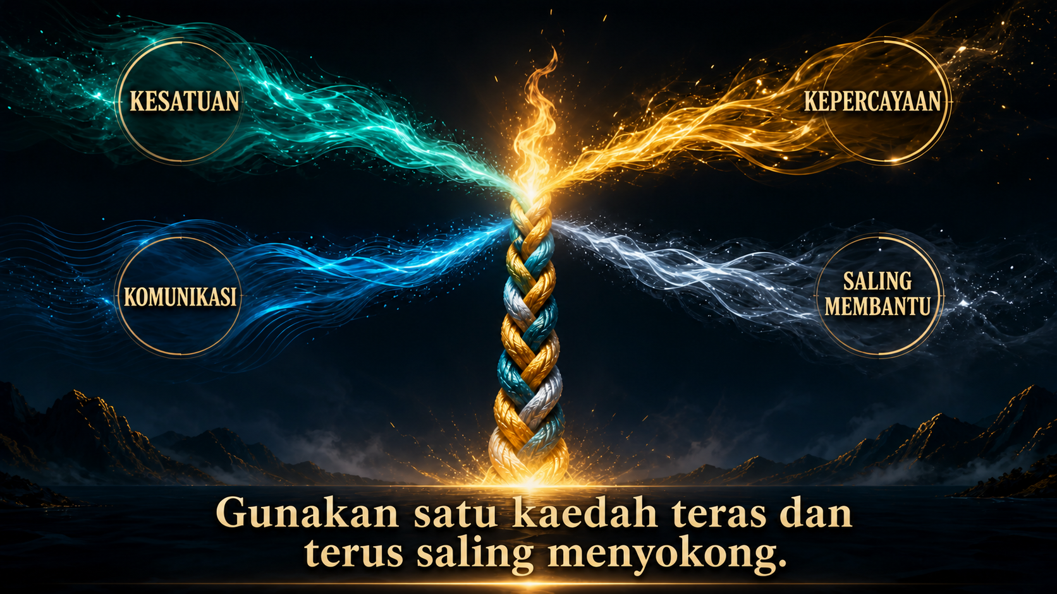
Notes:
[Sources]
- User-provided NP642 System Training (NST) source pages.
- OpenAI ImageGen generated slide visual.

Slide 19

Notes:
[Sources]
- User-provided NP642 System Training (NST) source pages.
- OpenAI ImageGen generated slide visual.

Slide 20

Notes:
[Sources]
- User-provided NP642 System Training (NST) source pages.
- OpenAI ImageGen generated slide visual.

Slide 21

Notes:
[Sources]
- User-provided NP642 System Training (NST) source pages.
- OpenAI ImageGen generated slide visual.

Slide 22

Notes:
[Sources]
- User-provided NP642 System Training (NST) source pages.
- OpenAI ImageGen generated slide visual.

Slide 23

Notes:
[Sources]
- User-provided NP642 System Training (NST) source pages.
- OpenAI ImageGen generated slide visual.

Slide 24

Notes:
[Sources]
- User-provided NP642 System Training (NST) source pages.
- OpenAI ImageGen generated slide visual.

Slide 25

Notes:
[Sources]
- User-provided NP642 System Training (NST) source pages.
- OpenAI ImageGen generated slide visual.

Slide 26

Notes:
[Sources]
- User-provided NP642 System Training (NST) source pages.
- OpenAI ImageGen generated slide visual.

