Slide 1

Notes:
[Sources]
- First-slide hook: Images 2.0 native generation from approved exact copy: 马尔代夫只是第一站，你的下一站在哪里？

Slide 2
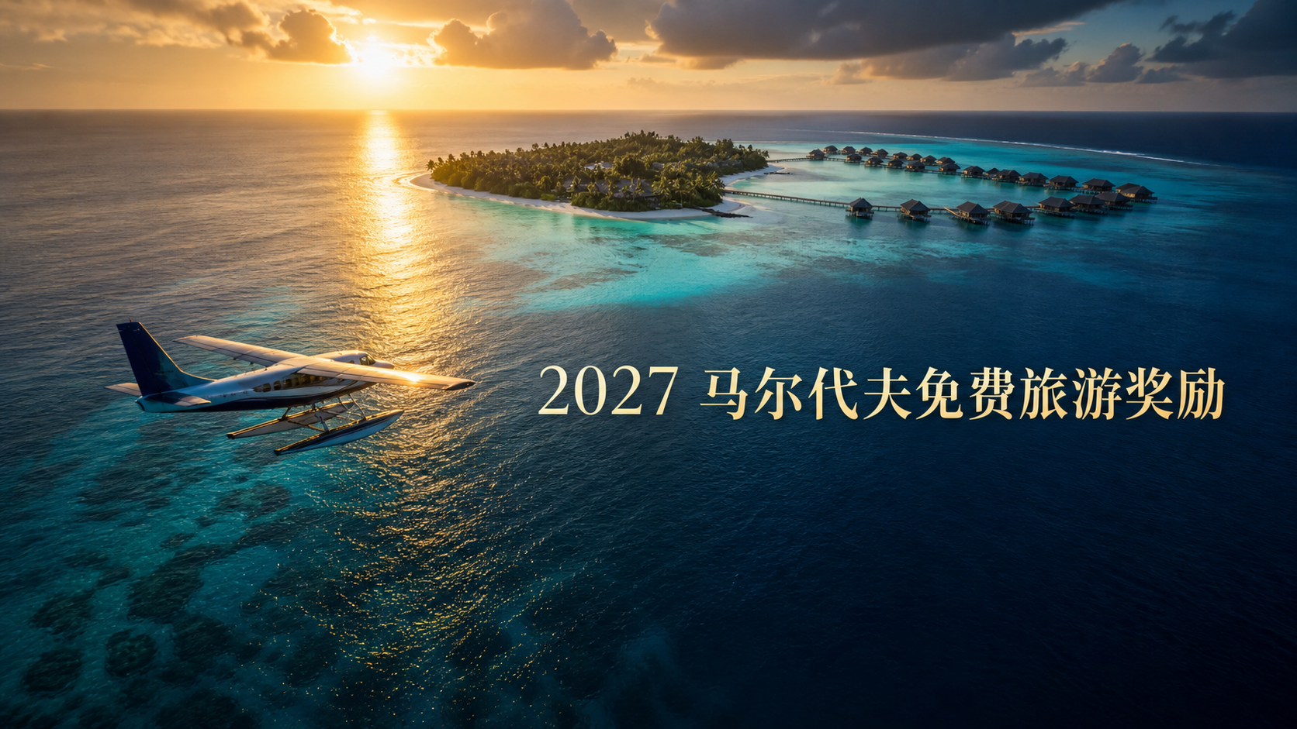
Notes:
[Sources] images/00_maldives_start.png
User-supplied Naturally Plus Malaysia campaign material and JS Loo approved campaign explanation.

Slide 3
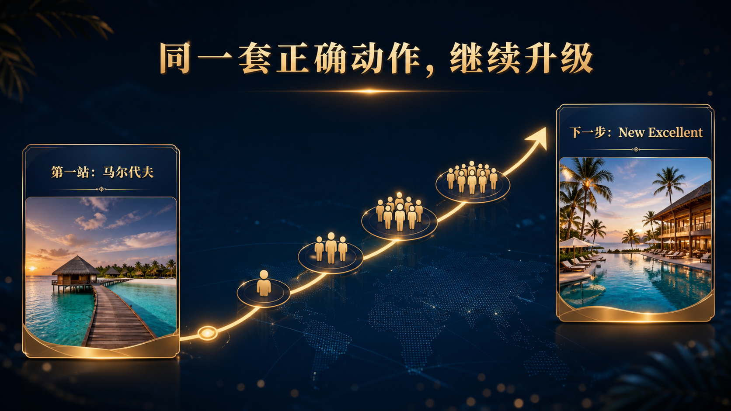
Notes:
[Sources] images/00_maldives_to_new_excellent.png
User-supplied Naturally Plus Malaysia campaign material and JS Loo approved campaign explanation.

Slide 4
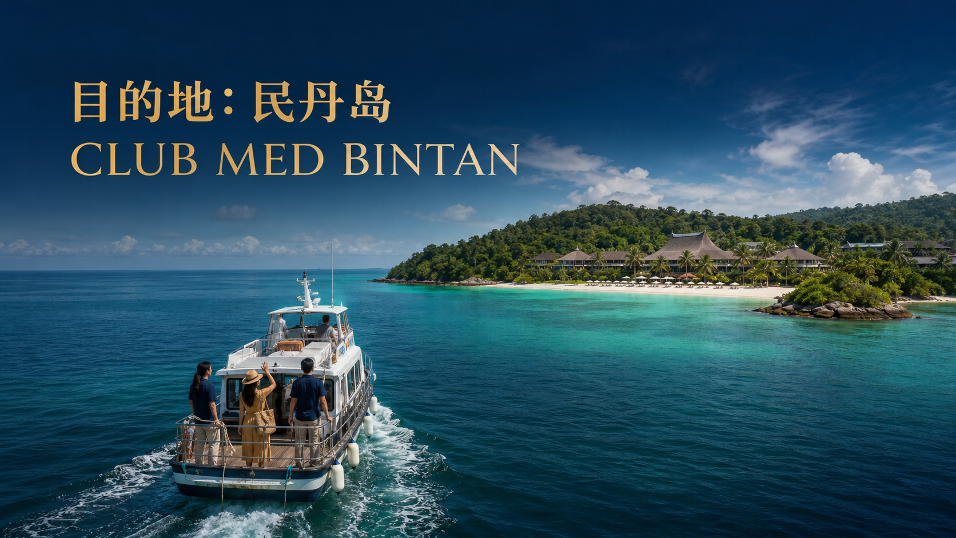
Notes:
[Sources] images/02_destination.png
User-supplied Naturally Plus Malaysia campaign material and JS Loo approved campaign explanation.

Slide 5

Notes:
[Sources] source/01_campaign_cover.jpg
User-supplied Naturally Plus Malaysia campaign material and JS Loo approved campaign explanation.

Slide 6
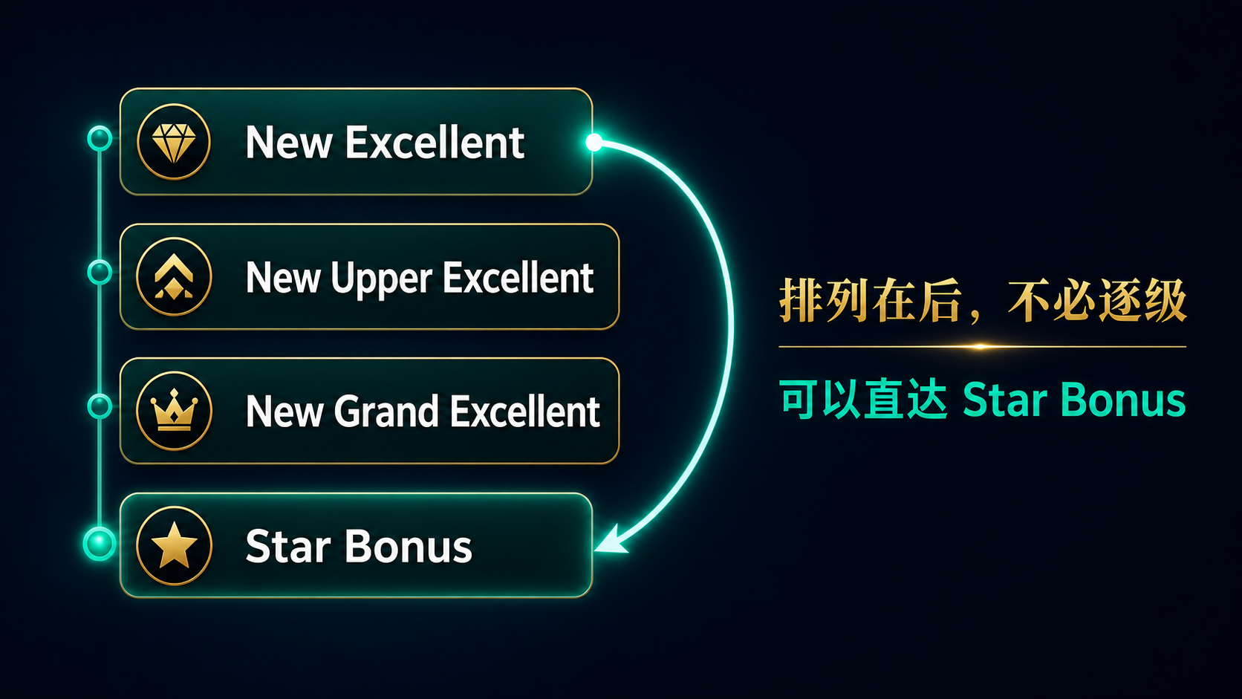
Notes:
[Sources] images/03_display_order_direct_star.png
User-supplied Naturally Plus Malaysia campaign material and JS Loo approved campaign explanation.

Slide 7
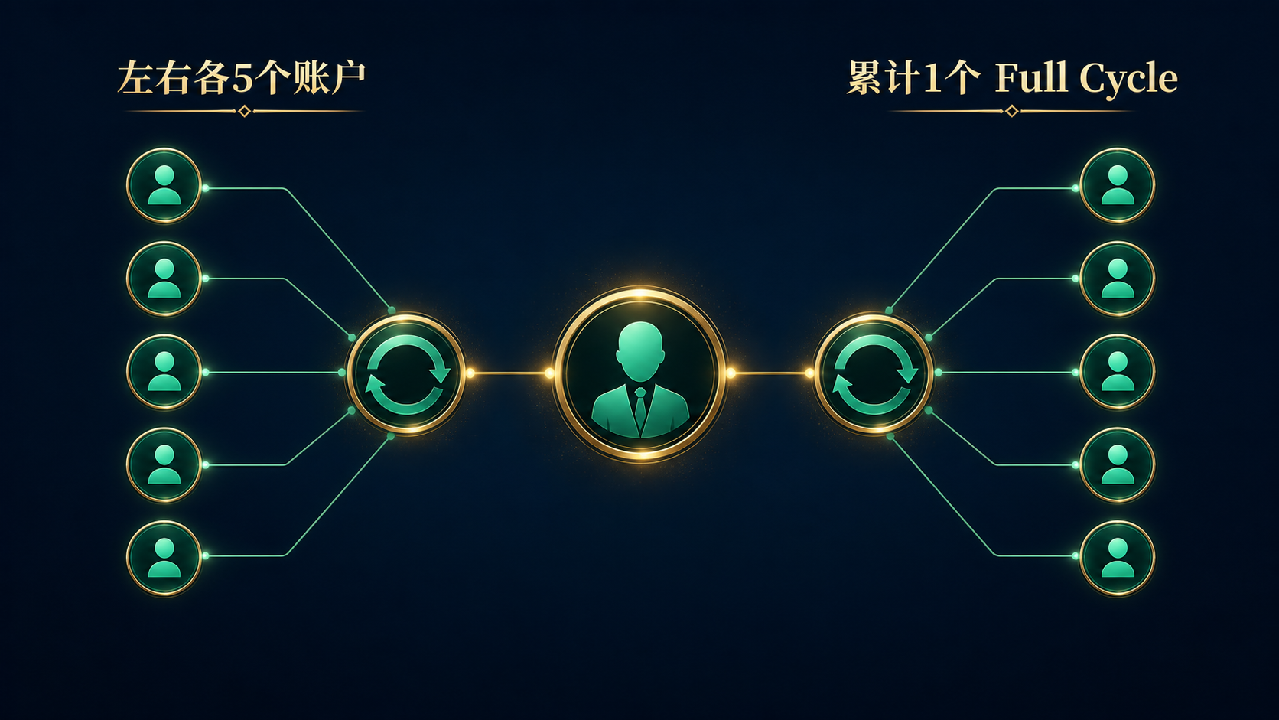
Notes:
[Sources] images/05_five_full_cycles.png
User-supplied Naturally Plus Malaysia campaign material and JS Loo approved campaign explanation.

Slide 8
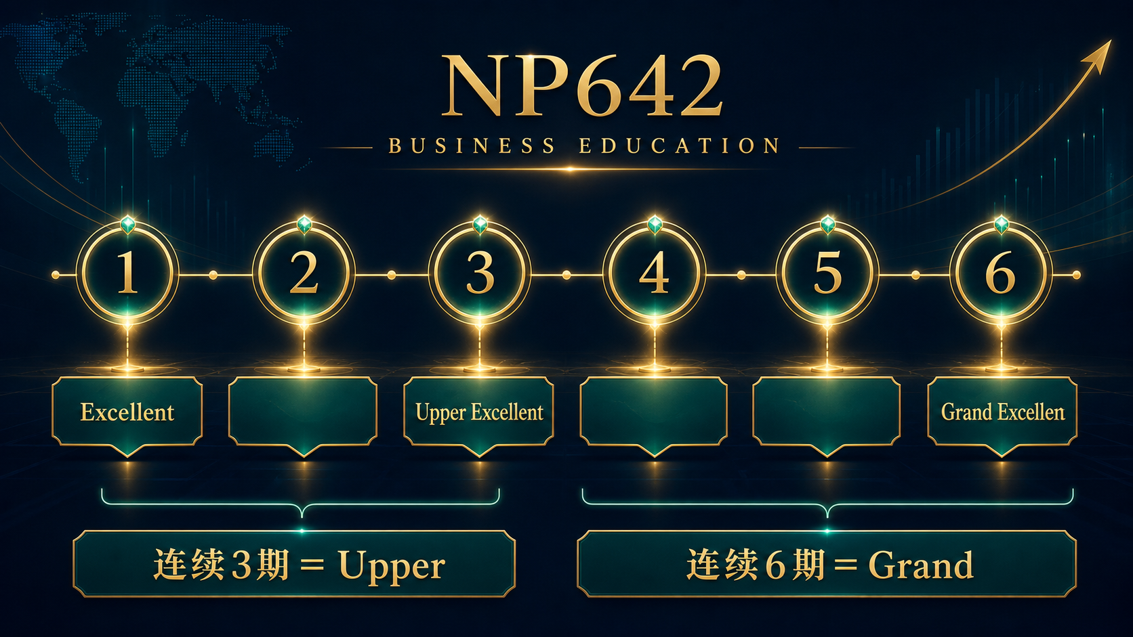
Notes:
[Sources] images/07_upper_grand_timeline.png
User-supplied Naturally Plus Malaysia campaign material and JS Loo approved campaign explanation.

Slide 9

Notes:
[Sources] images/08_direct_to_star.png
User-supplied Naturally Plus Malaysia campaign material and JS Loo approved campaign explanation.

Slide 10

Notes:
[Sources] images/12_star_ds_options.png
User-supplied Naturally Plus Malaysia campaign material and JS Loo approved campaign explanation.

Slide 11
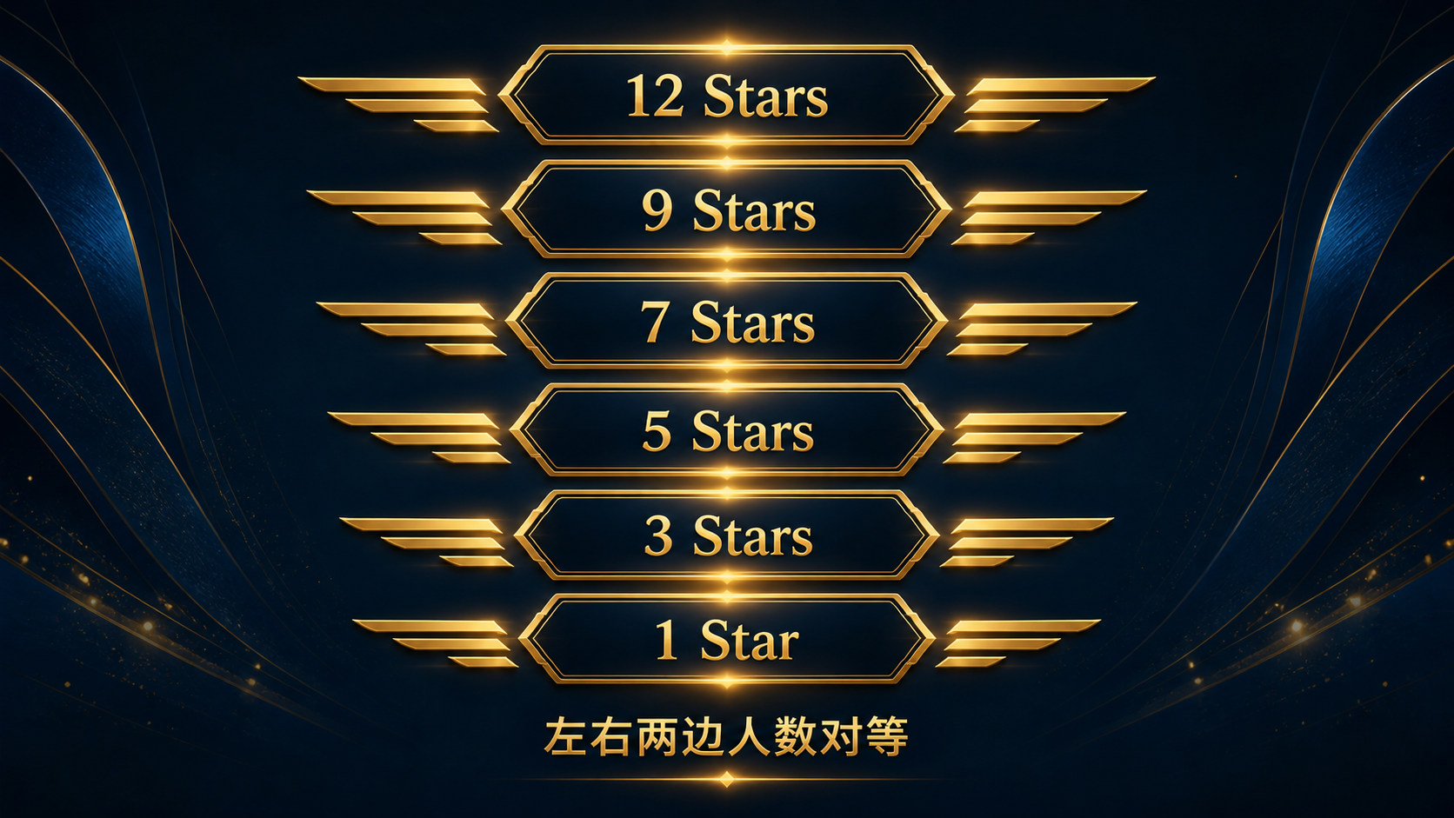
Notes:
[Sources] images/13_star_ladder.png
User-supplied Naturally Plus Malaysia campaign material and JS Loo approved campaign explanation.

Slide 12

Notes:
[Sources] images/14a_day_cycle_bonus.png
User-supplied Naturally Plus Malaysia campaign material and JS Loo approved campaign explanation.

Slide 13

Notes:
[Sources] images/14b_leadership_bonus.png
User-supplied Naturally Plus Malaysia campaign material and JS Loo approved campaign explanation.

Slide 14

Notes:
[Sources] images/14d_cfc_monthly_opportunity.png
User-supplied Naturally Plus Malaysia campaign material and JS Loo approved campaign explanation.

Slide 15
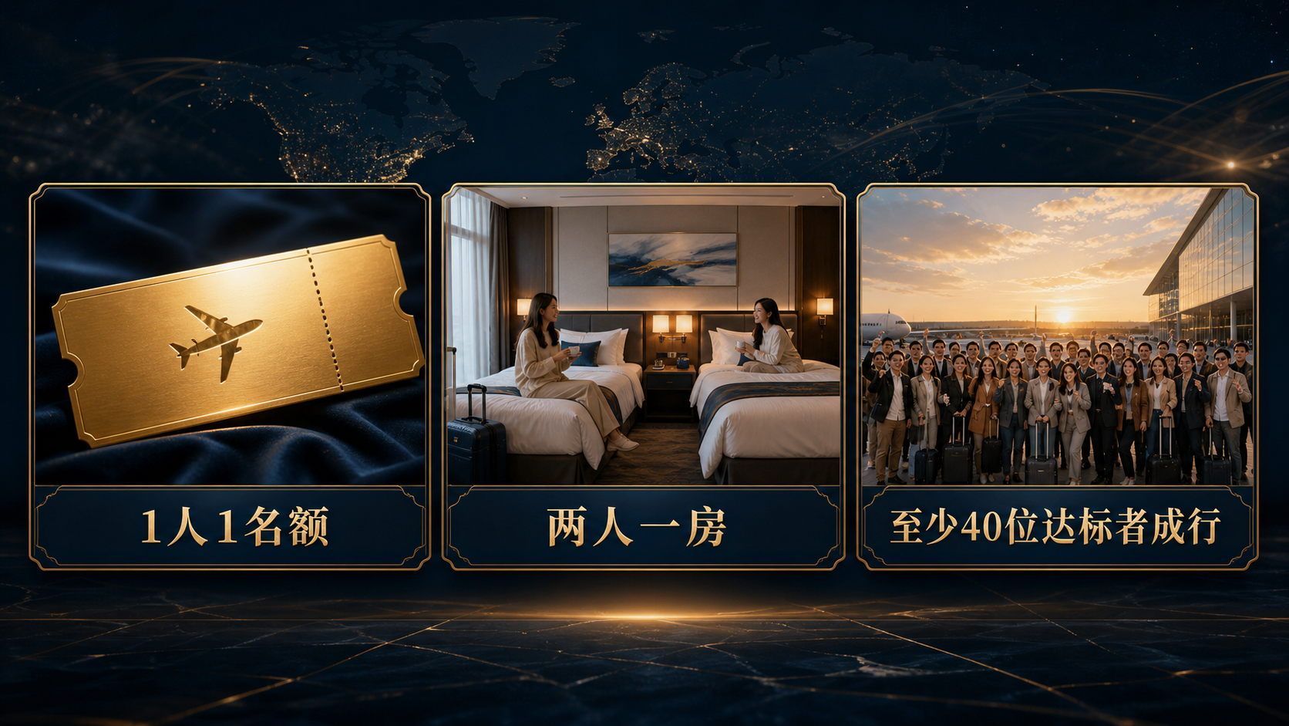
Notes:
[Sources] images/16_travel_terms.png
User-supplied Naturally Plus Malaysia campaign material and JS Loo approved campaign explanation.

Slide 16

Notes:
[Sources] images/23_cfc_routes.png
User-supplied Naturally Plus Malaysia campaign material and JS Loo approved campaign explanation.

Slide 17

Notes:
[Sources] images/21_closing_next.png
User-supplied Naturally Plus Malaysia campaign material and JS Loo approved campaign explanation.

