Slide 1
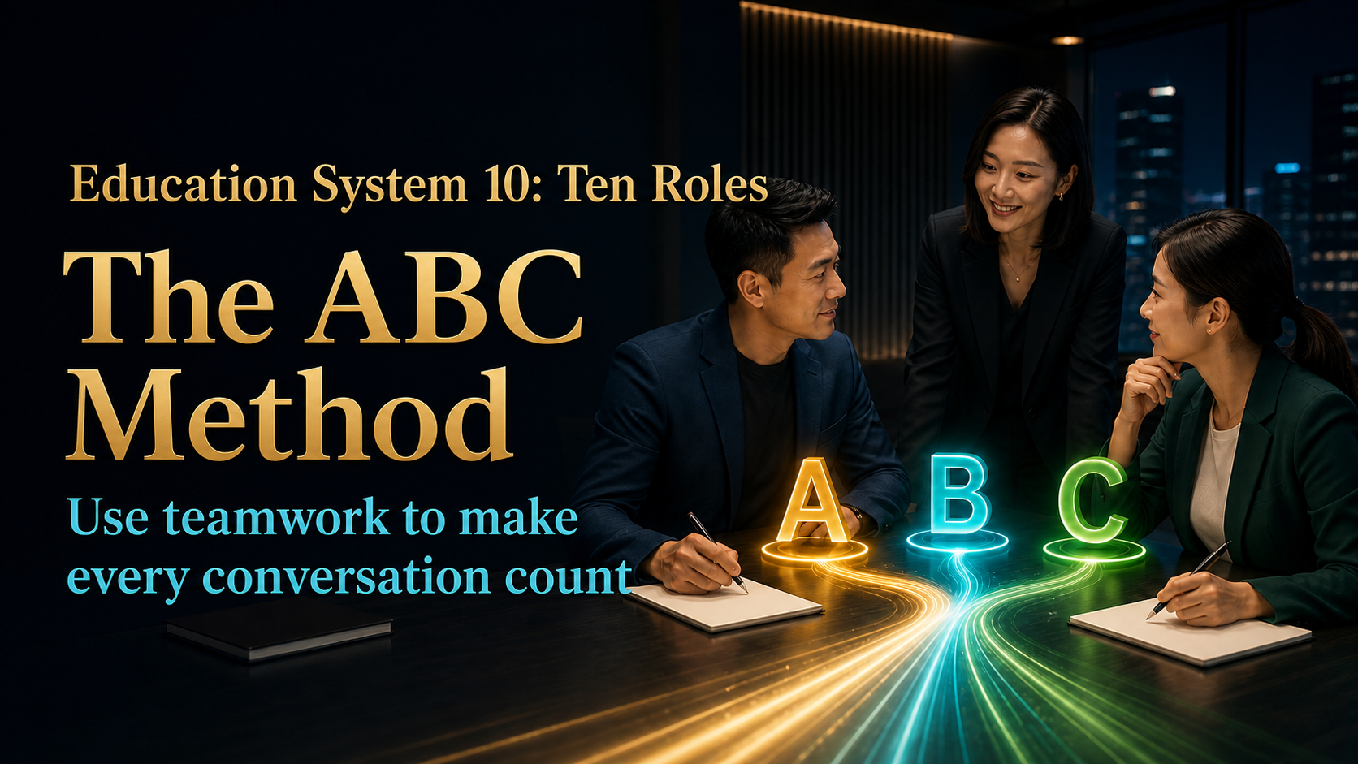
Notes:
Today we are learning Education System Ten: the Ten Roles, also known as the ABC Method. This is not about putting two people in front of one customer to pressure a decision. It is about placing the right person in the right role at the right moment. A brings relevant experience, B connects trust and context, and C keeps the right to decide. By the end, you should know how to prepare an ABC conversation, when to speak, when to hand over to A, and how to guide the discussion toward one clear next step.
[Sources]
- 用户提供的《十大角色／ABC法则》原始课程内容。
- JS Loo 确认的现代化课程编排与成交协助立场。
- OpenAI Images 2.0 生成的完整图文课程画面。

Slide 2

Notes:
When a customer does not act immediately, it does not always mean no. Often the person cannot yet see the difference between the options, is afraid of choosing wrongly, or worries that nobody will help after the decision. That is choice anxiety. If B simply leaves information and walks away, the service is incomplete. A capable B helps the customer name the real concern, makes the choices easier to compare, and supports one manageable next step. Hesitation deserves understanding, but understanding without direction can leave the customer stuck in exactly the same place.
[Sources]
- 用户提供的《十大角色／ABC法则》原始课程内容。
- JS Loo 确认的现代化课程编排与成交协助立场。
- OpenAI Images 2.0 生成的完整图文课程画面。

Slide 3

Notes:
Giving your best does not mean using only your own strength. It also means exploring every reasonable option and using the resources available around you. Many partners judge what is possible only by their own confidence, experience or speaking ability. A team exists so one person does not have to solve every problem alone. Asking for help, choosing someone with the right experience and bringing that person into the conversation are signs of mature collaboration. The real risk is not that you do not know. The real risk is pretending to know and giving an answer that damages trust.
[Sources]
- 用户提供的《十大角色／ABC法则》原始课程内容。
- JS Loo 确认的现代化课程编排与成交协助立场。
- OpenAI Images 2.0 生成的完整图文课程画面。

Slide 4
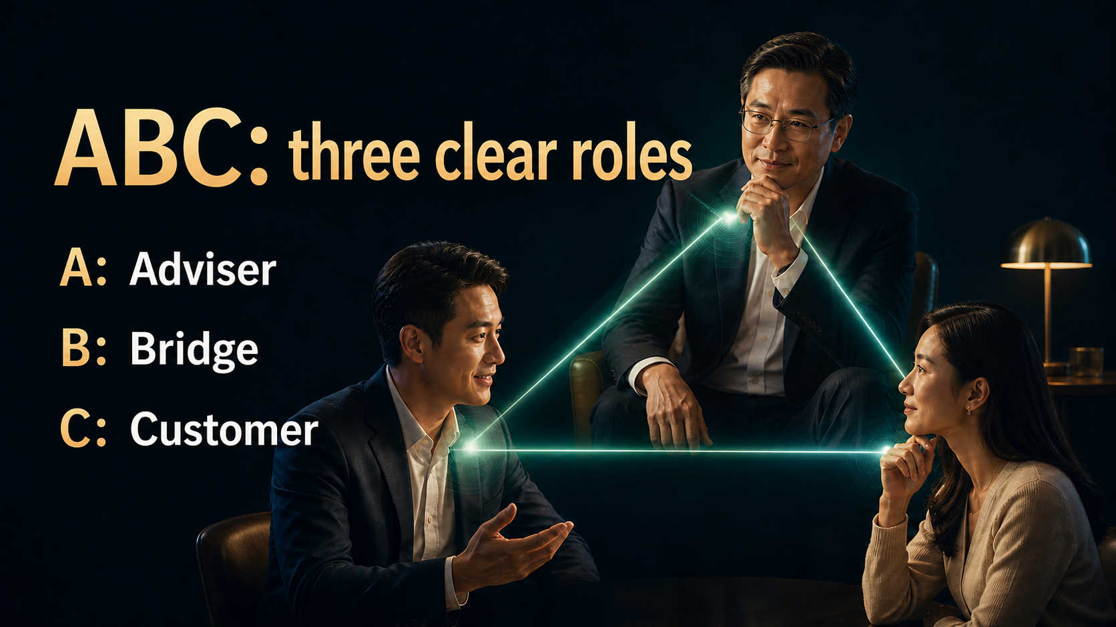
Notes:
The ABC Method begins by defining three roles. A is the Adviser, an upline or experienced partner who provides relevant explanation. B is the Bridge, the person who knows C, initiates the meeting and connects both sides. C is the Customer or potential partner who owns the final decision. These roles do not rank people. They organise responsibility. A contributes experience, B contributes context and trust, and C evaluates the information against real needs. One person may play different roles in different meetings, but within one conversation the roles should remain clear.
[Sources]
- 用户提供的《十大角色／ABC法则》原始课程内容。
- JS Loo 确认的现代化课程编排与成交协助立场。
- OpenAI Images 2.0 生成的完整图文课程画面。

Slide 5

Notes:
ABC is often misused when A and B take turns selling at C. That creates pressure, not leverage. Correct collaboration looks different. A fills a genuine experience gap. B protects the relationship, explains the background and checks understanding. C has room to ask questions and make a decision. The three people are not opponents; they are trying to understand the same situation together. You can see the difference in the room. If A and B lean forward, interrupt and keep adding arguments, C will pull back. When the conversation stays balanced, the customer is more willing to say what is really blocking the decision.
[Sources]
- 用户提供的《十大角色／ABC法则》原始课程内容。
- JS Loo 确认的现代化课程编排与成交协助立场。
- OpenAI Images 2.0 生成的完整图文课程画面。

Slide 6
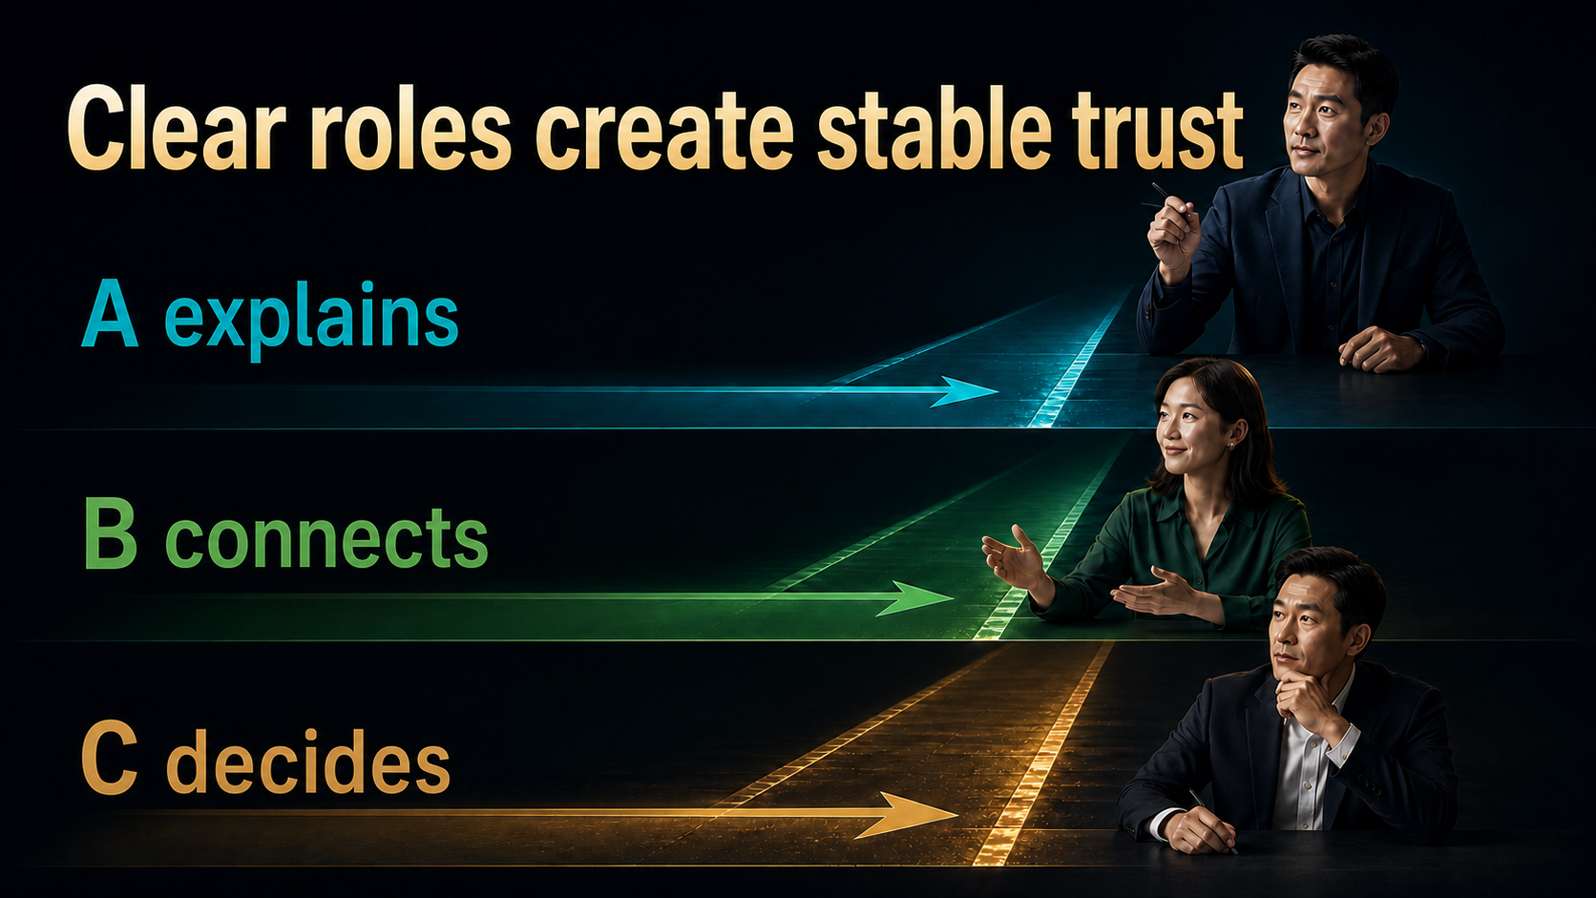
Notes:
The quality of an ABC conversation is not measured by who speaks the most. It depends on whether each person fulfils the right responsibility. A explains without taking over B's relationship. B connects without interrupting A or answering on C's behalf. C asks, compares and decides. When roles become mixed, the customer no longer knows whose answer to trust. Before the meeting, use one minute to agree on the opening, the main speaker, who handles which questions and who asks for the next action. That small alignment prevents confusion later.
[Sources]
- 用户提供的《十大角色／ABC法则》原始课程内容。
- JS Loo 确认的现代化课程编排与成交协助立场。
- OpenAI Images 2.0 生成的完整图文课程画面。

Slide 7
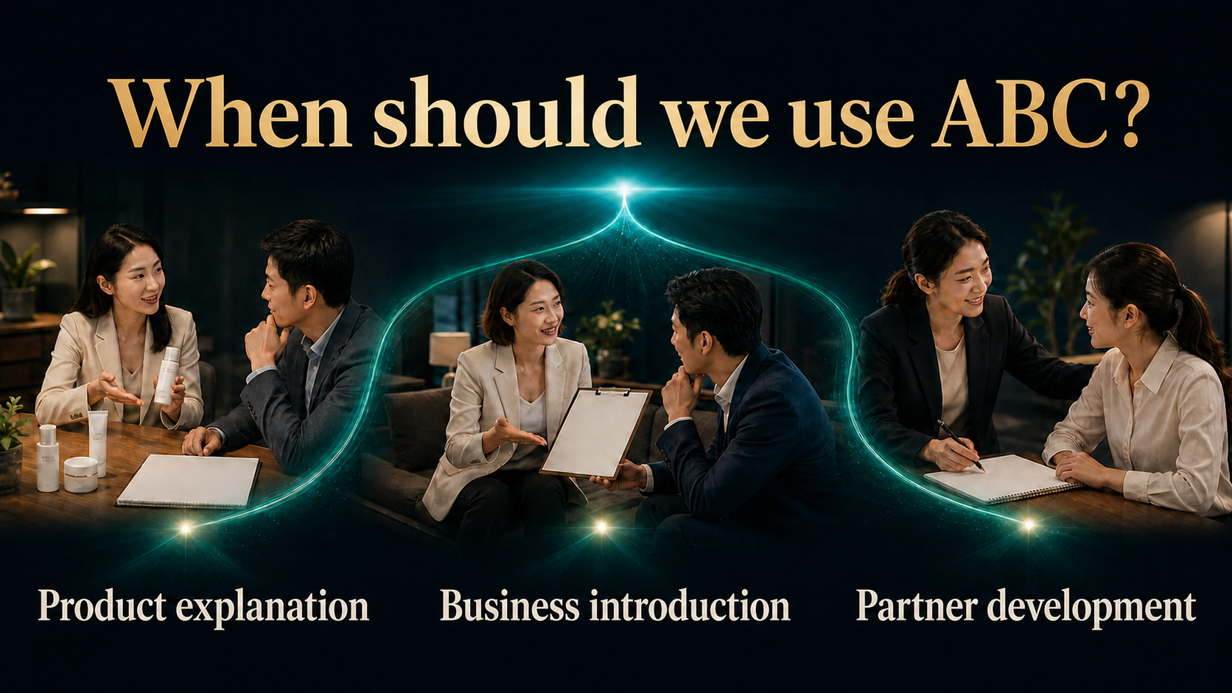
Notes:
ABC is not limited to a business presentation. During a product conversation, B can invite someone with stronger product experience. During a business introduction, an experienced leader can explain the system and development path. During partner training, a newcomer can first serve as B and learn by observing how A listens, explains and follows up. Even when you can present alone, the right A may relate better to C's background. Choose A for relevance, communication style and availability to serve, not simply for rank or title.
[Sources]
- 用户提供的《十大角色／ABC法则》原始课程内容。
- JS Loo 确认的现代化课程编排与成交协助立场。
- OpenAI Images 2.0 生成的完整图文课程画面。

Slide 8
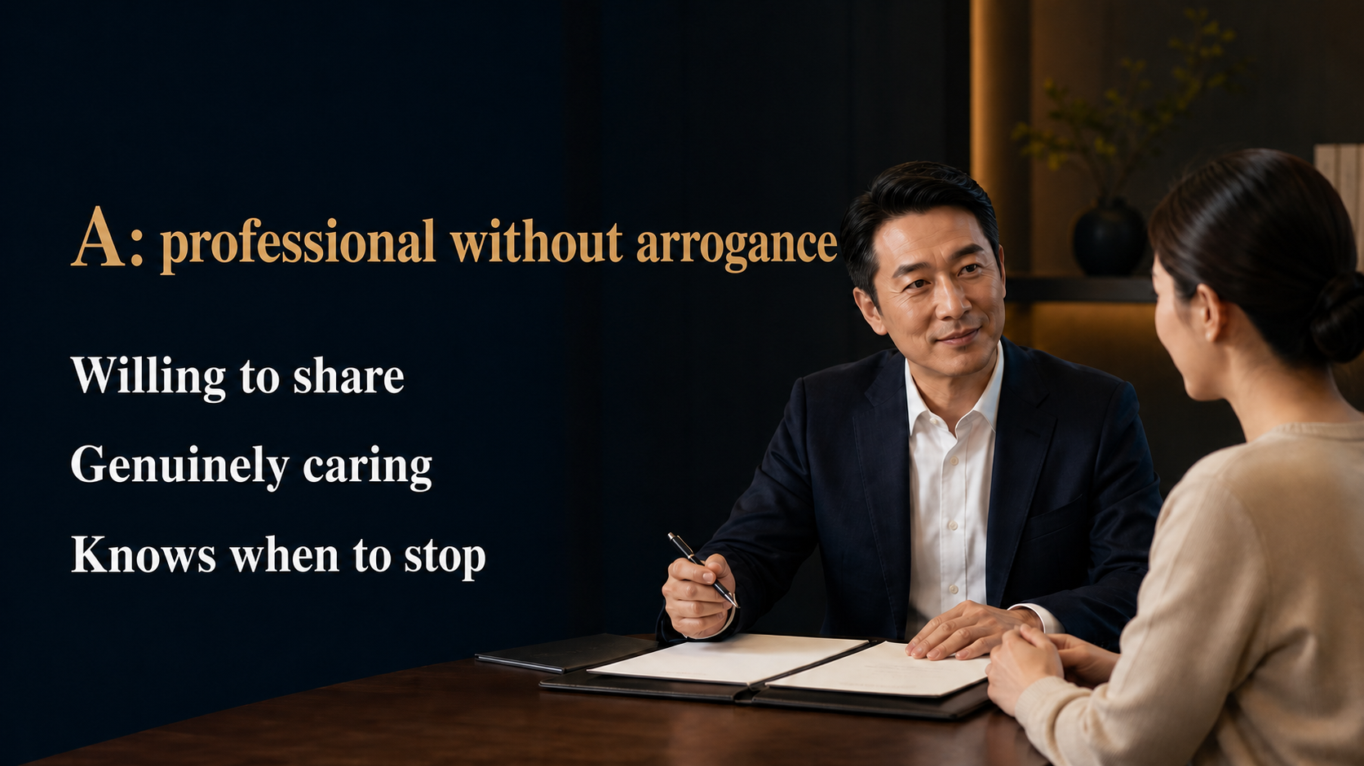
Notes:
A's value is not only knowledge. It is the ability to make knowledge useful and easy to receive. A good adviser first learns what C wants to solve, then offers the relevant explanation. A can be confident without acting superior, and professional without turning the meeting into a performance. When the customer understands, A knows when to stop. When the customer is not ready, speaking harder rarely helps. Before closing, A should return the relationship to B: your friend will continue to support you, and I will be available when needed. This keeps B involved and makes follow-up natural.
[Sources]
- 用户提供的《十大角色／ABC法则》原始课程内容。
- JS Loo 确认的现代化课程编排与成交协助立场。
- OpenAI Images 2.0 生成的完整图文课程画面。

Slide 9
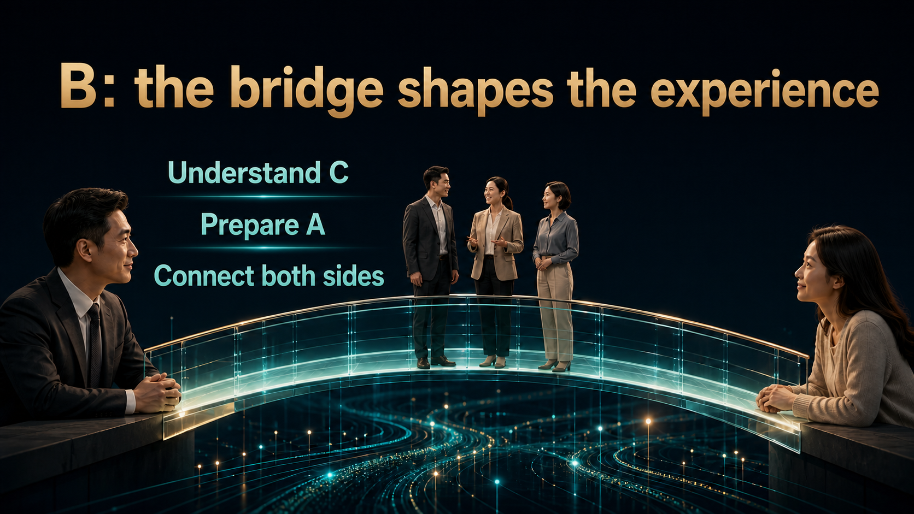
Notes:
B is not a courier who brings someone to A and then disappears. B designs the whole experience. Before the meeting, B learns C's background, needs and concerns, then gives A the useful context. During the meeting, B creates safety, listens, helps questions surface and checks that C understands. Afterward, B follows the decision and the experience. When the bridge is weak, even an excellent A struggles. When the bridge is strong, the conversation feels natural, organised and personal. A supplies expertise, while B keeps the trusted relationship present in the room.
[Sources]
- 用户提供的《十大角色／ABC法则》原始课程内容。
- JS Loo 确认的现代化课程编排与成交协助立场。
- OpenAI Images 2.0 生成的完整图文课程画面。

Slide 10
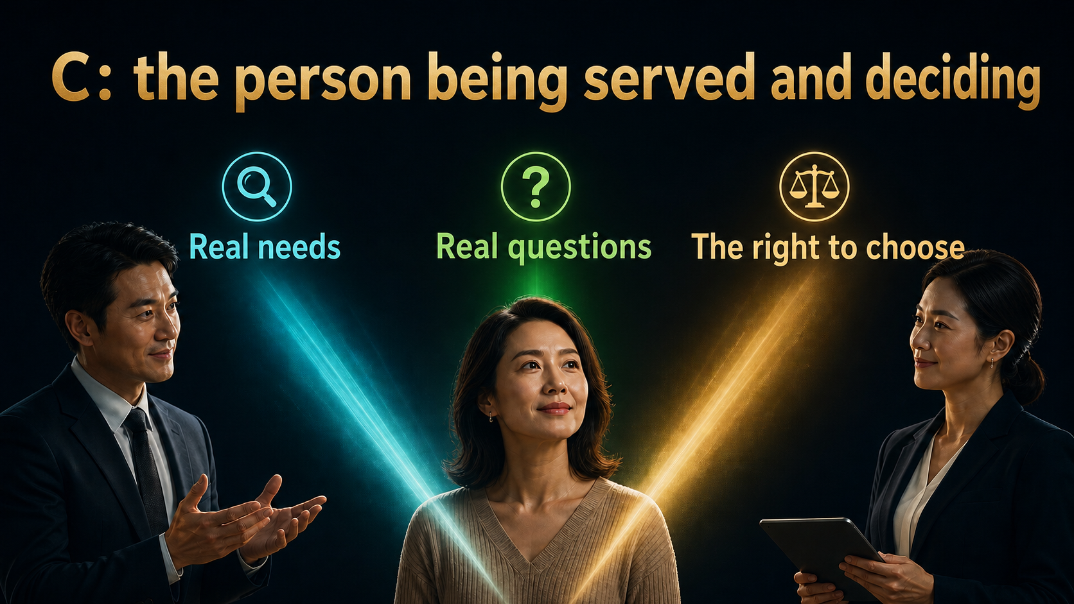
Notes:
C is not a number on a prospect list. This is a person with a real life, budget, hopes and concerns. C may need a product, may be exploring the business, may act today or may need more time. Our responsibility is to help the person see clearly, not to decide for them. The more we respect C's right to choose, the more honestly C will speak. Do not decide in advance that someone cannot afford it, has no time or will not be interested. Let the facts and needs appear first, then offer the most suitable choices.
[Sources]
- 用户提供的《十大角色／ABC法则》原始课程内容。
- JS Loo 确认的现代化课程编排与成交协助立场。
- OpenAI Images 2.0 生成的完整图文课程画面。

Slide 11
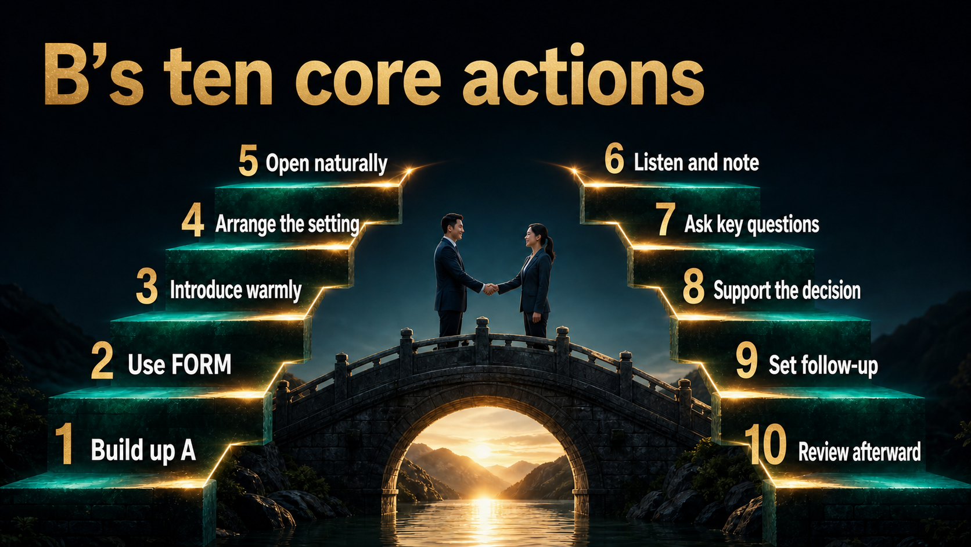
Notes:
The Ten Roles course spends most of its training time on B's ten core actions. One, build up A truthfully. Two, understand C through FORM. Three, introduce both sides warmly. Four, arrange the right environment. Five, open the topic naturally. Six, listen and record. Seven, ask key questions. Eight, support C in reaching a decision. Nine, arrange the next follow-up. Ten, review the meeting with A. These are not ten rigid scripts. They are ten checkpoints. The words can change with the customer and the situation, but the responsibility behind each action should not be skipped.
[Sources]
- 用户提供的《十大角色／ABC法则》原始课程内容。
- JS Loo 确认的现代化课程编排与成交协助立场。
- OpenAI Images 2.0 生成的完整图文课程画面。

Slide 12
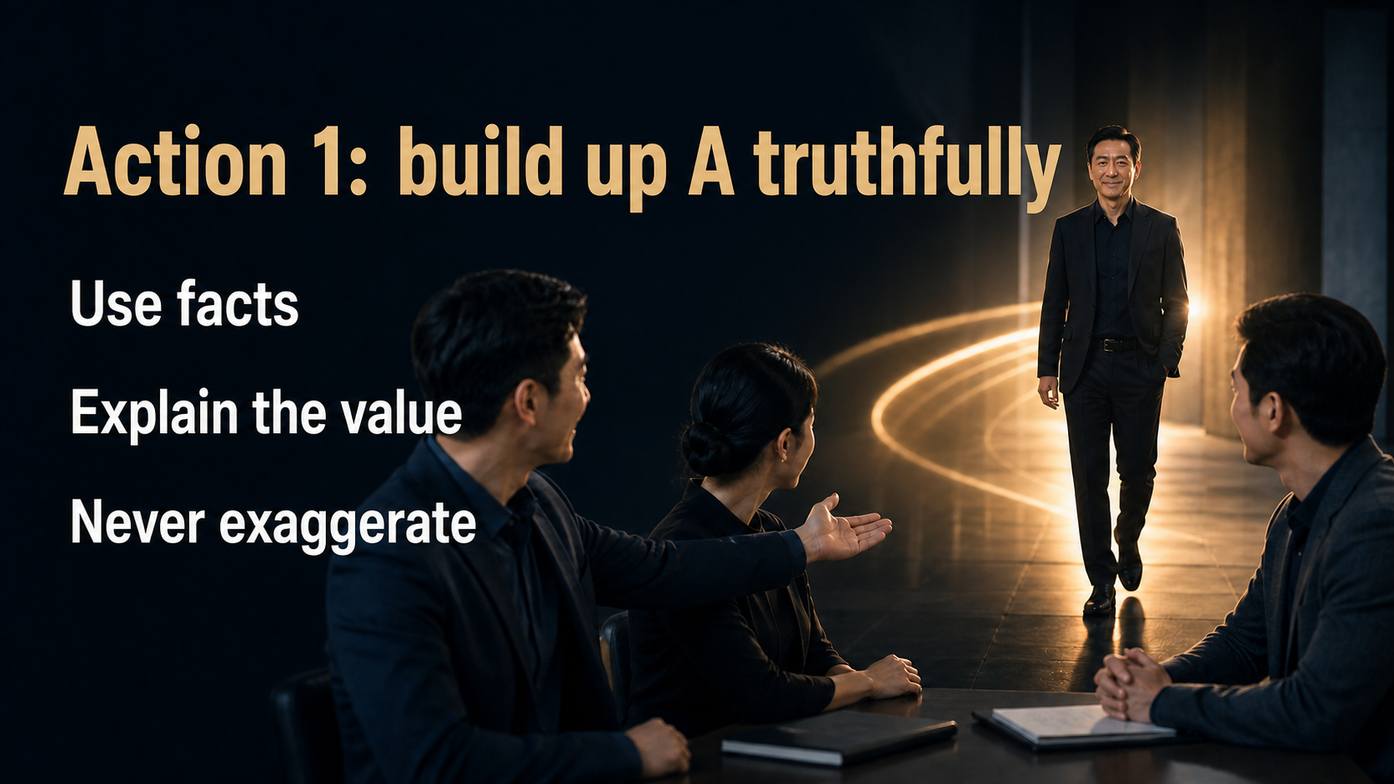
Notes:
Building up A tells C why this conversation is worth attention. The point is not to present A as someone who can solve everything. Share a true, specific fact that matters to this meeting: relevant experience, the kind of questions A handles well, or how A has helped you. Truthful positioning increases attention. Exaggeration creates suspicion and places unfair pressure on A. B is borrowing experience, not using status to overpower C. Ideally, explain the reason for choosing A before the meeting, then make only a short introduction when everyone arrives.
[Sources]
- 用户提供的《十大角色／ABC法则》原始课程内容。
- JS Loo 确认的现代化课程编排与成交协助立场。
- OpenAI Images 2.0 生成的完整图文课程画面。

Slide 13
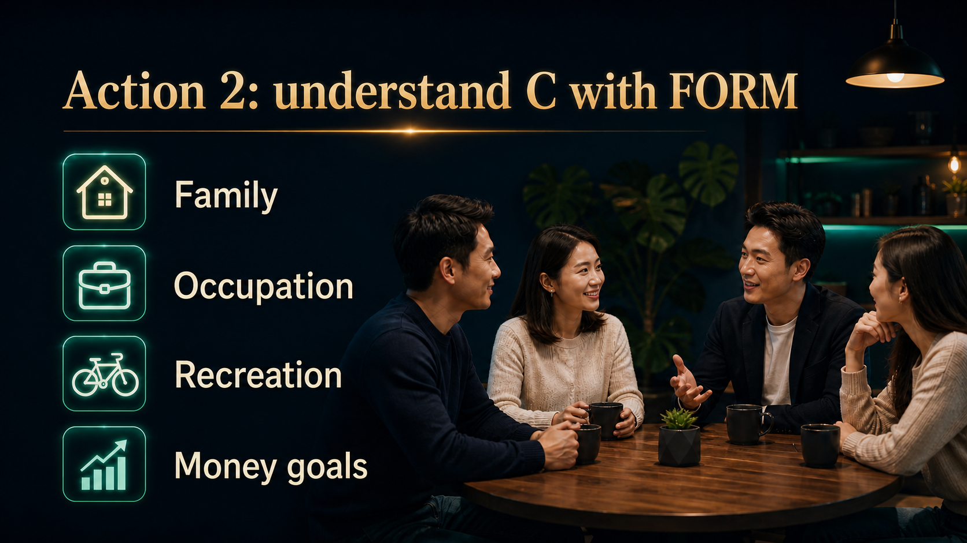
Notes:
FORM helps B understand C's life context. F is family, O is occupation, R is recreation or interests, and M is money goals. FORM is not an interrogation and it is not permission to collect unnecessary private information. It is a natural way to hear what matters most. Is the person exploring a product for family needs, or looking for additional income? Is time tight, or is budget the main concern? With this context, A can focus on what is relevant. The best FORM conversations happen naturally over time: listen to each answer before deciding whether another question is useful.
[Sources]
- 用户提供的《十大角色／ABC法则》原始课程内容。
- JS Loo 确认的现代化课程编排与成交协助立场。
- OpenAI Images 2.0 生成的完整图文课程画面。

Slide 14
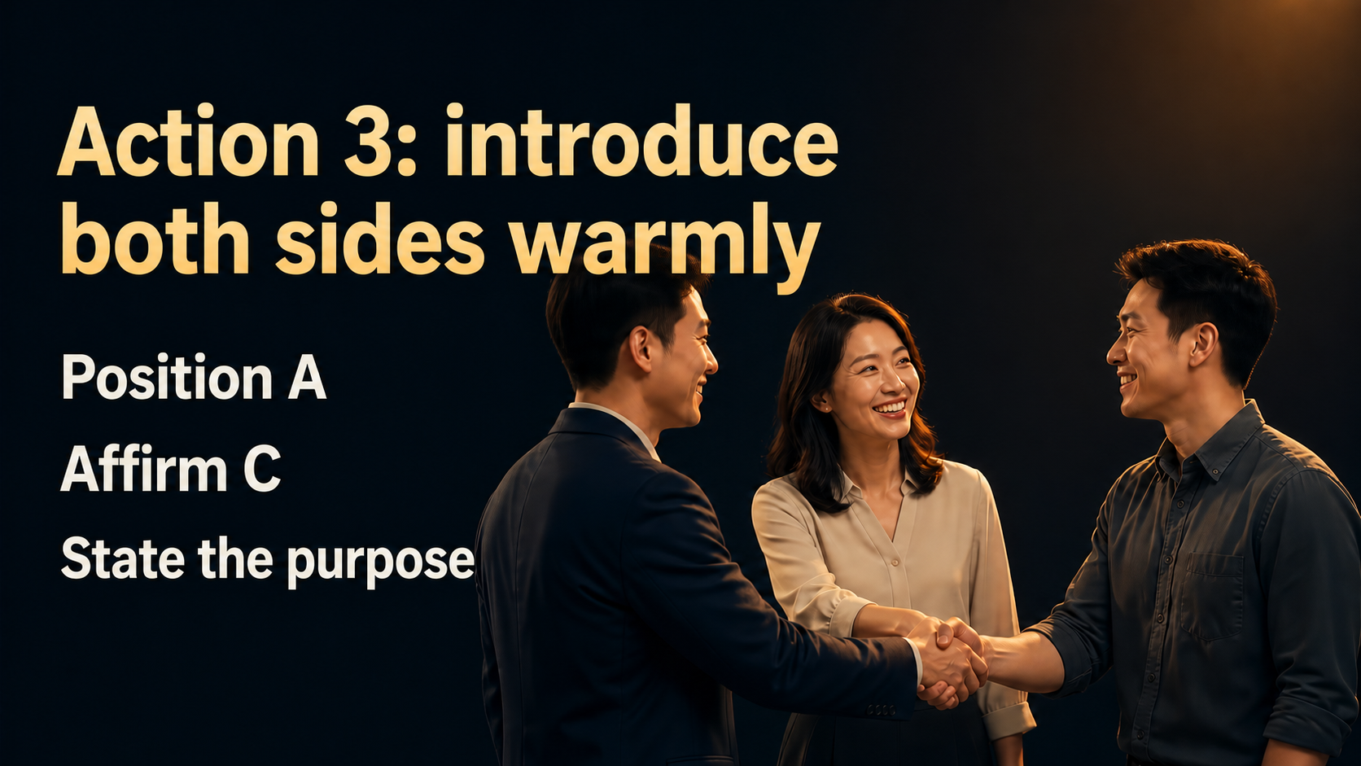
Notes:
A warm introduction should make both people comfortable in less than a minute. First mention one true reason you trust A. Then say something sincere about C. Finally, explain why you brought them together. For example: this is a partner I trust who has strong experience explaining the product; this is my friend who cares deeply about family wellbeing; today I hope we can clarify a few questions. Short, true and warm is enough. Then hand over with an open question such as: what is the first thing you hope to understand today? That lets A begin with the right priority.
[Sources]
- 用户提供的《十大角色／ABC法则》原始课程内容。
- JS Loo 确认的现代化课程编排与成交协助立场。
- OpenAI Images 2.0 生成的完整图文课程画面。

Slide 15
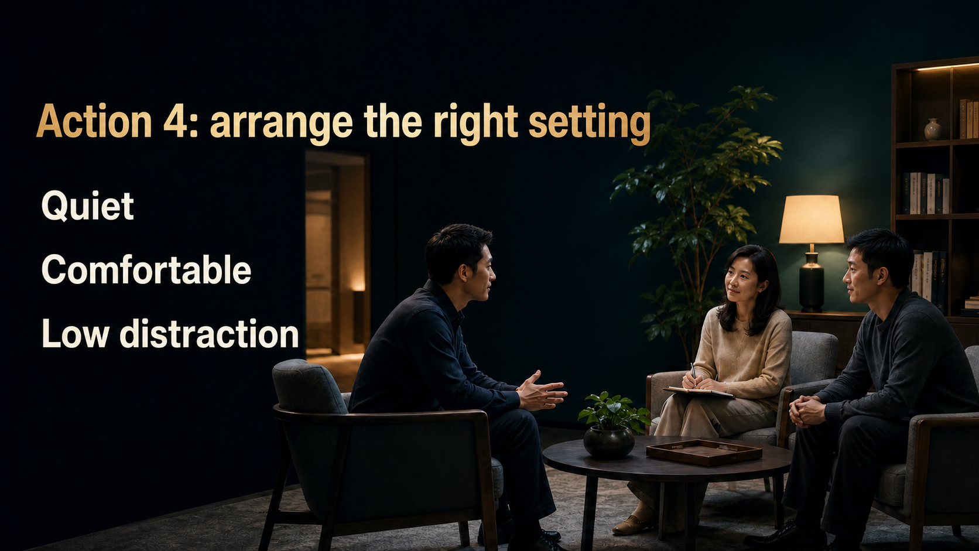
Notes:
The environment directly affects the conversation. It does not need to be luxurious, but it should be quiet, comfortable and free from constant interruption. Arrange the seats so C can see A naturally, while B stays near enough to maintain safety and connection. Silence the phones, prepare the material and agree on the time available. An orderly setting tells the customer that the meeting matters. Online conversations need the same care: test sound, camera and connection, and place the materials in the sequence they will be used. Professionalism is often felt through these small details.
[Sources]
- 用户提供的《十大角色／ABC法则》原始课程内容。
- JS Loo 确认的现代化课程编排与成交协助立场。
- OpenAI Images 2.0 生成的完整图文课程画面。

Slide 16
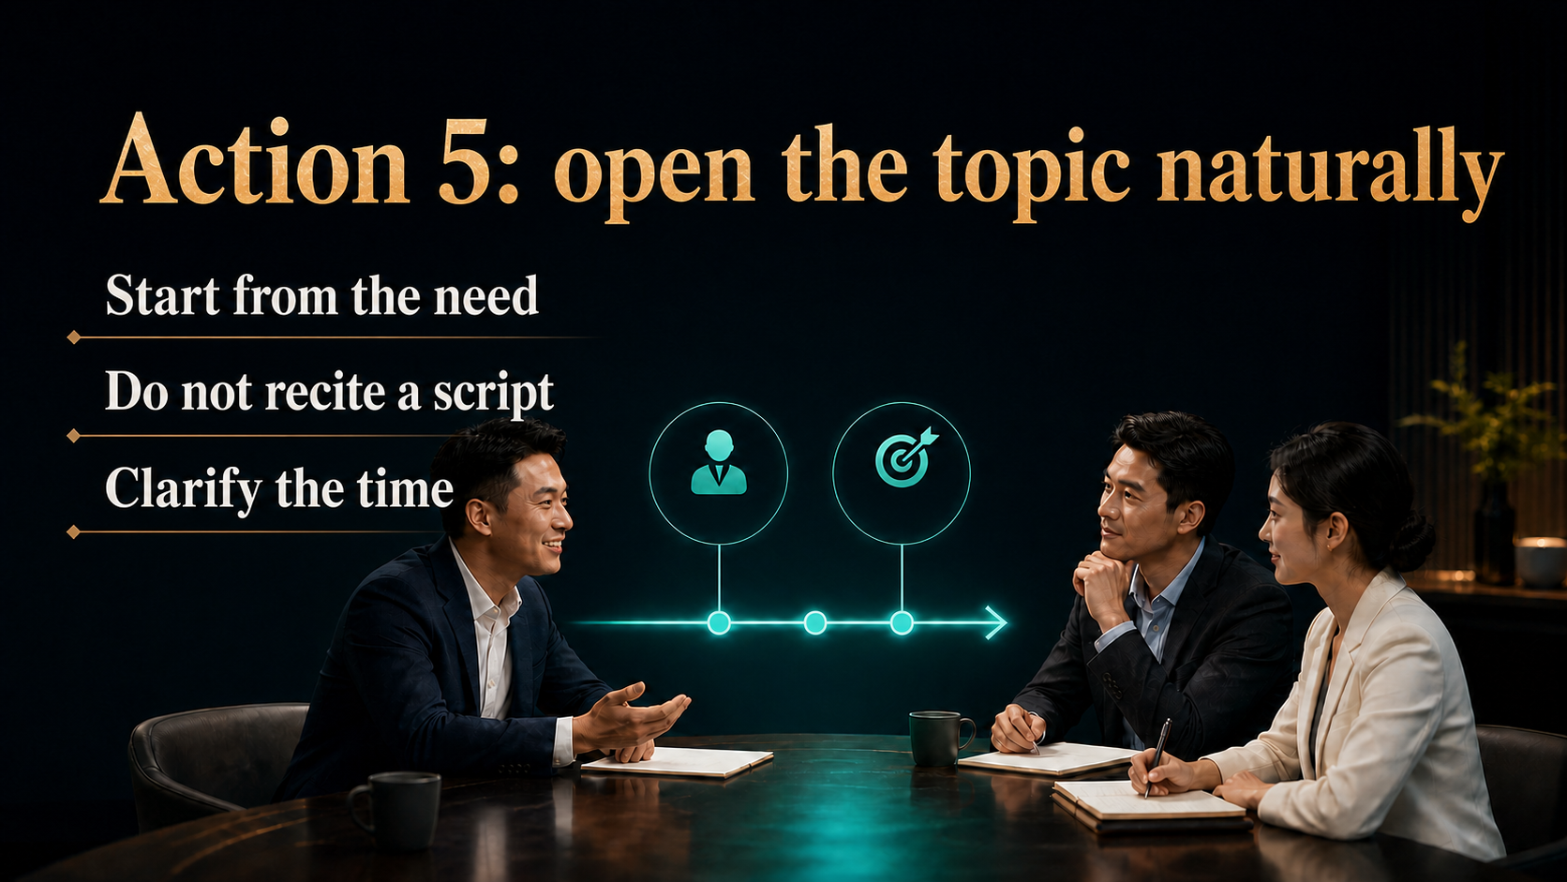
Notes:
The fastest way to make a conversation feel like a sales pitch is to recite a memorised opening. Start instead from the need C has already expressed and clarify the time. You might say: you mentioned that budget and correct usage are your two main concerns, so let us focus on those for about twenty minutes. C now knows what will happen and knows the questions will be addressed. A strong opening does not create artificial excitement. It reduces uncertainty and gives everyone a clear direction for the discussion.
[Sources]
- 用户提供的《十大角色／ABC法则》原始课程内容。
- JS Loo 确认的现代化课程编排与成交协助立场。
- OpenAI Images 2.0 生成的完整图文课程画面。

Slide 17
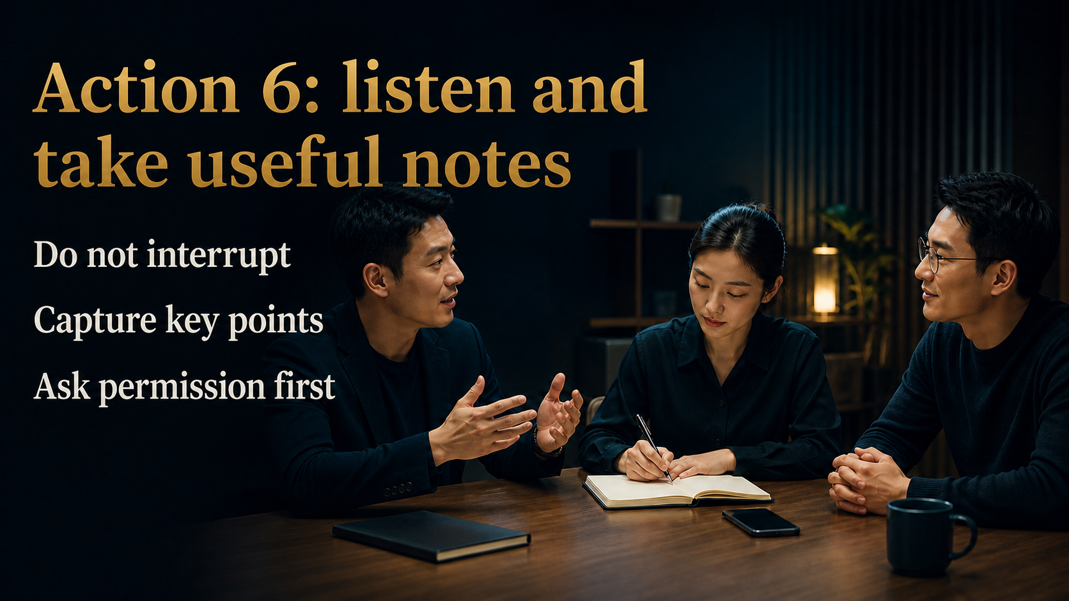
Notes:
While A explains, B's most important job is to listen. Do not check the phone and do not interrupt every time another thought appears. Record only the points C truly cares about. When appropriate, ask: may I note your questions so we can answer them one by one? The notes prevent concerns from being forgotten and help B learn from A. Record only necessary personal details and protect them carefully. Also observe non-verbal signals: when C leans forward, frowns or becomes quiet. Those signals often reveal the best next question.
[Sources]
- 用户提供的《十大角色／ABC法则》原始课程内容。
- JS Loo 确认的现代化课程编排与成交协助立场。
- OpenAI Images 2.0 生成的完整图文课程画面。

Slide 18
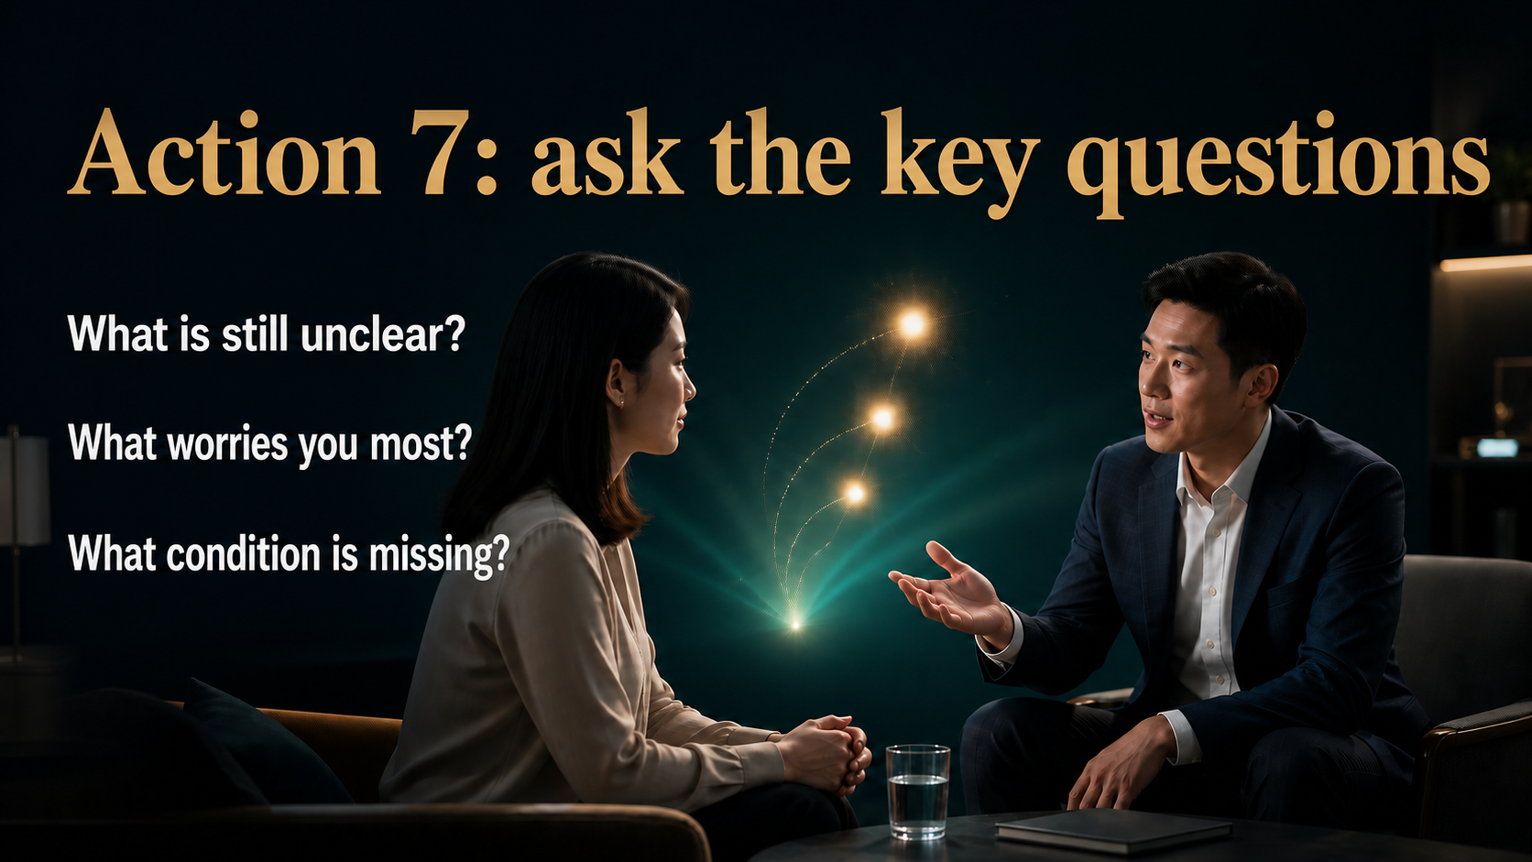
Notes:
A customer who asks nothing may still be confused or simply uncomfortable speaking. B can help the real questions surface without inventing objections. Three useful questions are: which part is still unclear? What concerns you most right now? If you were to begin, what condition is still missing? These questions turn silence into something we can discuss. Ask, then pause. Do not rush to fill the silence with another explanation. Valuable answers often come a few seconds later. Once the real concern is visible, A and B can solve the right problem instead of continuing to guess.
[Sources]
- 用户提供的《十大角色／ABC法则》原始课程内容。
- JS Loo 确认的现代化课程编排与成交协助立场。
- OpenAI Images 2.0 生成的完整图文课程画面。

Slide 19
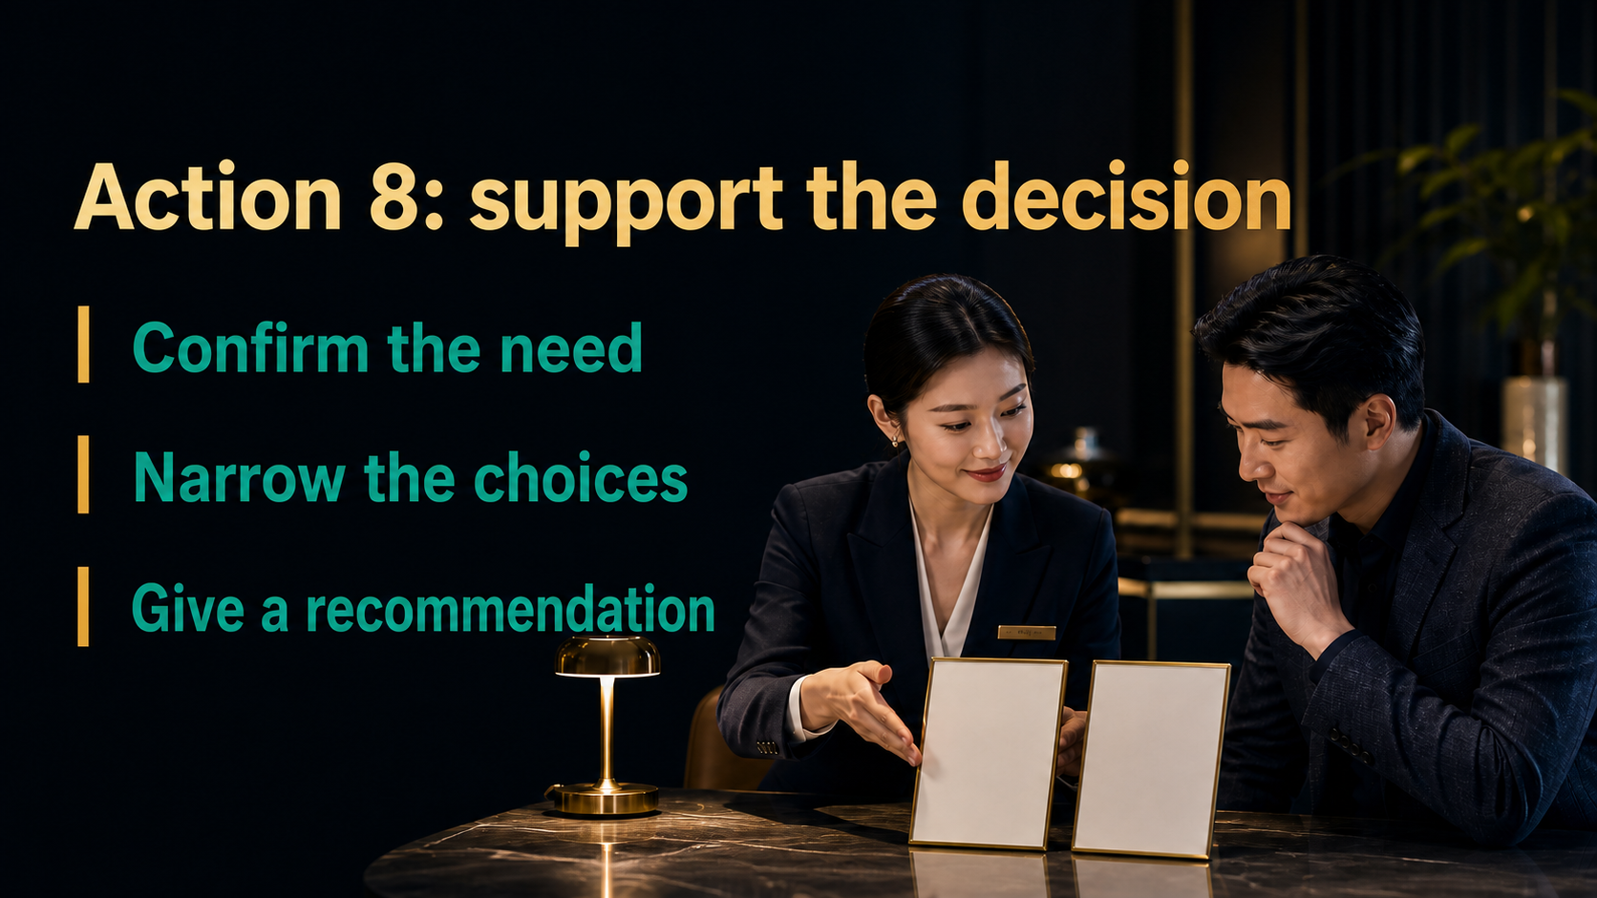
Notes:
Supporting the close is part of B's responsibility. A customer may already understand the value but stop because there are too many choices or because choosing wrongly feels risky. Confirm the need, narrow the options and make one clear recommendation based on the person's goal and budget. Professional service includes the courage to ask: if we have answered these concerns, are you comfortable starting now? Then stop speaking and let C answer. The question itself is not pressure. Pressure comes from hiding information, repeating demands or refusing to hear the answer.
[Sources]
- 用户提供的《十大角色／ABC法则》原始课程内容。
- JS Loo 确认的现代化课程编排与成交协助立场。
- OpenAI Images 2.0 生成的完整图文课程画面。

Slide 20

Notes:
Some customers do not lack an answer; they lack confidence to carry the answer. Saying take your time can leave them inside the same anxiety, while repeated pushing removes their sense of control. The better path is clear progress. Name the hesitation, confirm the real concern, offer a suitable starting point and explain who will follow up. You might say: it sounds as if the need is clear, but you are worried about choosing the wrong option. If we begin with the simplest plan that fits your budget and I stay with you through the first steps, would that feel more manageable?
[Sources]
- 用户提供的《十大角色／ABC法则》原始课程内容。
- JS Loo 确认的现代化课程编排与成交协助立场。
- OpenAI Images 2.0 生成的完整图文课程画面。

Slide 21
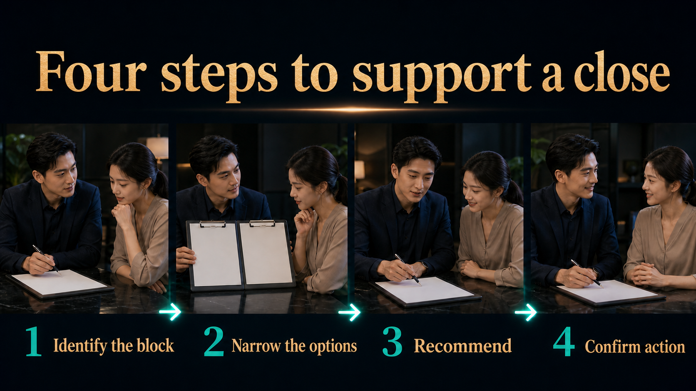
Notes:
Turn the close into four steps so it does not depend on courage in the moment. First, identify the block: is the concern the result, the budget or how to use it? Second, narrow the choices: which of these two fits better? Third, recommend: based on what you told me, I suggest starting with the basic option. Fourth, confirm action: now that the information is clear, shall we arrange it? These steps provide direction while preserving choice. If C does not act, identify which step remains unresolved so the next follow-up has a real purpose.
[Sources]
- 用户提供的《十大角色／ABC法则》原始课程内容。
- JS Loo 确认的现代化课程编排与成交协助立场。
- OpenAI Images 2.0 生成的完整图文课程画面。

Slide 22
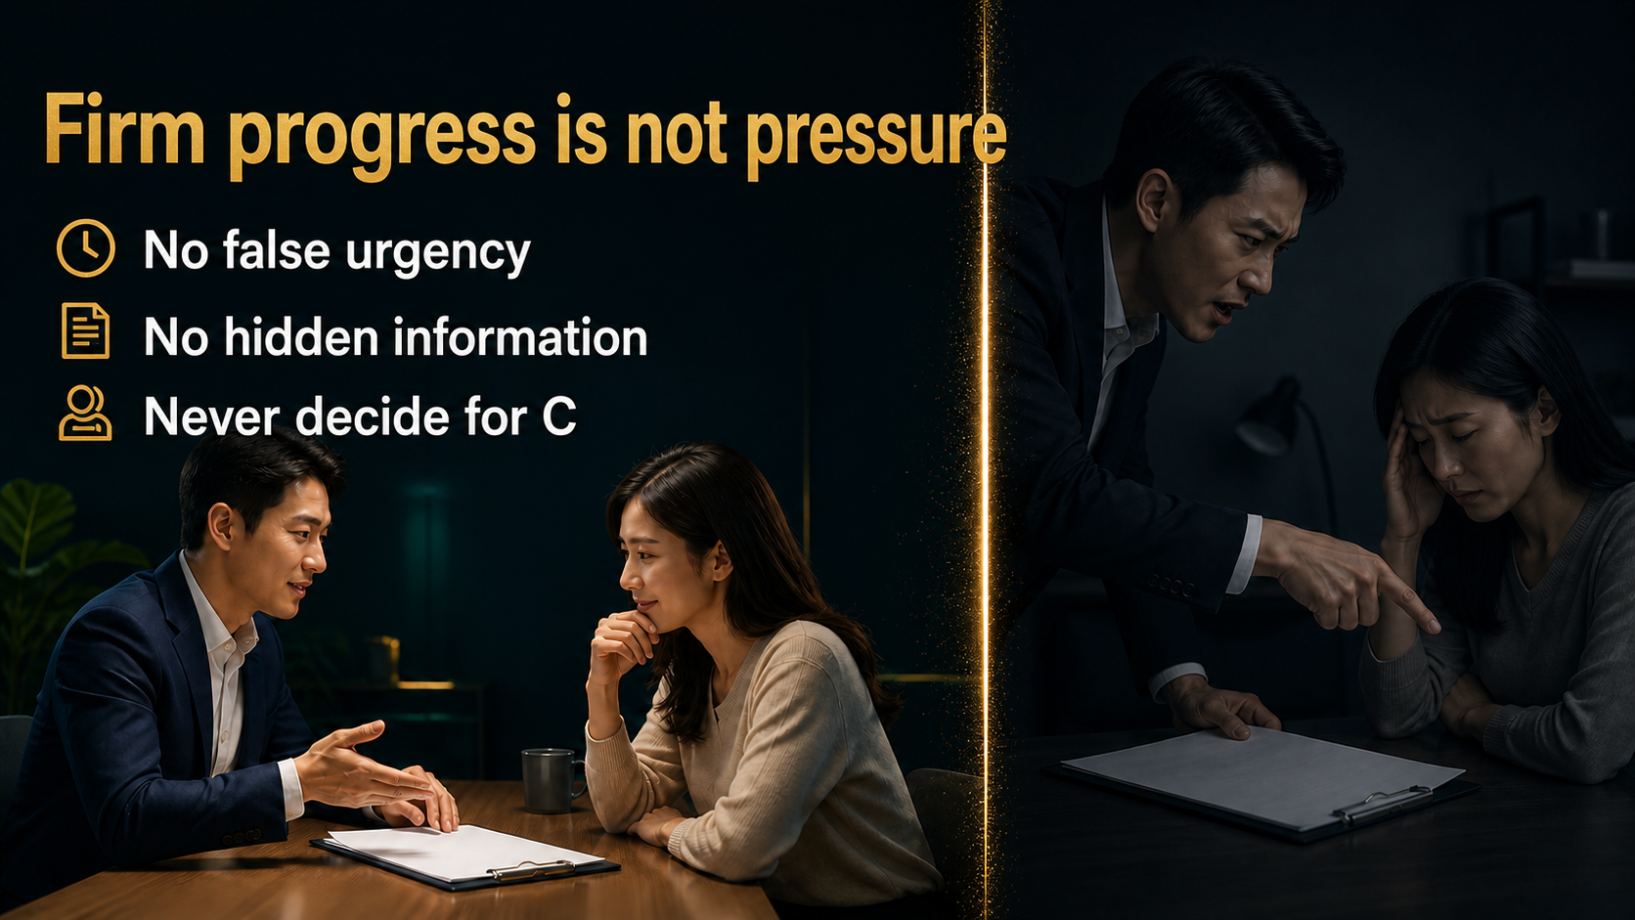
Notes:
The difference between firm guidance and pressure is the boundary. We can ask for a decision, bring out the form, help with the process and explore the reason for hesitation. We cannot create a false deadline, hide the price, usage or important conditions, or use the relationship to decide for C. A forced order may produce a short-term number and damage a long-term relationship. The strongest close leaves the customer feeling that the decision is still their own. A simple test is this: if C asks to pause, can we stop, listen and continue to serve?
[Sources]
- 用户提供的《十大角色／ABC法则》原始课程内容。
- JS Loo 确认的现代化课程编排与成交协助立场。
- OpenAI Images 2.0 生成的完整图文课程画面。

Slide 23

Notes:
Whether C acts today or not, do not end with the vague words keep in touch. Define three things: when the next contact happens, what it will cover and who will handle it. After a purchase, schedule a check on usage and experience. If the decision is pending, agree on the missing information. If there is business interest, arrange a more focused conversation. A clear next step reduces anxiety and proves that service continues after the sale. Put the time into both calendars while everyone is present, and repeat the purpose before leaving.
[Sources]
- 用户提供的《十大角色／ABC法则》原始课程内容。
- JS Loo 确认的现代化课程编排与成交协助立场。
- OpenAI Images 2.0 生成的完整图文课程画面。

Slide 24
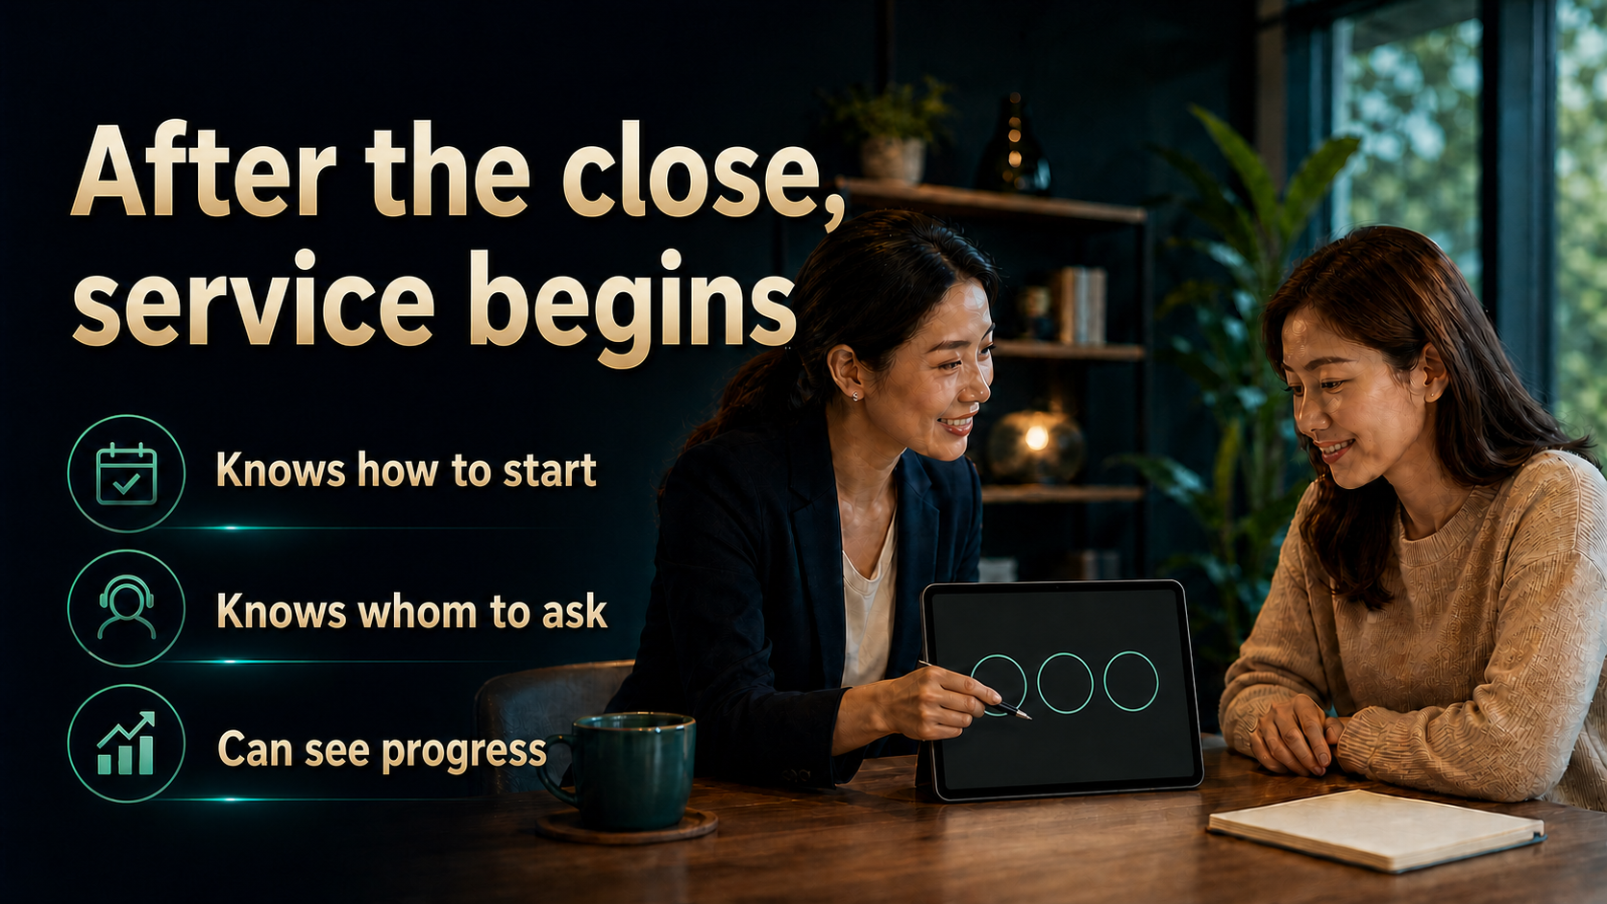
Notes:
Many disappointments happen because nobody follows through after the action. On the first day, confirm that the customer understands how to begin, has the necessary information and knows whom to contact. A few days later, ask about execution and experience before asking for referrals or another purchase. Continuous service turns one transaction into durable trust. The same applies to a new partner. Joining is only the starting point. The person needs a first action, a named guide and a review time. The order matters: understand the experience, solve the problem, then discuss the next step.
[Sources]
- 用户提供的《十大角色／ABC法则》原始课程内容。
- JS Loo 确认的现代化课程编排与成交协助立场。
- OpenAI Images 2.0 生成的完整图文课程画面。

Slide 25
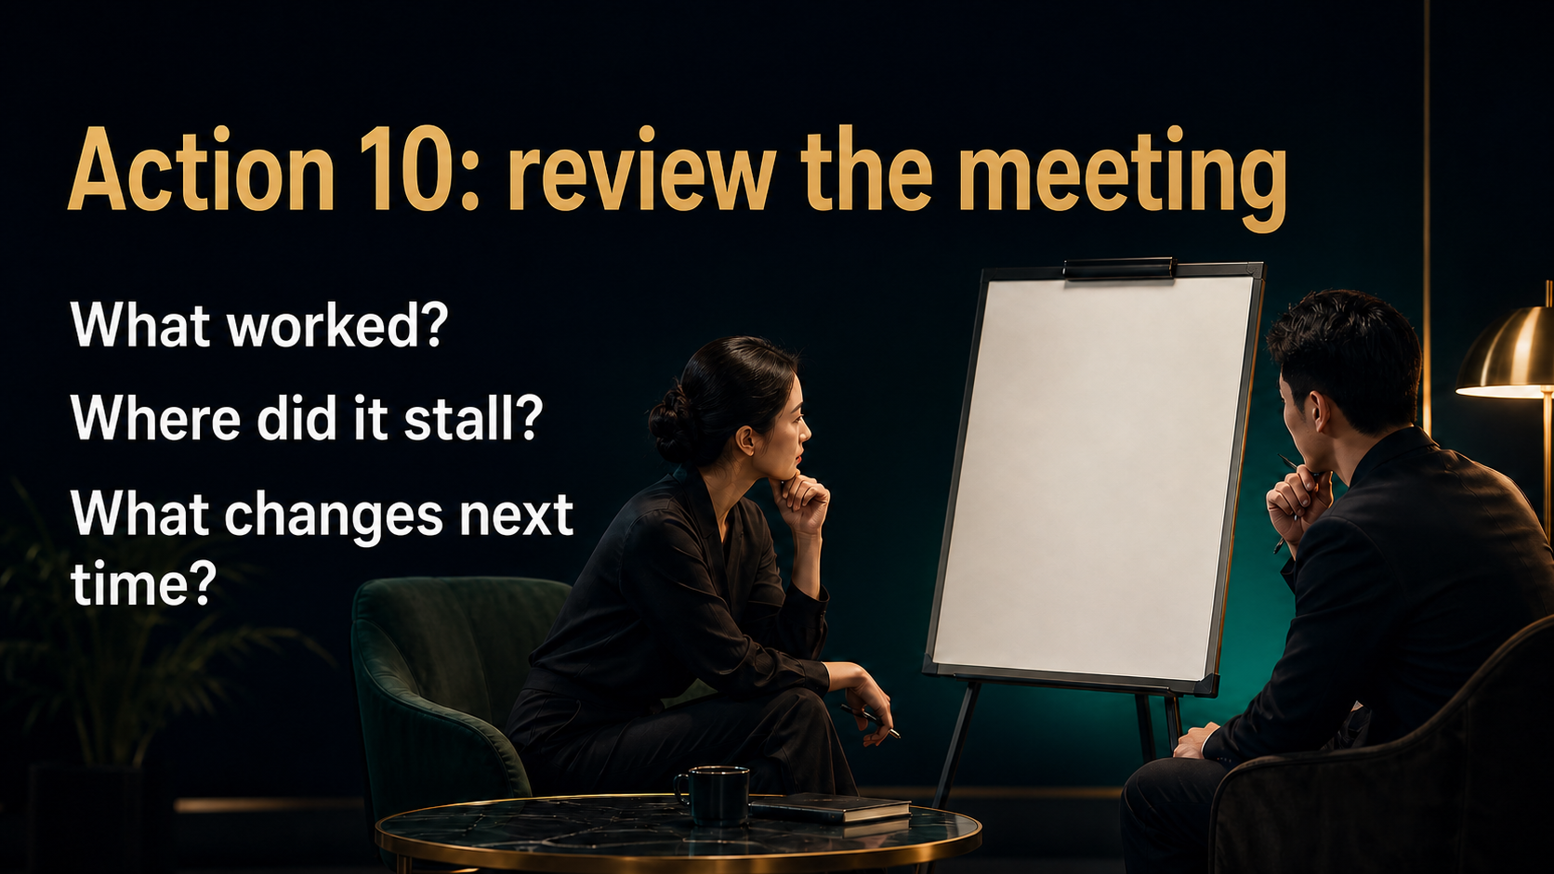
Notes:
After every ABC meeting, B and A should hold a short review. Start with what worked, identify where the conversation stalled, then choose one improvement for the next meeting. Did B give A accurate background? Did A uncover the real need? If C did not act, was a question unanswered or was trust still developing? The review is not about assigning blame. It converts one experience into a team asset. Finish with a concrete action: explain one section less, ask one better question, or confirm the budget context before the meeting. Reflection only matters when behaviour changes.
[Sources]
- 用户提供的《十大角色／ABC法则》原始课程内容。
- JS Loo 确认的现代化课程编排与成交协助立场。
- OpenAI Images 2.0 生成的完整图文课程画面。

Slide 26
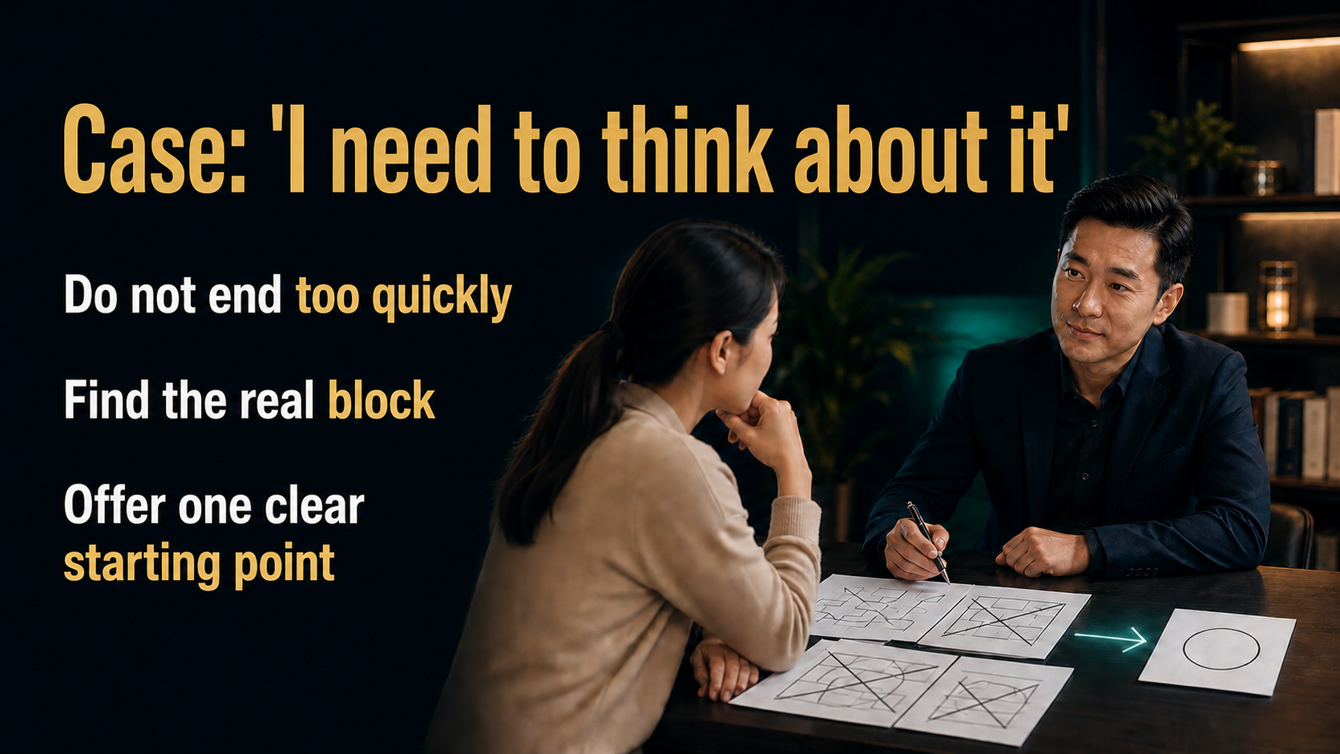
Notes:
Let us practise the most common response: I need to think about it. B should neither end immediately nor argue. Say: of course. To make sure we explained things clearly, which part do you need to think about most? If the issue is budget, return to budget. If it is correct usage, explain the follow-up. If there are too many choices, narrow them. Then give one practical recommendation and ask whether that starting point feels right. If the answer is still no, respect it and preserve the service relationship. A capable closer can guide firmly and also hear a clear refusal.
[Sources]
- 用户提供的《十大角色／ABC法则》原始课程内容。
- JS Loo 确认的现代化课程编排与成交协助立场。
- OpenAI Images 2.0 生成的完整图文课程画面。

Slide 27
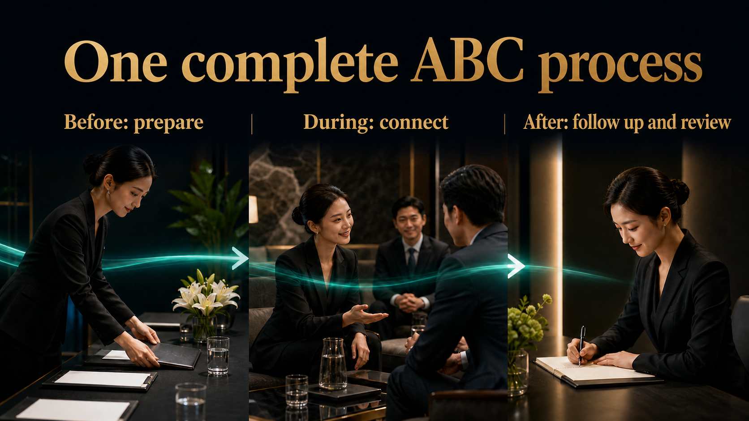
Notes:
Put the whole process together. Before the meeting, B understands C, chooses the right A, shares the useful background and arranges the setting. During the meeting, B introduces both sides, opens the topic, listens, records, brings out questions and supports a decision when the information is clear. Afterward, B schedules the next step, continues the service and reviews the meeting with A. ABC is not one impressive script. It is a complete process from preparation to service. A simple checklist before and after each meeting helps the team repeat important actions without becoming mechanical.
[Sources]
- 用户提供的《十大角色／ABC法则》原始课程内容。
- JS Loo 确认的现代化课程编排与成交协助立场。
- OpenAI Images 2.0 生成的完整图文课程画面。

Slide 28
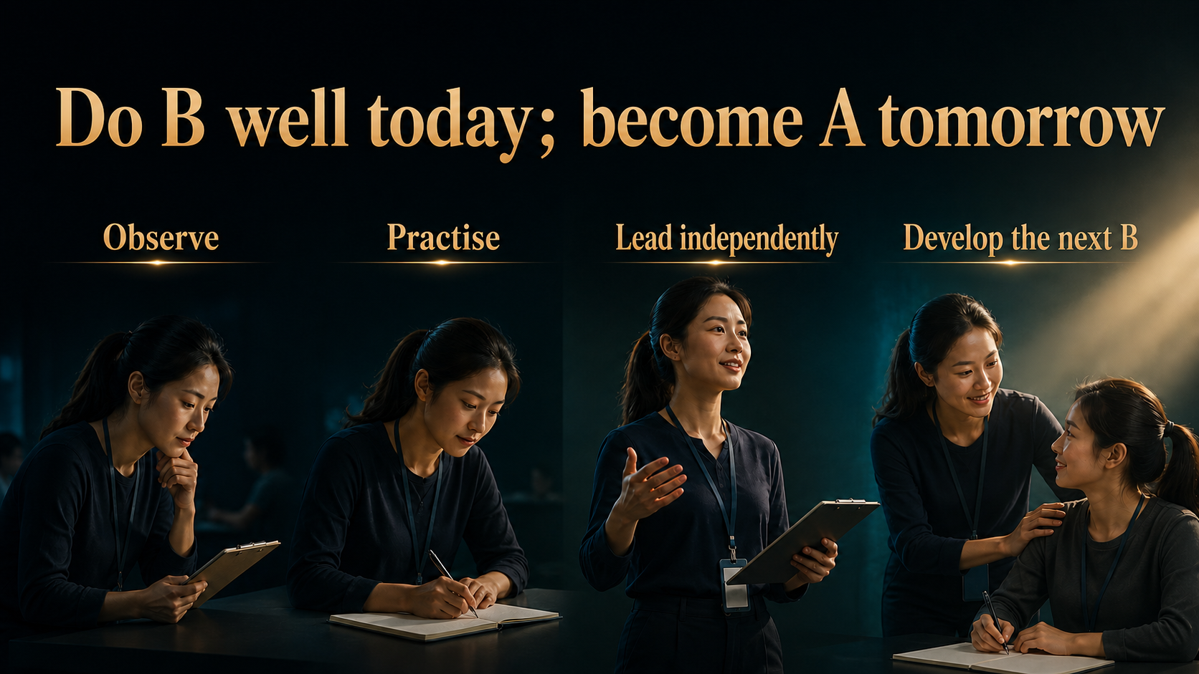
Notes:
ABC is also a people-development system. A newcomer begins as B and watches how A listens, explains and handles concerns. Then the newcomer practises one part, gradually becomes independent and eventually serves as A. Becoming A does not end the learning. A then develops the next B, so experience does not remain with one leader. Make the path concrete: observe the first meeting, lead the introduction in the second, explain one section in the third, and lead the fourth with A ready to support. Borrowed strength should eventually become personal capability.
[Sources]
- 用户提供的《十大角色／ABC法则》原始课程内容。
- JS Loo 确认的现代化课程编排与成交协助立场。
- OpenAI Images 2.0 生成的完整图文课程画面。

Slide 29
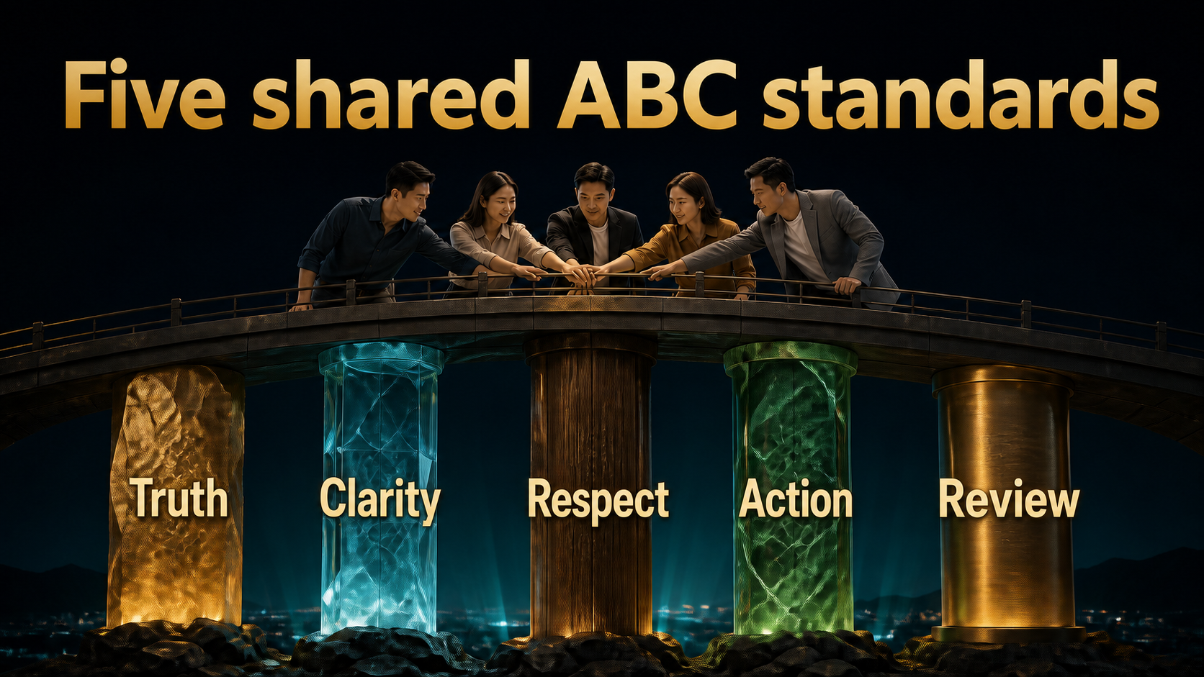
Notes:
To keep ABC from becoming different in every team, use five shared standards. Truth means we do not exaggerate A or the result. Clarity means roles, information and next actions are stated. Respect means C has questions and a real right to choose. Action means we do not only chat; when the information is clear, we ask for a decision. Review means every meeting leaves learning behind. All five are needed. Respect without action can stall. Action without respect becomes pressure. Experience without review keeps the whole team dependent on a few people.
[Sources]
- 用户提供的《十大角色／ABC法则》原始课程内容。
- JS Loo 确认的现代化课程编排与成交协助立场。
- OpenAI Images 2.0 生成的完整图文课程画面。

Slide 30

Notes:
The ABC Method should leave us with more than ten lines to memorise. It is a way for a team to work. A contributes relevant expertise. B connects trust and context. C makes a decision with clarity and respect. B's ten core actions give structure from preparation and explanation to closing, follow-up and review. People who use teamwork move faster; teams that protect boundaries travel farther. After this course, choose one customer who needs support, choose the right A and walk through the ten actions before the meeting. Real learning begins in the next conversation.
[Sources]
- 用户提供的《十大角色／ABC法则》原始课程内容。
- JS Loo 确认的现代化课程编排与成交协助立场。
- OpenAI Images 2.0 生成的完整图文课程画面。

