Slide 1

Notes:
EDUCATION SYSTEM 06
Welcome to NP642 Education System Six: Six Advantages. This course answers two practical questions: why is direct selling worth serious consideration, and why must a business platform be evaluated through the company, team, platform, track record, direction and market? By the end, you should be able to explain the opportunity with one complete logic, not merely repeat six headings.
Explain verified facts and business logic first, then connect them to an executable NP642 practice. Do not promise income or imply that individual results are typical.
[Sources]
- OpenAI Image 2.0 language-localized course visual.

Slide 2

Notes:
WHY IS DIRECT SELLING WORTH DOING?
Why is direct selling worth doing? Not because it is easy, and certainly not because income appears automatically after joining. Its real value is that ordinary people can begin with lower fixed costs, learn to serve customers, build trust and gradually develop a business of their own. Judge the opportunity by whether it can accumulate customers, capabilities and relationships, not only by today's income.
Explain verified facts and business logic first, then connect them to an executable NP642 practice. Do not promise income or imply that individual results are typical.
[Sources]
- https://dsam.org.my/what-is-direct-selling/
- https://mobile.naturally-plus.com/my/en/opportunity/compensation/

Slide 3

Notes:
DIRECT SELLING TRANSFERS VALUE BETWEEN PEOPLE
Direct selling is not about recruiting everyone you meet. It is the transfer of value between people. Begin with a genuine product experience, explain it clearly, provide ongoing service and let satisfaction create referrals. When the order is wrong, it becomes pressure selling. When the order is right, trust grows. Listen first, then decide whether product, service or business is the right entry point.
Explain verified facts and business logic first, then connect them to an executable NP642 practice. Do not promise income or imply that individual results are typical.
[Sources]
- https://dsam.org.my/what-is-direct-selling/

Slide 4

Notes:
LOWER FIXED COSTS. BUILD REAL CAPABILITY.
Traditional businesses often begin with rent, renovation, employees and inventory. Direct selling allows us to begin without carrying those fixed costs immediately, so resources can go into learning, product experience, communication and customer service. Lower cost does not mean zero cost. Time, travel, activities and training still require discipline. The advantage is room to test on a small scale and improve from real feedback.
Explain verified facts and business logic first, then connect them to an executable NP642 practice. Do not promise income or imply that individual results are typical.
[Sources]
- https://mobile.naturally-plus.com/my/en/opportunity/compensation/

Slide 5

Notes:
TRUST IS THE MOST IMPORTANT CHANNEL
Advertising may make someone notice us once, but trust is what makes a customer stay. The strongest channel is not the loudest voice. It is understanding the customer, keeping promises and remaining responsible when questions arise. Every follow-up should add value: answer a question, clarify correct use or check the actual experience. Do not reduce follow-up to asking whether someone is ready to buy.
Explain verified facts and business logic first, then connect them to an executable NP642 practice. Do not promise income or imply that individual results are typical.
[Sources]
- OpenAI Image 2.0 language-localized course visual.

Slide 6

Notes:
ONE PERSON CAN OPERATE WITH A COMPLETE SYSTEM
A partner serves customers at the front while the company's digital systems support the back end. Registration, orders, delivery, records and bonus calculations do not need to be rebuilt by each individual. That allows us to focus on the human work: understanding needs, explaining clearly, serving and following up. The system handles infrastructure, but it does not make the business happen automatically.
Explain verified facts and business logic first, then connect them to an executable NP642 practice. Do not promise income or imply that individual results are typical.
[Sources]
- https://mobile.naturally-plus.com/my/en/opportunity/compensation/

Slide 7

Notes:
DIRECT SELLING IS NOT A FRINGE MARKET
Direct selling is not a fringe market. WFDSA reported 2024 global retail sales of about 163.9 billion US dollars, with Malaysia ranked fifth among the ten largest markets. This proves that real demand exists. It does not prove that customers will automatically come to us, nor that every participant will succeed. Market size should create informed confidence, not fantasy.
Explain verified facts and business logic first, then connect them to an executable NP642 practice. Do not promise income or imply that individual results are typical.
[Sources]
- https://wfdsa.org/global-statistics/

Slide 8

Notes:
WORTH DOING DOES NOT MEAN EVERYONE EARNS
Here is an important truth: a worthwhile opportunity does not mean everyone earns money. Direct selling is not salaried employment, and no fixed pay is waiting at the end of the month. Results depend on customer value, learning, effort, expenses, local conditions and time. Saying this early creates a healthier team. We look for people willing to learn and act, not people attracted by unrealistic promises.
Explain verified facts and business logic first, then connect them to an executable NP642 practice. Do not promise income or imply that individual results are typical.
[Sources]
- https://www.ftc.gov/business-guidance/resources/business-guidance-concerning-multi-level-marketing

Slide 9

Notes:
A GOOD MODEL STILL REQUIRES THE RIGHT COMPANY
Even if we believe in the direct-selling model, we must still choose the company carefully. Check legal status, stability, product quality, team systems, operating efficiency, verifiable results and whether future demand remains. Validate the platform before investing effort, and understand the rules before teaching duplication. A correct choice reduces many costs that cannot be repaired later.
Explain verified facts and business logic first, then connect them to an executable NP642 practice. Do not promise income or imply that individual results are typical.
[Sources]
- OpenAI Image 2.0 language-localized course visual.

Slide 10

Notes:
NATURALLY PLUS × NP642: SIX ADVANTAGES
The six advantages form one complete evaluation. Company management determines the foundation. The system team provides the method. The business platform determines efficiency. Track record provides evidence. Business direction determines where we are going. Market space determines long-term possibility. For every advantage, ask three questions: what problem does it solve, what evidence supports it, and how do we apply it in daily business?
Explain verified facts and business logic first, then connect them to an executable NP642 practice. Do not promise income or imply that individual results are typical.
[Sources]
- OpenAI Image 2.0 language-localized course visual.

Slide 11

Notes:
ADVANTAGE ONE
Advantage one is world-quality company management. A long-term business cannot be judged by how exciting one event feels. We must ask whether the company can manage products, quality, regulation and cross-border service consistently. The company is the foundation; partners are the builders. When presenting the company, explain how its foundations reduce uncertainty instead of stacking dates and awards into a wall of information.
Explain verified facts and business logic first, then connect them to an executable NP642 practice. Do not promise income or imply that individual results are typical.
[Sources]
- OpenAI Image 2.0 language-localized course visual.

Slide 12

Notes:
FROM 1999 TO TODAY
Naturally Plus was established in Japan in 1999 and has continued through different economic cycles and market changes. Time does not prove that a company is perfect, but it tests the ability to operate, adapt and continue serving. We use the establishment year as evidence of operating history, not as a guarantee of personal success. Individual results still return to learning, service, action and long-term commitment.
Explain verified facts and business logic first, then connect them to an executable NP642 practice. Do not promise income or imply that individual results are typical.
[Sources]
- https://www.naturally-plus.com/jp/ja/company/overview/outline/

Slide 13

Notes:
OPERATING LEGALLY IN MALAYSIA
In Malaysia, Naturally Plus Malaysia has company number 200801033602 and direct sales licence AJL931789. These are verifiable business foundations, not decorative claims. Partners should keep official registration details and checking methods ready. Letting someone verify the information is stronger than asking for blind belief. Legality and transparency are the minimum standard for lasting trust.
Explain verified facts and business logic first, then connect them to an executable NP642 practice. Do not promise income or imply that individual results are typical.
[Sources]
- https://www.naturally-plus.com/my/en/company/outline/

Slide 14

Notes:
QUALITY COMES FROM PROCESS
Quality is not an adjective printed on a package. It comes from a chain of processes: raw-material checks, controlled production, Health Food GMP and food-safety management standards. We should translate these standards into customer language: materials are checked, production is controlled and finished products are traceable. Quality is managed, not left to chance. Facts are more persuasive than unprovable superlatives.
Explain verified facts and business logic first, then connect them to an executable NP642 practice. Do not promise income or imply that individual results are typical.
[Sources]
- https://www.naturally-plus.com/jp/ja/products/mirto_plus/quality/
- https://www.naturally-plus.com/my/en/products/izumio/quality_control/

Slide 15
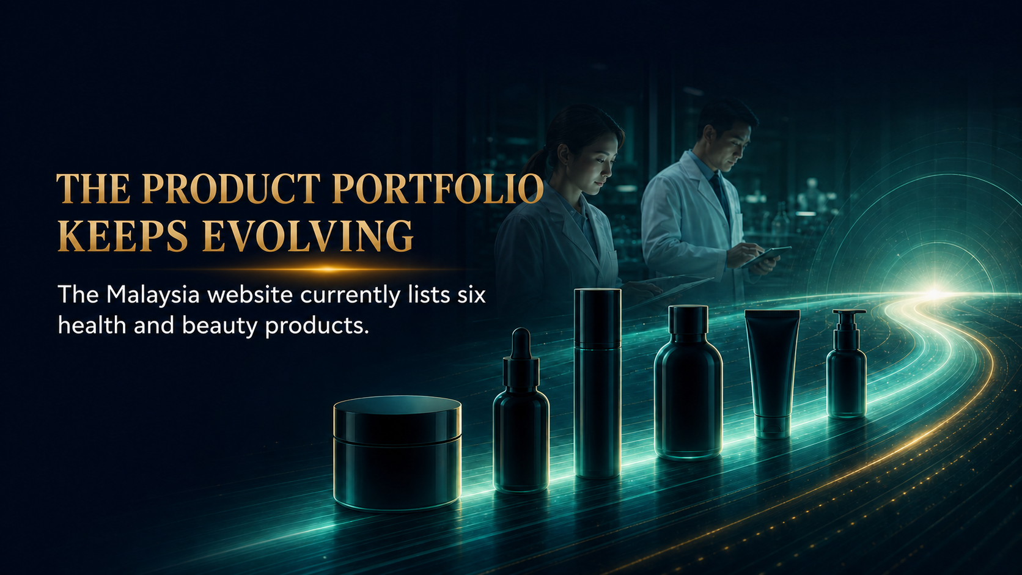
Notes:
THE PRODUCT PORTFOLIO KEEPS EVOLVING
A company cannot rely on one old product forever. The Malaysian website currently lists six health and beauty products, showing that the portfolio continues to be managed and developed. More products do not mean everyone needs everything. Start by identifying a real need, select the appropriate product and explain only functions supported by proper information. Every product must be learned separately.
Explain verified facts and business logic first, then connect them to an executable NP642 practice. Do not promise income or imply that individual results are typical.
[Sources]
- https://mobile.naturally-plus.com/my/en/

Slide 16

Notes:
REACHING 150+ COUNTRIES AND REGIONS
Official information states that products can reach more than 150 countries and regions through physical operations and NPGL. This matters when families, friends or partners move across borders. Global reach means wider service and delivery possibilities, not that everyone in the world is automatically our customer. Always confirm local availability, rules and conditions before making a promise.
Explain verified facts and business logic first, then connect them to an executable NP642 practice. Do not promise income or imply that individual results are typical.
[Sources]
- https://www.naturally-plus.com/my/en/company/npgl/

Slide 17

Notes:
A GOOD COMPANY GIVES EFFORT A FOUNDATION
The first advantage can be summarised in four words: legal, quality, continuity and global reach. A good company does not do the business for us, but it gives effort a stable place to accumulate. Every partner should learn to explain in three minutes whether the company is legal, stable and serious about quality. Verifiable foundations should come before vision and excitement.
Explain verified facts and business logic first, then connect them to an executable NP642 practice. Do not promise income or imply that individual results are typical.
[Sources]
- OpenAI Image 2.0 language-localized course visual.

Slide 18

Notes:
ADVANTAGE TWO
Advantage two is a professionally operated system team. One person can start, but few people can discover every correct method alone. A good system turns experience into courses, tools, demonstrations and coaching. New partners first practise a proven process, then develop their own natural expression. They do not need to invent the business from zero or improvise everything from day one.
Explain verified facts and business logic first, then connect them to an executable NP642 practice. Do not promise income or imply that individual results are typical.
[Sources]
- OpenAI Image 2.0 language-localized course visual.

Slide 19

Notes:
THE COMPANY PROVIDES THE PLATFORM. THE TEAM PROVIDES THE METHOD.
The company and the team have different responsibilities. Naturally Plus manages products, the compensation plan, orders and the back end. NP642 provides education, tools, training and support. For product, policy or bonus questions, return to official company information. For invitation, follow-up and people-development questions, return to the team system. Clear roles prevent confusion and personal guessing.
Explain verified facts and business logic first, then connect them to an executable NP642 practice. Do not promise income or imply that individual results are typical.
[Sources]
- User-provided NP642 FCC Six Advantages source material (2022-09-01).

Slide 20

Notes:
TURN EXPERIENCE INTO PRACTICE MATERIAL
A professional system converts the experience of a few into material that many can practise. Filing organises customer and follow-up information. The Ten Education Systems create common language. Demonstrations show a clear structure, while action processes turn learning into execution. Material must be used, not collected. After every lesson, schedule one practice, one real application and one review.
Explain verified facts and business logic first, then connect them to an executable NP642 practice. Do not promise income or imply that individual results are typical.
[Sources]
- User-provided NP642 FCC Six Advantages source material (2022-09-01).

Slide 21

Notes:
EVERY PARTNER KNOWS THE NEXT STEP
A system should help partners know what comes next every week. Sharing creates contact, training builds skill, activities increase experience, follow-up turns interest into understanding, and review improves the next attempt. A practical weekly focus is simple: serve existing customers, discover new needs and develop one partner. Fewer, clearer actions usually produce more stable execution.
Explain verified facts and business logic first, then connect them to an executable NP642 practice. Do not promise income or imply that individual results are typical.
[Sources]
- User-provided NP642 FCC Six Advantages source material (2022-09-01).

Slide 22

Notes:
A GOOD TEAM DOES NOT DEPEND ON A FEW STARS
A healthy team should not depend on one or two gifted speakers. It continually develops partners who can perform, teach and lead. One test is whether a newcomer can find the materials, attend training and identify the next step without depending entirely on the sponsor. When ordinary people can repeat the method, the team becomes a system rather than a personal performance.
Explain verified facts and business logic first, then connect them to an executable NP642 practice. Do not promise income or imply that individual results are typical.
[Sources]
- User-provided NP642 FCC Six Advantages source material (2022-09-01).

Slide 23

Notes:
ADVANTAGE THREE
Advantage three is a scalable entrepreneurship platform. Scaling is not one person doing the work of ten. It is ten people learning the same simple, correct and sustainable actions. Customers receive value, partners learn to serve and the method continues through teaching. The platform reduces complexity, the team duplicates capability, and each person remains responsible for honest action.
Explain verified facts and business logic first, then connect them to an executable NP642 practice. Do not promise income or imply that individual results are typical.
[Sources]
- OpenAI Image 2.0 language-localized course visual.

Slide 24

Notes:
BUY ONLY THE PRODUCTS YOU NEED
Official operating information emphasises buying only products that are needed. Partners do not need to stock inventory, meet a monthly quota or handle payments between customers. This protects cash flow and also protects team culture. The business should begin with genuine consumption and real service, not by transferring financial pressure to the next partner. Purchasing should always remain rational.
Explain verified facts and business logic first, then connect them to an executable NP642 practice. Do not promise income or imply that individual results are typical.
[Sources]
- https://mobile.naturally-plus.com/my/en/opportunity/compensation/

Slide 25

Notes:
FOCUS ON PEOPLE, NOT LOGISTICS
When the company manages orders, delivery, records and bonus calculations, partners do not need to turn their homes into warehouses. Time saved from repetitive logistics should return to high-value work: understanding customers, explaining well, recording feedback and following up at the right time. The platform handles complexity, but trust and service must still be delivered personally.
Explain verified facts and business logic first, then connect them to an executable NP642 practice. Do not promise income or imply that individual results are typical.
[Sources]
- https://mobile.naturally-plus.com/my/en/opportunity/compensation/

Slide 26

Notes:
REAL SCALING DUPLICATES CAPABILITY
Real scaling happens when capability is duplicated. A customer receives value, one partner learns the correct service process and then teaches the next person. We duplicate principles and processes, not personalities. Some people communicate face to face, others work well online, but the standards of honest experience, clear explanation, ongoing service and consistent action must remain the same.
Explain verified facts and business logic first, then connect them to an executable NP642 practice. Do not promise income or imply that individual results are typical.
[Sources]
- OpenAI Image 2.0 language-localized course visual.

Slide 27

Notes:
THE PLATFORM AMPLIFIES THE RIGHT ACTIONS
A platform is an amplifier. It amplifies whatever is repeated, so we should amplify product value, service quality and system execution, not pressure or exaggeration. Before accelerating, check customer satisfaction, follow-up quality and newcomer training. If the foundation is weak, speed only enlarges the problem. All three gears must move together for healthy growth.
Explain verified facts and business logic first, then connect them to an executable NP642 practice. Do not promise income or imply that individual results are typical.
[Sources]
- OpenAI Image 2.0 language-localized course visual.

Slide 28

Notes:
ADVANTAGE FOUR
Advantage four is a track record that can be verified. Results can build confidence, but only when presented correctly. Company history, legal operation, international reach and continuous updates are verifiable foundations. A personal award, team size or performance from one period describes specific conditions; it does not automatically represent today or guarantee another person's outcome.
Explain verified facts and business logic first, then connect them to an executable NP642 practice. Do not promise income or imply that individual results are typical.
[Sources]
- OpenAI Image 2.0 language-localized course visual.

Slide 29

Notes:
A TRACK RECORD IS MORE THAN AN AWARD PHOTO
When you see an impressive number, ask four questions: who is the source, what is the date, how is it defined, and can someone verify it again? An award photo may inspire, but it cannot prove a complete business result. Evidence that can answer follow-up questions is the evidence that deserves to build trust. Transparency makes a business story stronger.
Explain verified facts and business logic first, then connect them to an executable NP642 practice. Do not promise income or imply that individual results are typical.
[Sources]
- https://www.ftc.gov/business-guidance/resources/business-guidance-concerning-multi-level-marketing

Slide 30

Notes:
FOUR CURRENTLY VERIFIABLE FOUNDATIONS
Four current foundations can be verified clearly: the company was established in 1999, operates legally in Malaysia, reaches more than 150 countries and regions, and continues to provide information through its official website. Build a shared evidence list for the team with official pages, registration checks and current product information. Review and update it regularly.
Explain verified facts and business logic first, then connect them to an executable NP642 practice. Do not promise income or imply that individual results are typical.
[Sources]
- https://www.naturally-plus.com/jp/ja/company/overview/outline/
- https://www.naturally-plus.com/my/en/company/outline/
- https://www.naturally-plus.com/my/en/company/npgl/

Slide 31

Notes:
OLD RESULTS INFORM. THEY DO NOT PROVE TODAY.
Old rankings, membership numbers, sales, rewards and income may explain history, but they must not be presented as current facts without verification. State clearly that an old result belongs to a particular period. Honesty does not weaken the opportunity; it attracts more mature partners. We would rather omit one number than damage trust with one inaccurate number.
Explain verified facts and business logic first, then connect them to an executable NP642 practice. Do not promise income or imply that individual results are typical.
[Sources]
- User-provided NP642 FCC Six Advantages source material (2022-09-01).

Slide 32

Notes:
EVIDENCE BUILDS CONFIDENCE, NOT GUARANTEES
Evidence should create reasonable confidence, not an income guarantee. People differ in ability, effort, expenses, market conditions and time. We can say that the platform offers an opportunity while also explaining that results depend on individual action. Separating opportunity from guarantee is a standard every long-term business must protect. Honest language is one of our strongest assets.
Explain verified facts and business logic first, then connect them to an executable NP642 practice. Do not promise income or imply that individual results are typical.
[Sources]
- https://www.ftc.gov/business-guidance/resources/business-guidance-concerning-multi-level-marketing

Slide 33

Notes:
ADVANTAGE FIVE
Advantage five is a business direction aligned with future trends. A trend is not simply a fashionable word; it is a continuing change in customer behaviour. Healthy ageing, digital transactions and community trust are developing together. We should observe how people discover information, purchase products and maintain relationships, then build a business that serves those real changes.
Explain verified facts and business logic first, then connect them to an executable NP642 practice. Do not promise income or imply that individual results are typical.
[Sources]
- OpenAI Image 2.0 language-localized course visual.

Slide 34

Notes:
HEALTHY AGEING IS A LONG-TERM SOCIAL NEED
The World Health Organization states that by 2030, one in six people worldwide will be aged 60 or over. Ageing does not equal disease, but societies will pay increasing attention to nutrition, mobility, health management and quality of life. Our role is not to create fear. It is to provide understandable, sustainable choices that respond to genuine daily needs.
Explain verified facts and business logic first, then connect them to an executable NP642 practice. Do not promise income or imply that individual results are typical.
[Sources]
- https://www.who.int/news-room/fact-sheets/detail/ageing-and-health

Slide 35

Notes:
DIGITAL TRANSACTIONS CONTINUE TO GROW
Malaysia's official statistics reported 2024 e-commerce income of 1.2881 trillion ringgit, up 8.8 percent year on year. Digital tools can organise information, schedule follow-up and support cross-border communication. They improve efficiency, but they do not replace trust. The quality of information and the human experience of service still determine whether customers remain.
Explain verified facts and business logic first, then connect them to an executable NP642 practice. Do not promise income or imply that individual results are typical.
[Sources]
- https://www.dosm.gov.my/site/downloadrelease?id=usage-of-ict-and-e-commerce-by-establishment2025&lang=English

Slide 36
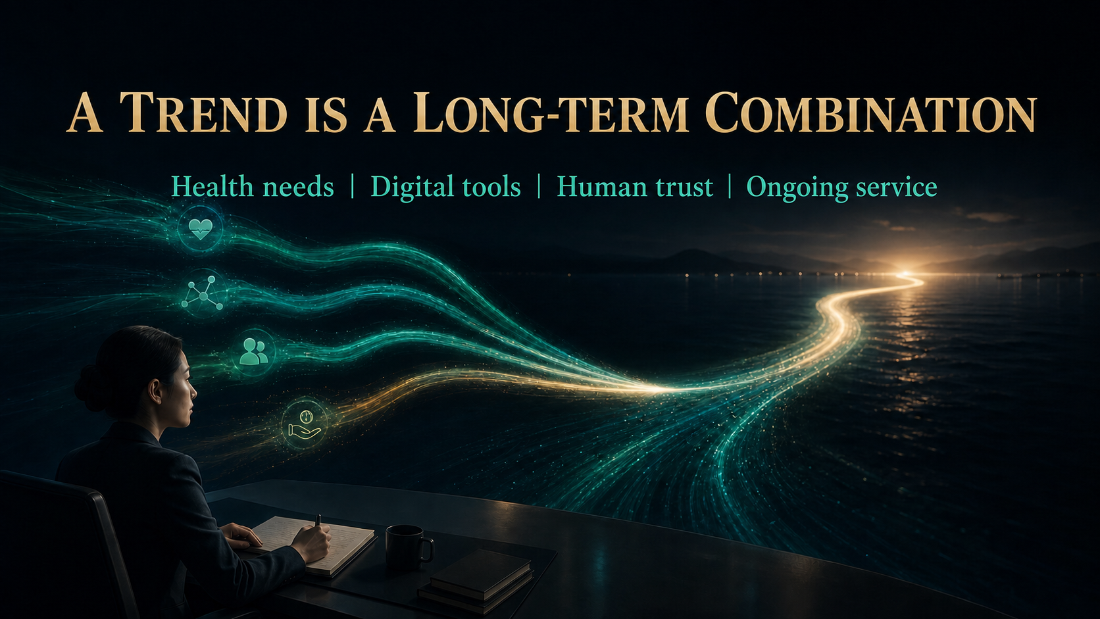
Notes:
A TREND IS A LONG-TERM COMBINATION
A worthwhile trend is not a temporary wave. It combines long-term health needs, efficient digital tools, human trust and ongoing service. Whenever a new trend appears, ask whether it improves customer experience, strengthens team efficiency or makes the business more sustainable. Adopt it only when it contributes real value. The combination matters more than the latest fashionable tool.
Explain verified facts and business logic first, then connect them to an executable NP642 practice. Do not promise income or imply that individual results are typical.
[Sources]
- OpenAI Image 2.0 language-localized course visual.

Slide 37

Notes:
ADVANTAGE SIX
Advantage six is continually large market space. New health, vitality, beauty and quality-of-life needs keep emerging as new families, relationships and regions appear. Market space comes from those continuing needs, but needs do not turn into customers by themselves. Partners must keep learning how to identify problems, present suitable solutions and provide dependable service.
Explain verified facts and business logic first, then connect them to an executable NP642 practice. Do not promise income or imply that individual results are typical.
[Sources]
- https://wfdsa.org/global-statistics/
- https://www.who.int/news-room/fact-sheets/detail/ageing-and-health

Slide 38

Notes:
THE MARKET IS LARGE, BUT IT IS NOT AUTOMATICALLY YOURS
A large market does not automatically belong to us. Opportunity comes from discovering new needs, building relationships, entering new areas and continuing to serve existing customers. Each day, identify three people: one customer to care for, one friend to follow up with and one partner to train. The market is opened through useful action, one relationship at a time.
Explain verified facts and business logic first, then connect them to an executable NP642 practice. Do not promise income or imply that individual results are typical.
[Sources]
- https://wfdsa.org/global-statistics/

Slide 39
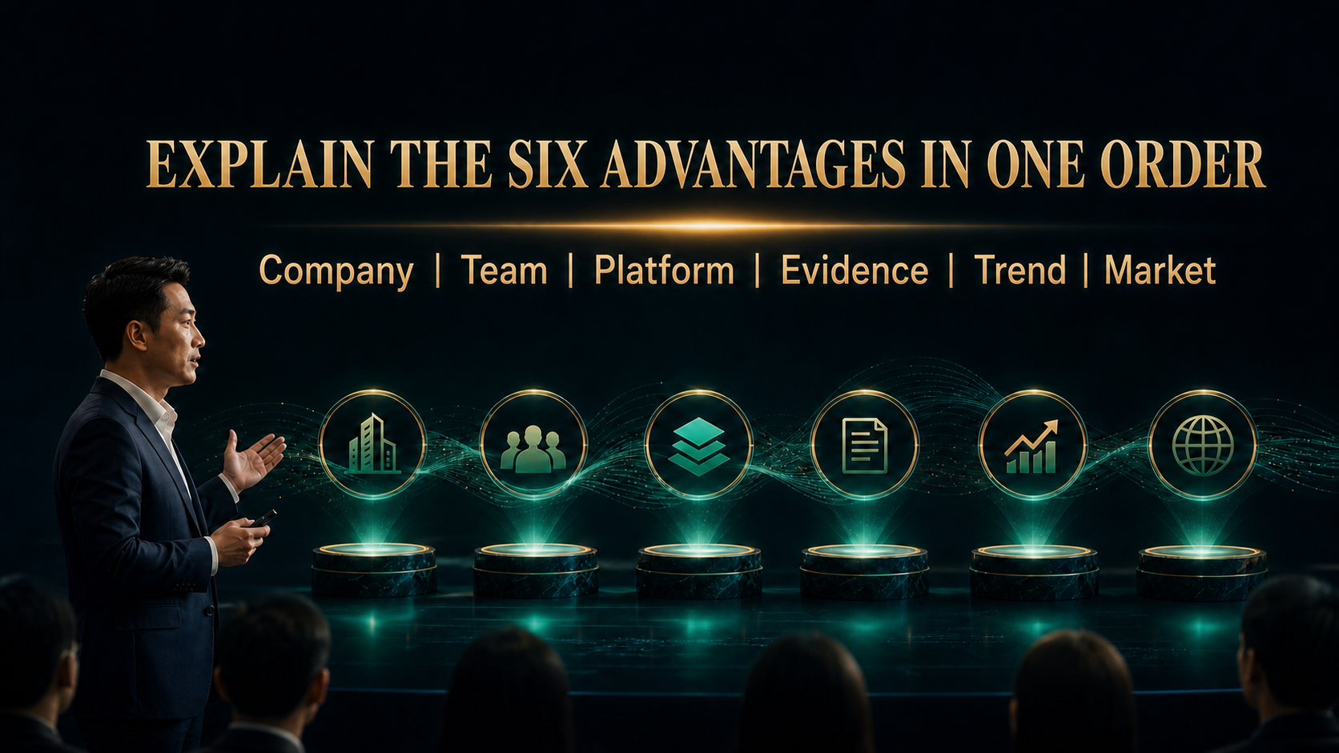
Notes:
EXPLAIN THE SIX ADVANTAGES IN ONE ORDER
Use one clear sequence when explaining the six advantages. Begin with the company to establish safety, then the team to show the method. Explain the platform and how work is done. Present evidence to build reasonable confidence. Connect the opportunity to long-term trends, then finish with the market and a practical next step. Clear order makes the explanation credible and easy to repeat.
Explain verified facts and business logic first, then connect them to an executable NP642 practice. Do not promise income or imply that individual results are typical.
[Sources]
- OpenAI Image 2.0 language-localized course visual.

Slide 40

Notes:
EXPLAIN TRUTHFULLY. BUILD FOR THE LONG TERM.
The purpose of the six advantages is not to memorise six sentences. It is to help us operate more professionally. Verify information so our explanation can withstand questions. Practise until complex ideas become simple. Serve customers so value becomes real. Develop partners so the correct method continues. Choose one advantage today, practise a three-minute explanation with a partner, and turn knowledge into action.
Explain verified facts and business logic first, then connect them to an executable NP642 practice. Do not promise income or imply that individual results are typical.
[Sources]
- OpenAI Image 2.0 language-localized course visual.

