Slide 1

Notes:
Seven Presentations
Today we are solving a practical problem. We may have products, a platform and a team, yet some partners still hesitate to speak. The issue is rarely a lack of words. It is the ability to present genuine belief with confidence. These seven presentations are not acting techniques. They help ordinary partners speak up, share sincerely and stay consistent until confidence becomes influence.
Teach the seven presentations as honest, repeatable communication habits. Do not add income claims, personal results or pressure-based selling language.
[Source]
- User-provided NP642 FCC 2022 Seven Presentations source material.
- OpenAI Image 2.0 language-localized course visual.

Slide 2

Notes:
Partners Don’t Lack Words
Think of a new partner who listens carefully and agrees in private, but freezes when meeting a friend. They say, I am not ready, I may explain it wrongly. It sounds like a skill problem, but the deeper issue is often belief. Giving them another stack of information will not solve it. We must help them build confidence that others can actually feel.
Teach the seven presentations as honest, repeatable communication habits. Do not add income claims, personal results or pressure-based selling language.
[Source]
- User-provided NP642 FCC 2022 Seven Presentations source material.
- OpenAI Image 2.0 language-localized course visual.

Slide 3

Notes:
Presentation Is Not Performance
Let us draw an important boundary. Presentation is not performance. Performance tries to make people think we are impressive. Presentation lets people feel what we sincerely believe and why we chose to share it. You do not need exaggeration, a perfect script or a borrowed personality. The most persuasive state is when your words, expression, actions and values all point in the same direction.
Teach the seven presentations as honest, repeatable communication habits. Do not add income claims, personal results or pressure-based selling language.
[Source]
- User-provided NP642 FCC 2022 Seven Presentations source material.
- OpenAI Image 2.0 language-localized course visual.

Slide 4

Notes:
Same Opportunity, Different Results
Two people may use the same company information, the same product material and the same opportunity, yet receive very different responses. One simply finishes the slides. The other creates enough trust for the listener to want the next conversation. Information can be duplicated, but influence comes alive through a real person. How we present determines whether the message feels cold, credible or worth exploring.
Teach the seven presentations as honest, repeatable communication habits. Do not add income claims, personal results or pressure-based selling language.
[Source]
- User-provided NP642 FCC 2022 Seven Presentations source material.
- OpenAI Image 2.0 language-localized course visual.

Slide 5
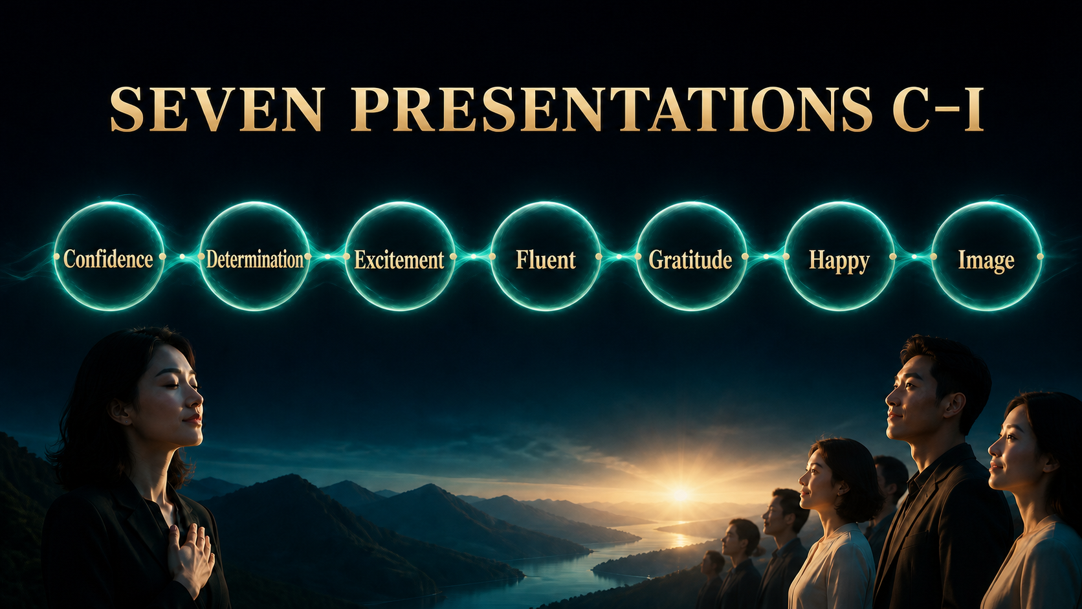
Notes:
Seven Presentations C–I
The seven presentations are easy to remember from C to I. C is Confidence. D is Determination. E is Excitement. F is Fluent. G is Gratitude. H is Happy. I is Image. The early steps build inner strength. The middle steps turn energy into communication. The final steps help people feel comfortable and safe. They are not seven tricks. Together they form one path from inner belief to outer trust.
Teach the seven presentations as honest, repeatable communication habits. Do not add income claims, personal results or pressure-based selling language.
[Source]
- User-provided NP642 FCC 2022 Seven Presentations source material.
- OpenAI Image 2.0 language-localized course visual.

Slide 6

Notes:
Confidence Is Built
Many people tell themselves, I will act when I feel confident. In real life, confidence usually grows in the opposite order. Learn one useful idea, practise it, take one small action, receive feedback and then gain more confidence. A leader does not force a beginner to look like an expert. A leader helps the beginner complete the first small cycle. Action creates evidence, and evidence creates stable confidence.
Teach the seven presentations as honest, repeatable communication habits. Do not add income claims, personal results or pressure-based selling language.
[Source]
- User-provided NP642 FCC 2022 Seven Presentations source material.
- OpenAI Image 2.0 language-localized course visual.

Slide 7

Notes:
Presentation 1 | Confidence
The first presentation is confidence. People do not only hear your sentences; they also sense how strongly you believe them. Confidence is not the loudest voice and it does not mean having no questions. It is a calm stability: I know why I am sharing, I know which facts I can confirm, and I know when I should check further. When you stand firmly inside, people are more willing to listen.
Teach the seven presentations as honest, repeatable communication habits. Do not add income claims, personal results or pressure-based selling language.
[Source]
- User-provided NP642 FCC 2022 Seven Presentations source material.
- OpenAI Image 2.0 language-localized course visual.

Slide 8

Notes:
Confidence Comes from Three Things
Build confidence on three pillars. First, know the product: not just its name, but what need it serves and how it should be used correctly. Second, understand the business: we grow through service, sharing and consistent action. Third, trust the team method: there is guidance, a tool and a practice process. One weak pillar makes confidence unstable. Strengthen all three and partners no longer depend on temporary emotion.
Teach the seven presentations as honest, repeatable communication habits. Do not add income claims, personal results or pressure-based selling language.
[Source]
- User-provided NP642 FCC 2022 Seven Presentations source material.
- OpenAI Image 2.0 language-localized course visual.

Slide 9

Notes:
Confident People Listen Better
A genuinely confident person listens more carefully. They do not rush to prove themselves or pour out every piece of information. They first discover what matters to the other person: health management, time pressure, additional development, or simple curiosity. Then they answer the most relevant part. Sharing is not finishing ten pages of material. It is helping this person see the one page that matters most to them.
Teach the seven presentations as honest, repeatable communication habits. Do not add income claims, personal results or pressure-based selling language.
[Source]
- User-provided NP642 FCC 2022 Seven Presentations source material.
- OpenAI Image 2.0 language-localized course visual.

Slide 10

Notes:
True Confidence Can Say I Don’t Know
Here is a powerful confidence sentence: I am not certain about that yet, so I will check and give you the correct answer. Beginners often fear that saying I do not know makes them look unprofessional. In fact, pretending and guessing damage trust much more. Honest boundaries plus responsible follow-up show maturity. You do not need to know everything. People need to know you will not say anything merely to close a sale.
Teach the seven presentations as honest, repeatable communication habits. Do not add income claims, personal results or pressure-based selling language.
[Source]
- User-provided NP642 FCC 2022 Seven Presentations source material.
- OpenAI Image 2.0 language-localized course visual.

Slide 11
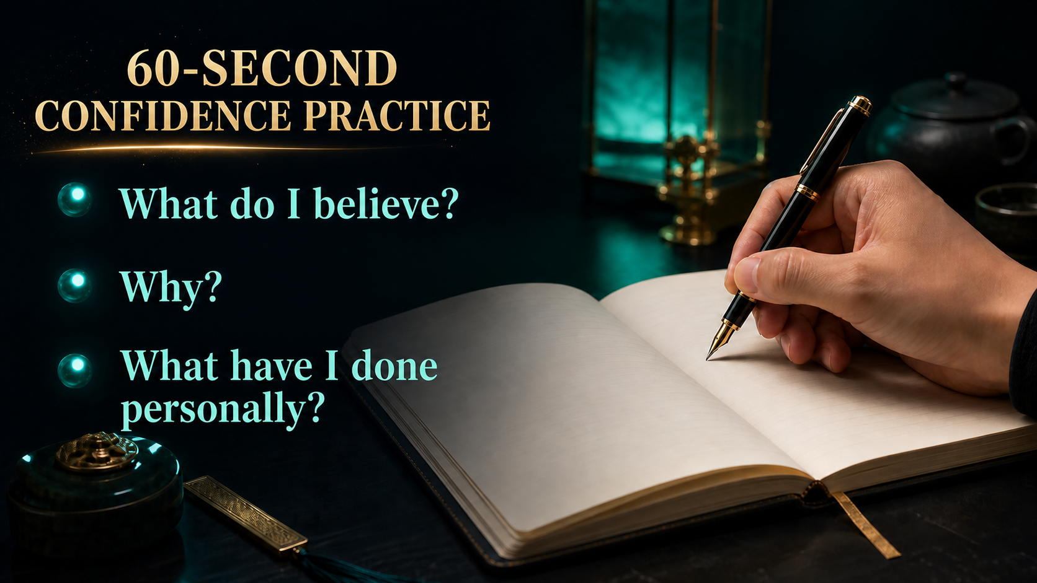
Notes:
60-Second Confidence Practice
Take sixty seconds and answer three questions. What do I genuinely believe? Why do I believe it? What have I personally learned, used or done? Avoid borrowed stories and grand claims. Use evidence that belongs to your real experience. When partners can explain these three answers in their own language, their sharing becomes calmer. Confidence grows because they are standing on truth rather than memory.
Teach the seven presentations as honest, repeatable communication habits. Do not add income claims, personal results or pressure-based selling language.
[Source]
- User-provided NP642 FCC 2022 Seven Presentations source material.
- OpenAI Image 2.0 language-localized course visual.

Slide 12
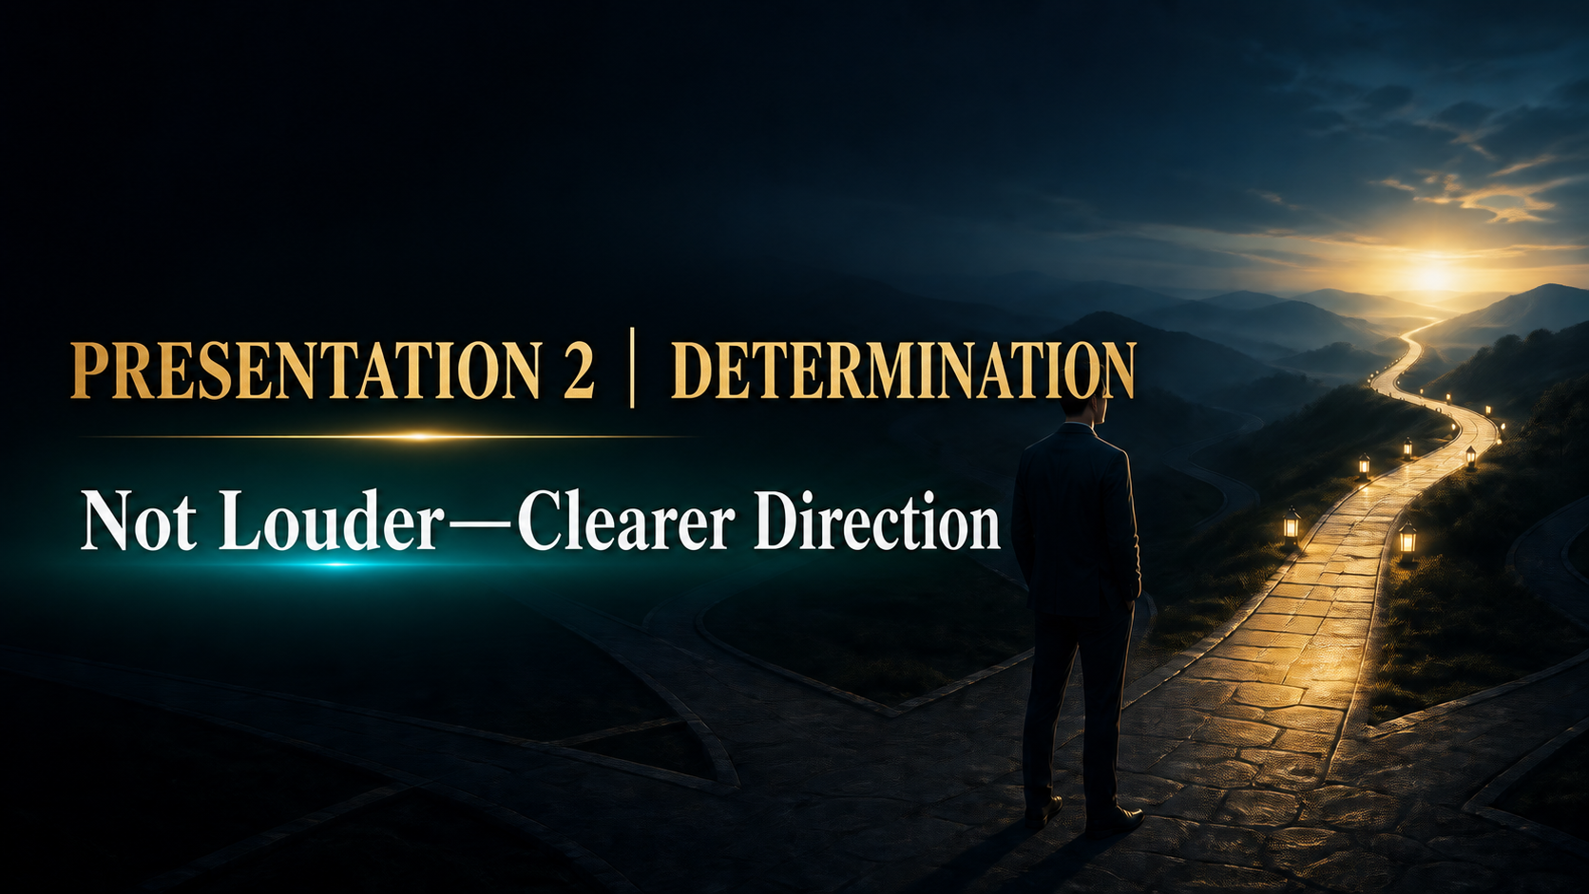
Notes:
Presentation 2 | Determination
The second presentation is determination. Determination is not speaking harder, pressuring people or acting aggressive. It means your direction is clear enough to guide your next action. Others can sense the difference between someone who is merely trying a mood and someone who has decided to practise seriously. Calm commitment is more convincing than dramatic promises because people can observe it over time.
Teach the seven presentations as honest, repeatable communication habits. Do not add income claims, personal results or pressure-based selling language.
[Source]
- User-provided NP642 FCC 2022 Seven Presentations source material.
- OpenAI Image 2.0 language-localized course visual.

Slide 13

Notes:
Which Level Are You On?
There are three common levels of commitment. The first says, I will try and see. The second says, I will do my best. The third says, I will execute the agreed action seriously and review the result. This is not about judging anyone. It helps us identify our present level honestly. Progress starts when a vague intention becomes a clear action that can be observed and improved.
Teach the seven presentations as honest, repeatable communication habits. Do not add income claims, personal results or pressure-based selling language.
[Source]
- User-provided NP642 FCC 2022 Seven Presentations source material.
- OpenAI Image 2.0 language-localized course visual.

Slide 14

Notes:
People Don’t Follow Perfection
Partners do not need a flawless leader. They need someone whose direction stays stable when a meeting is quiet, a prospect says no or a week feels slow. Stable direction creates psychological safety. It tells the team: we know what to practise, we will review the result and we will continue learning. Perfection is distant. Consistency is visible, and visible consistency gives people the courage to follow.
Teach the seven presentations as honest, repeatable communication habits. Do not add income claims, personal results or pressure-based selling language.
[Source]
- User-provided NP642 FCC 2022 Seven Presentations source material.
- OpenAI Image 2.0 language-localized course visual.

Slide 15
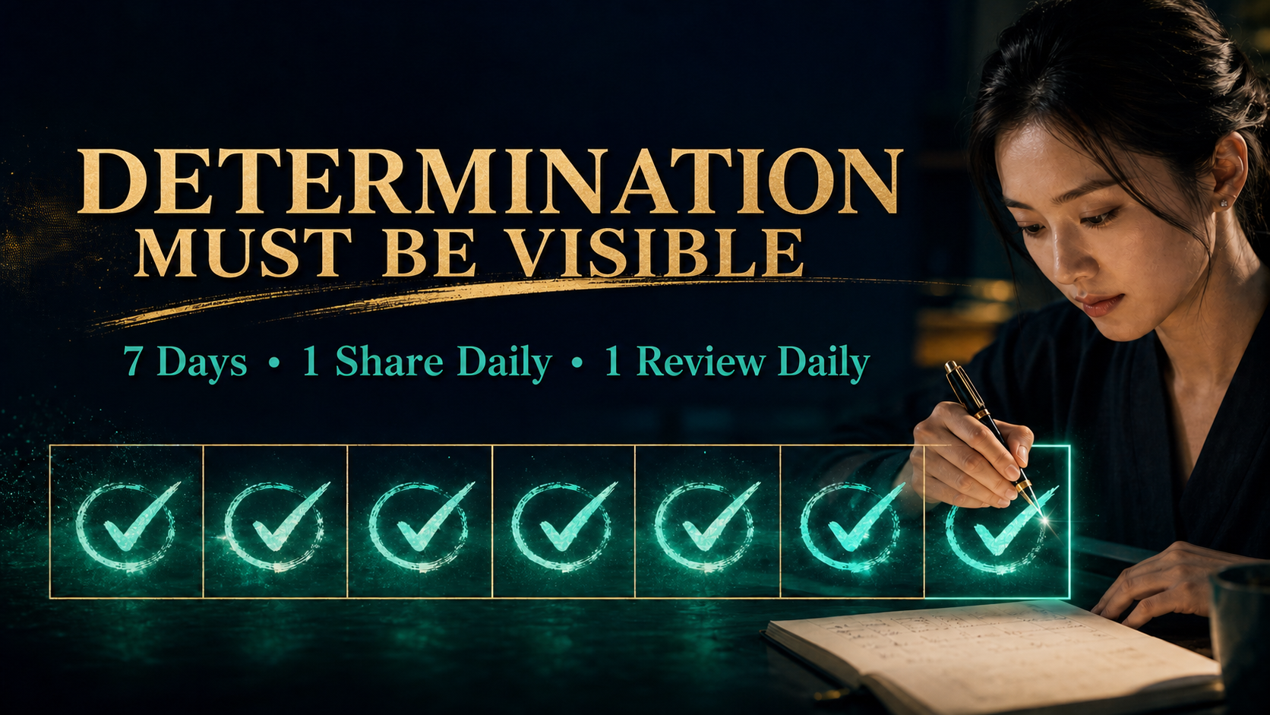
Notes:
Determination Must Be Visible
Turn determination into a seven-day commitment. Share once every day and review once every day. The share may be a short conversation, an invitation or a follow-up. The review asks: what felt natural, where did I become unclear, and what will I adjust tomorrow? Seven days are short enough to begin and long enough to create evidence. Determination becomes real when it can be seen on a calendar.
Teach the seven presentations as honest, repeatable communication habits. Do not add income claims, personal results or pressure-based selling language.
[Source]
- User-provided NP642 FCC 2022 Seven Presentations source material.
- OpenAI Image 2.0 language-localized course visual.

Slide 16

Notes:
Presentation 3 | Excitement
The third presentation is excitement. Excitement is not noise, speed or exaggerated volume. It is the life in your voice when you recognise genuine value. A quiet person can still be exciting because the eyes are engaged, the tone is alive and the reason is sincere. Our goal is not to manufacture emotion. It is to reconnect partners with the meaning that first made them willing to share.
Teach the seven presentations as honest, repeatable communication habits. Do not add income claims, personal results or pressure-based selling language.
[Source]
- User-provided NP642 FCC 2022 Seven Presentations source material.
- OpenAI Image 2.0 language-localized course visual.

Slide 17

Notes:
Real Excitement Has a Reason
Real excitement has a reason. We become energised when we see value, observe change and recognise a possible next step. Before sharing, ask yourself: what value do I see here, what change have I noticed, and what possibility might be useful for this person? Specific reasons create credible enthusiasm. Empty excitement disappears quickly, but meaning gives energy a strong foundation.
Teach the seven presentations as honest, repeatable communication habits. Do not add income claims, personal results or pressure-based selling language.
[Source]
- User-provided NP642 FCC 2022 Seven Presentations source material.
- OpenAI Image 2.0 language-localized course visual.

Slide 18

Notes:
Five Expressions Make Energy Visible
Energy becomes visible through five expressions: your eyes, voice, smile, movement and heart. Look at the person instead of the floor. Let the voice carry some light. Use a natural smile, open movement and an attitude that genuinely wants to help. None of these should become theatre. Practise until they support your message without distracting from it. The heart leads; the other four simply make it visible.
Teach the seven presentations as honest, repeatable communication habits. Do not add income claims, personal results or pressure-based selling language.
[Source]
- User-provided NP642 FCC 2022 Seven Presentations source material.
- OpenAI Image 2.0 language-localized course visual.

Slide 19

Notes:
Give This Is Good Real Life
Try saying, this is good, in two ways. First, say it with a flat voice and no reason. Then look up, brighten the tone and add one specific reason. Notice how the second version feels more alive without becoming loud. Excitement is not created by repeating stronger adjectives. It appears when the eyes are honest, the voice has energy and the listener can understand exactly why you care.
Teach the seven presentations as honest, repeatable communication habits. Do not add income claims, personal results or pressure-based selling language.
[Source]
- User-provided NP642 FCC 2022 Seven Presentations source material.
- OpenAI Image 2.0 language-localized course visual.

Slide 20
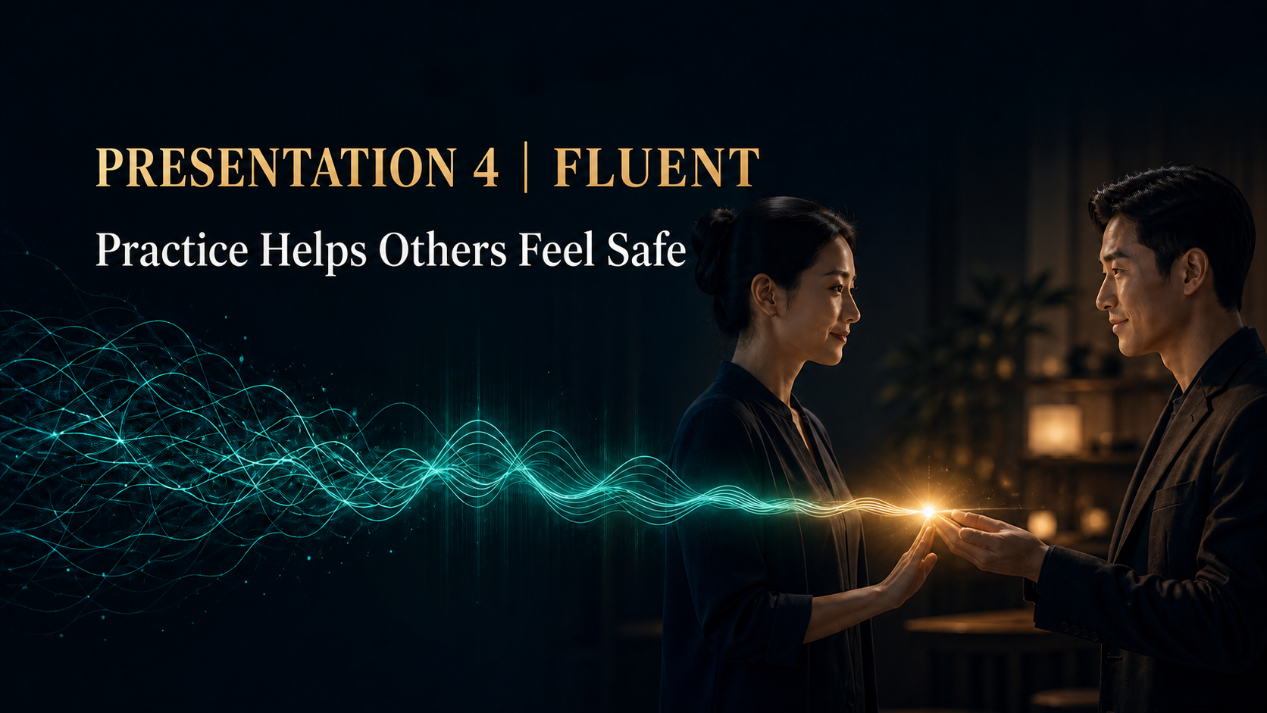
Notes:
Presentation 4 | Fluent
The fourth presentation is fluency. When your message flows clearly, the listener feels safer because they do not have to struggle to understand you. Fluency is earned through practice, not personality. A new partner may pause or feel nervous, and that is normal. Our task is to make practice small and repeatable until the important points can be explained naturally in everyday conversation.
Teach the seven presentations as honest, repeatable communication habits. Do not add income claims, personal results or pressure-based selling language.
[Source]
- User-provided NP642 FCC 2022 Seven Presentations source material.
- OpenAI Image 2.0 language-localized course visual.

Slide 21
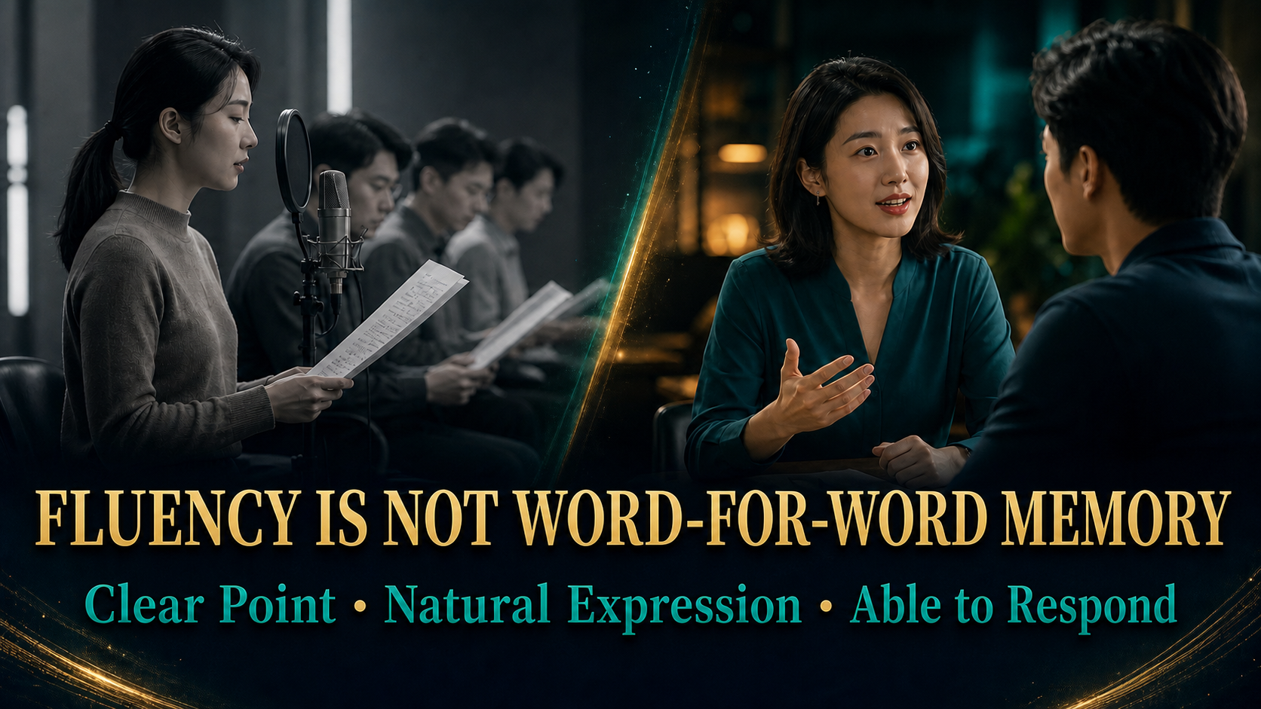
Notes:
Fluency Is Not Word-for-Word Memory
Fluency does not mean memorising every sentence exactly. A partner is fluent when the main point is clear, the expression sounds natural and they can respond when the conversation changes. If one forgotten word destroys the whole presentation, the material was memorised but not understood. Learn the structure, explain it in your own language, and leave enough attention to listen. That is practical fluency.
Teach the seven presentations as honest, repeatable communication habits. Do not add income claims, personal results or pressure-based selling language.
[Source]
- User-provided NP642 FCC 2022 Seven Presentations source material.
- OpenAI Image 2.0 language-localized course visual.

Slide 22
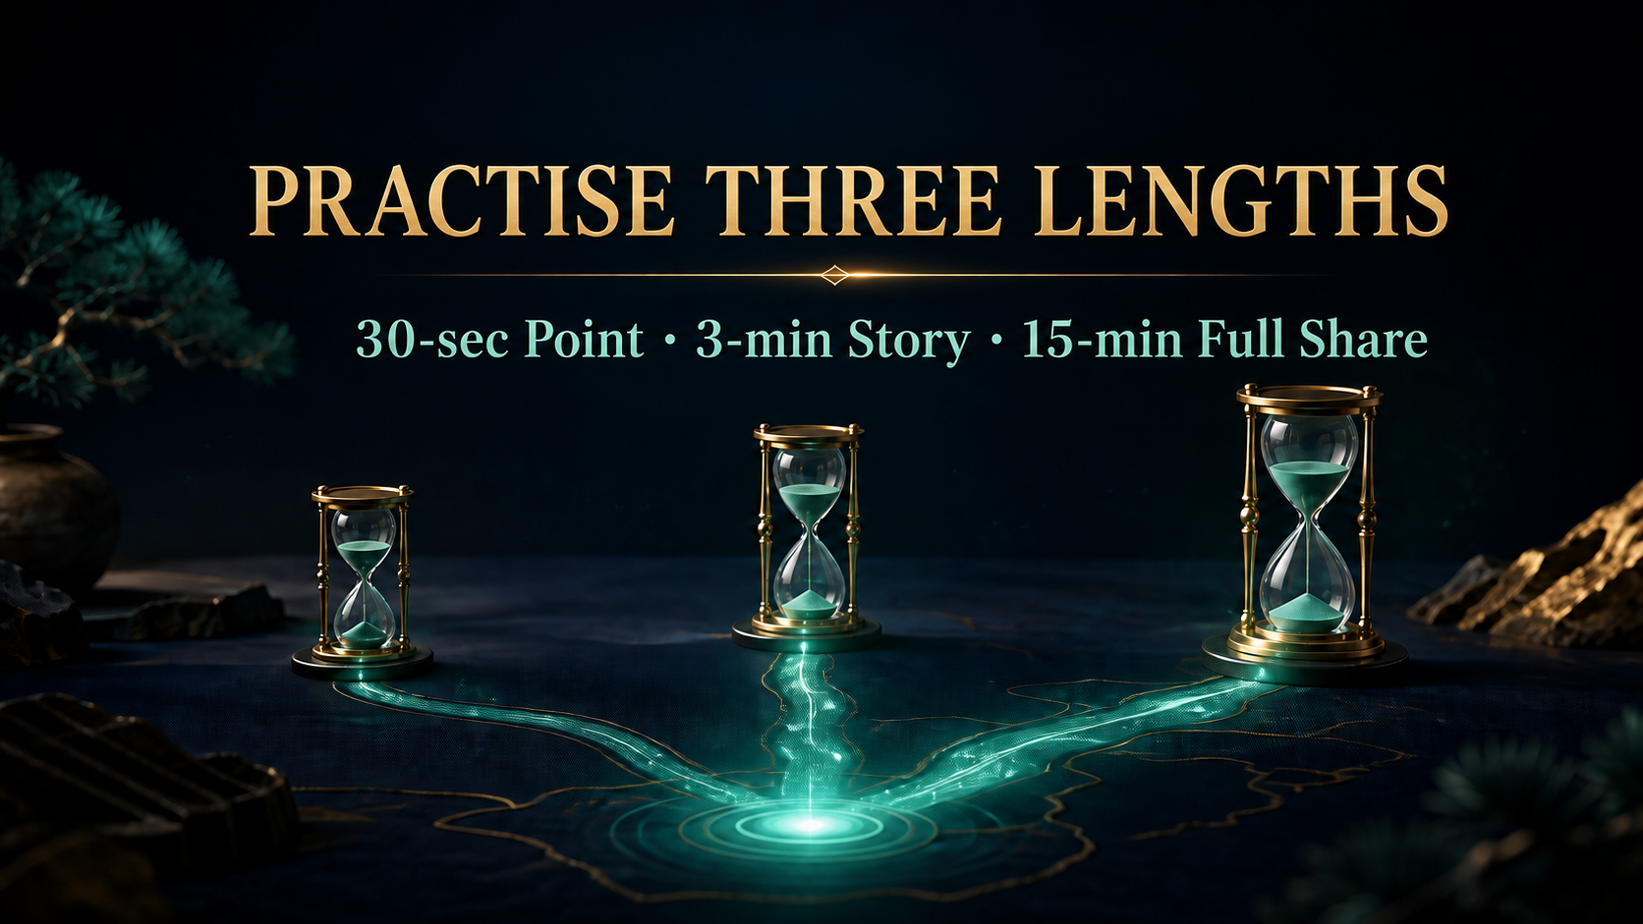
Notes:
Practise Three Lengths
Practise the same message in three lengths. In thirty seconds, state the core point. In three minutes, add a relevant story. In fifteen minutes, deliver the complete share and answer common questions. This protects partners from giving a fifteen-minute speech when someone only has thirty seconds. The message stays consistent, but the depth changes with the situation. That is a skill every team can duplicate.
Teach the seven presentations as honest, repeatable communication habits. Do not add income claims, personal results or pressure-based selling language.
[Source]
- User-provided NP642 FCC 2022 Seven Presentations source material.
- OpenAI Image 2.0 language-localized course visual.

Slide 23
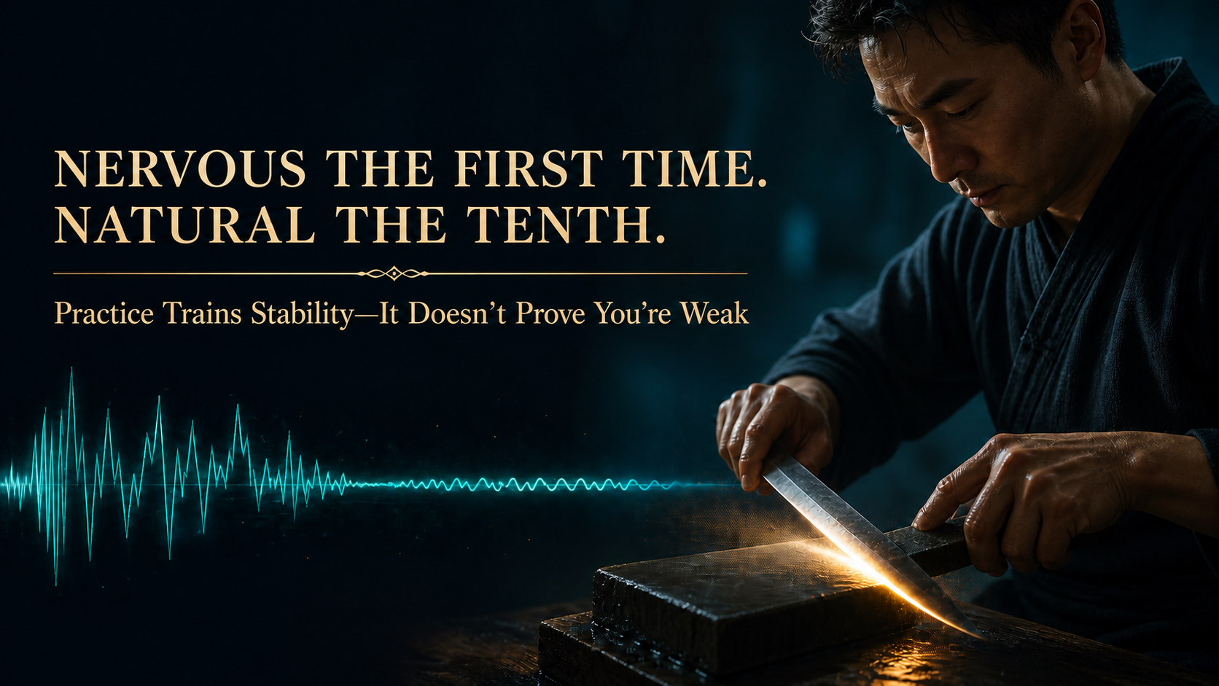
Notes:
Nervous the First Time, Natural the Tenth
The first attempt may feel nervous. By the tenth attempt, your body and voice begin to recognise the path. Practice is not proof that you are weak; it is how stability is trained. Record yourself, review one improvement and repeat. Do not change everything at once. One adjustment per round allows confidence and fluency to grow together. Repetition is the bridge between knowing and being able to do.
Teach the seven presentations as honest, repeatable communication habits. Do not add income claims, personal results or pressure-based selling language.
[Source]
- User-provided NP642 FCC 2022 Seven Presentations source material.
- OpenAI Image 2.0 language-localized course visual.

Slide 24

Notes:
Presentation 5 | Gratitude
The fifth presentation is gratitude. In a long-term business, relationships matter more than a single conversation. Gratitude changes the atmosphere from taking to appreciating. We recognise that someone gave us time, feedback, trust or support. This does not mean agreeing with everything or avoiding difficult conversations. It means we treat people as valuable human beings, not as numbers on a list. That is how relationships remain healthy.
Teach the seven presentations as honest, repeatable communication habits. Do not add income claims, personal results or pressure-based selling language.
[Source]
- User-provided NP642 FCC 2022 Seven Presentations source material.
- OpenAI Image 2.0 language-localized course visual.

Slide 25

Notes:
Make Gratitude Specific
Make gratitude specific so it can be felt. Say, thank you for listening even though you were busy. Thank you for reminding me about that detail. Thank you for trusting me enough to ask. Specific appreciation proves that you noticed the person. A general thank you is polite; a specific thank you builds connection. This is simple, free and powerful when it is sincere.
Teach the seven presentations as honest, repeatable communication habits. Do not add income claims, personal results or pressure-based selling language.
[Source]
- User-provided NP642 FCC 2022 Seven Presentations source material.
- OpenAI Image 2.0 language-localized course visual.

Slide 26

Notes:
Complain Less, Appreciate More
Protect relationships with three disciplines. Do not criticise people carelessly, do not mock their mistakes, and do not drain a partner’s confidence behind their back. Problems still need honest discussion, but discuss the behaviour, the impact and the next action. Gratitude is not pretending everything is perfect. It is choosing a respectful way to improve what is not working. Teams become stronger when correction and appreciation can exist together.
Teach the seven presentations as honest, repeatable communication habits. Do not add income claims, personal results or pressure-based selling language.
[Source]
- User-provided NP642 FCC 2022 Seven Presentations source material.
- OpenAI Image 2.0 language-localized course visual.

Slide 27

Notes:
Thank One Person Today
Choose one person today and thank them properly. Name exactly what they did right and why it mattered. You might say, thank you for following up with that new partner; your patience helped them feel welcome. This takes less than a minute, yet it tells people that good effort is visible. A culture of specific appreciation gives partners more courage to repeat positive behaviour.
Teach the seven presentations as honest, repeatable communication habits. Do not add income claims, personal results or pressure-based selling language.
[Source]
- User-provided NP642 FCC 2022 Seven Presentations source material.
- OpenAI Image 2.0 language-localized course visual.

Slide 28

Notes:
Presentation 6 | Happy
The sixth presentation is happiness, or more accurately, a positive and approachable state. Before people understand our information, they feel whether being near us is comfortable. A warm presence lowers pressure and opens conversation. Happiness does not require constant excitement. It means we take responsibility for the energy we bring into the room so that others are not forced to carry our tension.
Teach the seven presentations as honest, repeatable communication habits. Do not add income claims, personal results or pressure-based selling language.
[Source]
- User-provided NP642 FCC 2022 Seven Presentations source material.
- OpenAI Image 2.0 language-localized course visual.

Slide 29

Notes:
Happiness Is Not Hiding Emotion
Being happy does not mean hiding sadness, denying stress or wearing a permanent smile. It means recognising your emotion, managing it responsibly and choosing the right time and place to process it. We do not dump pressure on a prospect or punish the team with our mood. Honest emotion and professional self-management can exist together. That balance feels human, not fake.
Teach the seven presentations as honest, repeatable communication habits. Do not add income claims, personal results or pressure-based selling language.
[Source]
- User-provided NP642 FCC 2022 Seven Presentations source material.
- OpenAI Image 2.0 language-localized course visual.

Slide 30
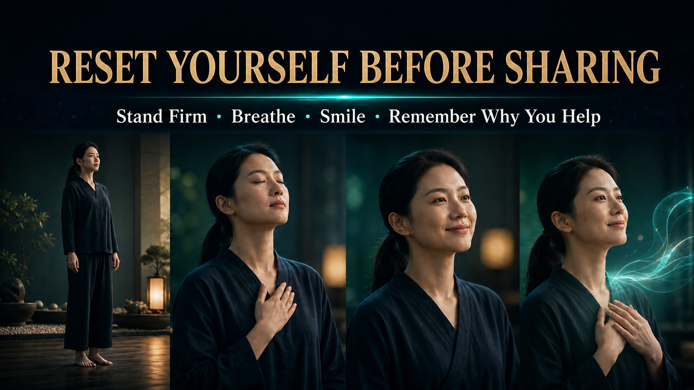
Notes:
Reset Yourself Before Sharing
Use a simple ninety-second reset before sharing. Stand firmly. Take a slow breath. Relax the face into a natural smile. Then remember why you want to help this person. This short ritual moves attention away from fear and back to service. You may still feel nervous, but your body becomes more stable and your voice becomes easier to hear. State management is a practical skill.
Teach the seven presentations as honest, repeatable communication habits. Do not add income claims, personal results or pressure-based selling language.
[Source]
- User-provided NP642 FCC 2022 Seven Presentations source material.
- OpenAI Image 2.0 language-localized course visual.

Slide 31

Notes:
The Power of Happiness
The power of a positive state is not that it makes everyone say yes. It helps people feel respected enough to think clearly. Ask questions, listen without interrupting and allow the other person to decide. When pressure drops, trust has room to grow. A good presentation should leave someone feeling understood even if they are not ready. Respect protects both the relationship and the reputation of the business.
Teach the seven presentations as honest, repeatable communication habits. Do not add income claims, personal results or pressure-based selling language.
[Source]
- User-provided NP642 FCC 2022 Seven Presentations source material.
- OpenAI Image 2.0 language-localized course visual.

Slide 32

Notes:
Presentation 7 | Image
The seventh presentation is image. Before we speak, people already notice whether we appear prepared, respectful and reliable. Image is not vanity. It is part of communication. A suitable appearance tells people that we value the meeting and their time. It cannot replace character or knowledge, but it can help those qualities become easier to notice. Professionalism begins before the first sentence.
Teach the seven presentations as honest, repeatable communication habits. Do not add income claims, personal results or pressure-based selling language.
[Source]
- User-provided NP642 FCC 2022 Seven Presentations source material.
- OpenAI Image 2.0 language-localized course visual.

Slide 33

Notes:
The Key to Image Is Suitability
A professional image does not require expensive clothing. The key is suitability. Be neat, look energised and dress appropriately for the occasion. A coffee conversation, online meeting and formal event may require different choices. The question is not, does this look luxurious? Ask instead, does this help the other person feel comfortable and confident in me? Suitability is practical, respectful and accessible to every partner.
Teach the seven presentations as honest, repeatable communication habits. Do not add income claims, personal results or pressure-based selling language.
[Source]
- User-provided NP642 FCC 2022 Seven Presentations source material.
- OpenAI Image 2.0 language-localized course visual.

Slide 34

Notes:
Your Phone Is Also a First Impression
Today, image also lives on the phone. Use a clear and appropriate profile photo. Write messages politely and make the next step easy to understand. Reply reliably; if you need time, acknowledge the message and say when you will return. People often meet our digital habits before meeting us in person. A trustworthy online presence is part of modern professionalism.
Teach the seven presentations as honest, repeatable communication habits. Do not add income claims, personal results or pressure-based selling language.
[Source]
- User-provided NP642 FCC 2022 Seven Presentations source material.
- OpenAI Image 2.0 language-localized course visual.

Slide 35

Notes:
Ask Three Questions Before You Go
Before leaving, ask three quick questions. Do I look trustworthy? Will people feel comfortable around me? Is this appropriate for today’s setting? These questions are more useful than comparing yourself with someone richer or more fashionable. Make the small adjustments you can control: clean details, a calm posture and a prepared phone. A consistent check builds a dependable personal standard.
Teach the seven presentations as honest, repeatable communication habits. Do not add income claims, personal results or pressure-based selling language.
[Source]
- User-provided NP642 FCC 2022 Seven Presentations source material.
- OpenAI Image 2.0 language-localized course visual.

Slide 36
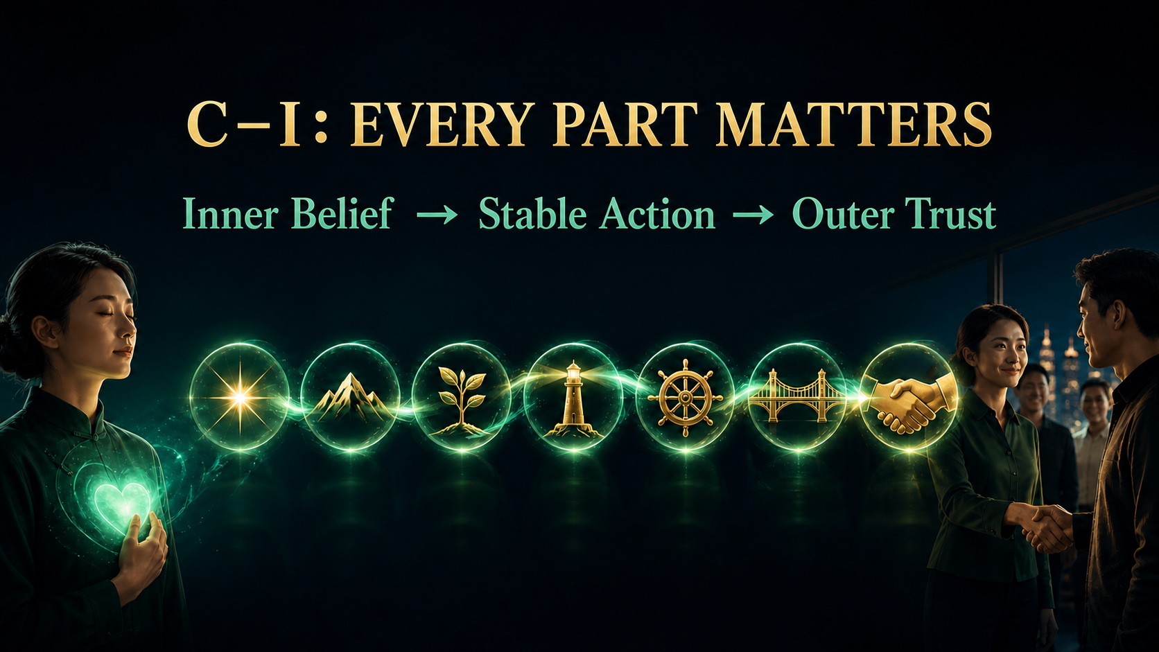
Notes:
C–I: Every Part Matters
Now connect all seven presentations. Confidence creates inner belief. Determination turns belief into stable action. Excitement gives the message life. Fluency makes it easy to follow. Gratitude protects relationships. Happiness makes communication approachable. Image supports the first impression. Remove one link and the chain becomes weaker. Practise them as one system that carries belief outward until another person can feel trust.
Teach the seven presentations as honest, repeatable communication habits. Do not add income claims, personal results or pressure-based selling language.
[Source]
- User-provided NP642 FCC 2022 Seven Presentations source material.
- OpenAI Image 2.0 language-localized course visual.

Slide 37
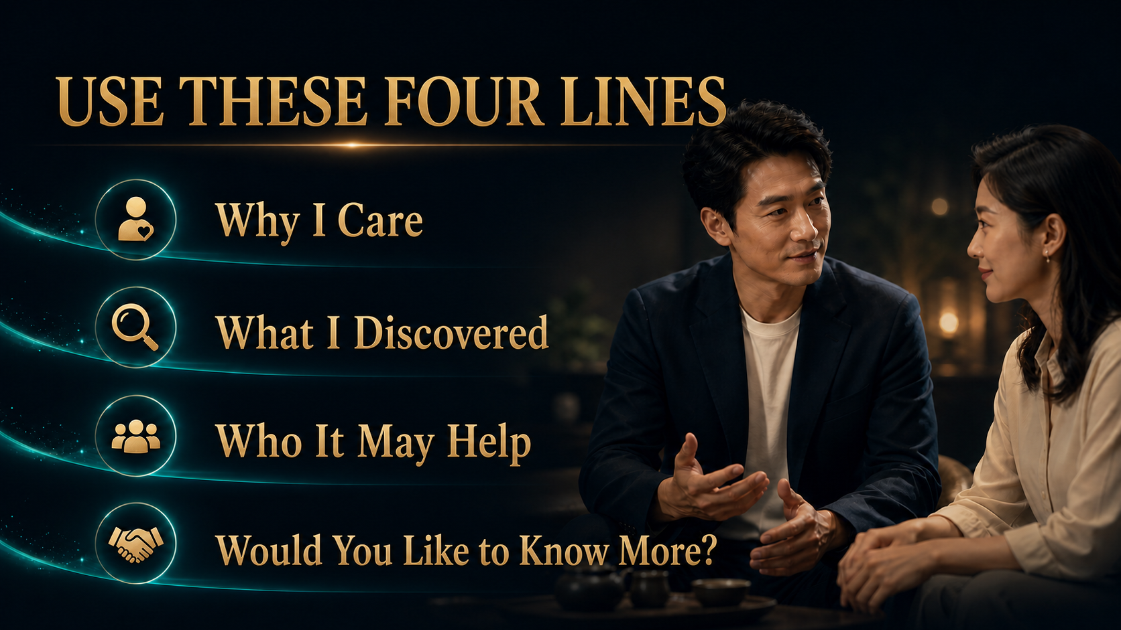
Notes:
Use These Four Lines
If you do not know how to begin, use four simple lines. First, why do I care about this? Second, what did I discover? Third, who might this help? Fourth, would you like to know more? This structure keeps the share personal, relevant and respectful. It ends with permission, not pressure. Practise it as a three-minute story in your own words and let the other person choose the next step.
Teach the seven presentations as honest, repeatable communication habits. Do not add income claims, personal results or pressure-based selling language.
[Source]
- User-provided NP642 FCC 2022 Seven Presentations source material.
- OpenAI Image 2.0 language-localized course visual.

Slide 38
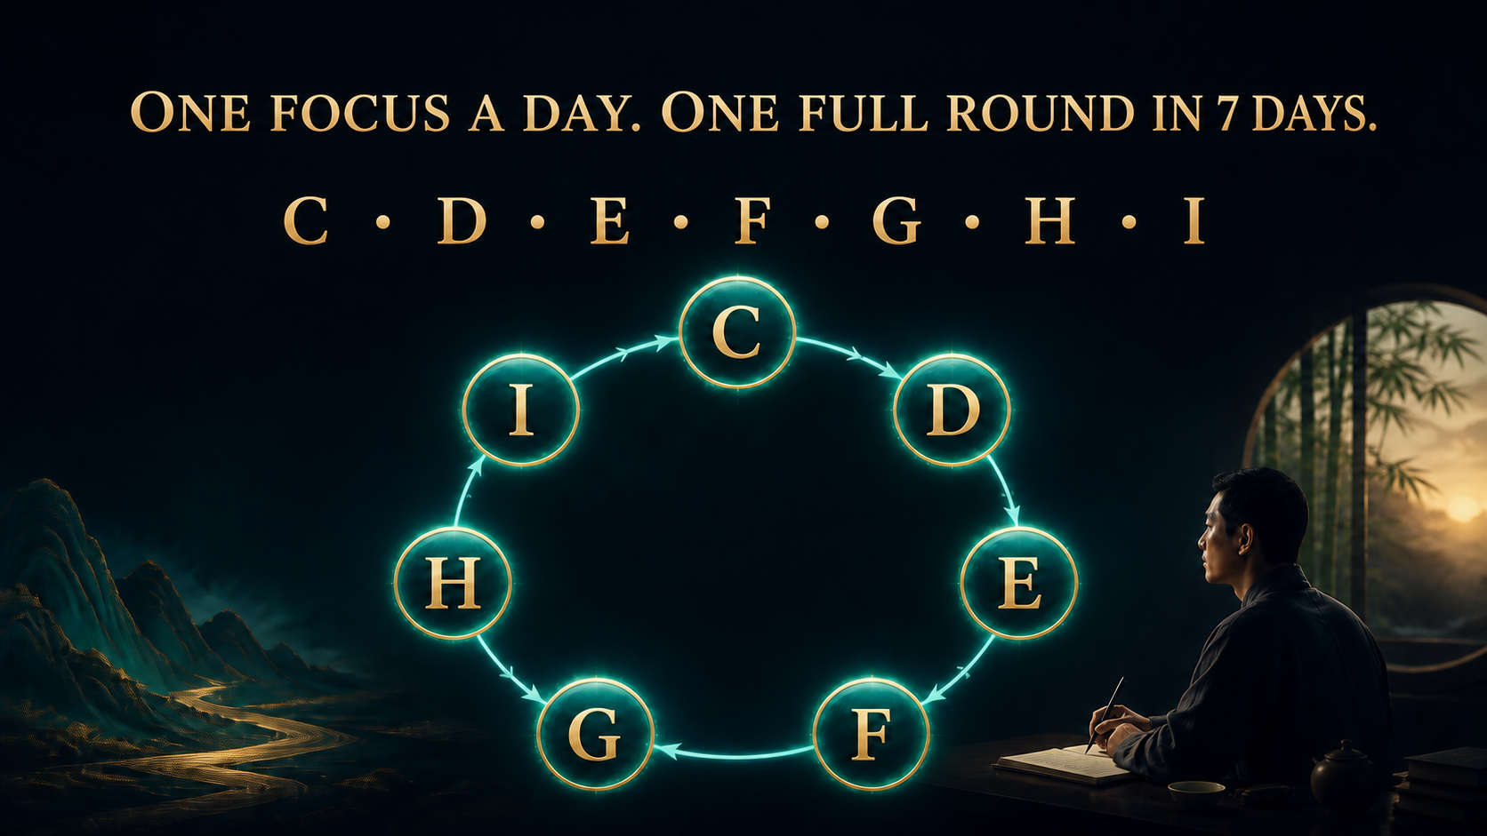
Notes:
One Focus a Day, One Full Round in 7 Days
Turn this course into a seven-day team practice. Day one focuses on Confidence, day two on Determination, then Excitement, Fluent, Gratitude, Happy and Image. Each day, watch one idea, practise one behaviour and share one learning with a partner. After seven days, review the full chain. A simple rhythm is easier to duplicate than a complicated programme, and repetition turns knowledge into behaviour.
Teach the seven presentations as honest, repeatable communication habits. Do not add income claims, personal results or pressure-based selling language.
[Source]
- User-provided NP642 FCC 2022 Seven Presentations source material.
- OpenAI Image 2.0 language-localized course visual.

Slide 39

Notes:
Don’t Wait Until You’re Fully Ready
Do not wait for the day when every fear disappears and every answer is perfect. That day may never come. Choose one person today and share sincerely for a few minutes. Listen first, use the four-line structure and respect their decision. Afterwards, review one thing you did well and one thing to improve. Courage is not the absence of nervousness. It is taking a responsible next step while nervousness is still present.
Teach the seven presentations as honest, repeatable communication habits. Do not add income claims, personal results or pressure-based selling language.
[Source]
- User-provided NP642 FCC 2022 Seven Presentations source material.
- OpenAI Image 2.0 language-localized course visual.

Slide 40

Notes:
Influence Yourself First
The seven presentations begin with one person: you. Build real confidence, choose a stable direction, reconnect with meaningful energy, practise until the message flows, appreciate people, manage your state and present yourself appropriately. When these become daily habits, influence no longer feels forced. You do not need to chase people. Speak up, share sincerely and stay consistent. First influence yourself; then you will have the strength to influence others.
Teach the seven presentations as honest, repeatable communication habits. Do not add income claims, personal results or pressure-based selling language.
[Source]
- User-provided NP642 FCC 2022 Seven Presentations source material.
- OpenAI Image 2.0 language-localized course visual.

