Slide 1
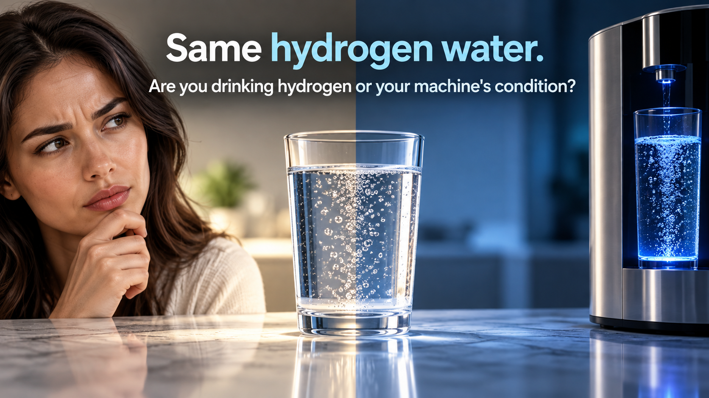
Notes:
Silent one-second opening hook.
[Sources]
[Visual]
- Native Image 2.5 language generation.
- Product-specific pages use authentic IZUMIO or OLEMIO package references.

Slide 2
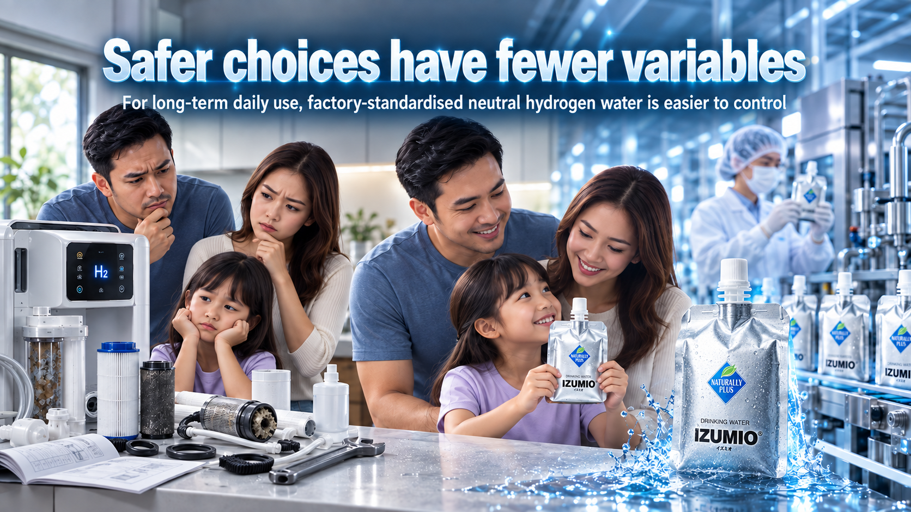
Notes:
Let us begin with the conclusion. For a typical household that wants neutral hydrogen water which is simple and consistent for long-term use, a finished product made, tested and packed under controlled factory conditions is easier to manage than water whose final quality depends every day on the home's tap water, filter, electrodes, flow rate and cleaning. This does not mean every machine is bad. Machines and finished water each have their strengths. The real comparison is how many variables must be managed, who manages them, and how much operating responsibility the customer carries each day.
[Sources]
- 00_事实证据基线.md
[Visual]
- Native Image 2.5 language generation.
- Product-specific pages use authentic IZUMIO or OLEMIO package references.

Slide 3
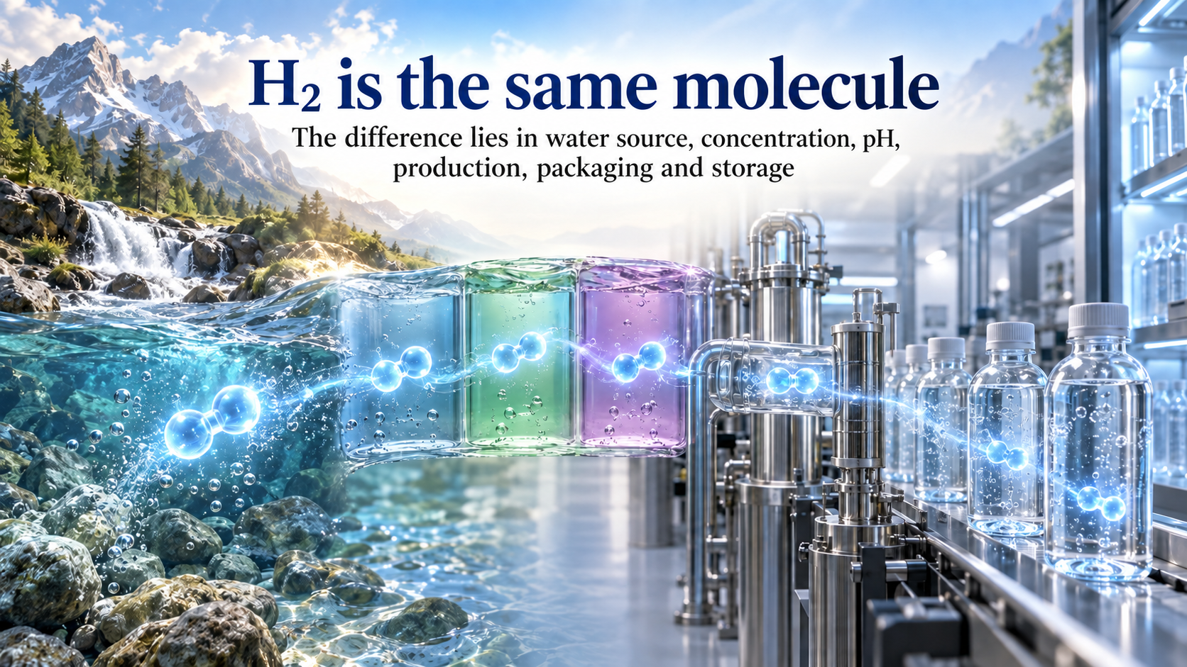
Notes:
Here is one honest fact that builds trust. Molecular hydrogen is H₂. It does not become a special kind of hydrogen because it comes from a particular brand. Our advantage should never depend on saying that our hydrogen molecule is superior. What changes the final water is the source water, the method used to dissolve hydrogen, the measured concentration, the pH, control of the production process, the package, storage, and how much hydrogen remains when the customer drinks it. When we compare these measurable factors, our explanation becomes clearer and more credible.
[Sources]
- https://pmc.ncbi.nlm.nih.gov/articles/PMC10816294/
[Visual]
- Native Image 2.5 language generation.
- Product-specific pages use authentic IZUMIO or OLEMIO package references.

Slide 4
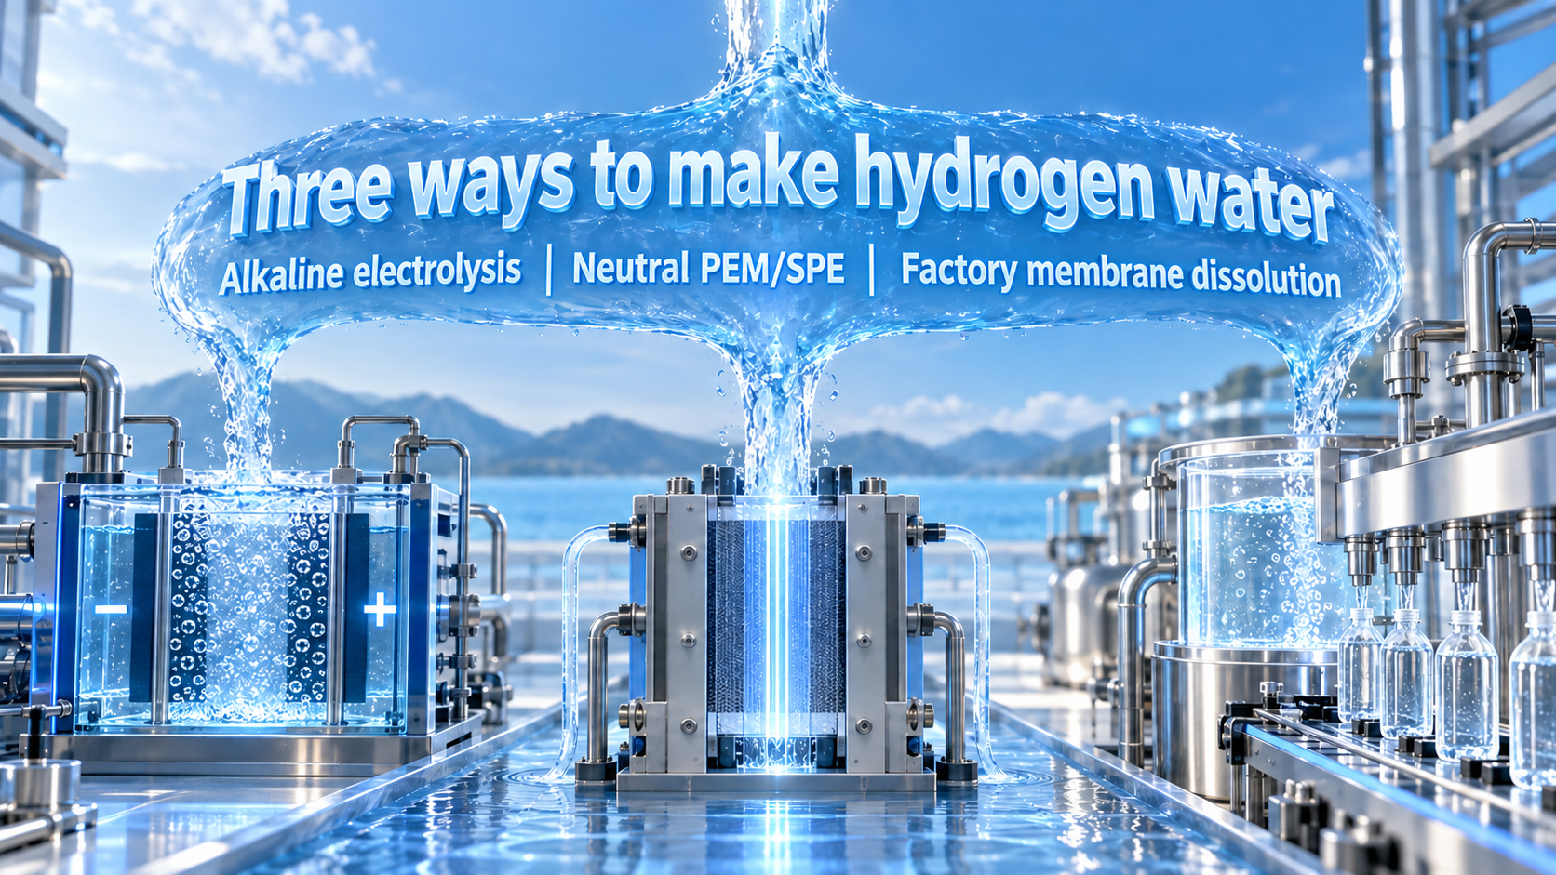
Notes:
Hydrogen water on the market generally follows three production routes. Traditional alkaline electrolysis separates water into an alkaline side and an acidic side, and the drinking side receives hydrogen together with a higher pH. Neutral PEM or SPE systems focus on generating molecular hydrogen while trying not to change the pH substantially. Factory production first treats the water, then dissolves hydrogen through a membrane process and immediately fills a finished package. All three routes can produce hydrogen water. The important difference is where each route places its process control, testing and maintenance responsibility.
[Sources]
- https://pmc.ncbi.nlm.nih.gov/articles/PMC9736533/
[Visual]
- Native Image 2.5 language generation.
- Product-specific pages use authentic IZUMIO or OLEMIO package references.

Slide 5
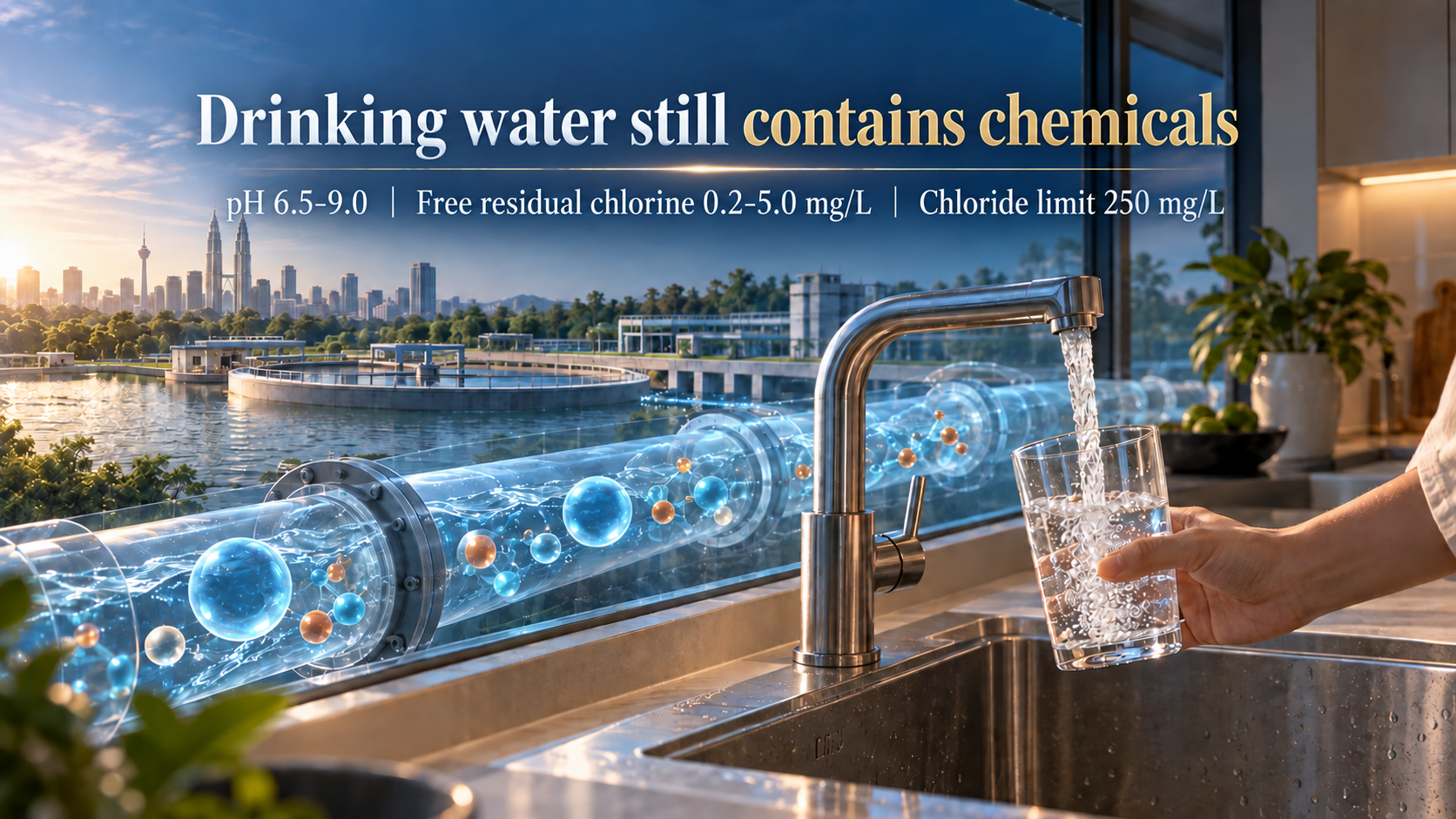
Notes:
Now consider the water entering a household machine in Malaysia. The national drinking-water standard lists a pH range of 6.5 to 9.0, free residual chlorine from 0.2 to 5.0 milligrams per litre, and a chloride limit of 250 milligrams per litre. These are public-health control limits, not a claim that every home has the same reading. The actual water can differ by area, building pipes, storage tanks and time. Water that meets drinking standards can still contain minerals and ions. Once that water enters an electrolytic device, those components affect conductivity, reactions, scaling and the final output.
[Sources]
- https://hq.moh.gov.my/engineering/images/perkhidmatan/kas/muat-turun/piawaian_kualiti_air_minum.pdf
[Visual]
- Native Image 2.5 language generation.
- Product-specific pages use authentic IZUMIO or OLEMIO package references.

Slide 6
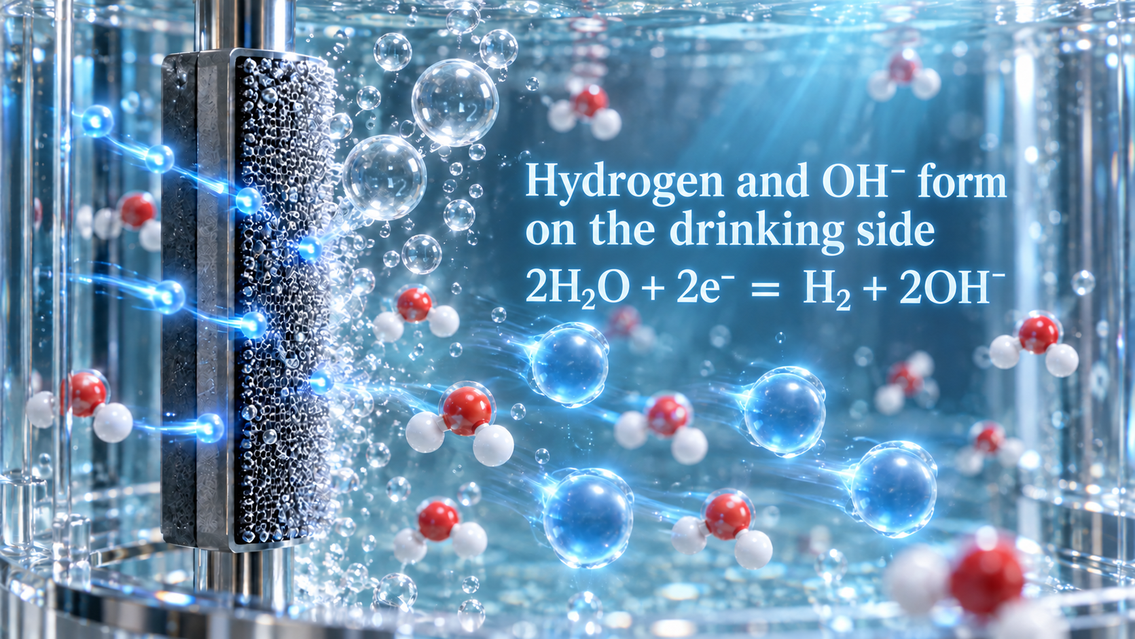
Notes:
At the cathode of a traditional alkaline electrolyser, water receives electrons and forms hydrogen gas together with hydroxide ions. This is why the drinking side can contain molecular hydrogen and also become alkaline. The equation is useful, but it does not tell us the exact hydrogen concentration in a customer's glass. That result still depends on the electrode area and condition, voltage, mineral content, flow rate, temperature and contact time. A selected setting on the machine is not the same as a verified measurement of dissolved hydrogen and pH in the water being consumed.
[Sources]
- https://pmc.ncbi.nlm.nih.gov/articles/PMC9736533/
[Visual]
- Native Image 2.5 language generation.
- Product-specific pages use authentic IZUMIO or OLEMIO package references.

Slide 7
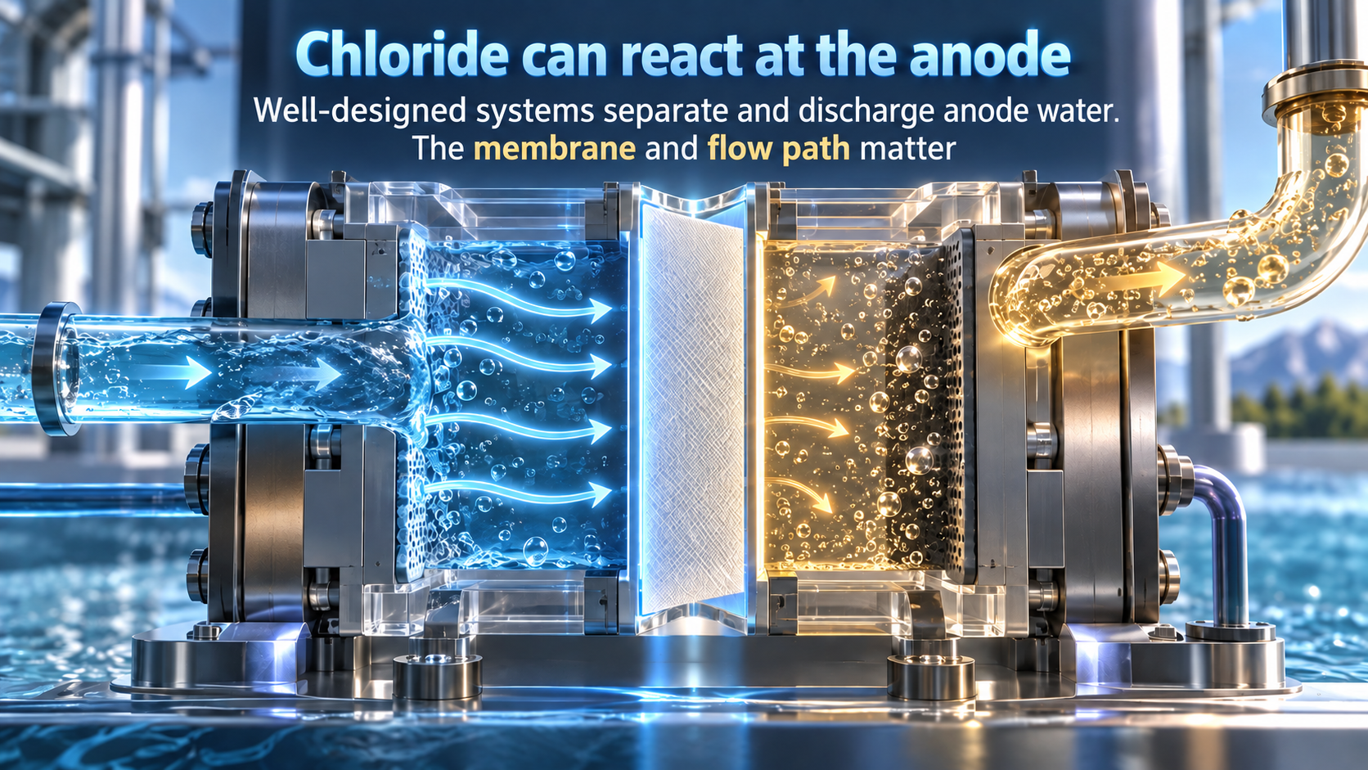
Notes:
The other side of the cell is the anode. If chloride ions are present, the right electrode, voltage and operating conditions can create chlorine or hypochlorous species. We must explain this fairly. A well-designed machine uses a membrane, separate flow paths and drainage to keep anode water away from the drinking side. It would be wrong to say that every machine puts these substances into the customer's drinking water. The practical questions are whether the membrane and flow path remain sound, whether the correct outlet is used, what the filter can remove, and whether the equipment is maintained according to its instructions. The chemistry is not a scare story. It is an engineering condition that must be managed.
[Sources]
- https://pmc.ncbi.nlm.nih.gov/articles/PMC7970539/
[Visual]
- Native Image 2.5 language generation.
- Product-specific pages use authentic IZUMIO or OLEMIO package references.

Slide 8
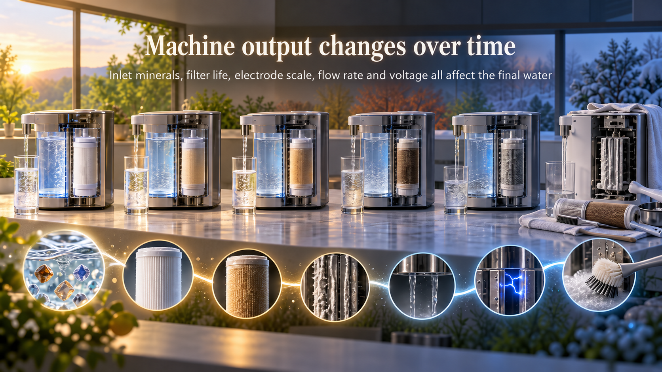
Notes:
A machine that performs well when it is first installed may not give exactly the same output six months or two years later. Minerals affect conductivity and electrolysis. Calcium and magnesium can form scale and reduce the effective electrode area. Filter life varies with water quality and volume. Faster flow reduces contact time, while slower flow can increase pH and electrolysis intensity. Cleaning cycles, applied voltage, electrode surfaces and internal pipes also affect the result. A household machine offers convenient high-volume production and may have a lower long-term unit cost. In return, the customer must keep managing this changing chain of variables.
[Sources]
- https://pmc.ncbi.nlm.nih.gov/articles/PMC9736533/
[Visual]
- Native Image 2.5 language generation.
- Product-specific pages use authentic IZUMIO or OLEMIO package references.

Slide 9
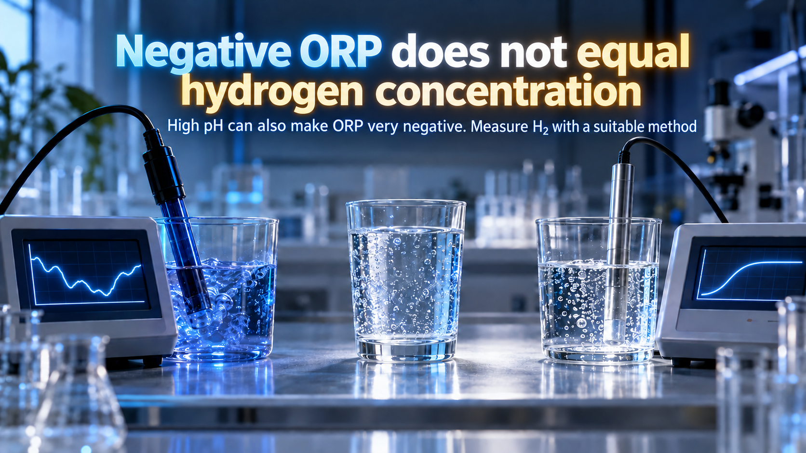
Notes:
ORP, or oxidation-reduction potential, is often used to make hydrogen water look impressive. A negative ORP may indicate reducing conditions, but it does not by itself reveal the dissolved hydrogen concentration. pH also changes the ORP reading. Published reviews describe water with a very negative ORP but little dissolved hydrogen because the pH was high. If the customer wants to know the H₂ concentration, it should be measured with a suitable hydrogen method. Ask for the actual concentration, the timing of the measurement and the method used. One attractive number should not replace the question the customer is really asking.
[Sources]
- https://pmc.ncbi.nlm.nih.gov/articles/PMC9736533/
[Visual]
- Native Image 2.5 language generation.
- Product-specific pages use authentic IZUMIO or OLEMIO package references.

Slide 10

Notes:
The body regulates blood acid-base balance very tightly. Drinking alkaline water does not simply turn the whole body into an alkaline body. Recent medical reviews find limited evidence for a few specific uses, while many broad anti-ageing, immunity and disease-treatment claims lack strong long-term support. For most healthy adults, moderate amounts of water around pH 8.5 to 9.5 are generally not considered a problem. Greater care is needed with persistently very high pH and for people with kidney, potassium or gastric-acid conditions. A sensible long-term choice focuses on stable quality, appropriate intake and personal suitability, rather than assuming that more alkaline must be better.
[Sources]
- https://pubmed.ncbi.nlm.nih.gov/42433989/
[Visual]
- Native Image 2.5 language generation.
- Product-specific pages use authentic IZUMIO or OLEMIO package references.

Slide 11
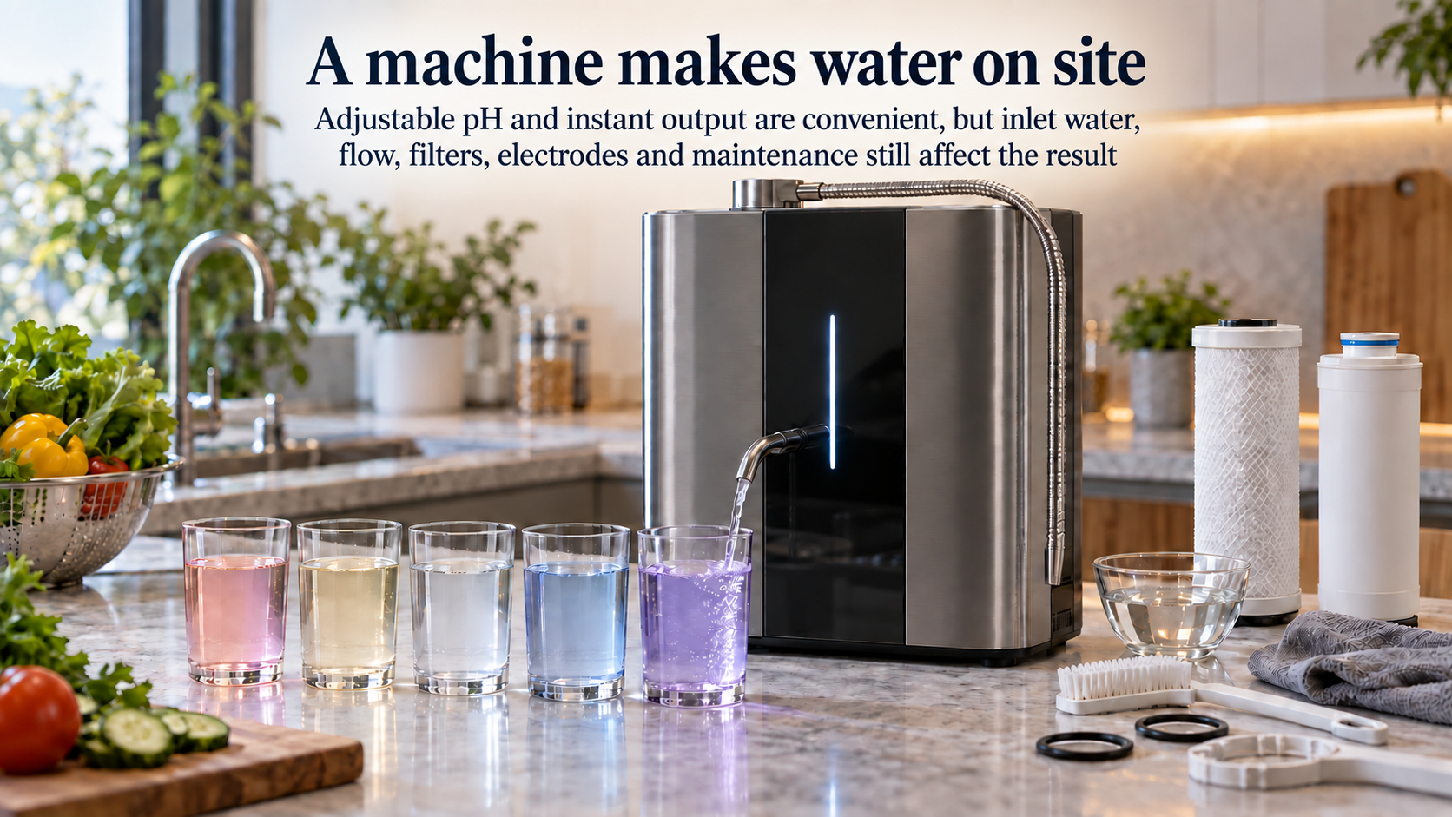
Notes:
A mature household alkaline ioniser can provide adjustable pH, instant production and different types of output water. Used correctly, it can make hydrogen-rich water. The user should follow the equipment instructions, choose a suitable drinking pH and check the actual output regularly. Even so, it remains equipment producing water in the customer's home. The final glass changes with inlet minerals, flow rate, filter life, electrode scale and cleaning. A qualified machine does not automatically make every glass in every home identical. People who enjoy maintaining and testing equipment may choose a machine. People who value simplicity and fewer operating variables may prefer a factory-finished product.
[Sources]
- https://pmc.ncbi.nlm.nih.gov/articles/PMC9736533/
[Visual]
- Native Image 2.5 language generation.
- Product-specific pages use authentic IZUMIO or OLEMIO package references.

Slide 12
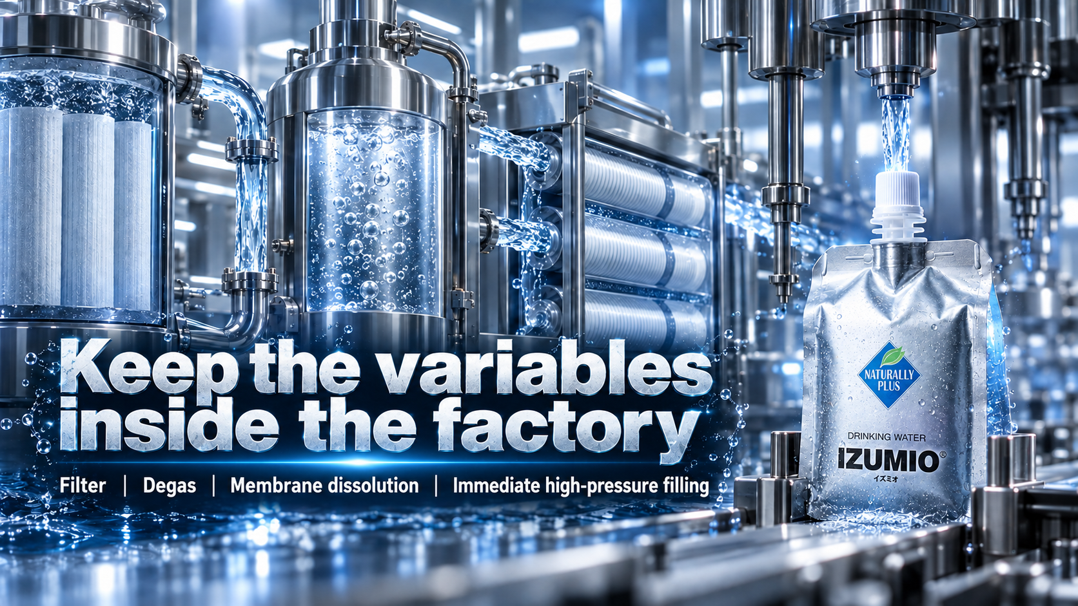
Notes:
Now return to IZUMIO. Its production route keeps the critical work inside a controlled factory instead of asking the customer to complete the final manufacturing in the kitchen. Official information describes treated water, membrane degassing to remove dissolved air, and membrane dissolution that introduces hydrogen into the water. The improved process sends hydrogen water directly into the package under pressure, reducing loss through an intermediate filling tank. The result is not another device for the customer to adjust. It is a finished pouch of IZUMIO. Professional production stays within a professional system, while the customer's daily action remains simple.
[Sources]
- https://www.naturally-plus.com/sg/en/products/izumio/quality_control/
[Visual]
- Native Image 2.5 language generation.
- Product-specific pages use authentic IZUMIO or OLEMIO package references.

Slide 13
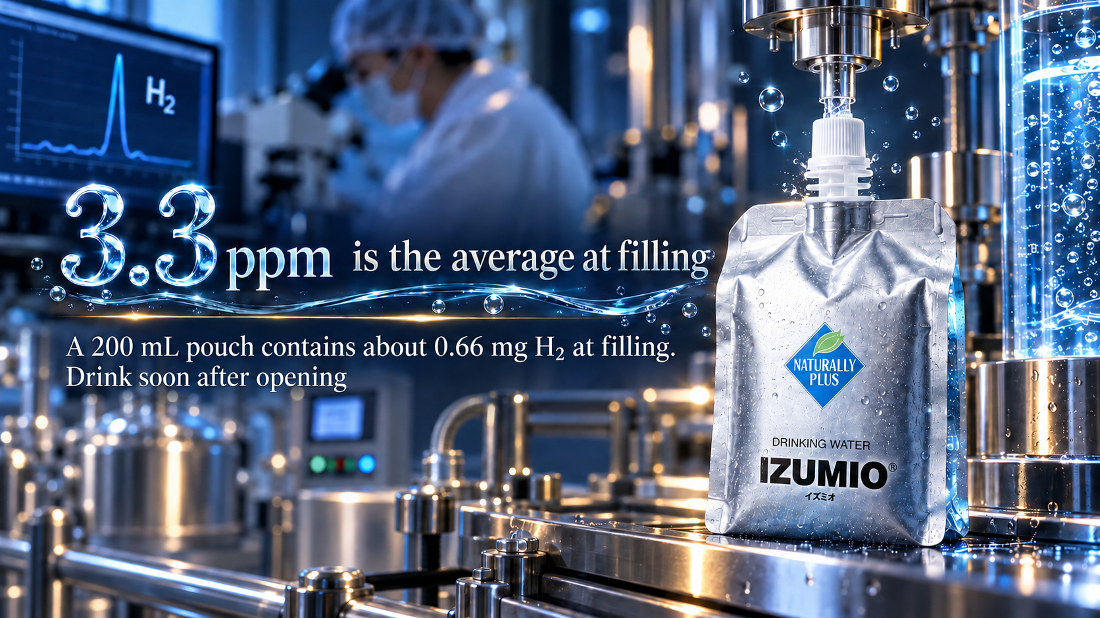
Notes:
IZUMIO states 3.3 ppm as the average reading at the time of filling. In this context, ppm can be read as milligrams of dissolved hydrogen per litre. Two hundred millilitres multiplied by 3.3 milligrams per litre gives a theoretical amount of about 0.66 milligrams of H₂ at filling. Why repeat the words at filling? Hydrogen molecules are small and gradually escape depending on time, temperature, storage, packaging and opening. We should not promise that every pouch still reads 3.3 ppm when opened. The accurate message is that the factory starts from a controlled filling level, uses specialised packaging to reduce loss, and recommends drinking soon after opening.
[Sources]
- https://www.naturally-plus.com/sg/en/products/izumio/features/
[Visual]
- Native Image 2.5 language generation.
- Product-specific pages use authentic IZUMIO or OLEMIO package references.

Slide 14
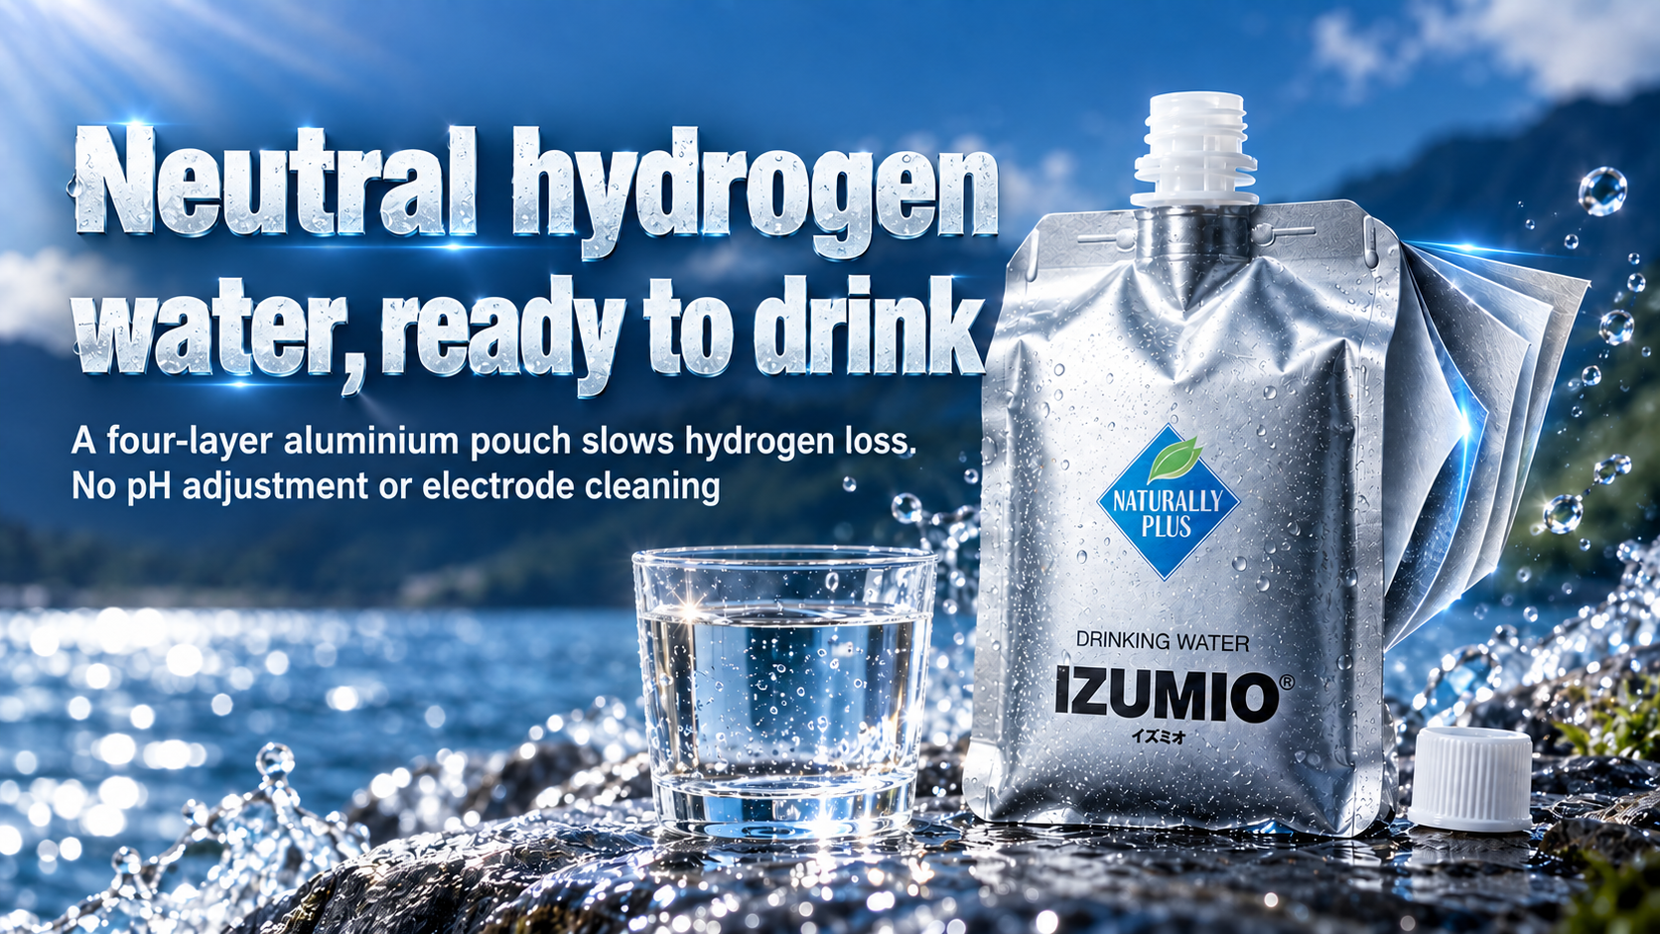
Notes:
Another important feature of IZUMIO is its neutral positioning. The customer does not have to choose between pH 8.5, 9.0 or 9.5, or use test drops to decide whether today's output is outside the preferred range. The four-layer aluminium pouch improves the barrier against hydrogen loss, while the cap and pouch have been designed and tested for storage and leakage. This does not mean that hydrogen can never escape. It means that the product uses purpose-built packaging to manage that issue. The daily experience is simple: take an original pouch, open it and drink it soon. There is no water hose, electrode cleaning or changing flow rate to manage.
[Sources]
- https://www.naturally-plus.com/sg/en/products/izumio/quality_control/
[Visual]
- Native Image 2.5 language generation.
- Product-specific pages use authentic IZUMIO or OLEMIO package references.

Slide 15
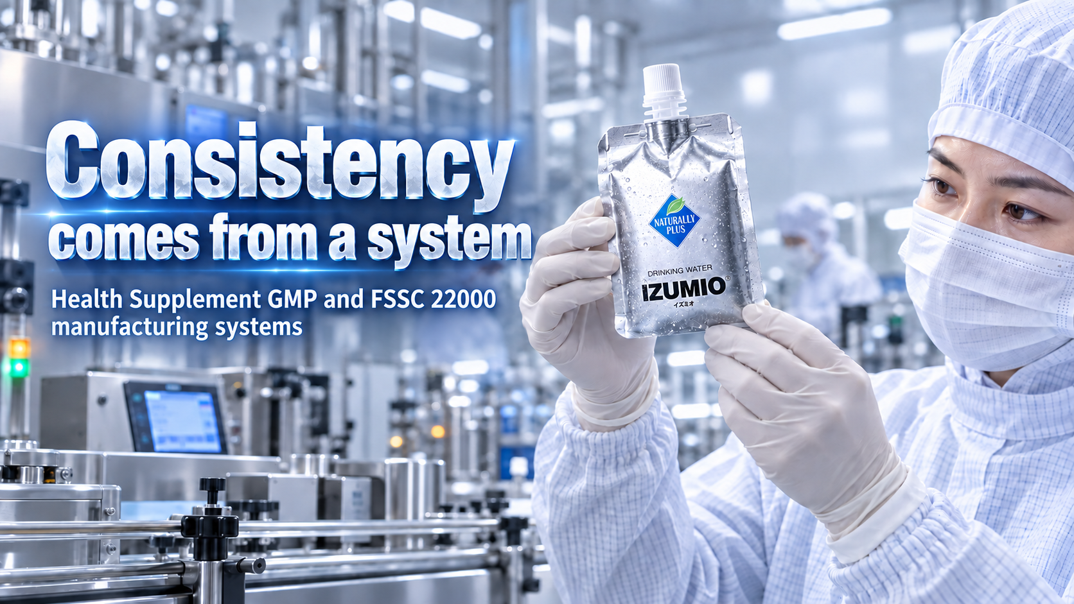
Notes:
Consistency is not created by an advertising phrase. It comes from a production discipline that can be repeated. Naturally Plus states that IZUMIO's designated manufacturer is in Tochigi, Japan, and that the relevant production follows Health Supplement GMP, while the Kanuma factory holds FSSC 22000 certification. GMP concerns production processes and appropriate quality checks. FSSC 22000 focuses on the food-safety management system. These systems are not proof that a product treats disease, but they do support a confident statement about defined standards for production, hygiene, process control and inspection. The factory repeats this specialised work so the customer does not have to become a water engineer.
[Sources]
- https://www.naturally-plus.com/sg/en/products/izumio/quality_control/
[Visual]
- Native Image 2.5 language generation.
- Product-specific pages use authentic IZUMIO or OLEMIO package references.

Slide 16
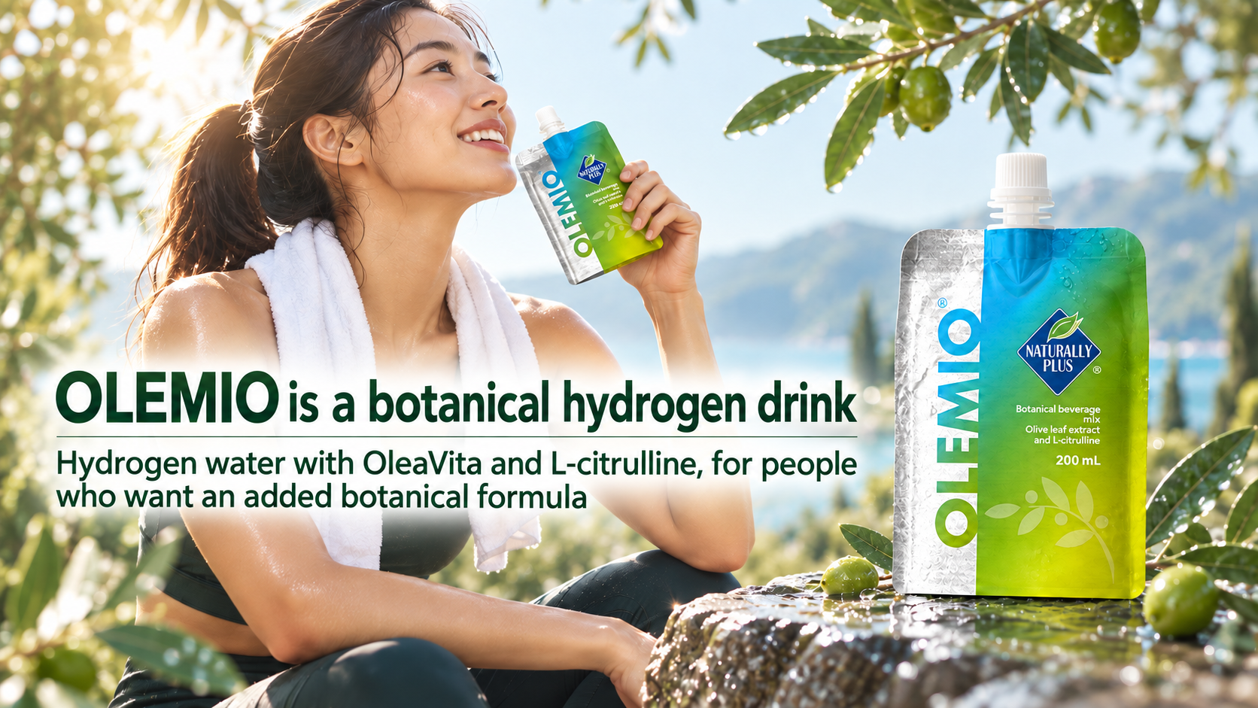
Notes:
OLEMIO and IZUMIO should not be treated as identical products simply because both contain hydrogen water. OLEMIO also uses a hydrogen-water base officially stated at an average 3.3 ppm at filling, and adds OleaVita olive-leaf extract, L-citrulline and other formulation ingredients. It is therefore positioned as a botanical beverage. It suits people who want an additional botanical formula or a product that fits an active daily routine. If the customer wants the simplest and most direct neutral hydrogen-water choice, I would introduce IZUMIO first. If the customer understands and prefers OLEMIO's added formula, OLEMIO becomes the suitable option. Clear product positioning supports long-term satisfaction.
[Sources]
- https://www.naturally-plus.com/my/en/products/olemio/overview/
- https://www.naturally-plus.com/my/en/products/olemio/formula/
[Visual]
- Native Image 2.5 language generation.
- Product-specific pages use authentic IZUMIO or OLEMIO package references.

Slide 17
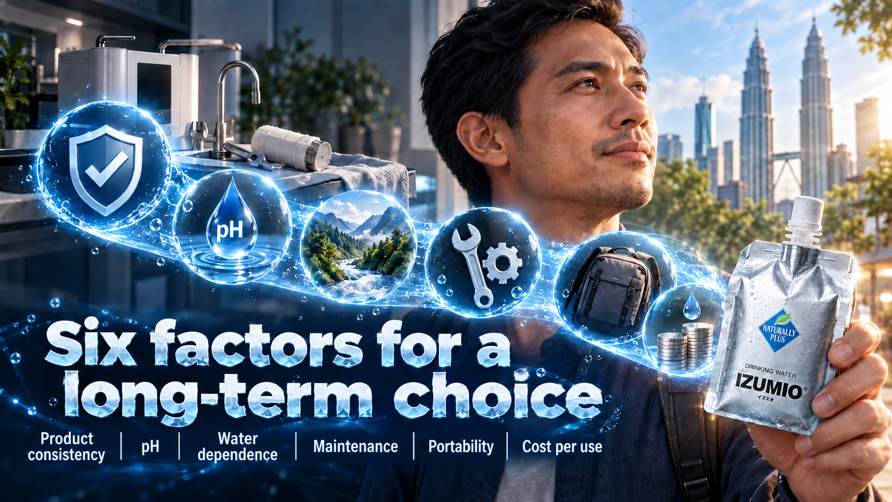
Notes:
Place the two routes on the same comparison. A household machine may lead in instant high-volume output and long-term unit cost, but it depends more on inlet water, filters, electrodes, flow, cleaning and testing. IZUMIO costs more per pouch and still requires an authentic product, a valid shelf life, correct storage and prompt consumption after opening. Its strengths are finished-product consistency, neutral pH, portability and low operating burden. There is no need to claim that one route suits everyone. The right choice depends on the responsibility the customer is willing to carry. A person who likes equipment and regular testing may prefer a machine. A person who values simple and consistent use may prefer IZUMIO.
[Sources]
- 00_事实证据基线.md
[Visual]
- Native Image 2.5 language generation.
- Product-specific pages use authentic IZUMIO or OLEMIO package references.

Slide 18
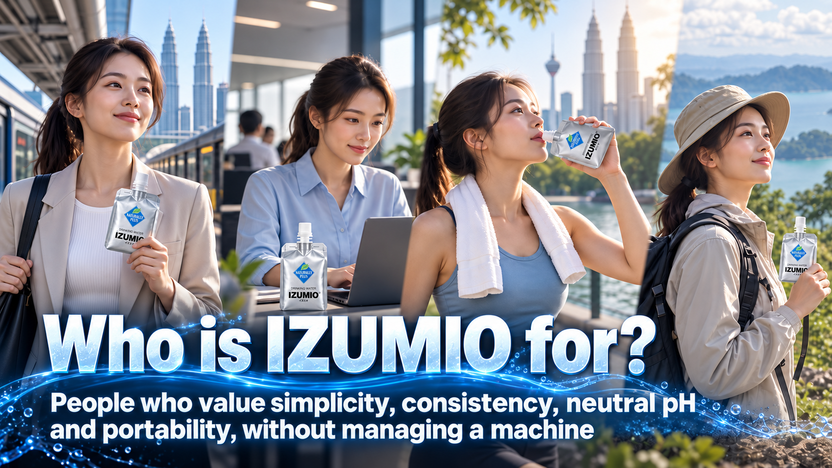
Notes:
Who is especially well suited to IZUMIO? It fits people who do not want to study household water quality or maintain a machine and simply want to open a pouch and drink. It also suits people who work outside, travel, exercise or want hydrogen water available away from home. A third group does not seek the idea of high alkalinity and places greater value on neutral pH, controlled production and packaging. Good selling does not force every customer into the same answer. Ask one simple question: do you want a water-making machine that you will manage every day, or a finished pouch that is ready to carry and drink? The customer's lifestyle often provides the answer.
[Sources]
- 00_事实证据基线.md
[Visual]
- Native Image 2.5 language generation.
- Product-specific pages use authentic IZUMIO or OLEMIO package references.

Slide 19
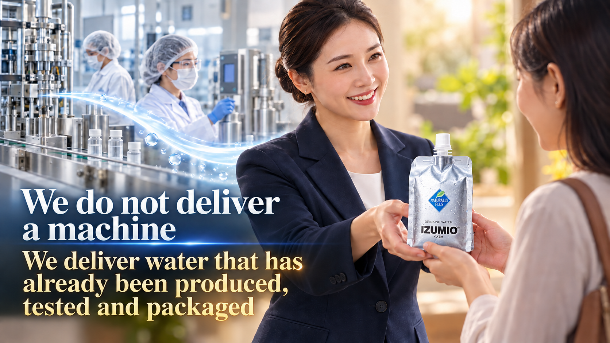
Notes:
Remember this final line. We do not deliver a machine. We deliver water that has already been produced, tested and packaged. Its final quality is not left entirely to the customer's water source, filter, electrodes and cleaning habits. We also do not need the inaccurate claim that another company's machine has been banned in America. IZUMIO's value is that it keeps complexity in the factory and returns simplicity to daily life. The customer does not want to become an electrolysis expert. The customer wants a choice that can be followed consistently. For someone who values neutral pH, controlled production and convenience, my conclusion is clear: begin with authentic IZUMIO.
[Sources]
- 00_事实证据基线.md
[Visual]
- Native Image 2.5 language generation.
- Product-specific pages use authentic IZUMIO or OLEMIO package references.

