Slide 1

Notes:
Welcome to the Fifth Education System: The Five Principles. Every team needs a shared line that everyone understands and respects. Without it, good intentions can still create confusion, mistrust and conflict. These five principles are not decorative slogans. They protect the system, information, cooperation, money and goods, and relationships. They tell us what must be confirmed, what must be reported and what must never be used for personal advantage. The purpose is straightforward: protect people, protect trust and build a team that can work together for the long term.
[Sources]
- 用户提供的《五大原则》原始内容。
- OpenAI Image 2.0 生成的图文一体课程画面。

Slide 2
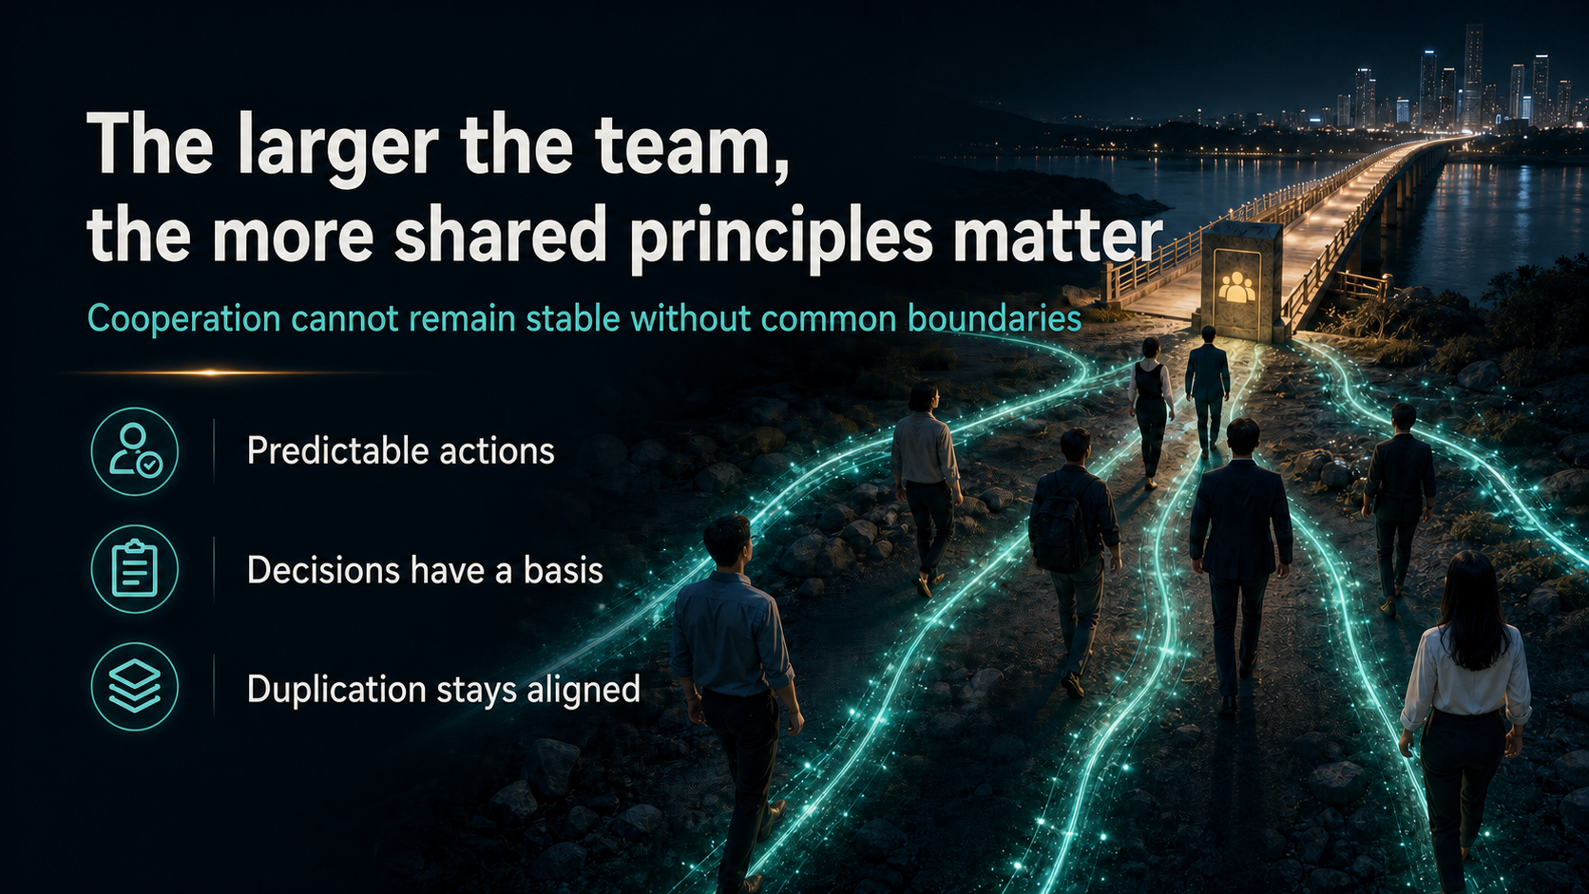
Notes:
A small group may rely on personal understanding, but that becomes unreliable as the team grows. Different backgrounds and working styles naturally create different interpretations. Shared principles make actions predictable, give decisions a clear basis and keep duplication aligned. When everyone knows where the boundary is, people do not need to guess what a leader wants or follow whoever speaks the loudest. A principle is valuable because it still guides behaviour when the leader is not in the room. The larger the team becomes, the more important it is to use one visible standard instead of many private versions.
[Sources]
- 用户提供的《五大原则》原始内容。
- OpenAI Image 2.0 生成的图文一体课程画面。

Slide 3
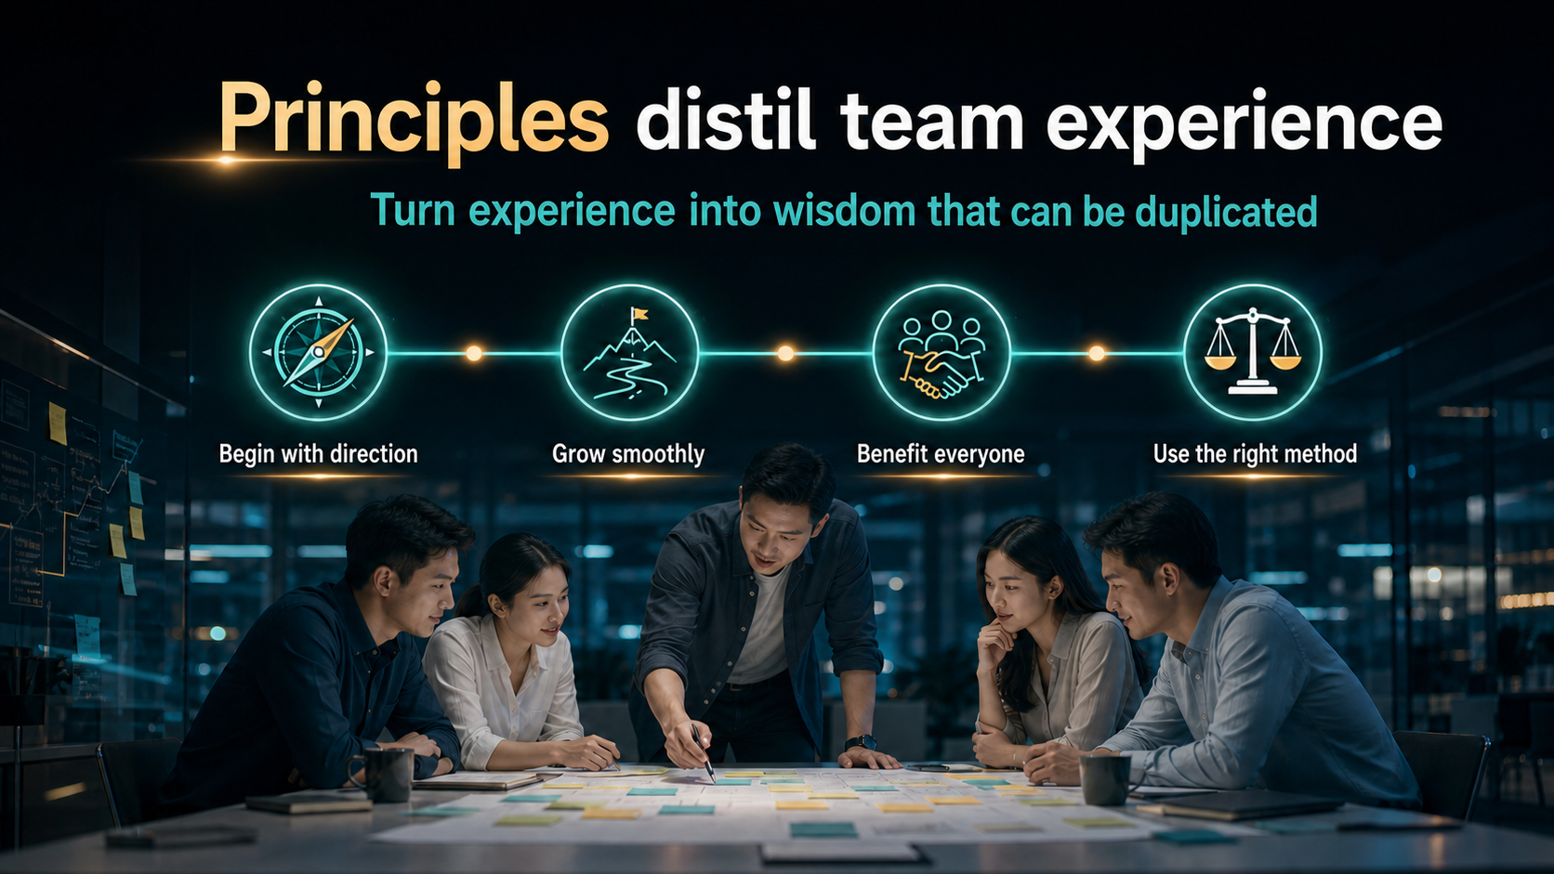
Notes:
Useful principles do not appear by accident. They are distilled from real cooperation, including success, friction and correction. A good beginning needs direction. Growth should be smooth rather than chaotic. Benefits should serve customers, partners and the wider team. Most importantly, the method must be right. We are not learning these principles to memorise a set of lines. We are turning experience into a shared standard that can be practised, reviewed and passed on. A principle proves its value when it helps a person make the right choice under pressure, not only when everything is easy.
[Sources]
- 用户提供的《五大原则》原始内容。
- OpenAI Image 2.0 生成的图文一体课程画面。

Slide 4
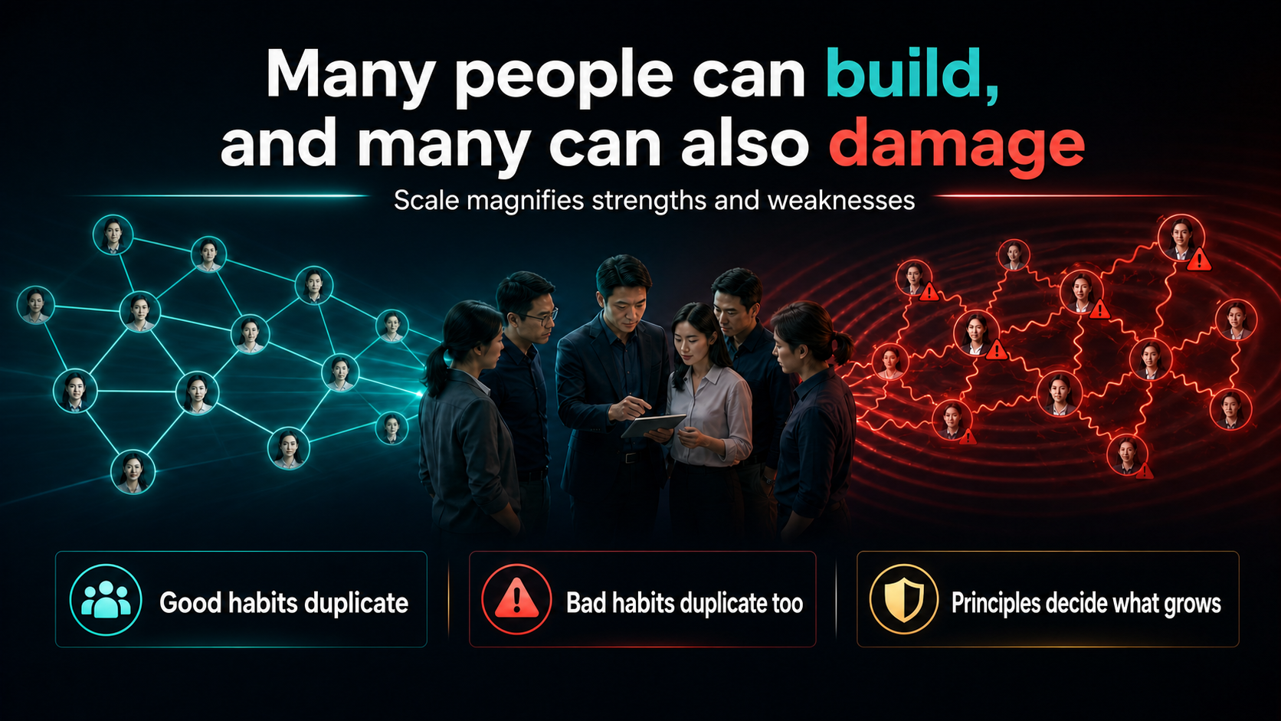
Notes:
More people can make work easier, but they can also accelerate damage. Team size alone is not the answer. The real question is what the team is duplicating. If people duplicate respect, integrity, learning and responsibility, scale becomes a strength. If they duplicate unilateral action, rumours, price cutting, network grabbing, unclear debts or confused relationships, the harm also spreads faster. Leaders must look beyond today's sales and ask a harder question: if everyone copied this behaviour, where would the team end up? Principles decide which habits are allowed to grow and which must stop before they become culture.
[Sources]
- 用户提供的《五大原则》原始内容。
- OpenAI Image 2.0 生成的图文一体课程画面。

Slide 5
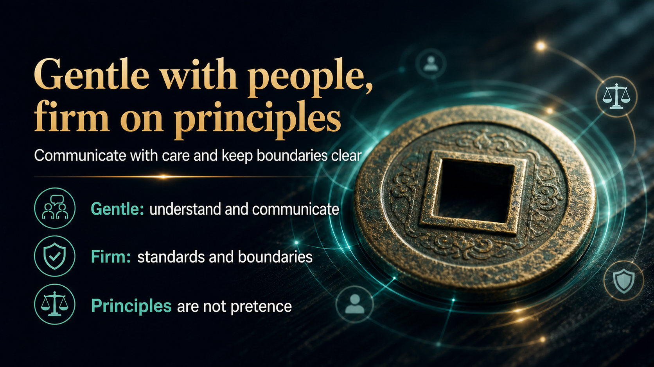
Notes:
The old round coin with a square centre offers a useful picture. Being round on the outside means respecting people, listening and giving them room to explain. Being square on the inside means important matters still have standards, boundaries and records. Firmness without humanity turns principles into pressure. Warmth without firmness allows the strongest personality to control the outcome. Mature leadership can speak respectfully while protecting the standard. The person is treated with dignity, but the facts do not change because of friendship, rank or emotion. That balance keeps both relationships and the organisation healthy.
[Sources]
- 用户提供的《五大原则》原始内容。
- OpenAI Image 2.0 生成的图文一体课程画面。

Slide 6
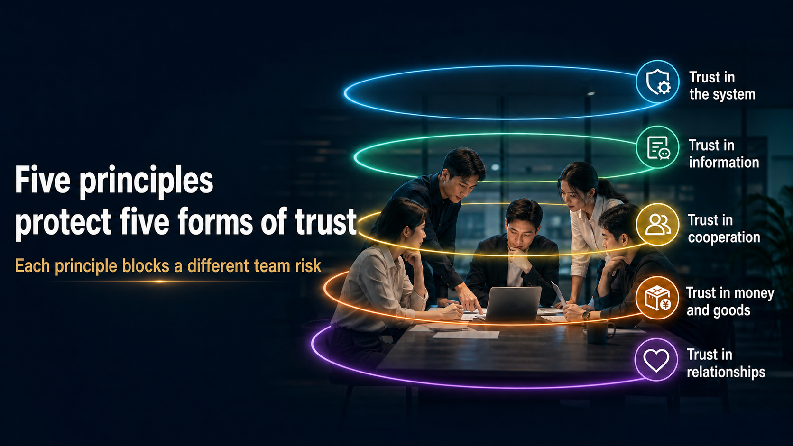
Notes:
The Five Principles are connected, not five isolated restrictions. The first protects trust in the system. The second protects trust in information. The third protects cooperation and team boundaries. The fourth protects dealings involving money and goods. The fifth protects relationships from control, pressure and personal interest. When the system is changed at will, information becomes confused. When information is confused, cooperation and financial matters become harder to manage. When boundaries and relationships collapse, even the best slogans cannot rescue the team. Protecting these five forms of trust is how we protect the team's future.
[Sources]
- 用户提供的《五大原则》原始内容。
- OpenAI Image 2.0 生成的图文一体课程画面。

Slide 7
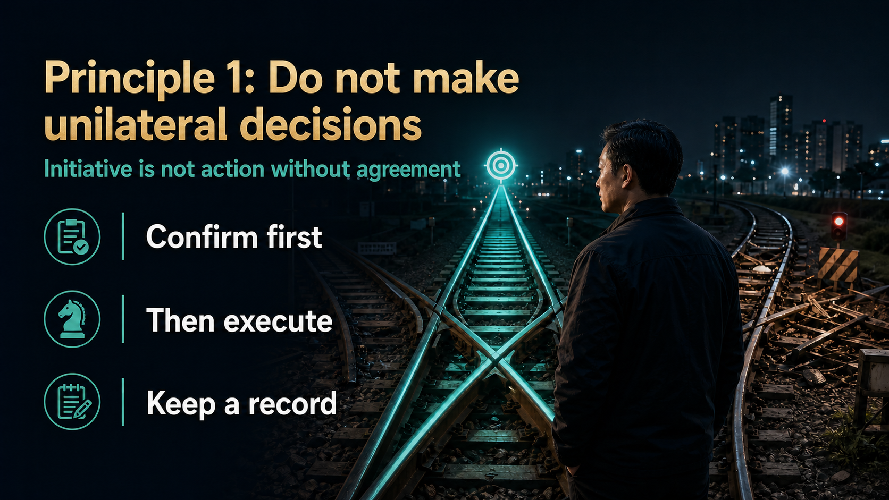
Notes:
The first principle is simple: do not make unilateral decisions. A team needs initiative, but initiative does not mean skipping communication or turning a personal idea into a team decision. Public promotions, pricing, accounts, network arrangements and brand presentation can affect everyone. Mature initiative begins with a clear proposal, an explanation of the purpose and risk, confirmation from the responsible person and execution according to the agreed version. Acting first and explaining later may feel fast, but the cost of repairing the consequences is carried by the whole team. Confirm first, execute second and keep a record.
[Sources]
- 用户提供的《五大原则》原始内容。
- OpenAI Image 2.0 生成的图文一体课程画面。

Slide 8
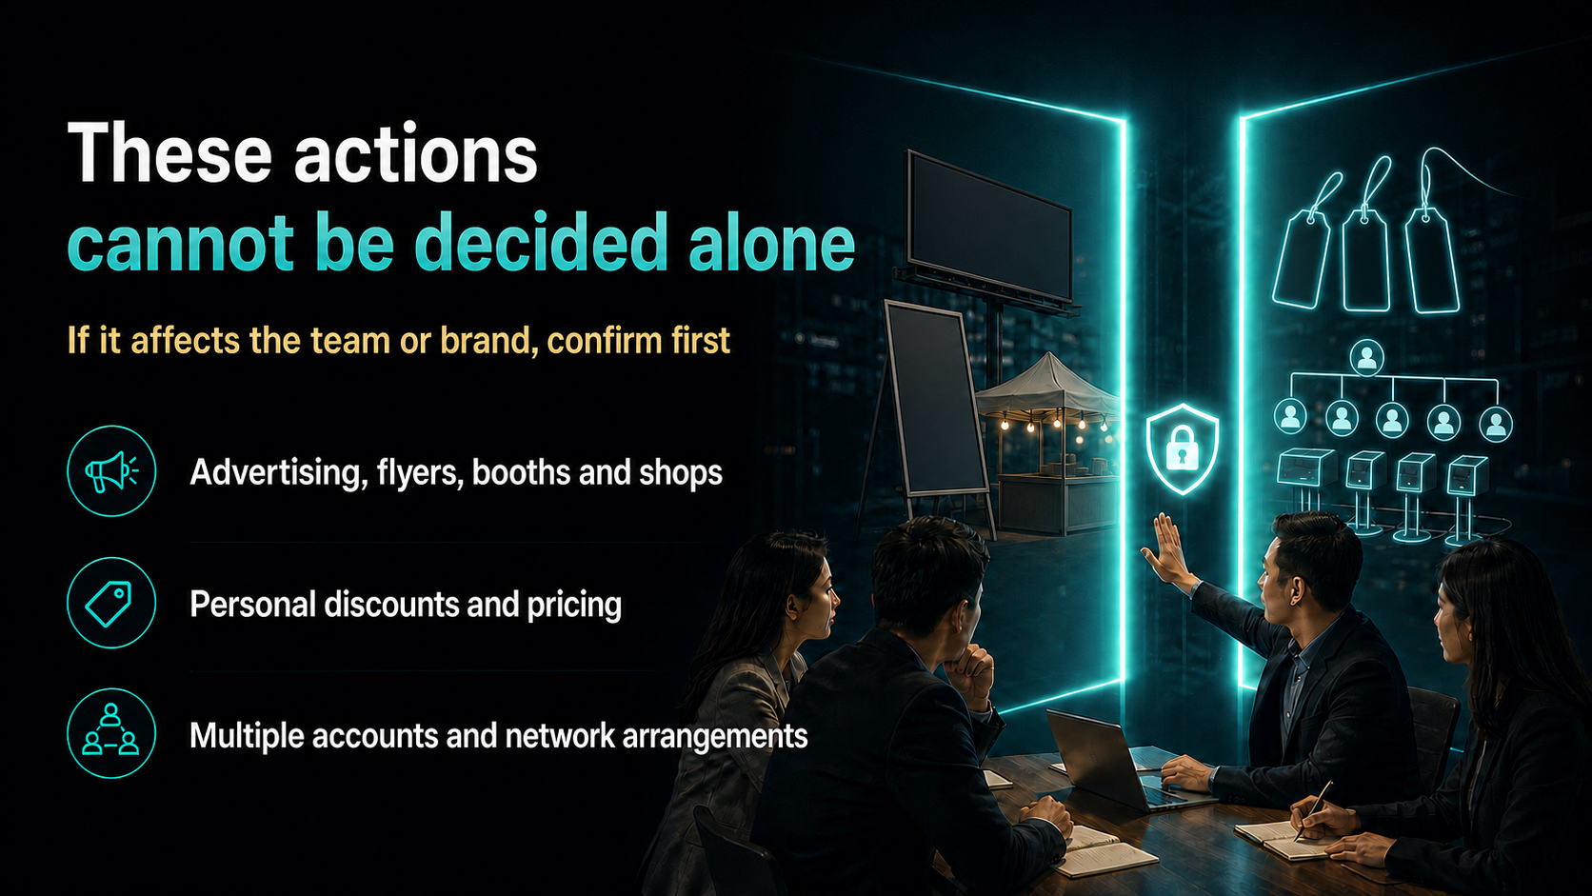
Notes:
Examples include placing advertisements, distributing flyers, opening a booth or shop, offering special discounts, investing through multiple accounts or arranging a large network independently. These actions may look hardworking, yet they can involve company policy, local rules, pricing discipline and organisational fairness. If an action affects the brand, customers, accounts, team structure or other partners, it cannot be decided by one person alone. Leaders are subject to the same rule. In fact, the higher the responsibility, the greater the duty to confirm before acting. Effort is valuable only when it moves through the right channel.
[Sources]
- 用户提供的《五大原则》原始内容。
- OpenAI Image 2.0 生成的图文一体课程画面。

Slide 9
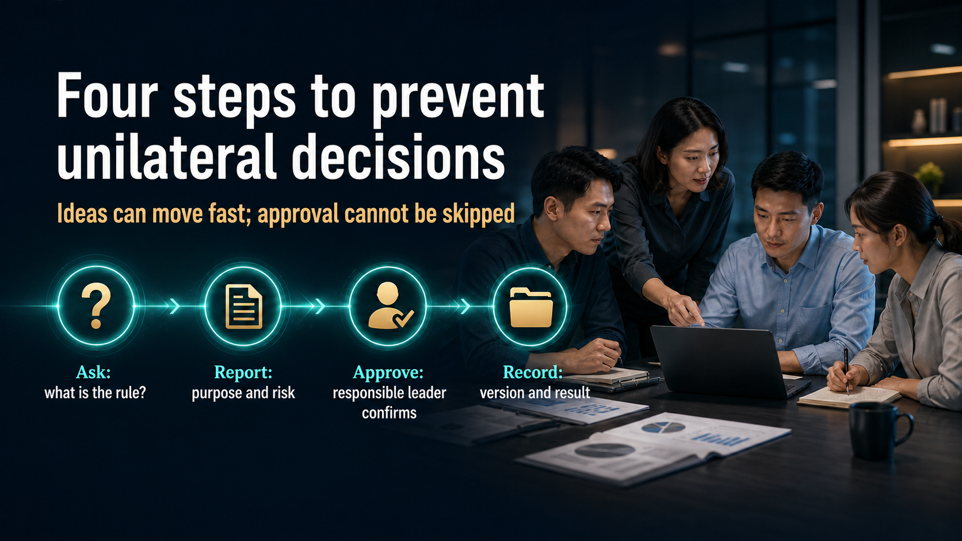
Notes:
When you have a new idea, use four steps. First, ask and understand the existing rule. Second, report the purpose, method, cost and risk clearly. Third, obtain confirmation from the person who is genuinely responsible, not from a vague claim that someone allowed it before. Fourth, keep the approved version and record the result. This process is not designed to kill creativity. It places creativity inside a flow that can be explained and owned. In short: ask clearly, write clearly, confirm with the right person and preserve the record.
[Sources]
- 用户提供的《五大原则》原始内容。
- OpenAI Image 2.0 生成的图文一体课程画面。

Slide 10
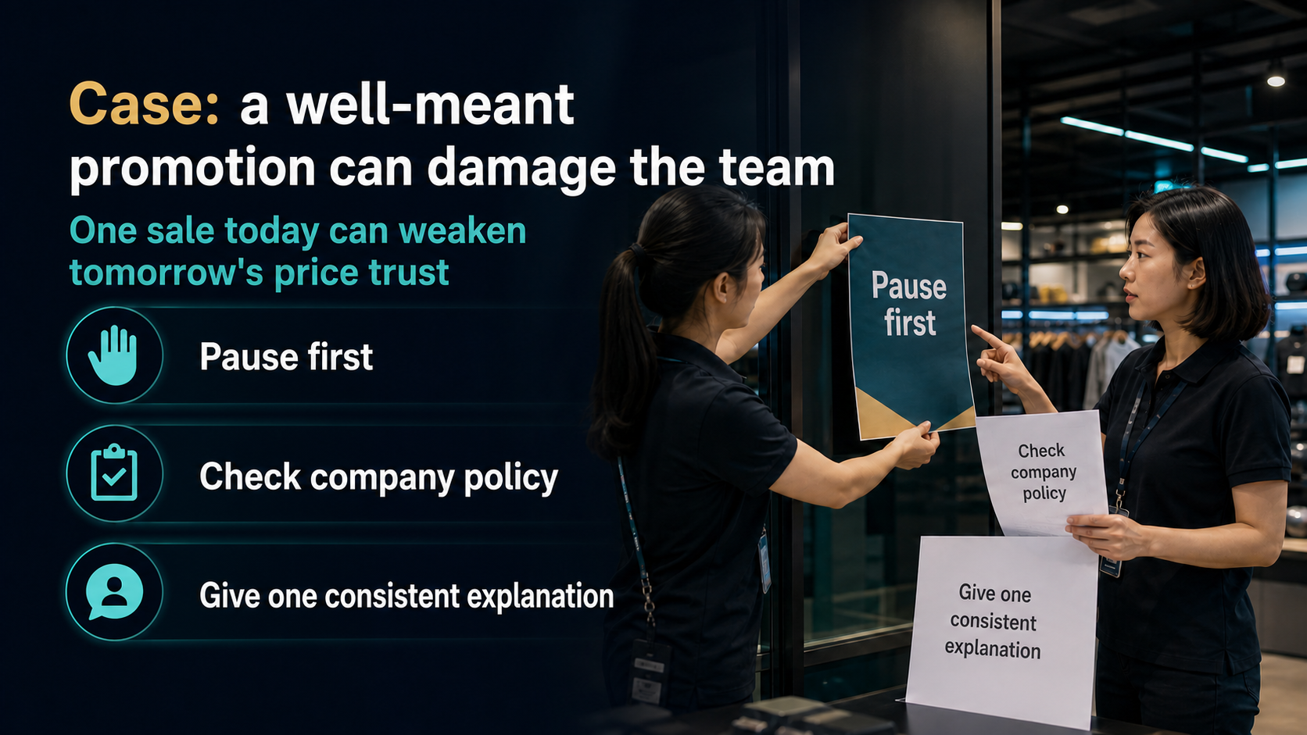
Notes:
Imagine a partner promises an extra discount to help a customer. One sale may succeed, but what happens when others start lowering the price too? Once customers receive different prices from different people, they begin to doubt the whole team. The correct response is to pause, check company and team policy, then explain the value in one consistent and transparent way. Protecting the boundary in a small transaction protects trust in the next hundred transactions. Good intentions still need the right method. A sale is never worth creating a price problem that everyone else must carry.
[Sources]
- 用户提供的《五大原则》原始内容。
- OpenAI Image 2.0 生成的图文一体课程画面。

Slide 11
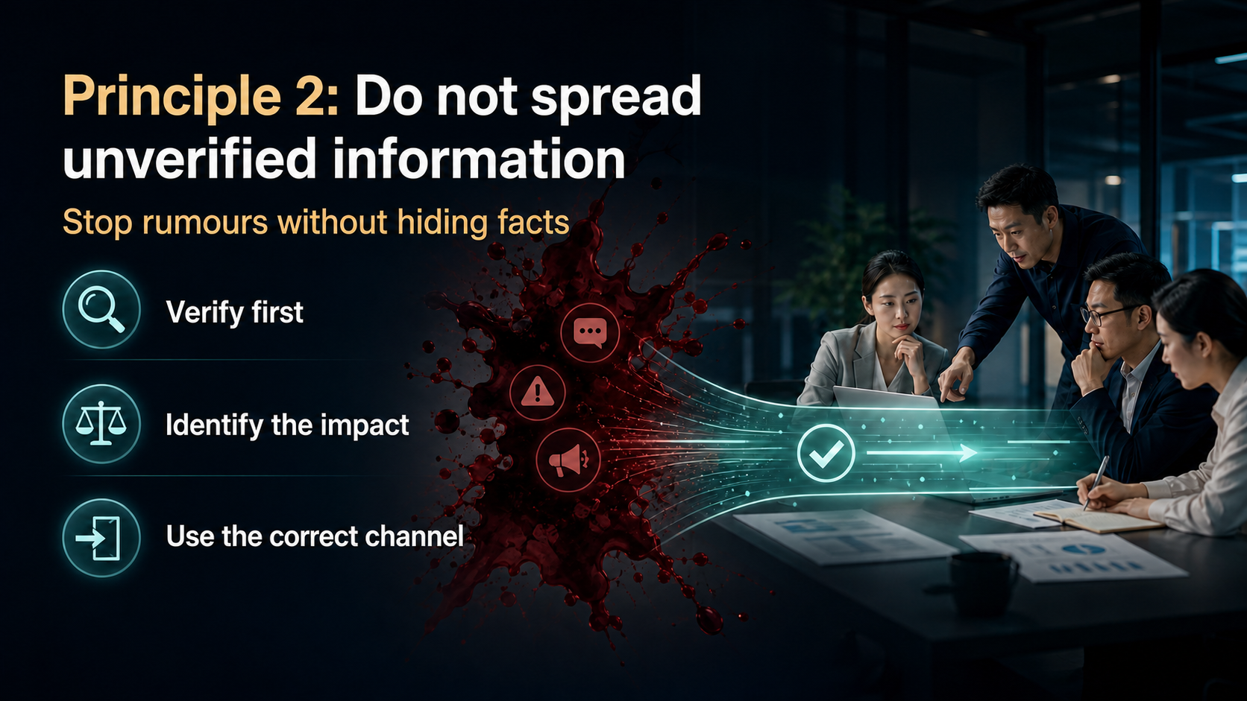
Notes:
The second principle is not simply about staying quiet. It is about handling information responsibly. Before sharing, verify the source. Then identify who may be affected and whether the matter is a fact, an assumption, private information or a real risk. Finally, use the correct channel. Rumours spread because people add details, repeat partial stories or forward messages before checking them. At the same time, real risks must not be buried in the name of loyalty. Responsible communication stops speculation, protects privacy and moves important facts quickly to the people who can act.
[Sources]
- 用户提供的《五大原则》原始内容。
- OpenAI Image 2.0 生成的图文一体课程画面。

Slide 12

Notes:
Not all information should be handled in the same way. A fact should be checked against a reliable source. An assumption should not be circulated as though it were true. Private information should go only to the people who genuinely need it. A serious risk should be reported quickly through the responsible channel. Confusion begins when these categories are mixed together. Someone may call an assumption a fact, treat gossip as concern or spread private details in the name of transparency. Before forwarding anything, ask which category it belongs to and then use the matching response.
[Sources]
- 用户提供的《五大原则》原始内容。
- OpenAI Image 2.0 生成的图文一体课程画面。

Slide 13
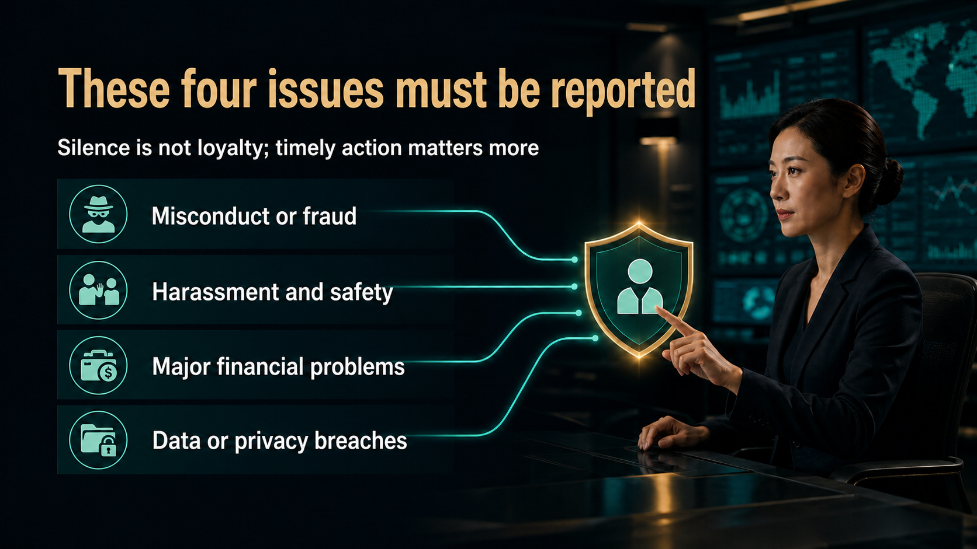
Notes:
Four categories must be reported through the proper channel: misconduct or fraud, harassment and safety concerns, major financial problems, and data or privacy breaches. Silence is not loyalty when people, trust or the organisation may be harmed. Reporting also does not mean spreading the matter to everyone. It means preserving what is known, avoiding added speculation and bringing the facts to the responsible person in time. The goal is not drama or public judgement. The goal is to stop harm, protect those involved and allow the right process to begin while the facts are still clear.
[Sources]
- 用户提供的《五大原则》原始内容。
- OpenAI Image 2.0 生成的图文一体课程画面。

Slide 14
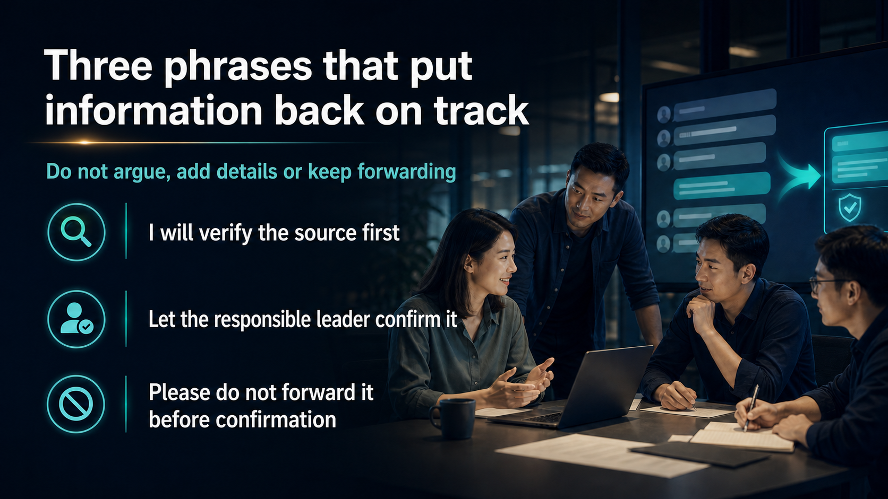
Notes:
You do not need a long debate to stop doubtful information. Use three simple phrases. First: I will verify the source before commenting. Second: let us send this to the responsible leader for confirmation. Third: please do not forward it until it has been confirmed. These phrases reduce emotion and return the conversation to a process. They also prevent you from accidentally becoming the next person in the rumour chain. Good communication is not about winning an argument. It is about protecting accuracy, privacy and the ability of the team to respond responsibly.
[Sources]
- 用户提供的《五大原则》原始内容。
- OpenAI Image 2.0 生成的图文一体课程画面。

Slide 15
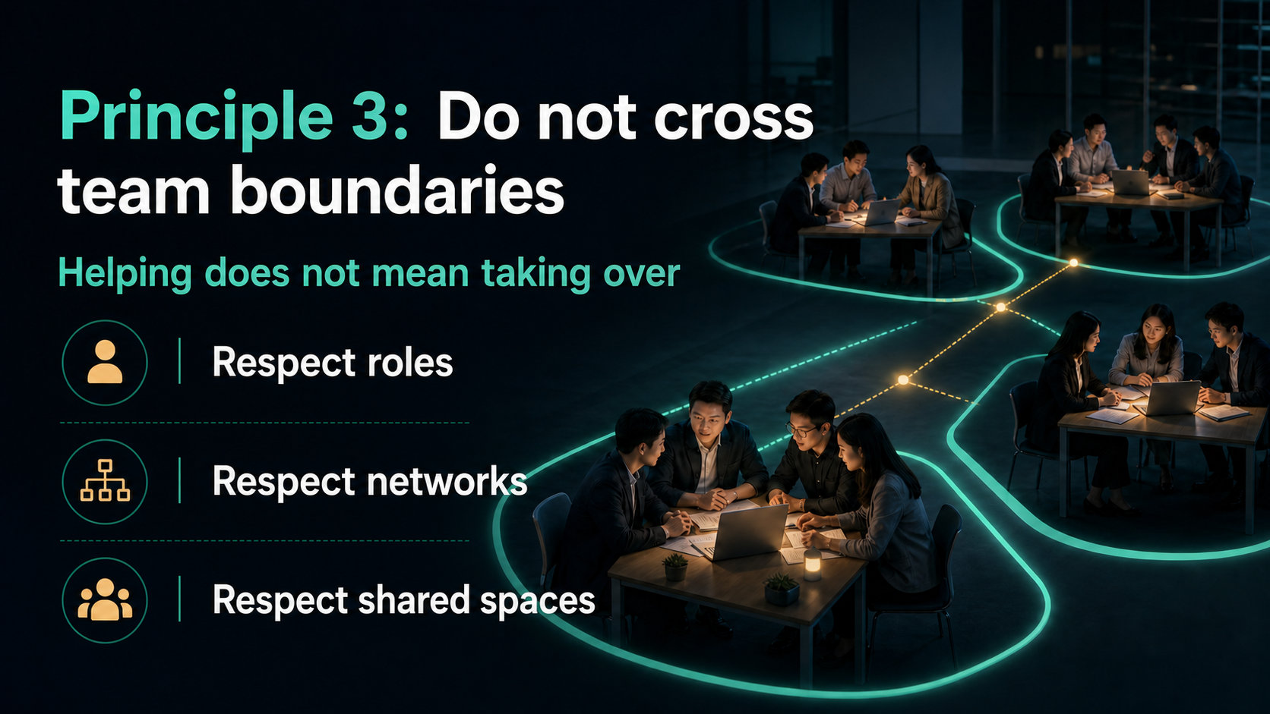
Notes:
The third principle protects the boundaries that make cooperation possible. Helping someone does not mean taking over their role, controlling their network or using a shared platform for personal purposes. Respect the role of the upline, the independence of the downline, the boundary of the crossline and the purpose of team spaces. When a boundary is unclear, ask before acting. When help is requested, agree on the scope. The aim is not to build walls between people. It is to make cooperation clear enough that support strengthens responsibility instead of replacing it.
[Sources]
- 用户提供的《五大原则》原始内容。
- OpenAI Image 2.0 生成的图文一体课程画面。

Slide 16

Notes:
An upline can guide, teach and support, but should not become a permanent driver, delivery service, personal storeroom or substitute for another person's responsibility. Ask for help clearly: explain what is needed, why it matters, when it is required and what you have already tried. Respect the other person's time and accept that support has a reasonable scope. A healthy team develops capable partners. It does not create dependence on the most responsible person. When everyone carries their own duties, leaders can focus on teaching, solving important problems and developing the next generation.
[Sources]
- 用户提供的《五大原则》原始内容。
- OpenAI Image 2.0 生成的图文一体课程画面。

Slide 17
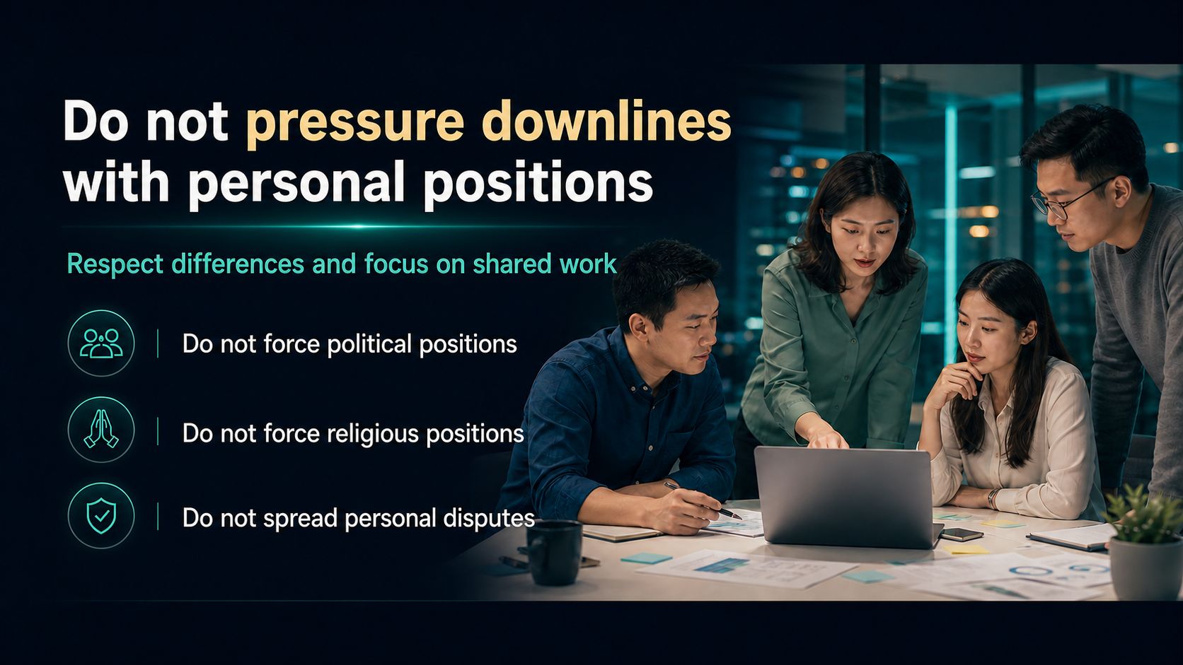
Notes:
Leadership does not give anyone the right to impose personal political or religious positions on a downline, or to pull the team into a private dispute. Partners may have different backgrounds and beliefs while still cooperating professionally. Keep team communication focused on shared work, customer service, learning and agreed responsibilities. If a personal matter is affecting the work, discuss the practical impact without demanding personal loyalty. Respect is strongest when people can contribute without fear that their beliefs, friendships or private choices will be used against them.
[Sources]
- 用户提供的《五大原则》原始内容。
- OpenAI Image 2.0 生成的图文一体课程画面。

Slide 18
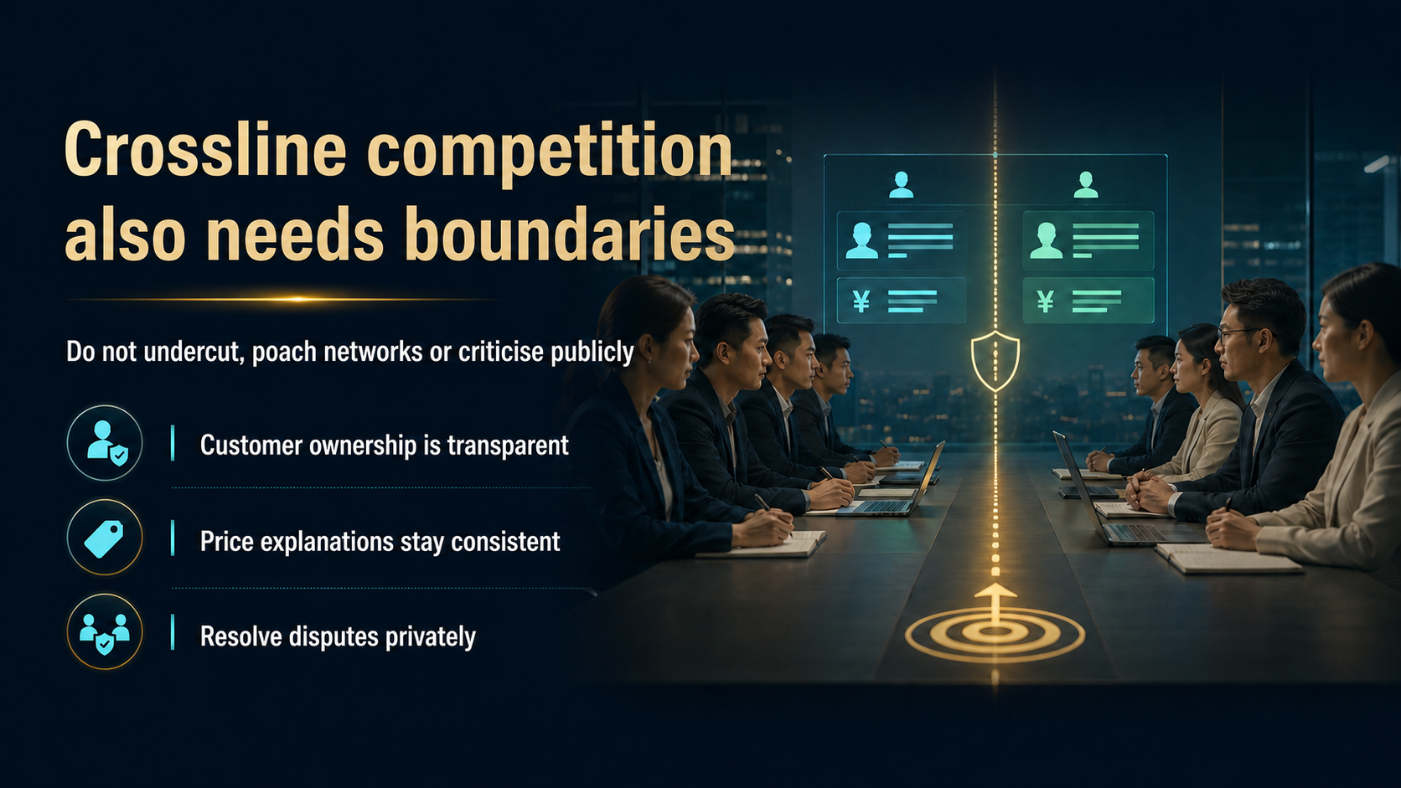
Notes:
Crossline partners may serve the same market, so boundaries must be especially clear. Do not cut prices to win a customer, pull someone from another network or criticise another partner in public. Keep customer ownership transparent, explain prices consistently and move disputes into a private resolution channel. Healthy competition improves service and skill. Destructive competition turns partners into enemies and teaches the whole organisation to distrust one another. The short-term gain from winning one customer is not worth damaging a culture that must support many customers and partners for years.
[Sources]
- 用户提供的《五大原则》原始内容。
- OpenAI Image 2.0 生成的图文一体课程画面。

Slide 19
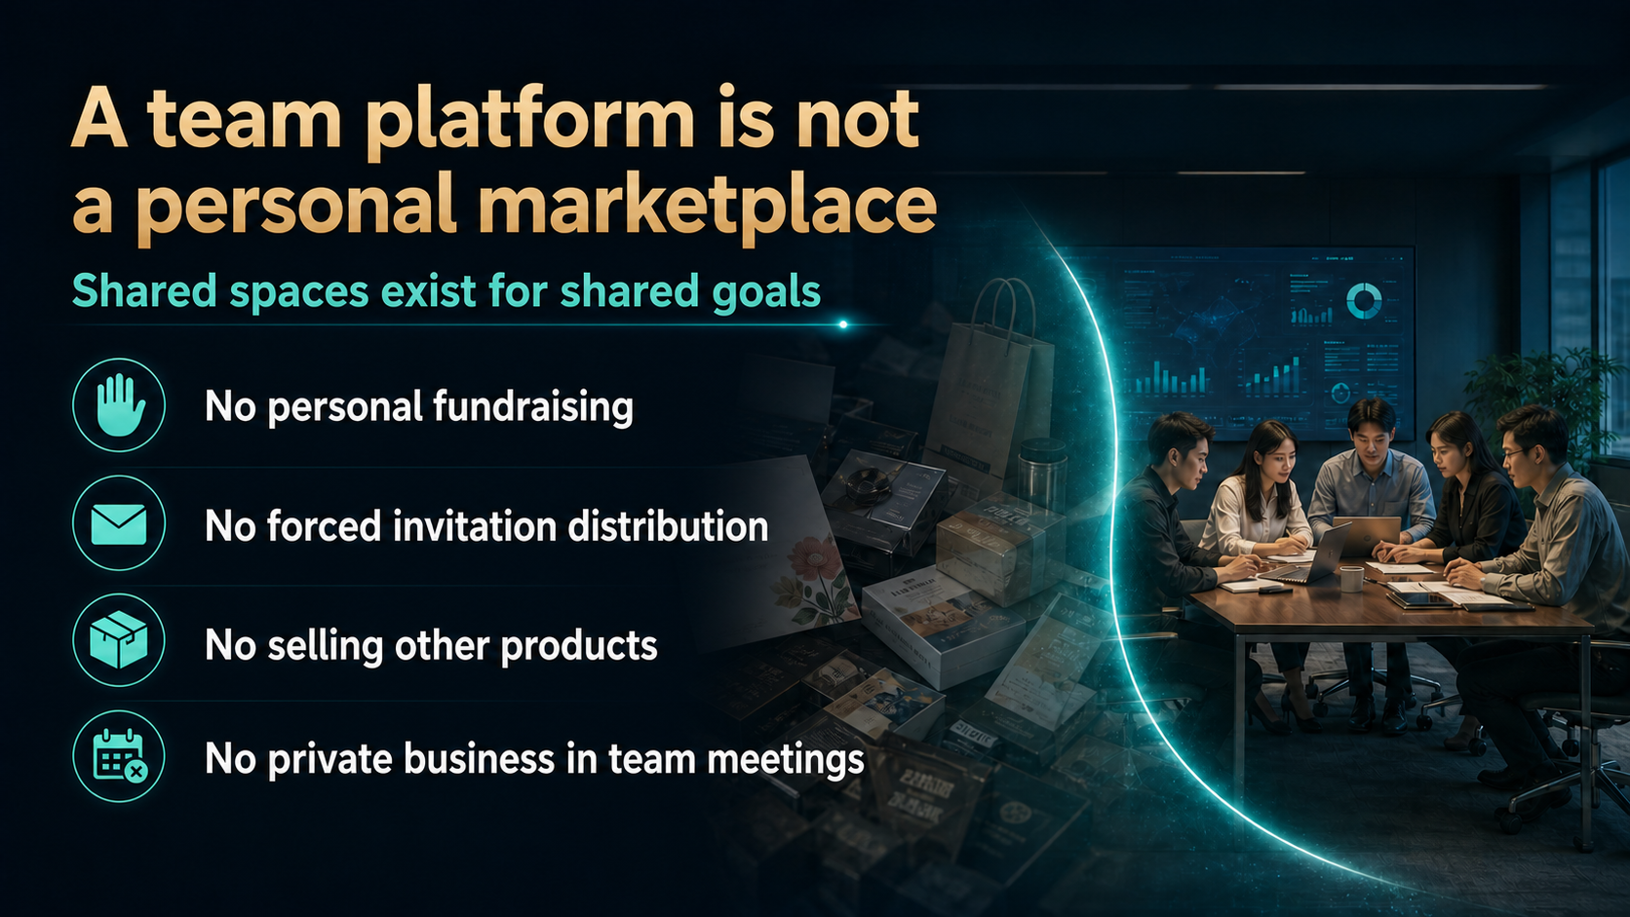
Notes:
A team chat, meeting, class or event exists for a shared purpose. It should not be turned into a personal marketplace. Do not use it to collect personal funds, force others to distribute invitations, sell unrelated products or conduct private business during team activities. People join a team space because they trust its purpose. Once that space becomes a channel for personal requests and side businesses, participation falls and trust weakens. If an unrelated matter genuinely deserves attention, seek permission and use a separate channel. Protecting shared space is part of protecting the team.
[Sources]
- 用户提供的《五大原则》原始内容。
- OpenAI Image 2.0 生成的图文一体课程画面。

Slide 20
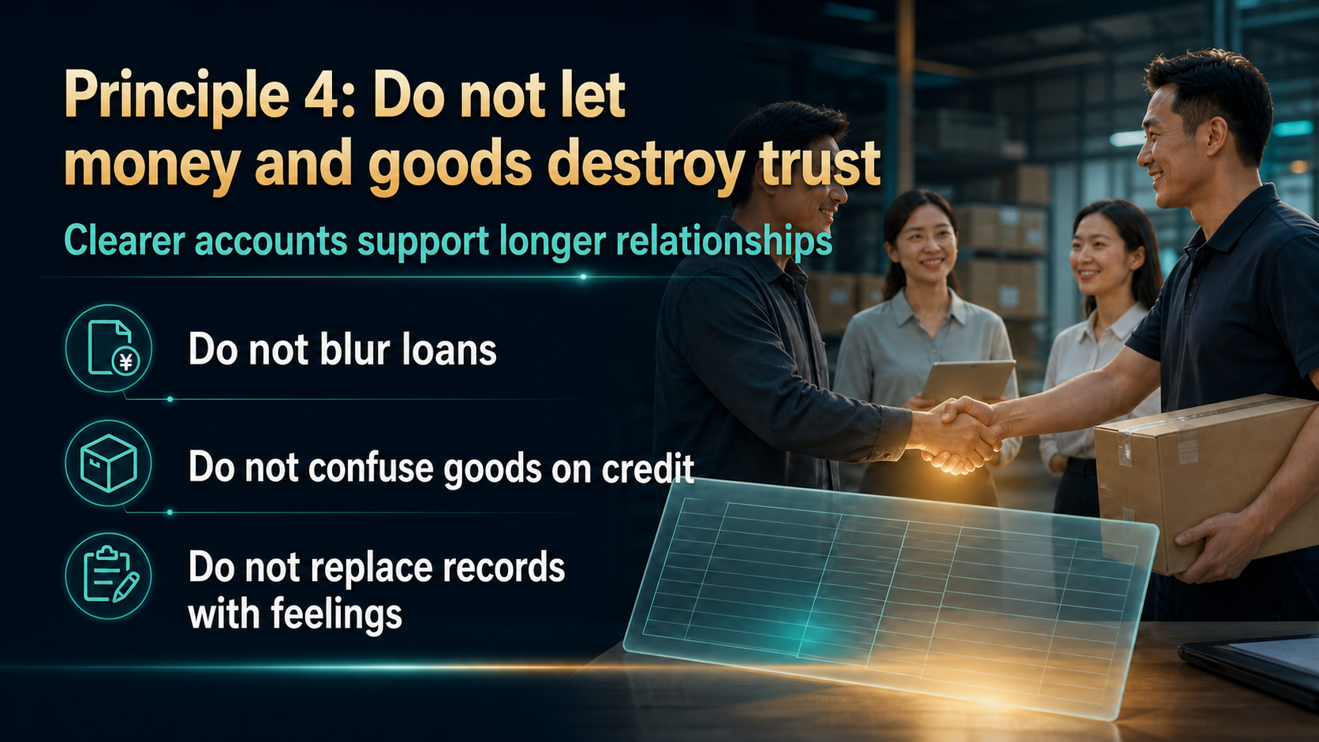
Notes:
The fourth principle protects trust whenever money or goods change hands. Do not blur the difference between a gift, a loan, a shared cost and goods supplied on credit. Do not rely on memory or emotion when a simple record can keep both sides clear. State the amount, quantity, date, responsibility and expected completion. A written record is not a sign of distrust. It prevents two honest people from remembering the same event differently. The clearer the account, the more room the relationship has to remain warm and long lasting.
[Sources]
- 用户提供的《五大原则》原始内容。
- OpenAI Image 2.0 生成的图文一体课程画面。

Slide 21

Notes:
Loans and goods on credit should never become a casual habit inside the team. If help is truly necessary, stay within your capacity, write the terms, confirm the handover and address any delay early. Do not lend money you cannot afford to lose or use a loan to control another person's decisions. Do not keep extending credit because a difficult conversation feels uncomfortable. Good help restores responsibility; it should not create new dependence. Clear terms protect the giver, the receiver and the wider team from a private problem becoming an organisational conflict.
[Sources]
- 用户提供的《五大原则》原始内容。
- OpenAI Image 2.0 生成的图文一体课程画面。

Slide 22
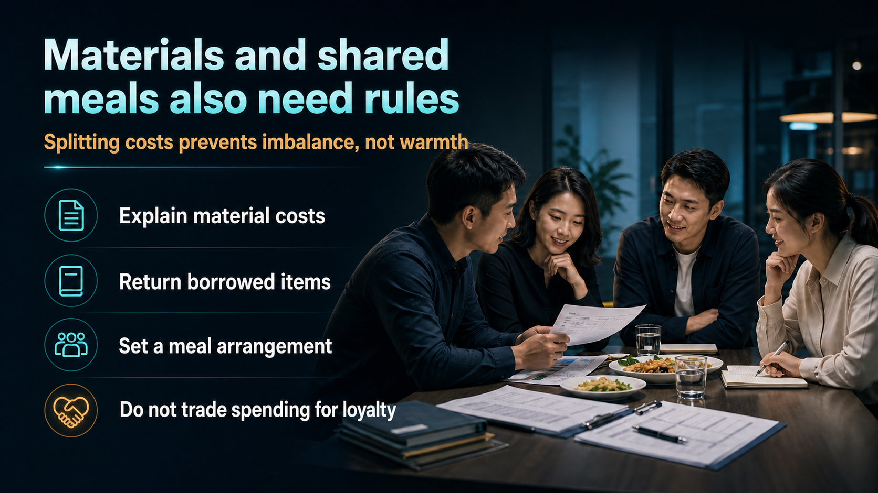
Notes:
Small expenses can also create large resentment when expectations are unclear. Explain the cost of materials, return borrowed items, agree how meals will be paid and never use spending to purchase loyalty. Splitting costs does not make a team cold. It prevents one person from carrying an invisible burden while others assume everything is free. Generosity is welcome when it is voluntary and does not create control. The purpose is simple: let appreciation remain appreciation, let expenses remain clear and prevent money from becoming a hidden test of loyalty.
[Sources]
- 用户提供的《五大原则》原始内容。
- OpenAI Image 2.0 生成的图文一体课程画面。

Slide 23

Notes:
Three simple records prevent many disputes: a payment record, a goods handover record and a shared expense record. Each record should capture the key facts, such as date, amount or quantity, the people involved and completion status. Keep the conversation warm, but keep the writing clear. A short message or shared sheet is often enough. The objective is not bureaucracy. It is to make sure both sides see the same facts and can resolve a question without depending on memory. Good records save time, protect trust and allow relationships to remain human.
[Sources]
- 用户提供的《五大原则》原始内容。
- OpenAI Image 2.0 生成的图文一体课程画面。

Slide 24
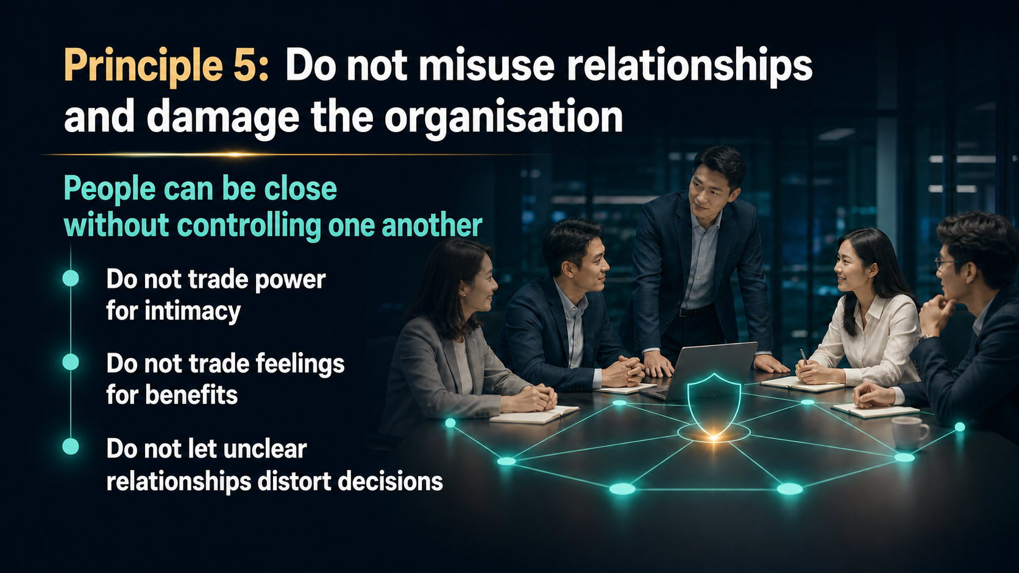
Notes:
The fifth principle protects the organisation from relationships being used as power. People can be close, but closeness must not become control. Do not exchange authority for intimacy, feelings for benefits or personal loyalty for business decisions. When a relationship is unclear, decisions become difficult to explain and other partners lose confidence in the process. Healthy relationships support honest communication and independent judgement. The closer people are, the more important it is to keep responsibilities, benefits and decision rights visible. Affection and friendship should strengthen character, not weaken the standard.
[Sources]
- 用户提供的《五大原则》原始内容。
- OpenAI Image 2.0 生成的图文一体课程画面。

Slide 25
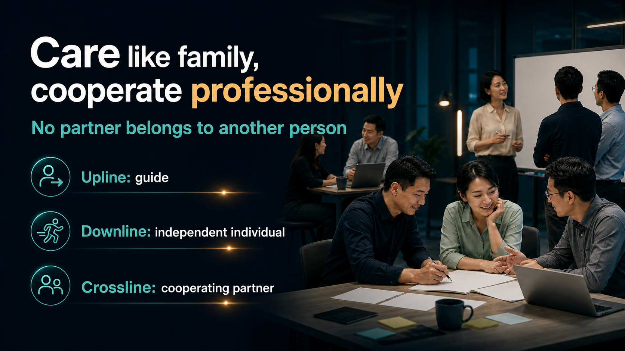
Notes:
A strong team can care like a family while still cooperating professionally. The upline is a guide, not an owner. The downline is an independent individual, not a possession. The crossline is a cooperating partner, not an enemy. This language matters because it shapes behaviour. Guidance should develop judgement. Support should increase independence. Cooperation should respect boundaries. When people are treated as capable adults, trust becomes stronger and the team can grow beyond one personality. Care deeply, but do not confuse care with control or professional responsibility with personal ownership.
[Sources]
- 用户提供的《五大原则》原始内容。
- OpenAI Image 2.0 生成的图文一体课程画面。

Slide 26

Notes:
If you are harassed, threatened or repeatedly pressured, speak up. Preserve messages and other evidence, stop meeting alone, report the situation to the responsible person and seek formal help when necessary. Protecting people matters more than protecting someone's image. Reporting is not an invitation for gossip. Keep the information with those who need it and focus on facts. Leaders must create a path where a person can raise a concern without retaliation. A team that cannot protect its people cannot claim that relationships are its strength.
[Sources]
- 用户提供的《五大原则》原始内容。
- OpenAI Image 2.0 生成的图文一体课程画面。

Slide 27
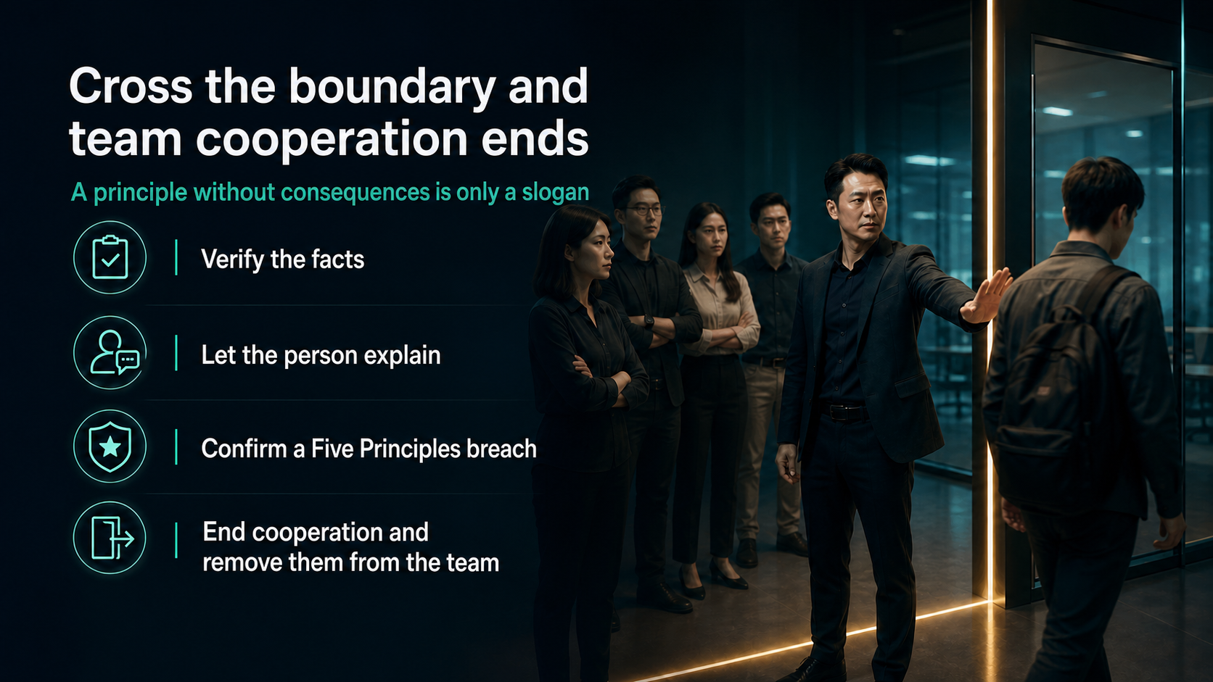
Notes:
Our team has made the consequence clear: when a confirmed breach touches these Five Principles, team cooperation ends. That decision must still follow a disciplined process. Verify the facts, give the person a fair opportunity to explain and confirm that the behaviour truly breaches the stated principles. Once confirmed, end the cooperation and remove the person from the team. This is not about public humiliation or emotional punishment. It is about protecting the boundaries that every other partner is expected to respect. A principle with no consequence eventually becomes an optional suggestion.
[Sources]
- 用户提供的《五大原则》原始内容。
- OpenAI Image 2.0 生成的图文一体课程画面。

Slide 28
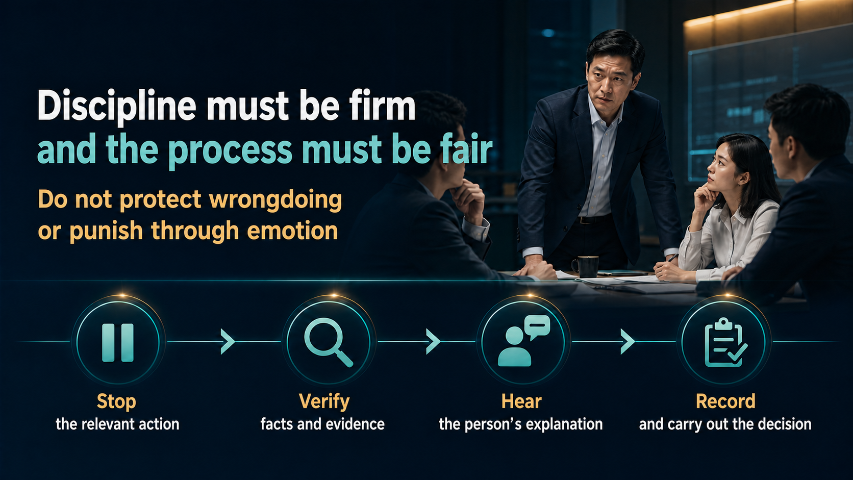
Notes:
Firm discipline and a fair process belong together. First, stop the relevant action so the risk does not continue. Second, verify the facts and evidence. Third, hear the explanation of the person involved. Fourth, record and carry out the decision consistently. Do not hide wrongdoing because of friendship, rank or past contribution. At the same time, do not punish someone merely because emotions are high. Fairness protects both the team and the credibility of the principle. The decision should be understandable even to someone who was not part of the conflict.
[Sources]
- 用户提供的《五大原则》原始内容。
- OpenAI Image 2.0 生成的图文一体课程画面。

Slide 29
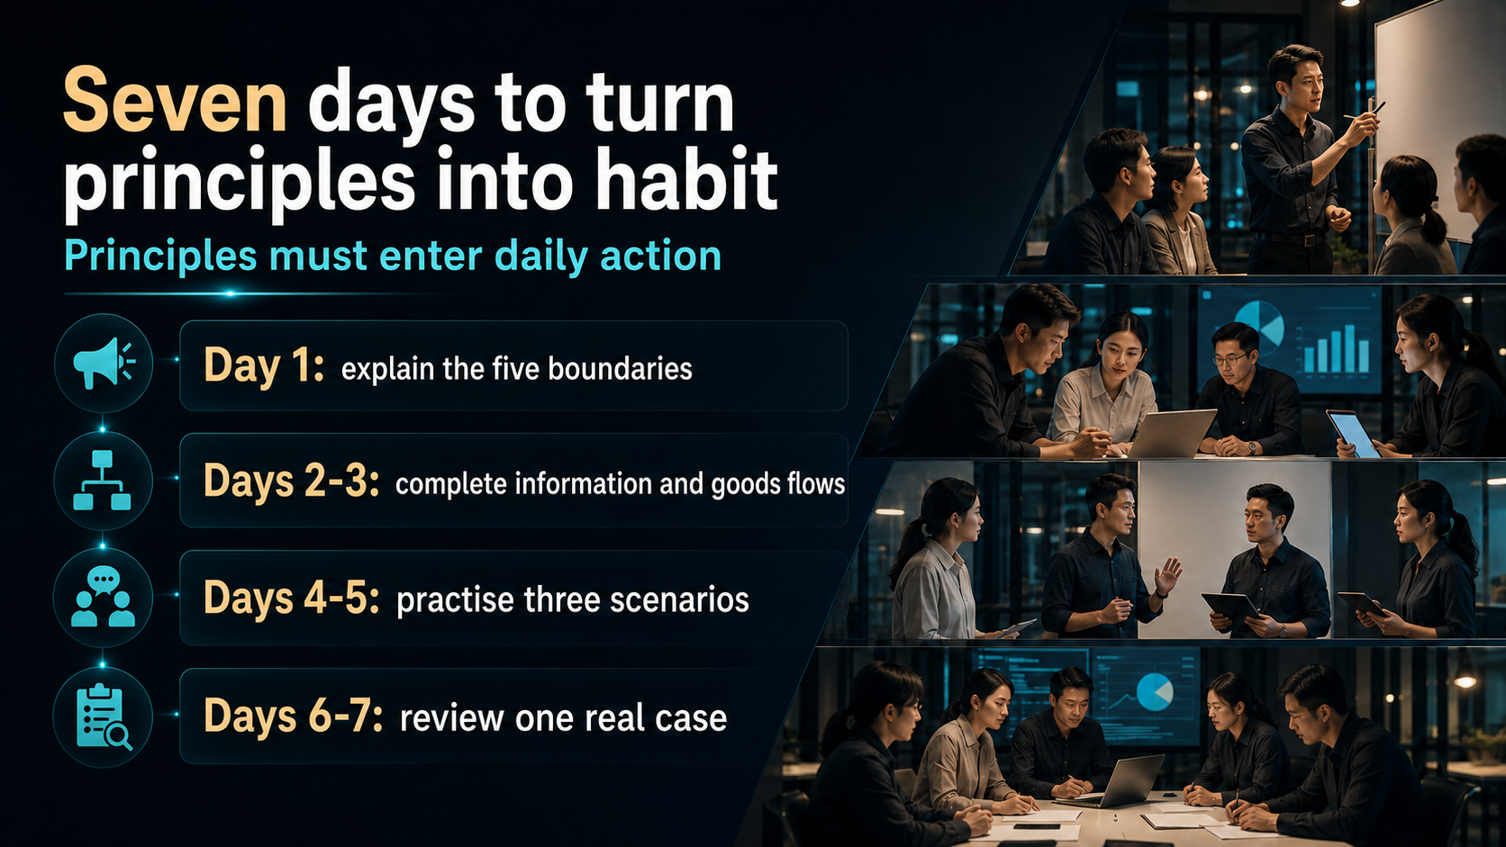
Notes:
Use the next seven days to make the principles practical. On day one, explain all five boundaries in simple language. On days two and three, complete the team's information, payment and goods handover flows. On days four and five, practise three realistic situations: an unapproved promotion, an unverified message and a boundary dispute. On days six and seven, review one real case and ask what the correct process should be. Principles become culture through repeated action, not through one presentation. A small week of practice can prevent a much larger future problem.
[Sources]
- 用户提供的《五大原则》原始内容。
- OpenAI Image 2.0 生成的图文一体课程画面。

Slide 30

Notes:
Let us close with a clear commitment. I do not exceed my authority. I do not spread rumours. I do not interfere with team boundaries. I do not blur accounts involving money or goods. I do not misuse relationships and damage the organisation. These are not promises made only when convenient. They are the conditions for long-term cooperation. People can make mistakes and learn, but confirmed violations of these core boundaries cannot be normalised. Only those willing to uphold the principles should remain in the team. Shared boundaries protect shared trust, and shared trust protects our future.
[Sources]
- 用户提供的《五大原则》原始内容。
- OpenAI Image 2.0 生成的图文一体课程画面。

