Slide 1
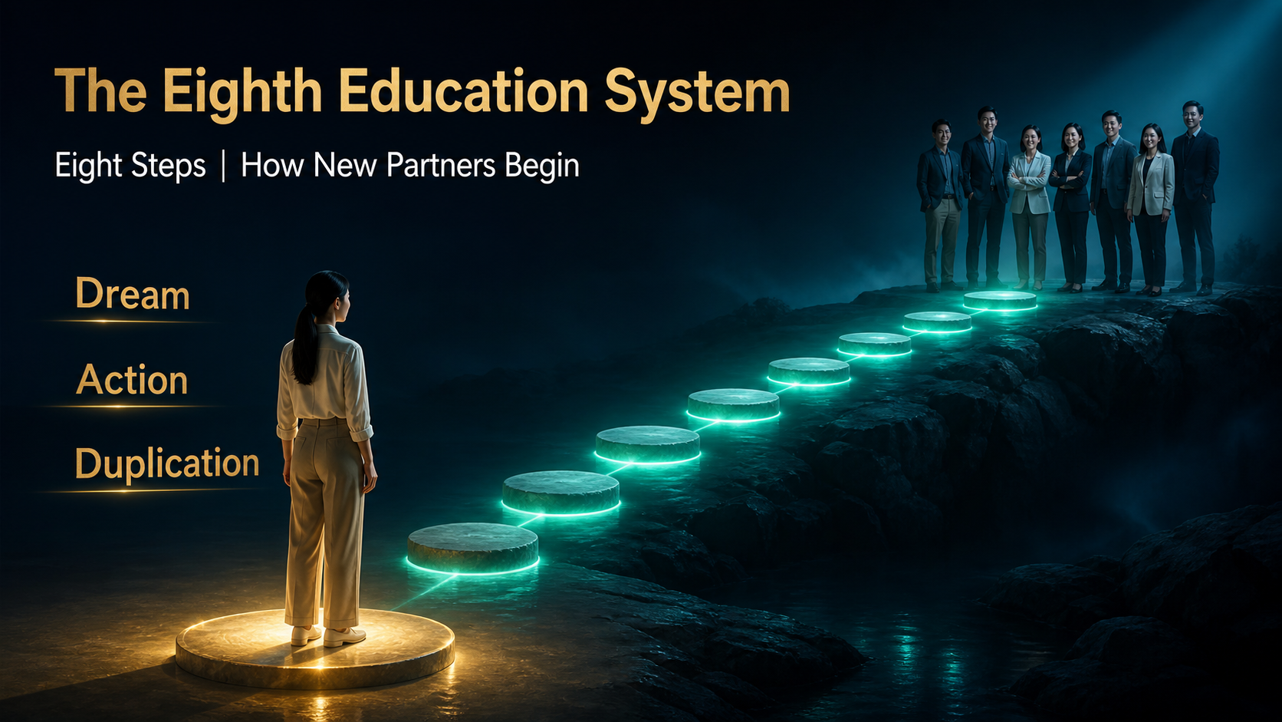
Notes:
Welcome to the Eighth Education System: Eight Steps for New Partners. A new partner does not need to master everything on day one. What matters is having a clear sequence that turns intention into action and action into a method that can be taught. These eight steps are Dream, Commitment, Build a Name List, Invitation, Sharing, Follow-Up, Review and Duplication. Learn them in order, practise them honestly, and use them as a simple map whenever you are unsure what to do next.
[Sources]
- User-provided 81-slide master, System Education - Eight Steps.
- OpenAI Image 2.0 native full-slide visuals with integrated typography.
- Localized review master: English.

Slide 2

Notes:
Most new partners are not unwilling. They are overloaded. They receive product facts, business ideas, messages, videos and advice from many directions. When the sequence is unclear, even motivated people pause because they do not know which action comes first. The Eight Steps remove that confusion. They do not promise an outcome. They give you a practical next move. Whenever information feels too heavy, return to the map, identify your current step and complete the smallest useful action before collecting more material.
[Sources]
- User-provided 81-slide master, System Education - Eight Steps.
- OpenAI Image 2.0 native full-slide visuals with integrated typography.
- Localized review master: English.

Slide 3
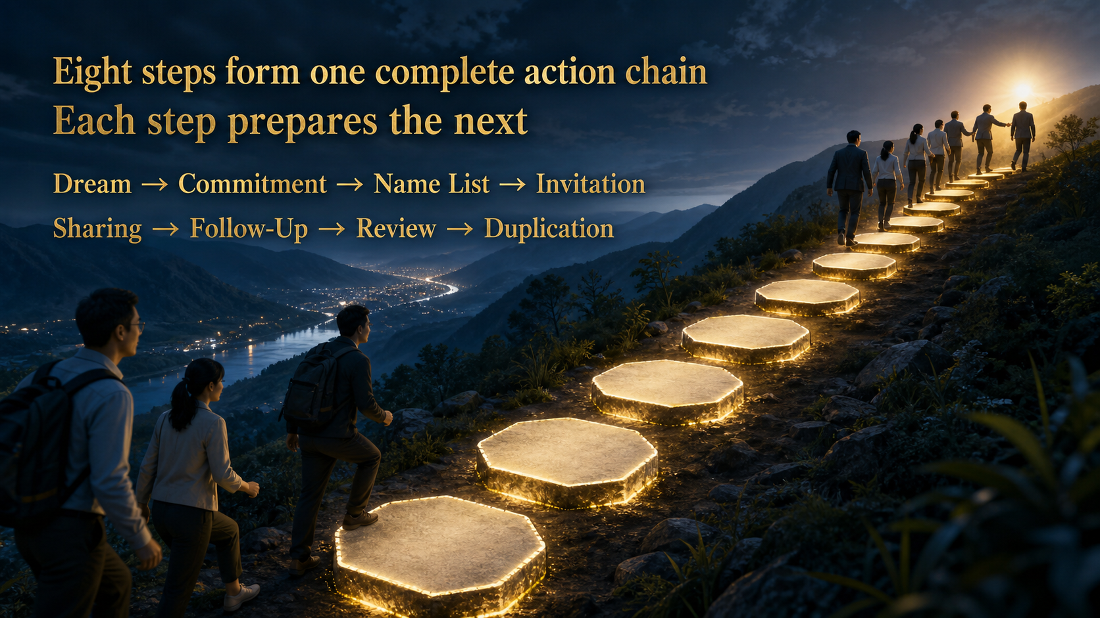
Notes:
The eight steps are not eight unrelated techniques. They are one action chain. A dream gives direction. Commitment creates discipline. A name list turns relationships into an organised plan. Invitation opens a conversation. Sharing helps the other person understand. Follow-up continues service. Review improves the next attempt. Duplication passes the correct method to another person. Skipping a step usually creates pressure later. Following the sequence keeps the work understandable, respectful and teachable.
[Sources]
- User-provided 81-slide master, System Education - Eight Steps.
- OpenAI Image 2.0 native full-slide visuals with integrated typography.
- Localized review master: English.

Slide 4

Notes:
A useful dream is more than a beautiful picture. It explains what you want to change, why now matters and who may benefit from your growth. It could involve health, family time, confidence, contribution or financial improvement, but it must remain honest and personal. No one else can assign your dream. Write a reason that still matters on an ordinary day, not only when you feel excited. A clear reason gives meaning to the small actions that follow.
[Sources]
- User-provided 81-slide master, System Education - Eight Steps.
- OpenAI Image 2.0 native full-slide visuals with integrated typography.
- Localized review master: English.

Slide 5

Notes:
Move the dream from your head onto paper. Describe the change in clear language, choose something you can observe and give it a review date. The date is not a guarantee; it is a point for checking progress. Instead of saying, I want a better life, state what better means and what you will practise this week. A visible goal helps you decide what deserves time today. It also gives your mentor something concrete to support and review with you.
[Sources]
- User-provided 81-slide master, System Education - Eight Steps.
- OpenAI Image 2.0 native full-slide visuals with integrated typography.
- Localized review master: English.

Slide 6

Notes:
Dreams become useful when they enter today's schedule. Choose one thing to learn, one person to contact respectfully and one action to review before the day ends. These do not need to be dramatic. Consistent small actions create more progress than occasional bursts of enthusiasm. At night, ask whether today's actions matched the reason you wrote down. Tomorrow, adjust and continue. The objective is not perfection. It is a rhythm you can sustain.
[Sources]
- User-provided 81-slide master, System Education - Eight Steps.
- OpenAI Image 2.0 native full-slide visuals with integrated typography.
- Localized review master: English.

Slide 7
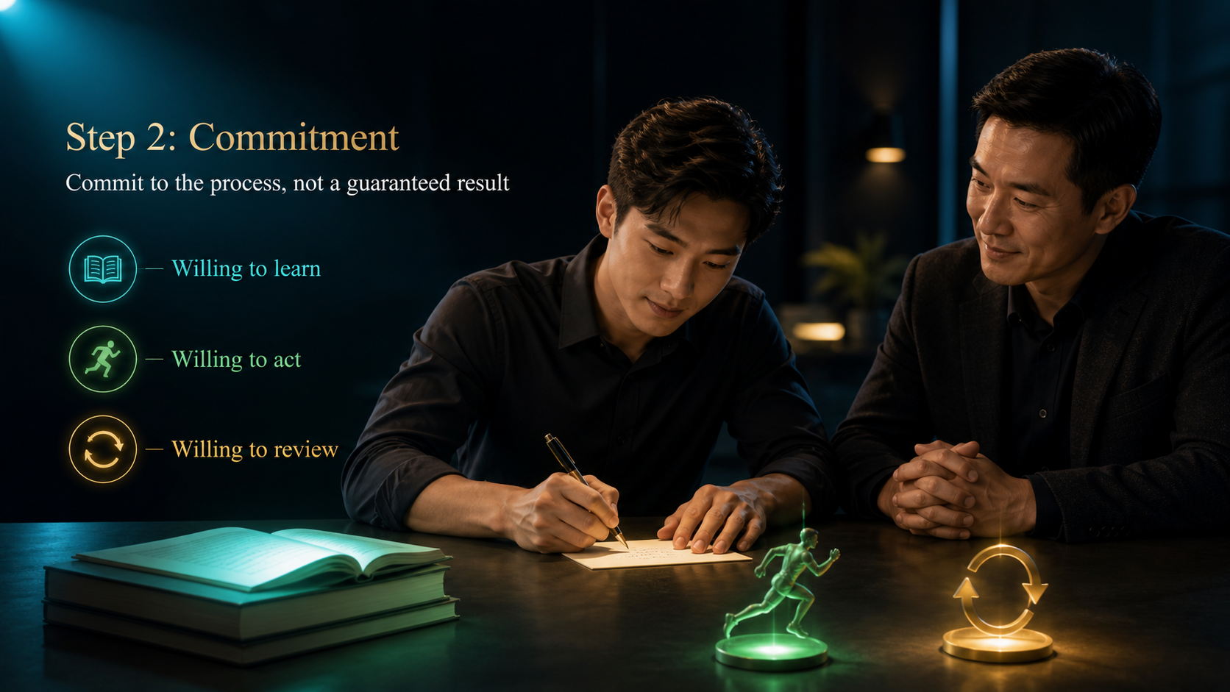
Notes:
Commitment does not mean promising that a certain income, rank or outcome must happen. It means accepting responsibility for the process you control. Be willing to learn the correct version, take agreed actions and review the facts afterward. Commitment becomes visible in your calendar, preparation and follow-through. It also includes respecting customers, partners and team boundaries. When results are slower than expected, commitment helps you learn and adjust instead of disappearing or blaming others.
[Sources]
- User-provided 81-slide master, System Education - Eight Steps.
- OpenAI Image 2.0 native full-slide visuals with integrated typography.
- Localized review master: English.

Slide 8
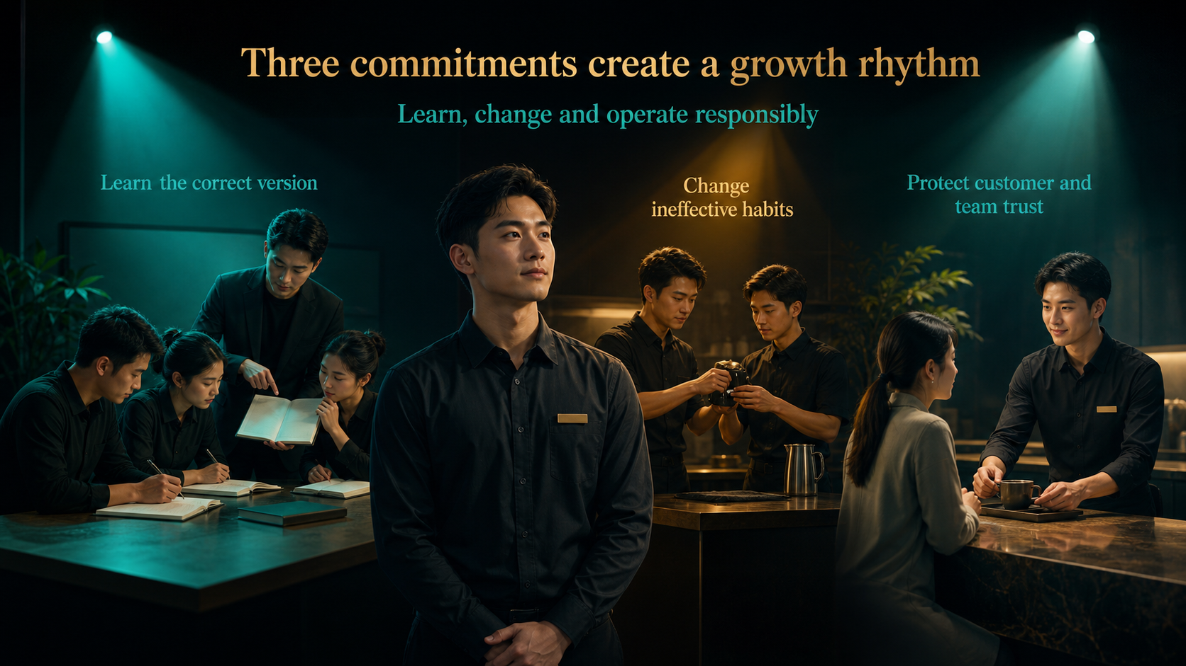
Notes:
First, learn the correct version instead of collecting conflicting private versions. Second, change habits that do not work, even when they feel comfortable. Third, protect the trust of customers and the team. Responsible operation means using accurate information, keeping promises you can control and correcting mistakes quickly. These three commitments create a stable rhythm: learn, practise, review and improve. They turn good intention into professional behaviour.
[Sources]
- User-provided 81-slide master, System Education - Eight Steps.
- OpenAI Image 2.0 native full-slide visuals with integrated typography.
- Localized review master: English.

Slide 9

Notes:
Begin with a focused seven-day start. Use it to understand the eight steps and complete your first simple cycle. Then continue practising for ninety days so the actions become familiar. A weekly review keeps the cycle honest. This is not a promise of rank or earnings within a fixed time. It is a learning period that gives enough repetition to see what is working. Record activity, questions and lessons, then improve one part each week.
[Sources]
- User-provided 81-slide master, System Education - Eight Steps.
- OpenAI Image 2.0 native full-slide visuals with integrated typography.
- Localized review master: English.

Slide 10

Notes:
A name list is not a list of people you will pressure. It is a practical record of relationships you may care for, learn from or speak with appropriately. Do not decide too early who will or will not be interested. Begin broadly, organise what you genuinely know and keep the list updated as life changes. The list helps you remember context and plan respectful contact. It never gives permission to misuse personal information.
[Sources]
- User-provided 81-slide master, System Education - Eight Steps.
- OpenAI Image 2.0 native full-slide visuals with integrated typography.
- Localized review master: English.

Slide 11

Notes:
Your network already exists in everyday life. It includes family, friends, former classmates, colleagues, neighbours and people you meet through interests or service. The goal is not to turn every relationship into a sales target. It is to become more aware of people, needs and natural opportunities for conversation. Keep meeting new people through genuine participation, not through pretending to be interested only to recruit them. Relationships come first.
[Sources]
- User-provided 81-slide master, System Education - Eight Steps.
- OpenAI Image 2.0 native full-slide visuals with integrated typography.
- Localized review master: English.

Slide 12

Notes:
Your list contains human relationships, not inventory. Record only the minimum information needed for legitimate follow-up. Do not pass it to others without permission, upload it carelessly or send repeated mass messages. When someone says no, asks to stop or is not ready, respect that boundary. Protecting privacy is not a technical detail. It shows whether people can trust you with their information and their relationship.
[Sources]
- User-provided 81-slide master, System Education - Eight Steps.
- OpenAI Image 2.0 native full-slide visuals with integrated typography.
- Localized review master: English.

Slide 13

Notes:
A large list has little value if it has no thoughtful next action. For each person, remember the relationship, understand any genuine need and decide whether another contact is appropriate. Begin with care, not a pitch. Listen before offering information. Then choose a suitable action: a message, a conversation, a resource, a later reminder or no further contact. Good list management reduces pressure because every action has a reason.
[Sources]
- User-provided 81-slide master, System Education - Eight Steps.
- OpenAI Image 2.0 native full-slide visuals with integrated typography.
- Localized review master: English.

Slide 14

Notes:
An invitation is not the full presentation. Its purpose is simply to create a clear conversation. Keep it brief, say honestly why you thought of the person and offer a choice of time or format. You do not need to hide the subject or create false urgency. A transparent invitation may receive fewer automatic yeses, but it builds stronger trust. The other person should understand what they are agreeing to and feel free to decline.
[Sources]
- User-provided 81-slide master, System Education - Eight Steps.
- OpenAI Image 2.0 native full-slide visuals with integrated typography.
- Localized review master: English.

Slide 15

Notes:
A natural invitation has four parts. Start from the relationship. Explain the reason you are reaching out. Suggest a practical amount of time, and give the person a real choice. For example, reconnect first, then say you have something relevant to a need they mentioned and ask whether they prefer a short call or coffee on one of two days. The structure keeps the message human and clear without becoming a long script.
[Sources]
- User-provided 81-slide master, System Education - Eight Steps.
- OpenAI Image 2.0 native full-slide visuals with integrated typography.
- Localized review master: English.

Slide 16

Notes:
A refusal is not an invitation to argue. Do not exaggerate the opportunity, hide the purpose or keep chasing after the person has declined. Thank them for answering and leave the relationship in good condition. Sometimes timing changes; sometimes it does not. Both are acceptable. Professional invitation protects the person's freedom to choose. Your reputation after a no is often more important than the immediate response.
[Sources]
- User-provided 81-slide master, System Education - Eight Steps.
- OpenAI Image 2.0 native full-slide visuals with integrated typography.
- Localized review master: English.

Slide 17

Notes:
Sharing begins with listening. Find out what the person wants to understand and what matters in their situation. Then provide relevant, accurate information in a simple order. Do not overwhelm them with every product, bonus or testimonial. Your job is to help the person make a clearer decision, not to control the decision. A good sharing session ends with understanding, an honest choice and a reasonable next step.
[Sources]
- User-provided 81-slide master, System Education - Eight Steps.
- OpenAI Image 2.0 native full-slide visuals with integrated typography.
- Localized review master: English.

Slide 18

Notes:
Preparation improves both confidence and accuracy. Check your mindset, professional appearance, communication flow, current materials, product information, appropriate stories, follow-up plan and practical tools. Confirm that the version is correct, the audience is clear and everyone knows the available time and role. Preparation does not mean creating a perfect performance. It means removing avoidable confusion so you can pay attention to the person in front of you.
[Sources]
- User-provided 81-slide master, System Education - Eight Steps.
- OpenAI Image 2.0 native full-slide visuals with integrated typography.
- Localized review master: English.

Slide 19

Notes:
Use a simple eight-part flow. Prepare, build connection, transition into the subject, explain the key value, check understanding, answer questions, confirm understanding again and agree on the next step. The flow is a guide, not a rigid performance. If you do not know an answer, say so and bring back accurate information. Clarity and honesty are more persuasive than pretending to know everything.
[Sources]
- User-provided 81-slide master, System Education - Eight Steps.
- OpenAI Image 2.0 native full-slide visuals with integrated typography.
- Localized review master: English.

Slide 20

Notes:
A good sharing session creates clarity in three areas: the person's need, the available choice and the next step. It does not require an immediate yes. Protect the conversation with three boundaries. Do not invent testimonials, promise income or diagnose medical conditions. Use verified information and appropriate product guidance. When the person can explain what they understood and what they want to do next, the sharing has done its job.
[Sources]
- User-provided 81-slide master, System Education - Eight Steps.
- OpenAI Image 2.0 native full-slide visuals with integrated typography.
- Localized review master: English.

Slide 21

Notes:
Follow-up shows whether your service continues after the first conversation. Record the person's actual question, verify the answer and return when you said you would. Do not send repeated messages simply because you want a decision. Respect the person's pace and preferred channel. Useful follow-up may include clarification, practical help, product-use support or arranging another conversation. Service earns trust through accuracy and reliability.
[Sources]
- User-provided 81-slide master, System Education - Eight Steps.
- OpenAI Image 2.0 native full-slide visuals with integrated typography.
- Localized review master: English.

Slide 22
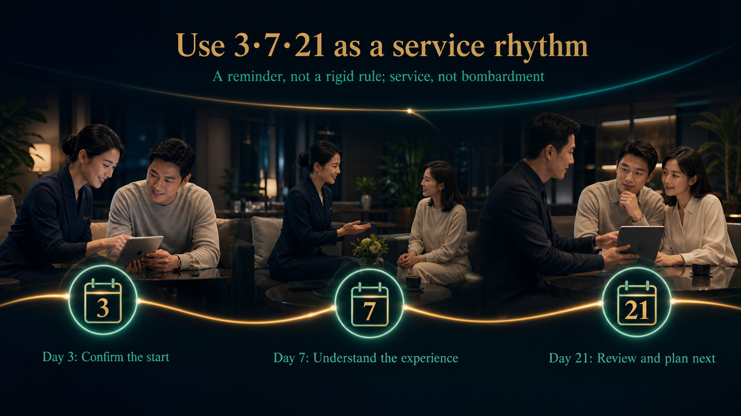
Notes:
The 3, 7 and 21-day rhythm is a reminder, not a rule that overrides common sense. Around day three, confirm that the person has started and understands the basics. Around day seven, ask about the experience and any questions. Around day twenty-one, summarise what has happened and agree on an appropriate next step. Adapt the timing to the person and the situation. The purpose is consistent service, never message bombardment.
[Sources]
- User-provided 81-slide master, System Education - Eight Steps.
- OpenAI Image 2.0 native full-slide visuals with integrated typography.
- Localized review master: English.

Slide 23
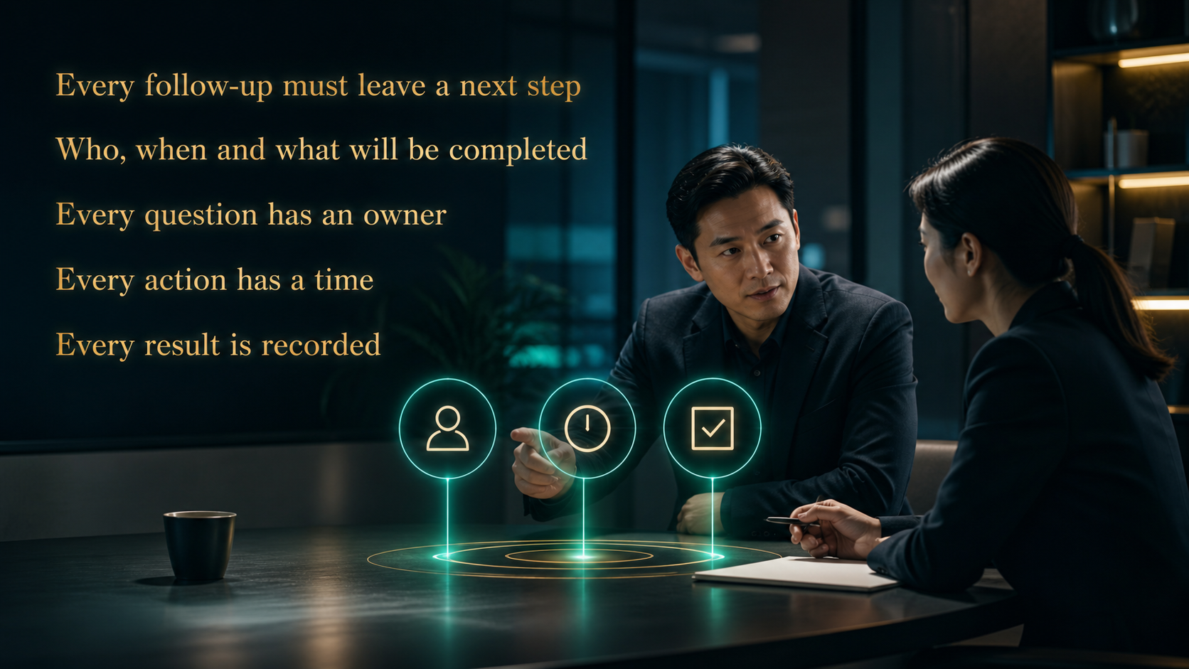
Notes:
End each follow-up with a clear next action. Who will find the answer? When will contact happen again? What exactly will be completed? A question without an owner disappears. A promise without a time remains vague. A result without a record is difficult to review. Keep the record brief and factual. Clear next steps protect both sides from misunderstanding and make service easier to continue.
[Sources]
- User-provided 81-slide master, System Education - Eight Steps.
- OpenAI Image 2.0 native full-slide visuals with integrated typography.
- Localized review master: English.

Slide 24

Notes:
Review is not a punishment session. It is how experience becomes improvement. Start with facts: what action happened and what result followed? Then look for the cause without inventing excuses or attacking yourself. Finally, choose one adjustment for the next attempt. A useful review is specific enough to change behaviour. It helps the newcomer see progress, ask better questions and continue with confidence grounded in evidence.
[Sources]
- User-provided 81-slide master, System Education - Eight Steps.
- OpenAI Image 2.0 native full-slide visuals with integrated typography.
- Localized review master: English.

Slide 25

Notes:
Use four questions. What actually happened? What part worked? Where did the action genuinely stall? What will you change next time? Separate observation from interpretation. A low response may come from the list, the invitation, timing, explanation or follow-up. Do not change everything at once. Identify the most likely point, adjust it and test again. This keeps learning practical.
[Sources]
- User-provided 81-slide master, System Education - Eight Steps.
- OpenAI Image 2.0 native full-slide visuals with integrated typography.
- Localized review master: English.

Slide 26

Notes:
Healthy progress includes real activity, better skill, stronger service and growing ability to teach the method. Do not manufacture the appearance of success by buying sales volume, buying rank or presenting income dishonestly. Inflated numbers may impress briefly, but they damage judgment and trust. Review what the organisation can sustain. A healthy system creates customer value, develops people and keeps its standards even when no one is watching.
[Sources]
- User-provided 81-slide master, System Education - Eight Steps.
- OpenAI Image 2.0 native full-slide visuals with integrated typography.
- Localized review master: English.

Slide 27

Notes:
Duplication does not mean turning everyone into the same personality. The core method and boundaries remain consistent, while each person communicates naturally. Teach the sequence, show the action, let the newcomer practise and review the result together. If the method only works when one gifted presenter is present, it is not yet a system. Good duplication allows ordinary people to begin correctly and improve through practice.
[Sources]
- User-provided 81-slide master, System Education - Eight Steps.
- OpenAI Image 2.0 native full-slide visuals with integrated typography.
- Localized review master: English.

Slide 28
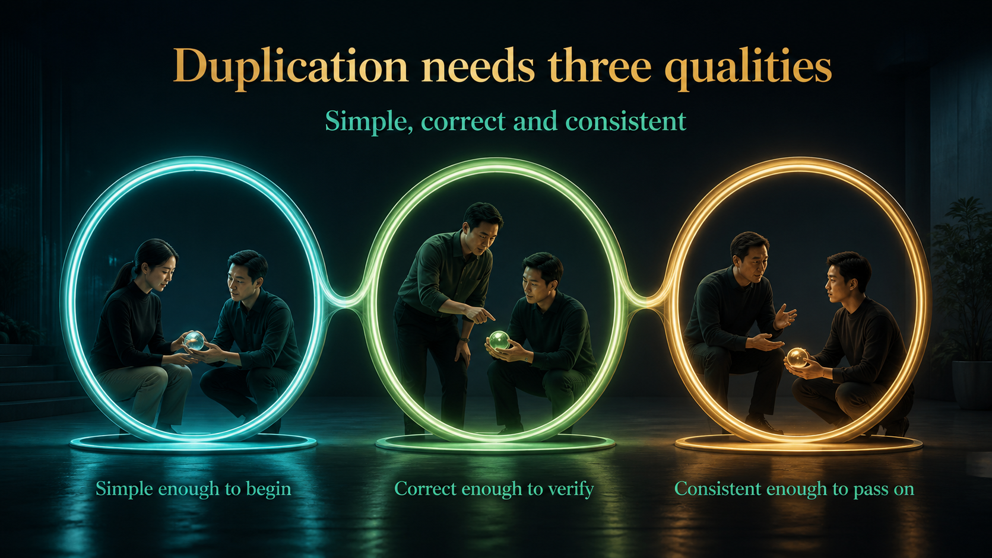
Notes:
A duplicable method must be simple enough for a new person to begin, correct enough to withstand checking and consistent enough to pass through the team. Simplicity without accuracy spreads mistakes. Accuracy without simplicity stays in a file. Consistency without review can repeat outdated habits. Keep the essential steps clear, verify the version and teach the same standard repeatedly.
[Sources]
- User-provided 81-slide master, System Education - Eight Steps.
- OpenAI Image 2.0 native full-slide visuals with integrated typography.
- Localized review master: English.

Slide 29
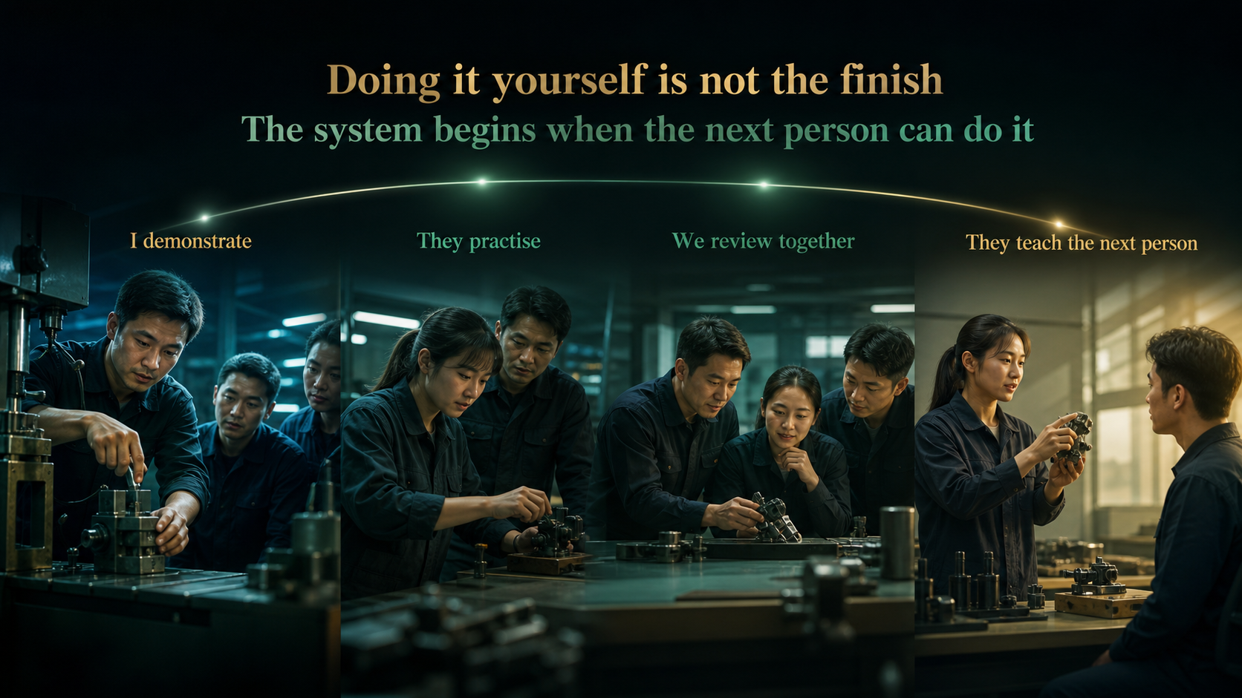
Notes:
The work is not complete because you can perform it. Demonstrate the action, let the newcomer practise personally, review the facts together and then support them as they teach the next person. This four-part handoff turns knowledge into team capability. Do not take the task back whenever the learner is slower. Coach the process until they can own it responsibly.
[Sources]
- User-provided 81-slide master, System Education - Eight Steps.
- OpenAI Image 2.0 native full-slide visuals with integrated typography.
- Localized review master: English.

Slide 30
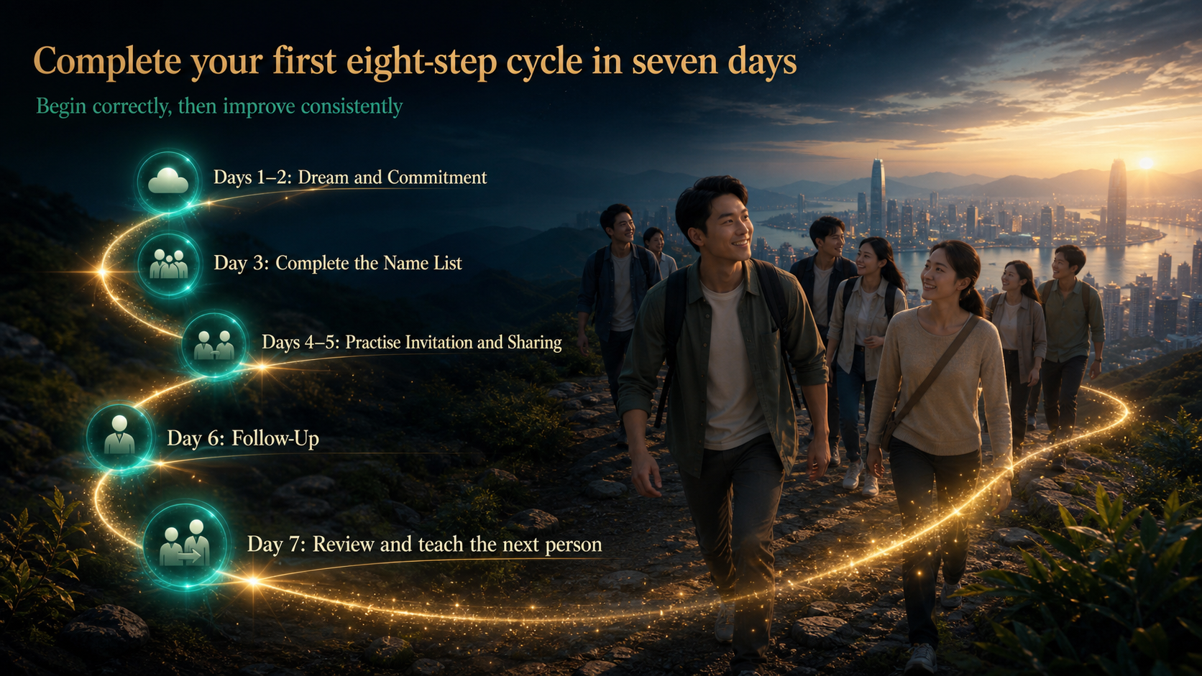
Notes:
Use the first seven days to complete one simple eight-step cycle. Clarify your dream and commitment, organise your name list, practise invitation and sharing, complete a follow-up, review what happened and explain the method to another person. The goal is not a perfect result in seven days. The goal is to experience the complete sequence once. Then repeat it with better judgment, better service and stronger consistency. Begin correctly, keep learning and help the next person begin correctly too.
[Sources]
- User-provided 81-slide master, System Education - Eight Steps.
- OpenAI Image 2.0 native full-slide visuals with integrated typography.
- Localized review master: English.

